Slide 1
Python
Lecture-1

Slide 2
Topics
Python Intro
Installation
Syntax
Variables
Datatypes
Arrays
Operators
If / Else
Loops
Functions
Modules

Slide 3
Python Intro
Python is a popular programming language. It was created by Guido van Rossum, and released in 1991.
Web development (server-side)
Software development
Mathematics
System scripting.
Machine Learning

Slide 4
Installation
https://www.python.org/downloads/
Install Extension on VS Code or you can use CLI, PowerShell or bash to run python codes.

Slide 5
Syntax
Python was designed for readability, and has some similarities to the English language with influence from mathematics.
Python uses new lines to complete a command, as opposed to other programming languages which often use semicolons or parentheses.
Python relies on indentation, using whitespace, to define scope; such as the scope of loops, functions and classes. Other programming languages often use curly-brackets for this purpose.
Indentation refers to the spaces at the beginning of a code line.
Where in other programming languages the indentation in code is for readability only, the indentation in Python is very important.
Python uses indentation to indicate a block of code.

Slide 6
Variables
Python has no command for declaring a variable.
A variable is created the moment you first assign a value to it.
Variables do not need to be declared with any particular type, and can even change type after they have been set.
If you want to specify the data type of a variable, this can be done with casting.
Variable names are case-sensitive.

Slide 7
Data Types
Text Type: | str
Numeric Types: | int, float, complex
Sequence Types: | list, tuple, range
Mapping Type: | dict
Set Types: | set, frozenset
Boolean Type: | bool
Binary Types: | bytes, bytearray, memoryview
None Type: | NoneType

Slide 8
Arrays
An array is a special variable, which can hold more than one value at a time.
Python does not have built-in support for Arrays, but Python Lists can be used instead, however, to work with arrays in Python you will have to import a library, like the NumPy library.

Slide 9
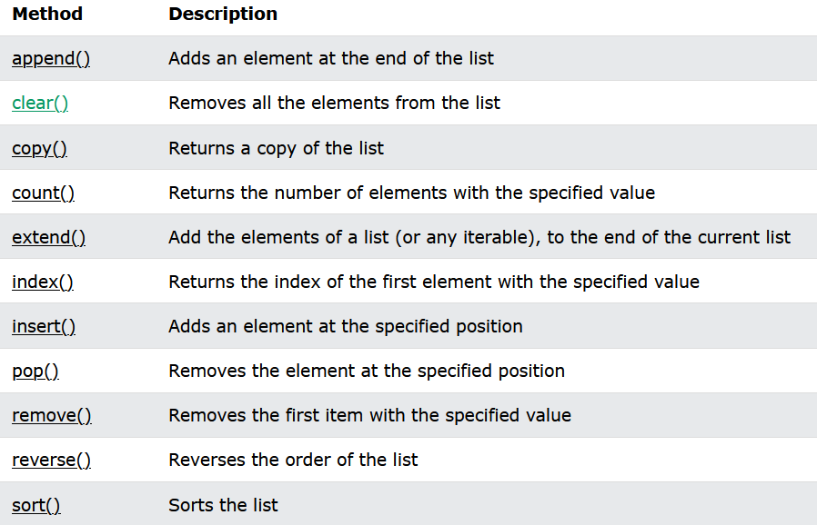
Arrays Methods

Slide 10
Operators
Python divides the operators in the following groups:
Arithmetic operators
Assignment operators
Comparison operators
Logical operators
Identity operators
Membership operators
Bitwise operators

Slide 11
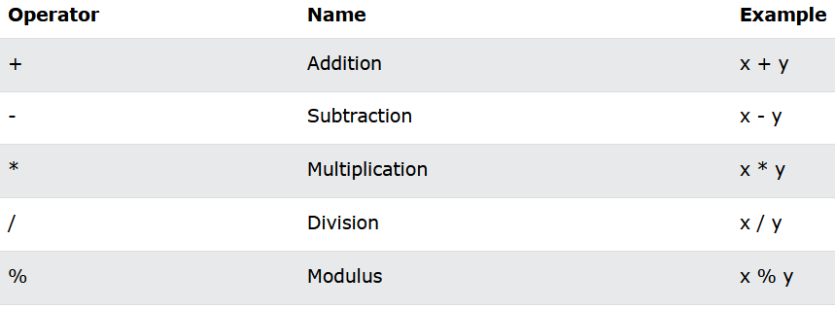
Arithmetic Operators

Slide 12
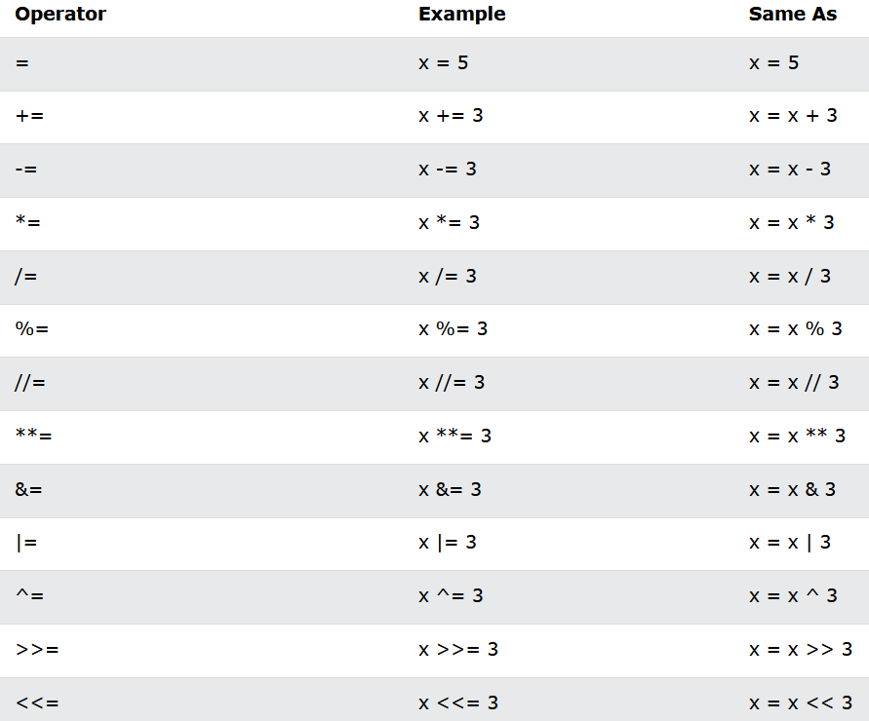
Assignment Operators

Slide 13
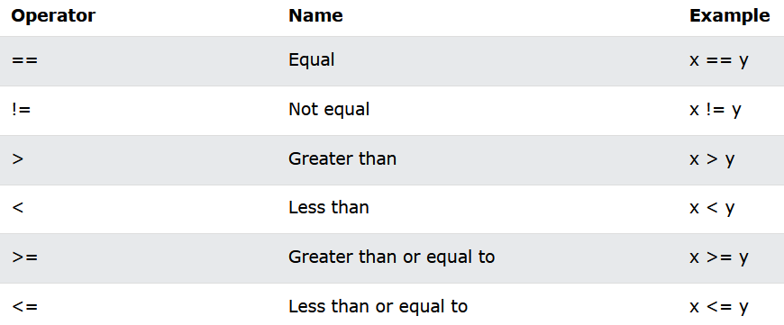
Comparison Operators

Slide 14
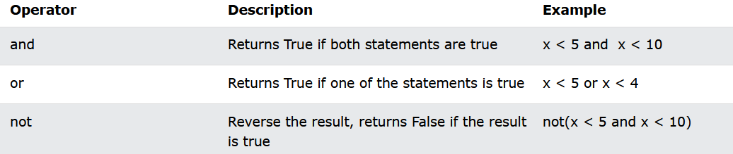
Logical Operators

Slide 15
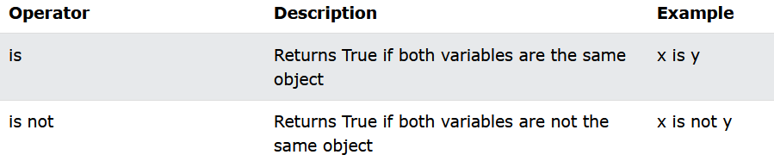
Identity Operators
Identity operators are used to compare the objects, not if they are equal, but if they are actually the same object, with the same memory location:

Slide 16
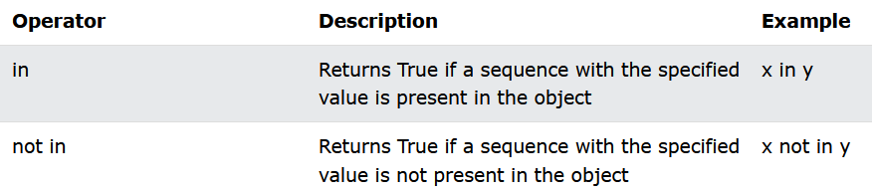
Membership Operators
Membership operators are used to test if a sequence is presented in an object:

Slide 17
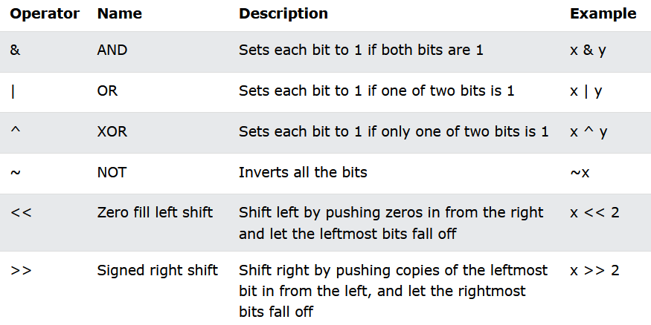
Bitwise Operators
Bitwise operators are used to compare (binary) numbers:

Slide 18
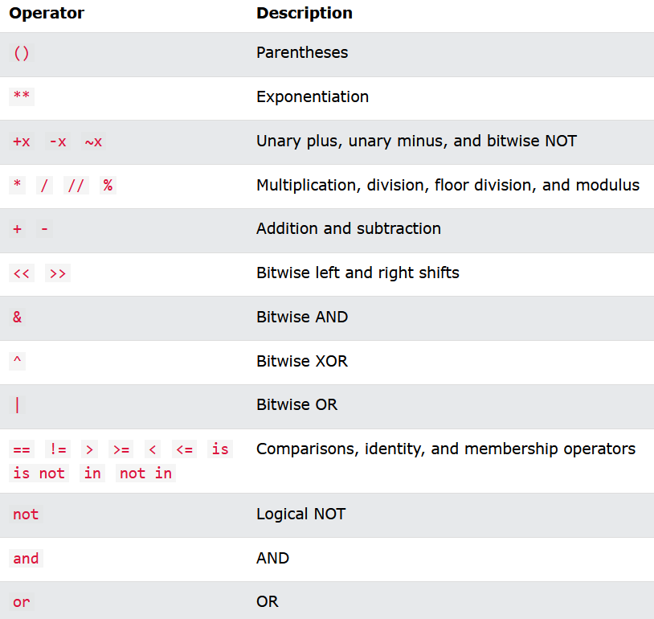
Operator Precedence

Slide 19
If / Else
Python supports the usual logical conditions from mathematics:
Equals: a == b
Not Equals: a != b
Less than: a < b
Less than or equal to: a <= b
Greater than: a > b
Greater than or equal to: a >= b
These conditions can be used in several ways, most commonly in "if statements" and loops.

Slide 20
Loops
Python has two primitive loop commands:
while loops
for loops

Slide 21
Functions
A function is a block of code which only runs when it is called.
You can pass data, known as parameters, into a function.
A function can return data as a result.

Slide 22
Function : Parameters or Arguments
The terms parameter and argument can be used for the same thing: information that are passed into a function.
From a function's perspective:
A parameter is the variable listed inside the parentheses in the function definition.
An argument is the value that is sent to the function when it is called.

Slide 23
Modules
Consider a module to be the same as a code library.
A file containing a set of functions you want to include in your application.

