Slide 1
Ansible

Slide 2
Topics
Introduction
Configuration Management
How Ansible Works?
Environment Setup
Ansible - Ad hoc Commands
Playbook
Playbook Structure
Roles
Variables
Exception Handling
Loops
Conditions

Slide 3
Introduction
Ansible is simple open source IT engine which automates application deployment, intra service orchestration, cloud provision and many other IT tools.
Ansible uses playbooks to do so.
Ansible playbooks are written in Yaml.
Ansible is a tool Configuration Management.

Slide 4
Introduction
Ansible is designed for multi-tier deployment. Ansible does not manage one system at time, it models IT infrastructure by describing all of your systems are interrelated. Ansible is completely agentless which means Ansible works by connecting your nodes through ssh(by default). But if you want other method for connection like Kerberos, Ansible gives that option to you.
After connecting to your nodes, Ansible pushes small programs called as “Ansible Modules”. Ansible runs that modules on your nodes and removes them when finished. Ansible manages your inventory in simple text files (These are the hosts file). Ansible uses the hosts file where one can group the hosts and can control the actions on a specific group in the playbooks.

Slide 5
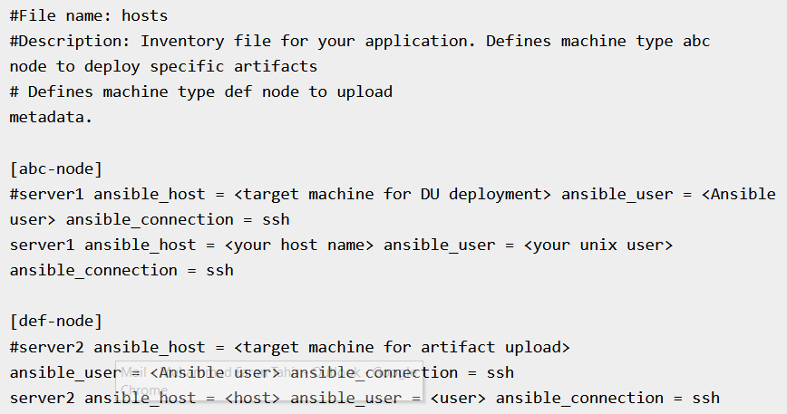
Sample Hosts File

Slide 6
Configuration Management
Configuration management in terms of Ansible means that it maintains configuration of the product performance by keeping a record and updating detailed information which describes an enterprise’s hardware and software.
Such information typically includes the exact versions and updates that have been applied to installed software packages and the locations and network addresses of hardware devices. For e.g. If you want to install the new version of WebLogic/WebSphere server on all of the machines present in your enterprise, it is not feasible for you to manually go and update each and every machine.
You can install WebLogic/WebSphere in one go on all of your machines with Ansible playbooks and inventory written in the most simple way. All you have to do is list out the IP addresses of your nodes in the inventory and write a playbook to install WebLogic/WebSphere. Run the playbook from your control machine & it will be installed on all your nodes.

Slide 7
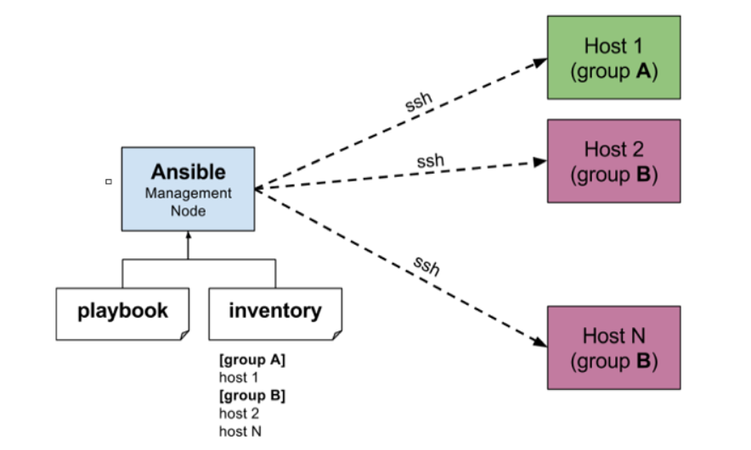
How Ansible Works?
Ansible works by connecting to your nodes and pushing out small programs, called "Ansible modules" to them. Ansible then executes these modules (over SSH by default), and removes them when finished. Your library of modules can reside on any machine, and there are no servers, daemons, or databases required.
The management node in the above picture is the controlling node (managing node) which controls the entire execution of the playbook. It’s the node from which you are running the installation. The inventory file provides the list of hosts where the Ansible modules needs to be run and the management node does a SSH connection and executes the small modules on the hosts machine and installs the product/software.
Beauty of Ansible is that it removes the modules once those are installed so effectively it connects to host machine , executes the instructions and if it’s successfully installed removes the code which was copied on the host machine which was executed.

Slide 8
Environment Setup
Mainly, there are two types of machines when we talk about deployment:
Control machine − Machine from where we can manage other machines.
Remote machine − Machines which are handled/controlled by control machine.
There can be multiple remote machines which are handled by one control machine. So, for managing remote machines we have to install Ansible on control machine.

Slide 9
Control Machine Requirements
Ansible can be run from any machine with Python 2 (versions 2.6 or 2.7) or Python 3 (versions 3.5 and higher) installed.
Note − Windows does not support control machine.
By default, Ansible uses ssh to manage remote machine.
Ansible does not add any database. It does not require any daemons to start or keep it running. While managing remote machines, Ansible does not leave any software installed or running on them. Hence, there is no question of how to upgrade it when moving to a new version.
Ansible can be installed on control machine which have above mentioned requirements in different ways. You can install the latest release through Apt, yum, pkg, pip, OpenCSW, pacman, etc.

Slide 10
Ansible - Ad hoc Commands
Ad hoc commands are commands which can be run individually to perform quick functions. These commands need not be performed later.
For example, you have to reboot all your company servers. For this, you will run the Adhoc commands from ‘/usr/bin/ansible’.
These ad-hoc commands are not used for configuration management and deployment, because these commands are of one time usage.
ansible-playbook is used for configuration management and deployment.

Slide 11
Playbook
Playbooks are the files where Ansible code is written. Playbooks are written in YAML format. YAML stands for Yet Another Markup Language. Playbooks are one of the core features of Ansible and tell Ansible what to execute. They are like a to-do list for Ansible that contains a list of tasks.
Playbooks contain the steps which the user wants to execute on a particular machine. Playbooks are run sequentially. Playbooks are the building blocks for all the use cases of Ansible.

Slide 12
Playbook Structure
Each playbook is an aggregation of one or more plays in it. Playbooks are structured using Plays. There can be more than one play inside a playbook.
The function of a play is to map a set of instructions defined against a particular host.
YAML is a strict typed language; so, extra care needs to be taken while writing the YAML files. There are different YAML editors but we will prefer to use a simple editor like notepad++. Just open notepad++ and copy and paste the below yaml and change the language to YAML (Language → YAML).

Slide 13
Playbook Structure
name:
This tag specifies the name of the Ansible playbook. As in what this playbook will be doing. Any logical name can be given to the playbook.
hosts:
This tag specifies the lists of hosts or host group against which we want to run the task. The hosts field/tag is mandatory. It tells Ansible on which hosts to run the listed tasks. The tasks can be run on the same machine or on a remote machine. One can run the tasks on multiple machines and hence hosts tag can have a group of hosts’ entry as well.
vars:
Vars tag lets you define the variables which you can use in your playbook. Usage is similar to variables in any programming language.
tasks:
All playbooks should contain tasks or a list of tasks to be executed. Tasks are a list of actions one needs to perform. A tasks field contains the name of the task. This works as the help text for the user. It is not mandatory but proves useful in debugging the playbook. Each task internally links to a piece of code called a module. A module that should be executed, and arguments that are required for the module you want to execute.

Slide 14
Roles
Roles provide a framework for fully independent, or interdependent collections of variables, tasks, files, templates, and modules.
In Ansible, the role is the primary mechanism for breaking a playbook into multiple files. This simplifies writing complex playbooks, and it makes them easier to reuse. The breaking of playbook allows you to logically break the playbook into reusable components.
Each role is basically limited to a particular functionality or desired output, with all the necessary steps to provide that result either within that role itself or in other roles listed as dependencies.
Roles are not playbooks. Roles are small functionality which can be independently used but have to be used within playbooks. There is no way to directly execute a role. Roles have no explicit setting for which host the role will apply to.
Top-level playbooks are the bridge holding the hosts from your inventory file to roles that should be applied to those hosts.

Slide 15
Variables
Variable in playbooks are very similar to using variables in any programming language. It helps you to use and assign a value to a variable and use that anywhere in the playbook. One can put conditions around the value of the variables and accordingly use them in the playbook.

Slide 16
Exception Handling

Slide 17
Loops
Below is the example to demonstrate the usage of Loops in Ansible.
The tasks is to copy the set of all the war files from one directory to tomcat webapps folder.
Most of the commands used in the example below are already covered before. Here, we will concentrate on the usage of loops.
Initially in the 'shell' command we have done ls *.war. So, it will list all the war files in the directory.
Output of that command is taken in a variable named output.
To loop, the 'with_items' syntax is being used.
with_items: "{{output.stdout_lines}}" --> output.stdout_lines gives us the line by line output and then we loop on the output with the with_items command of Ansible.

Slide 18
Conditions

