Slide 1
Jenkins

Slide 2
Topics
Continuous Integration
Continuous Delivery
Continuous Deployment
Deployment strategies
Jenkins
Jenkins Setup
Jenkins GUI Overview
Create Jenkins Free Style Project
Jenkins Pipelines Through Script
Jenkins Pipelines Through JenkinsFile
Build & Push Docker Image to AWS ECR with Jenkins Pipeline

Slide 3
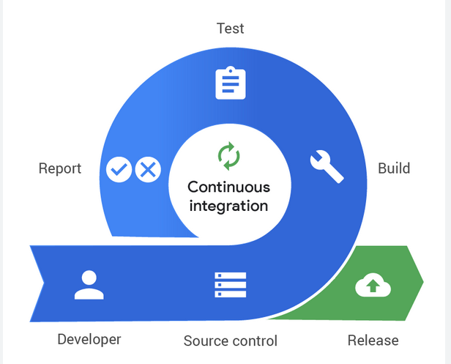
Continuous Integration
Continuous Integration is a software development practice that involves frequently merging code changes from multiple developers into a shared repository. The goal is to detect integration issues early by automating the process of building and testing the software. Whenever a developer makes a change, they commit their code to the shared repository, triggering an automated build and test process. The primary focus of CI is to ensure that the code integrates smoothly with the existing codebase.

Slide 4
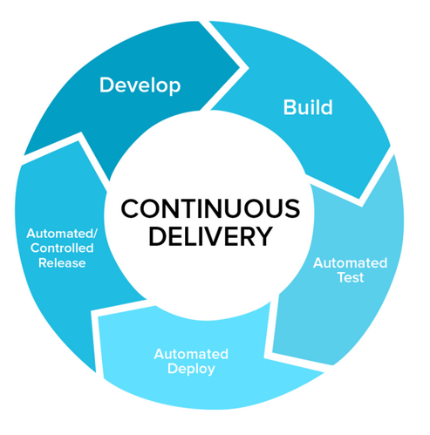
Continuous Delivery
Continuous Delivery is an extension of Continuous Integration that aims to automate the release process of software to various environments, such as staging or production. It involves continuously building, testing, and preparing software releases in a consistent and repeatable manner. CD focuses on ensuring that software is always in a releasable state, even if it's not immediately deployed to production. The decision to deploy the software is typically a manual one, allowing teams to control when the software is released.

Slide 5
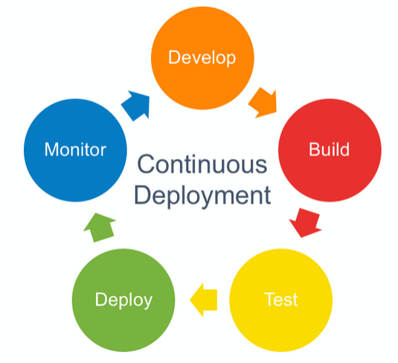
Continuous Deployment
Continuous Deployment takes the concept of Continuous Delivery a step further by automating the entire release process, including the deployment to production. With Continuous Deployment, every validated change that passes through the CI/CD pipeline is automatically deployed to production, typically without any manual intervention. This approach allows for rapid and frequent releases, enabling organizations to deliver new features and fixes to users more quickly.

Slide 6
Characteristics
Continuous Integration
Frequent integration of code changes into a shared repository.
Automated build and test processes to detect integration issues.
Quick feedback loop to developers about the status of their changes.
Helps maintain code quality and reduces the risk of integration problems.
Continuous Delivery
Automated build, test, and release processes.
Software is always in a releasable state.
Frequent releases are possible, but the decision to deploy is manual.
Reduces the time and effort required to deliver software to production.
Continuous Deployment
Automated build, test, release, and deployment processes.
Changes are automatically deployed to production once validated.
Enables rapid and frequent releases.
Requires a high level of confidence in the CI/CD pipeline and automated tests.

Slide 7
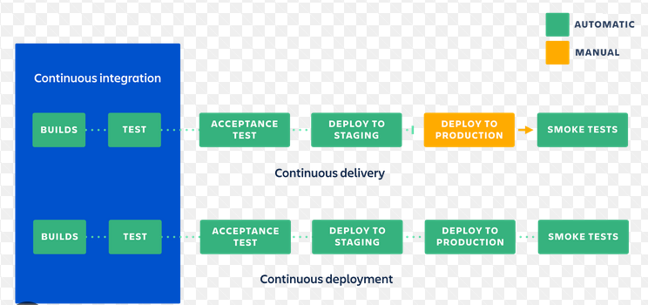
Architectural View

Slide 8
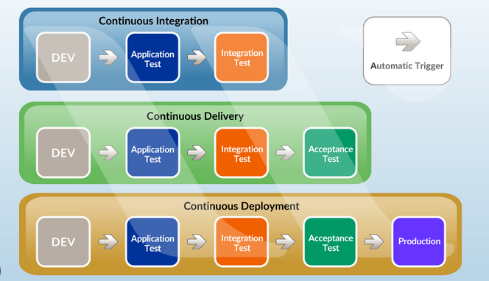
Architectural View

Slide 9
Why CI/CD?
Low risk releases
Faster time to market
Higher quality
Lower costs
Better products
Happier teams

Slide 10
Deployment strategies
Once an application is built, how do we deploy it to distributed infrastructure?
Strategy for deploying to 1 server very different than 100’s.
Trade-offs between deployment speed and risk.
Cloud elasticity and pricing model supports new strategies.

Slide 11
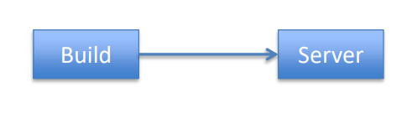
Single Server Deployment
Application is deployed to a single server.
Very common for testing and small production applications.
Benefits:
Easy and quick to deploy app on a single server.
Problems:
Service outage occurs during app deployment
No ability to test app in production before deployment
Rolling back app requires complete reinstallation

Slide 12
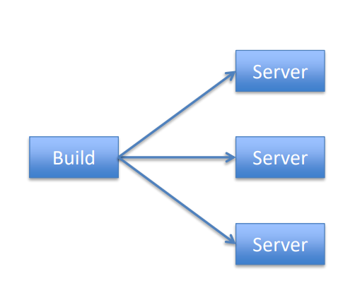
Big Bang Deployment
Application is deployed to all servers at once.
Common for a small set of servers (2-5)
Benefits:
Quick to deploy app on multiple servers, though requires orchestration.
Problems:
Service outage occurs during app deployment.
No ability to test app in production before deployment.
Rolling back app requires complete reinstallation.

Slide 13
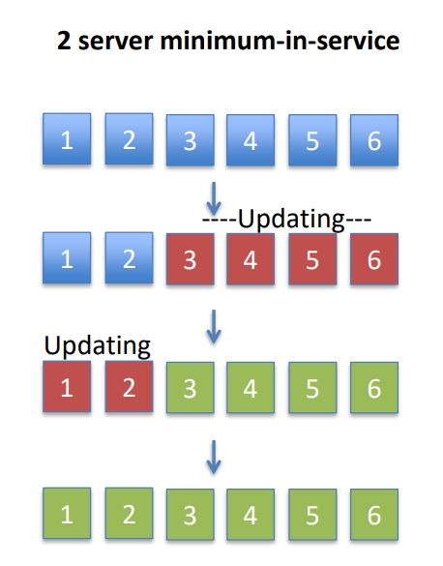
Minimum-in-service Deployment
Application is deployed in multiple stages with a minimum set of servers supporting service.
Benefits:
Supports large environments
No downtime
Fast, most systems updated
Deployments are tested in production
Problems:
Requires significant automation and orchestration capabilities
May require rollback

Slide 14
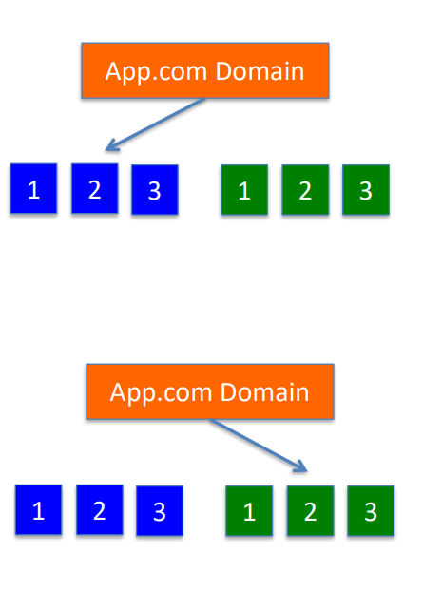
Blue Green Deployment
Application is deployed to a completely new production environment in parallel.
Benefits:
Maintains health of service
Rapid cut-over deployment
Ability to test complete deployment in production
Easy to perform full rollback
Problems:
Requires significant automation and orchestration capability
Extra cost, but manageable with cloud instances

Slide 15
Jenkins
Jenkins offers a simple way to set up a continuous integration or continuous delivery (CI/CD) environment for almost any combination of languages and source code repositories using pipelines, as well as automating other routine development tasks.
While Jenkins doesn’t eliminate the need to create scripts for individual steps, it does give you a faster and more robust way to integrate your entire chain of build, test, and deployment tools than you can easily build yourself.

Slide 16
Jenkins Setup

Slide 17
Jenkins GUI Overview

Slide 18
Create Jenkins Free Style Project

Slide 19
Jenkins Pipelines Through Script

Slide 20
Jenkins Pipelines Through JenkinsFile

Slide 21
Build & Push Docker Image to AWS ECR with Jenkins Pipeline

