Slide 1
AGRONOMIC INTELLIGENCE PLATFORM
AgriVision
Software Architecture, Multi-Spectral Remote Sensing & HITL Guardrails
Enterprise precision agriculture platform unifying satellite remote sensing, edge IoT telemetry, and autonomous Gemini AI reasoning with Human-in-the-Loop clinical safety guardrails.
SYSTEMS ARCHITECT & SOLE DEVELOPER
Muhammad Ahmad
Full-Stack • Firmware • Distributed Backend • Spatial GIS • Mobile
COMPREHENSIVE TECHNOLOGY ECOSYSTEM
iOS (SwiftUI/MVVM-C) • Cloud Backend (FastAPI/PostGIS/TimescaleDB)
Web GIS Portal (React 19) • Edge Hardware (ESP32-S3 PlatformIO/C++)
AgriVision Platform • Technical Architecture & SRS Specification
01 / 11

Slide 2
STRATEGIC FOUNDATION
Platform Mission & Architectural Scope
Synthesizing macro satellite earth observation, micro IoT edge telemetry, and multimodal visual diagnostics.
Tri-Source Telemetry Synthesis [CORE MISSION]
Target Stakeholders [USER ROLES]
Multi-Tier Scope [SYSTEM STACK]
• Macro Telemetry (Satellite): Automated synchronization with Sentinel-2 and AgroMonitoring for 8 spectral indices (NDVI, NDWI, EVI, DSWI, etc.).
• Micro Telemetry (IoT Sensors): Sub-surface telemetry capture via ESP32-S3 nodes measuring volumetric moisture & root-zone soil temperature.
• Visual Telemetry (Multimodal): In-field high-resolution visual capture submitted by farmers via mobile for generative AI disease pathology.
• Unified Agronomic Core: Cross-correlates multi-tier data points to eradicate diagnostic blind spots and optimize crop yields.
• Field Farmers (iOS Native): High-performance offline-first native mobile app for boundary drafting, sensor alerts, and camera diagnostic consultations.
• Certified Agronomists (Web Portal): High-density GIS workstation for spatial raster inspection, index time-series analysis, and clinical HITL steering.
• System Administrators: Fleet device provisioning, MQTT broker health monitoring, worker queue management, and role-based access audit logs.
• Collaborative Field Tenancy: Granular role assignments per field enabling supervised agricultural management.
• iOS Client: SwiftUI / MVVM-Coordinator architecture with Combine state bindings, SwiftData offline cache, and MapKit vector rendering.
• Cloud Backend: Asynchronous Python FastAPI gateway, TimescaleDB hypertable telemetry storage, PostGIS spatial computation, Celery workers.
• Web GIS Portal: Modern React 19 + TypeScript dashboard leveraging TanStack Query, Leaflet / MapLibre raster rendering, and Tailwind CSS.
• Edge Firmware: ESP32-S3 firmware in PlatformIO/C++ implementing MQTT QoS 1 telemetry and hardware fault isolation.
AgriVision Platform • Technical Architecture & SRS Specification
02 / 11

Slide 3
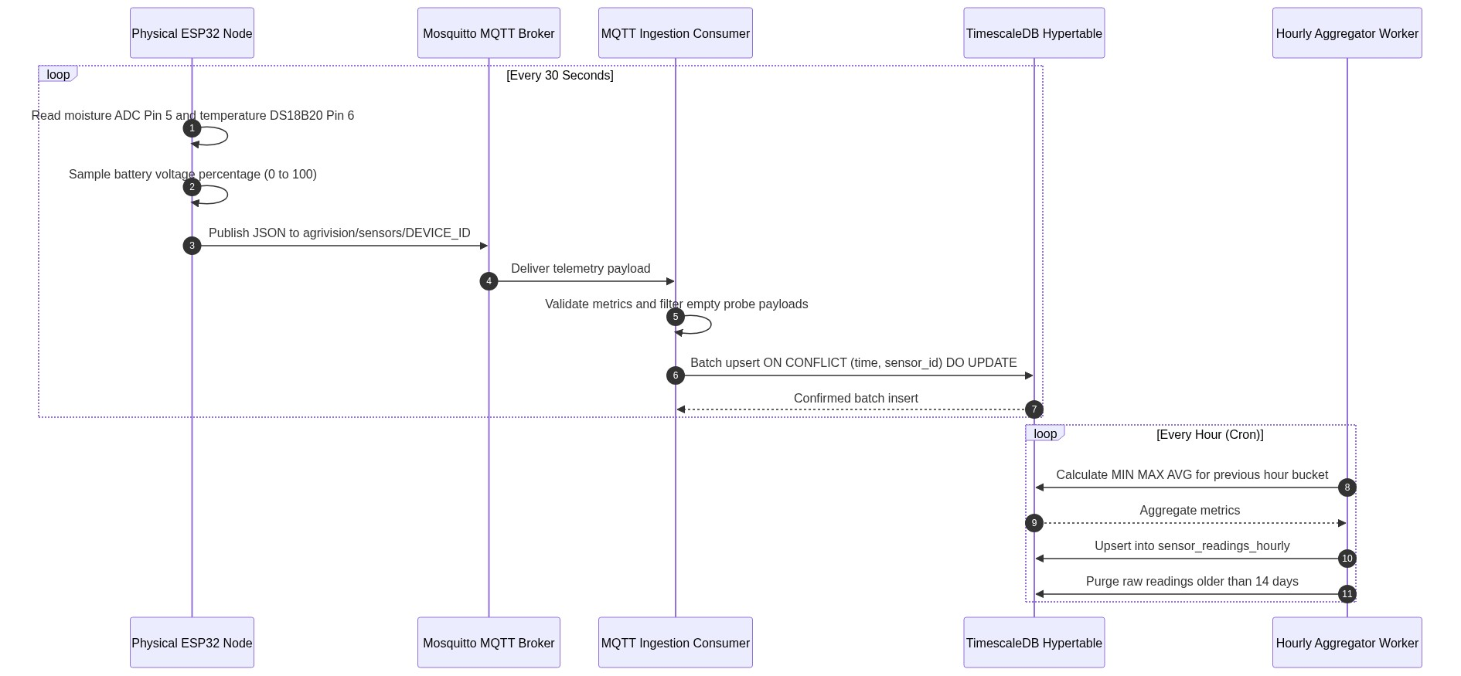
EDGE & EMBEDDED TELEMETRY
Edge Sensing & IoT Hardware Telemetry Pipeline
Industrial-grade ESP32-S3 sensor nodes with fault protection, MQTT broker ingestion, and TimescaleDB hypertable rollups.
Embedded Node Hardware Specs [ESP32-S3 / C++]
TELEMETRY INGESTION SEQUENCE FLOW
• Microcontroller Unit: ESP32-S3 dual-core Xtensa LX7 @ 240MHz with 512KB SRAM and integrated 2.4GHz Wi-Fi/BLE.
• Soil Moisture Sensing (GPIO 5): Capacitive analog probe with ADC calibration and open/short-circuit detection circuit (ADC < 50mV or > 3250mV flags wire cuts).
• Soil Temperature (GPIO 6): Dallas DS18B20 1-Wire digital probe (-55°C to +125°C, ±0.5°C accuracy) with parasitic/external pull-up verification.
Ingestion & Rollup Safeguards [INGESTION PIPELINE]
• MQTT Ingestion Topology: Eclipse Mosquitto broker (QoS 1) -> Async FastAPI background consumers -> TimescaleDB hypertables.
• Batch Writes & Conflict Handling: Ingestion batches up to 50 rows via `COPY`/bulk `INSERT ... ON CONFLICT DO NOTHING` on `(sensor_id, time)`.
• Per-Device Flood Limit: Token-bucket rate limiter enforces maximum 120 messages per 60 seconds per device ID to prevent DDoS/loops.
• Clock Skew & Rollup Pruning: 5-minute skew rejection guard. Automated continuous aggregates compute hourly min/max/mean rollups; 14-day raw data pruning.
AgriVision Platform • Technical Architecture & SRS Specification
03 / 11

Slide 4
EARTH OBSERVATION & SPATIAL GIS
Multi-Spectral Satellite Remote Sensing & GIS Engine
Automated Sentinel-2 / AgroMonitoring synchronization, topological boundary validation, and 8 spectral index rasters.
Vector Boundary Validation [POSTGIS ENGINE]
Constellation Synchronization [SENTINEL-2 / AGRO]
Dynamic Tile Delivery & Proxy [CLIENT RENDER]
• PostGIS Georeferencing: Fields stored as `ST_Polygon` in SRID 4326 (WGS 84), with automatic planar projection to EPSG:3857 for precise cartography.
• Topological Integrity Checks: Rigorous geometry validation via `ST_IsValid()` rejects self-intersecting loops, spikes, and duplicate vertices.
• Area Threshold Enforcement: Calculated surface area enforced between 1.0 hectare and 3,000.0 hectares using `ST_Area(geography)`.
• Dynamic Centroid Computation: Real-time calculation of visual centroids for weather forecast station anchoring and satellite bounding box queries.
• Automated Acquisition Pipeline: Celery beat workers query European Space Agency (ESA) Sentinel-2 passes via AgroMonitoring APIs every 5 days.
• Cloud Coverage Filtering: Ingests only scenes with < 20% cloud cover to guarantee spectral purity and eliminate false cloud anomalies.
• 8 Multi-Spectral Indices: Full support for NDVI (Canopy Vigour), NDWI (Canopy Water Content), EVI/EVI2 (Atmospheric Corrected Vigour), Truecolor (RGB), Falsecolor (NIR/Red/Green), NRI (Nitrogen Reflectance Index), and DSWI (Drought Stress Water Index).
• Historic Baseline Profiling: Computes 12-month trailing index trajectories for anomalies.
• Authenticated Tile Proxy: FastAPI endpoints `/api/v1/satellite/tiles/{field_id}/{layer}/{z}/{x}/{y}` securely proxy raster data.
• API Key Protection: Third-party upstream API keys remain entirely concealed within the private cloud infrastructure.
• Low-Latency In-Memory Caching: High-speed caching stores fetched 256x256 Web Mercator raster tiles, reducing upstream latency from 850ms to < 25ms.
• Dual-Client Harmonization: Seamless tile consumption across React 19 Leaflet overlays and iOS MapKit `MKTileOverlay` renderers.
AgriVision Platform • Technical Architecture & SRS Specification
04 / 11

Slide 5
GENERATIVE AI & AGRONOMIC REASONING
Autonomous Generative AI Advisory & RAG Pipeline
Multimodal plant pathology, localized Punjabi agricultural grounding via Vertex AI Search, and rolling seasonal memory.
Multimodal Camera Diagnostics [GEMINI VISION]
Grounded RAG Retrieval [VERTEX AI SEARCH]
Long-Term Season Memory [ROLLING MEMORY]
• Native iOS Capture Pipeline: Farmers capture diseased foliage or insect infestations directly using the native hardware camera interface.
• Privacy & Optimization Filter: Server-side stripping of sensitive EXIF metadata (GPS, serials, timestamps) prior to model ingestion.
• Image Preprocessing: Automated bilinear downscaling to max 2048px dimension with progressive JPEG re-encoding (reducing payload by 85%).
• Dual-Model Vision Inference: Gemini 1.5 Pro / Flash vision models identify pathogen symptoms, lesion geometry, and leaf necrosis patterns.
• Official Local Grounding: Real-time semantic vector retrieval indexed against official Punjab Agricultural Extension guides and manuals.
• Pathology & Dosage Knowledge: Validates pesticide chemistry, bio-fungicides, fertilizer compatibility, and region-specific sowing calendars.
• Hallucination Suppression: Strict system prompt instructions enforce zero hallucination; ungrounded synthetic chemical formulas are strictly rejected.
• Contextual Field Injection: Queries are augmented with real-time field state: current soil moisture, 5-day weather forecast, and NDVI score.
• Field Memory Store: `field_season_memory` table maintains an autonomous 1,200-character rolling digest of field crop history.
• Multi-Month Context Awareness: Tracks prior fertilizer applications, past pest infestations, soil depletion trends, and agronomist steering notes.
• Autonomous Consolidation: Background LLM summarizer compresses conversational turns and clinical decisions after every interaction.
• Continuity Across Cycles: Guarantees that advice given in August accounts for chemical treatments and crop rotation applied in May.
AgriVision Platform • Technical Architecture & SRS Specification
05 / 11

Slide 6
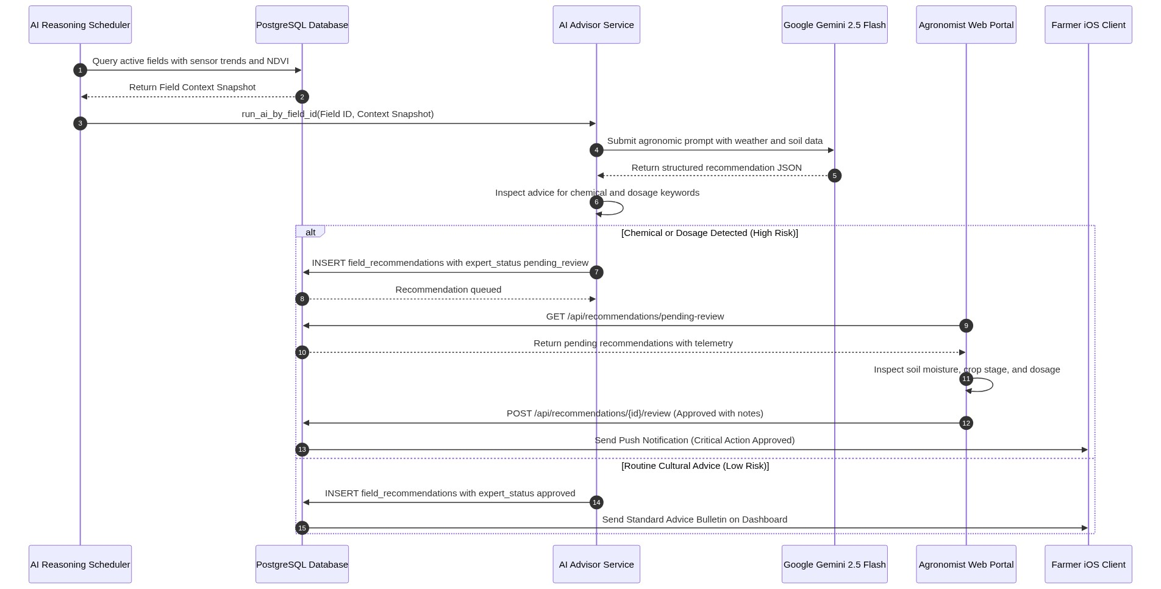
SAFETY GUARDRAILS & CLINICAL GOVERNANCE
Human-in-the-Loop (HITL) Safety & Expert Steering
Rule-based chemical policy interception, agronomist clinical triage queue, and authoritative expert steering drawer.
Chemical Interception & Triage Queue [CLINICAL GATE]
HITL INTERCEPTION & CLINICAL APPROVAL FLOW
• Deterministic Safety Interceptor: Rule-based policy engine inspects all raw AI outputs for restricted chemical compounds (e.g. organophosphates, systemic fungicides).
• Safety Level Classification: Any dosage or toxicity recommendation automatically flags `safety_level = 'high_risk'` and marks `expert_status = 'pending'`.
• Delivery Quarantine: Toxic recommendations are strictly suppressed from the farmer's mobile interface until an accredited agronomist signs off.
Agronomist Portal & Expert Steering [STEERING DRAWER]
• Clinical Triage Portal (`AIAdvisoryView`): Dedicated Web GIS clinical queue where agronomists review raw AI diagnostics alongside satellite imagery & sensor curves.
• Direct Intervention Actions: Agronomists can: [1] Approve as-is, [2] Edit dosage/chemistry with clinical notes, or [3] Reject and substitute alternative treatments.
• Authoritative Memory Injection: Expert steering drawer directly injects agronomist directives into `field_season_memory`, constraining future AI reasoning loops.
AgriVision Platform • Technical Architecture & SRS Specification
06 / 11

Slide 7
DEVELOPMENT METHODOLOGY & QUALITY GATES
Software Engineering Methodology & Resourcing
High-discipline single-lane Kanban execution across 5 tech stacks with dual-tier automated test verification.
Solo Execution Constraints [5 TECH STACKS]
Work Discipline & Kanban [WIP LIMIT = 1]
Quality Assurance Gates [392 AUTOMATED TESTS]
• Single-Resource Execution: Designed, engineered, verified, and deployed entirely by sole developer Muhammad Ahmad.
• Unified Systems Breadth: Spans ESP32-S3 C++ firmware, distributed FastAPI services, PostGIS spatial queries, SwiftUI iOS, and React 19 GIS.
• Architectural Modularity: Decoupled micro-services and clear contract boundaries prevented dependency lock-in and cognitive overload.
• Full DevOps Ownership: Single-handedly authored Docker Compose orchestration, TimescaleDB migrations, and CI test pipelines.
• Single-Lane Kanban Cadence: Strict Work-In-Progress (WIP) limit of 1 active subsystem at any given time to eliminate context-switching waste.
• Vertical-Slice Increments: Every sprint delivered a fully functional end-to-end slice (sensor -> MQTT -> database -> API -> mobile/web UI).
• Defect-First Triage: Zero tolerance for lingering architectural debt; automated regressions halted forward development until resolved.
• Living Documentation: Complete traceability from PRD/SRS requirements to automated test case execution IDs.
• Automated Test Suite: 179 Pytest backend test cases (API routes, GIS math, Celery workers) + 213 XCTest iOS client tests (models, views, coordinators).
• Strict Static Analysis: Automated `oxlint` rule evaluation and zero-warning `tsc -b` TypeScript build enforcement on Web GIS.
• AI-Assisted Pair Audits: Integrated Claude / GitHub Copilot audit branches to rigorously review security boundaries, memory leaks, and race conditions.
• Regression Immunity: Automated pre-commit hooks ensure zero compilation errors across firmware, backend, web, and iOS targets.
AgriVision Platform • Technical Architecture & SRS Specification
07 / 11

Slide 8
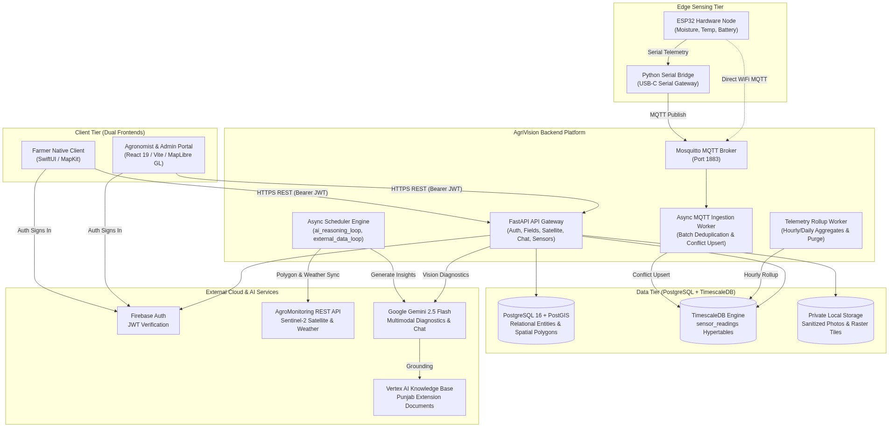
DISTRIBUTED SYSTEM ARCHITECTURE
Multi-Tier System Architecture
6-tier decoupled topology with isolated container networks, Firebase JWT auth, and least-privilege security.
6 Architectural Tiers & Security [TIER BREAKDOWN]
LOGICAL ARCHITECTURE & DATA FLOWS
• Tier 1 - Client Presentation: iOS 17+ Native app (SwiftUI, MVVM-C) + Web GIS Clinical Portal (React 19, TypeScript).
• Tier 2 - Edge Hardware: ESP32-S3 nodes publishing encrypted telemetry over Wi-Fi via MQTT with hardware ADC fault detection.
• Tier 3 - Gateway & Ingestion: Mosquitto MQTT Broker + FastAPI ASGI Gateway handling JWT validation, rate limiting, and routing.
• Tier 4 - Domain Services & Workers: Celery background workers managing satellite raster sync, weather polling, and continuous telemetry rollups.
• Tier 5 - Persistent Storage: PostgreSQL 16 + PostGIS (spatial polygons) + TimescaleDB (sensor hypertables) + Redis (cache/broker).
• Tier 6 - External Cloud Services: Vertex AI Search, Google Gemini Vision 1.5, AgroMonitoring Satellite APIs, Firebase Auth.
• Network Security & Hardening: Docker bridge network (`agrivision_net`) isolates databases; non-root user execution; Firebase asymmetric JWT verification on all endpoints.
AgriVision Platform • Technical Architecture & SRS Specification
08 / 11

Slide 9
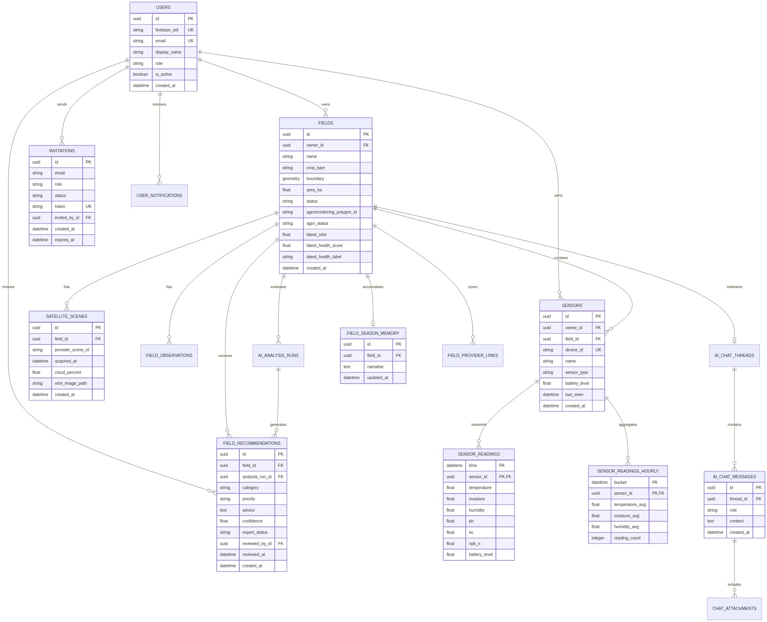
RELATIONAL & TIME-SERIES PERSISTENCE
Data Persistence & ERD Topology
22-entity hybrid relational, spatial, and hypertable time-series schema engineered for high-throughput precision agronomy.
Core Schema Entities & Polyglot Storage [22 CORE ENTITIES]
ENTITY-RELATIONSHIP (ERD) TOPOLOGY
• Spatial Entities (`fields`, `zones`): PostGIS `GEOMETRY(Polygon, 4326)` columns with spatial indexing (`GIST`) for rapid containment queries.
• Time-Series Hypertables (`sensor_readings`): TimescaleDB chunked hypertable partitioned on `(time, sensor_id)` with compression policies for millions of data points.
• Identity & RBAC (`users`, `user_roles`, `invitations`): Multi-tenant role-based access control linking Firebase UID to domain tenancy.
• Telemetry Hardware (`devices`, `sensors`, `device_health`): Hardware registry tracking firmware versions, battery voltages, and MAC addresses.
• AI & Clinical Governance (`ai_analysis_runs`, `field_recommendations`): Full audit log storing raw Gemini prompts, RAG references, intercepted high-risk dosage flags, and agronomist signature status.
• Continuous Rollups (`sensor_readings_hourly`): Materialized views providing pre-computed statistical aggregations for instant dashboard charts.
AgriVision Platform • Technical Architecture & SRS Specification
09 / 11

Slide 10
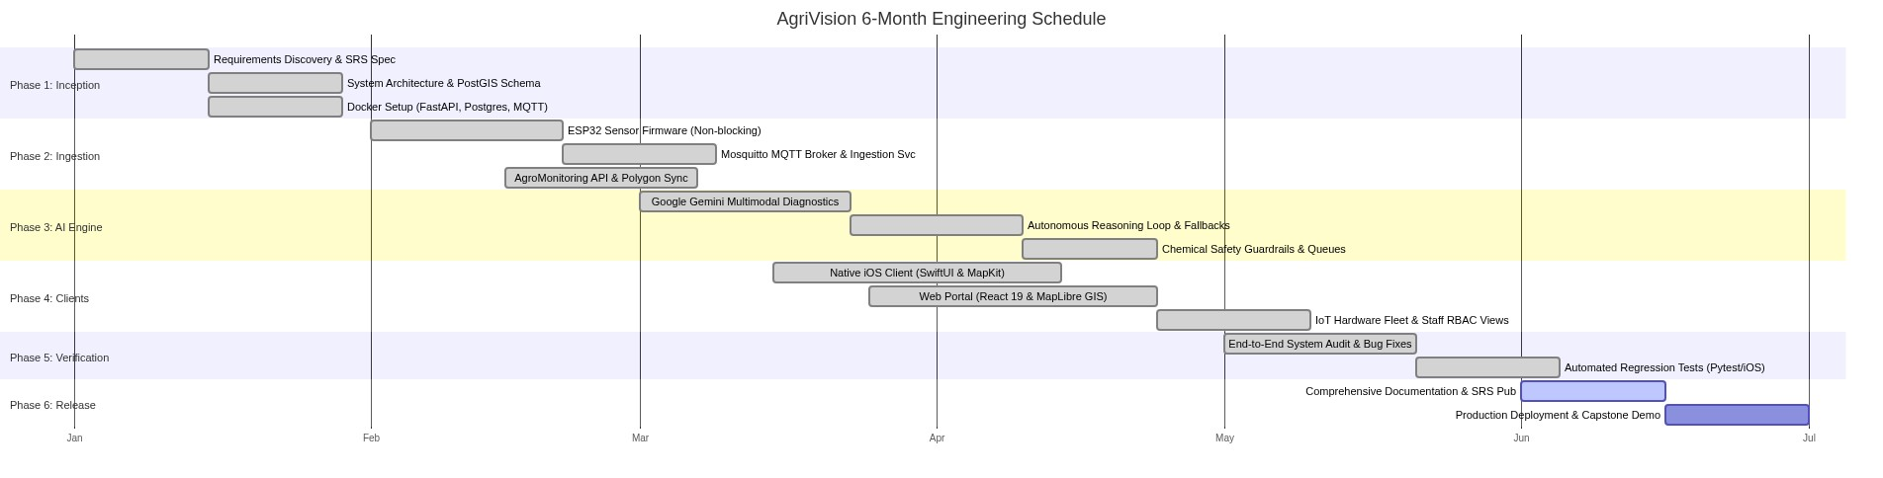
DELIVERY ROADMAP & EXECUTION TIMELINE
Deliverables & Milestones Roadmap
10-month systematic milestone execution spanning Jan 2026 to Oct 2026 across all core subsystems.
Subsystem Execution Milestones [JAN 2026 - OCT 2026]
PROJECT GANTT SCHEDULE & MILESTONES
• Phase 1 (Jan - Feb 2026): Foundation & Mobile Architecture: Setup FastAPI project skeleton, Docker environment, PostgreSQL/PostGIS databases, and native iOS SwiftUI architecture.
• Phase 2 (Mar - Apr 2026): Edge Hardware & Telemetry Ingestion: ESP32-S3 sensor firmware development, Mosquitto MQTT broker configuration, and TimescaleDB hypertable ingestion pipelines.
• Phase 3 (May - Jun 2026): Satellite Remote Sensing & GIS Engine: AgroMonitoring API integration, automated Sentinel-2 synchronization, PostGIS vector validation, and raster tile proxy endpoints.
• Phase 4 (Jul - Aug 2026): AI Advisory, RAG & HITL Interception: Gemini Vision multimodal model integration, Vertex AI Search RAG knowledge grounding, and clinical safety interception gate.
• Phase 5 (Sep 2026): Agronomist Web GIS Portal (React 19): Web GIS dashboard with raster layer overlays, interactive NDVI curves, and the clinical recommendation triage review queue.
• Phase 6 (Oct 2026): Comprehensive QA, Hardening & Deployment: Complete automated test suite execution (392 tests), security audits, and production container deployment.
AgriVision Platform • Technical Architecture & SRS Specification
10 / 11

Slide 11
EXECUTIVE SUMMARY & FUTURE OUTLOOK
Summary & System Impact
Delivering state-of-the-art agronomic intelligence with zero-compromise safety, spatial rigor, and production readiness.
Key Engineering Achievements [CORE ACCOMPLISHMENTS]
Future Enhancements & Scalability [NEXT-PHASE ROADMAP]
✔ Operational Tri-Source Telemetry: Unified satellite Earth observation (8 spectral layers), sub-surface IoT sensors (ESP32-S3), and farmer visual camera capture into one cohesive system.
✔ Safety-Guarded Autonomous AI Advisory: Gemini multimodal reasoning grounded with official Punjabi agricultural guides and strictly gated behind an agronomist HITL approval workflow.
✔ High-Performance Spatial & Time-Series Core: Sub-millisecond GIS polygon validation via PostGIS and scalable time-series hypertable aggregation via TimescaleDB.
✔ Dual-Client Enterprise Experience: Frictionless offline-first native iOS mobile app for field operations combined with an advanced React 19 GIS clinical workstation for agronomists.
✔ Robust Software Engineering Rigor: 392 automated test cases verifying 100% of critical domain services, zero-leak telemetry ingestion, and strict type safety.
➔ Remote Push Notifications (APNs / FCM): Implement real-time background push alerts notifying farmers immediately upon critical frost warnings, drought stress, or agronomist prescription releases.
➔ Automated Hardware Diagnostics & Over-The-Air (OTA): Roll out remote firmware updates over MQTT/HTTPS with automatic rollback and predictive battery failure warnings.
➔ Edge ML Pathogen Detection: Deploy quantized TinyML vision models directly onto ESP32-CAM devices for offline real-time pest trap monitoring.
➔ Automated Variable-Rate Irrigation Dispatch: Direct integration with motorized solenoid valves to trigger closed-loop precision irrigation based on real-time soil moisture rollups.
➔ Multi-Regional RAG Knowledge Expansion: Expand vector retrieval databases to encompass Sindh, KPK, and international agronomic extension authorities.
AgriVision Platform • Technical Architecture & SRS Specification
11 / 11

