Slide 1
Business Innovation and Growth Strategies in the Modern Smartphone Industry
A Study of Unicorn Companies,
Product Evaluation,
and the Rapid Growth of Global Smartphone Brands

Slide 2
In today’s modern world, business is growing faster than ever before. Technology has completely changed how companies start, grow, and compete in the global market.
Some companies reach billion-dollar valuations in a very short time. At the same time, smartphone companies like Samsung, Apple, Oppo, and Huawei have grown from small beginnings into global giants.
In this presentation, we will discuss:
• What is a Unicorn company?
• What is product evaluation, especially phone evaluation?
• How major smartphone companies started and became so successful

Slide 3
What is a Unicorn Company?
A Unicorn Company is a privately owned startup that has reached a valuation of 1 billion US dollars or more.
The term was introduced in 2013 by venture capitalist Aileen Lee.
The word “Unicorn” is used because billion-dollar startups were once very rare, just like the mythical unicorn creature.
A unicorn company:
• Is privately owned (not listed on stock exchange)
• Is usually technology-based
• Has very high market valuation
• Grows at a very fast speed
These companies are considered highly innovative and disruptive.

Slide 4
Key Characteristics of Unicorn Companies
Unicorn companies have some common characteristics:
1: Innovation
They introduce new ideas or improve existing systems significantly.
2: Scalability
Their business model allows rapid expansion globally without high physical cost.
3: Technology-Based Model
Most unicorns operate through digital platforms or advanced technology.
4: Strong Investor Support
They receive funding from venture capitalists and private investors.
5: High Growth Potential
They focus on rapid expansion rather than slow traditional growth.

Slide 5
Reasons Behind the Success of Unicorn Companies
Unicorn companies become successful due to strong strategic reasons:
1: First-Mover Advantage
They enter the market early with new ideas and capture customers before competitors.
2: Market Disruption
They do not follow traditional systems — they change them completely.
3: Solving Real Problems
They provide convenient, fast, and affordable solutions.
4: Digital Platform Model
They use apps or websites to scale quickly worldwide.
5: Network Effect
More users increase the value of the service automatically

Slide 6
2: Why Do Unicorn Companies Grow So Fast?
Unicorn companies grow quickly because:
• They use digital platforms (low physical cost)
• They expand globally through the internet
• They attract strong investors
• They focus on customer needs
• They use aggressive marketing strategies
• They benefit from the “network effect” (more users = more value)
This combination helps them reach billion-dollar valuation rapidly.

Slide 7
Example of Uber (Disrupting Taxi Industry)
Before Uber:
• Traditional taxis had no digital tracking
• No fixed transparent pricing
• No customer rating system
• Limited availability
Uber introduced:
• App-based ride booking
• GPS tracking
• Online payment
• Driver and customer ratings
Uber does not own cars.
It uses a platform business model where drivers use their own vehicles.
This innovation disrupted the traditional taxi industry and helped Uber grow rapidly into a unicorn company.

Slide 8
The Evolution of Phones – From Wires to Pocket Supercomputers
1: The First Telephone – Talking Through Wires (1876)
In 1876, a man named Alexander Graham Bell changed the world forever. He invented the first telephone.
Before this, people could only communicate by letters or telegrams. It could take days or even weeks to send a message.
Bell’s telephone allowed people to talk to each other using wires. The voice traveled as electrical signals through long cables.
1: It was simple.
2: It had no buttons.
3: It connected two places directly.
It was slow, but it was magical. For the first time in history, people could hear someone’s voice from far away.
This was the beginning of a communication revolution.

Slide 9
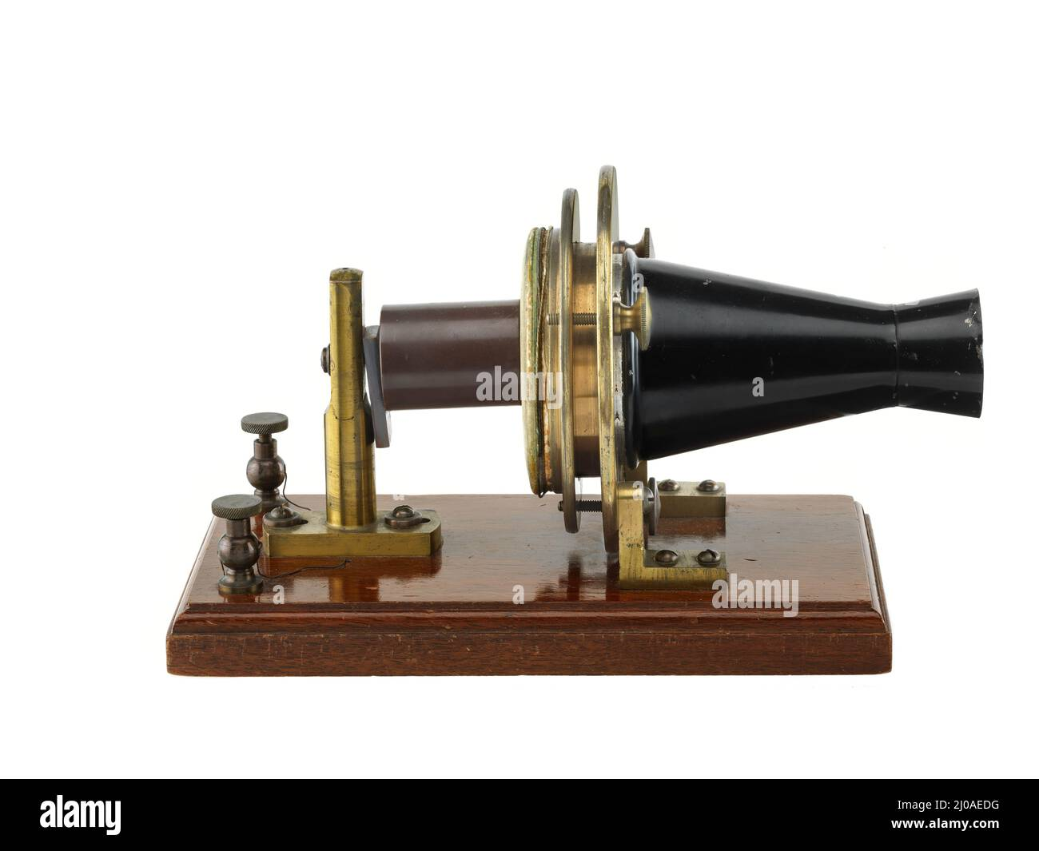

Slide 10
2: The Rotary Phone Era – Spin to Call (1900–1960)
As telephones became common in homes, a new version appeared: the rotary phone.
Instead of asking an operator to connect calls, people could dial numbers themselves.
The rotary phone had:
A circular dial
Numbers 0–9
You put your finger in a hole and rotated it
It made a satisfying clicking sound while dialing.
☎️ Calling someone took time.
If you made a mistake? You had to start again!
But this phone made communication more independent and modern.

Slide 11


Slide 12
3: Push-Button & Cordless Phones (1970–1980)
Technology improved again.
Rotary phones were replaced with push-button phones.
Instead of spinning a dial, you simply pressed buttons. It was:
Faster
Easier
More convenient
Then came cordless phones.
Now you could walk around your house while talking. No wires attached to your hand!
It felt futuristic at that time.

Slide 13
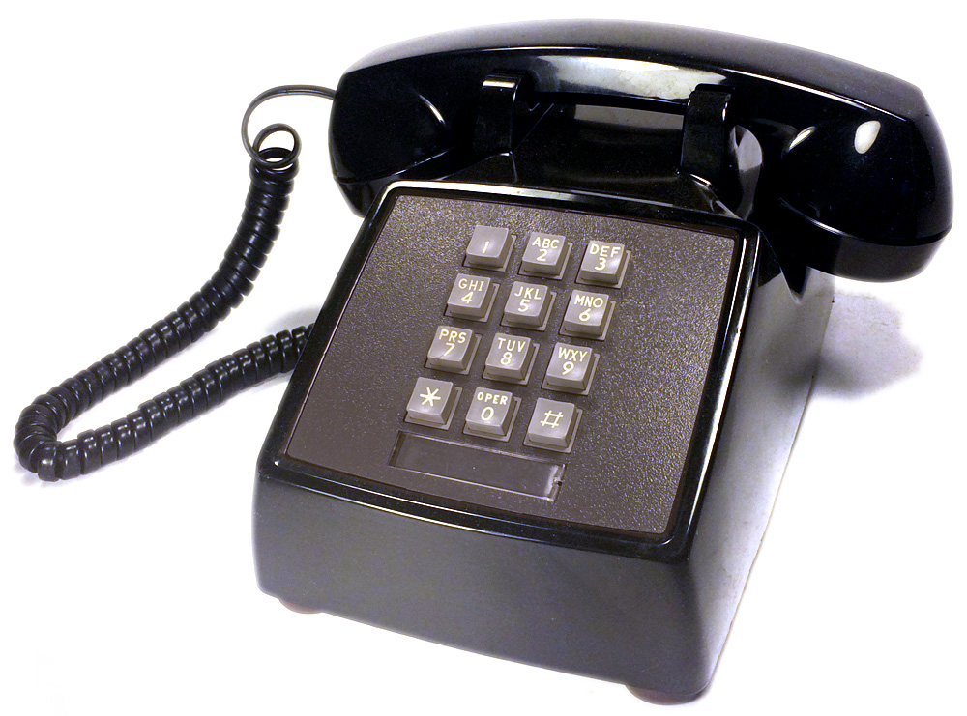

Slide 14
4: The First Mobile Phones (1980s)
Then came a huge breakthrough — mobile phones.
In 1973, Martin Cooper from Motorola made the first mobile phone call.
By the 1980s, mobile phones became available to the public.
But they were:
Very big
Very heavy
Very expensive
They were called “brick phones” because they looked like bricks.
Only rich business people could afford them.
Still, this was a massive change:
📱 You could talk without wires — anywhere!

Slide 15
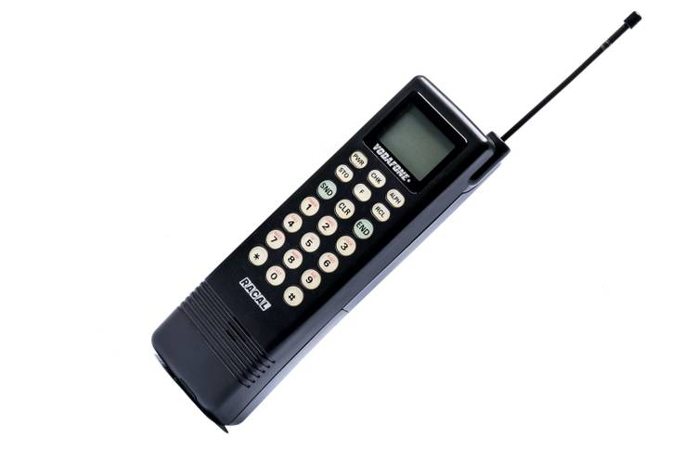

Slide 16
5: Flip Phones & Texting Era (1990s – Early 2000s)
Mobile phones became smaller and smarter.
This era introduced:
Flip phones
Smaller antennas
Color screens
SMS texting
Text messaging became extremely popular.
One famous phone was the Nokia 3310.
It was:
Very strong
Long battery life
Simple to use
People loved playing Snake game and sending short messages.
Phones were no longer just for calling — they became personal devices.

Slide 17
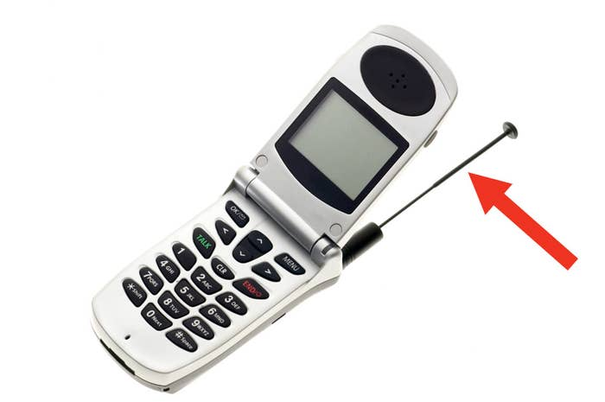

Slide 18
6: The Smartphone Revolution (2007)
In 2007, everything changed again.
iPhone by Apple was introduced.
It had:
A full touchscreen
No physical keyboard
Internet browsing
Apps
Soon, companies like Samsung followed.
Now phones were not just phones.
They became:
Cameras
Music players
GPS systems
Gaming devices
Internet machines
This was the beginning of the smartphone era.

Slide 19
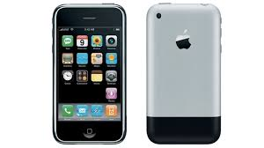

Slide 20
7: Modern Smartphones – Pocket Supercomputers
Today’s smartphones are incredibly powerful.
They have:
High-quality cameras
Face recognition
Artificial Intelligence
5G internet
Huge storage
Powerful processors
Your phone today is more powerful than the computers used to send humans to the moon.
It fits in your pocket.
It connects you to the entire world.
It is truly a pocket supercomputer.

Slide 21
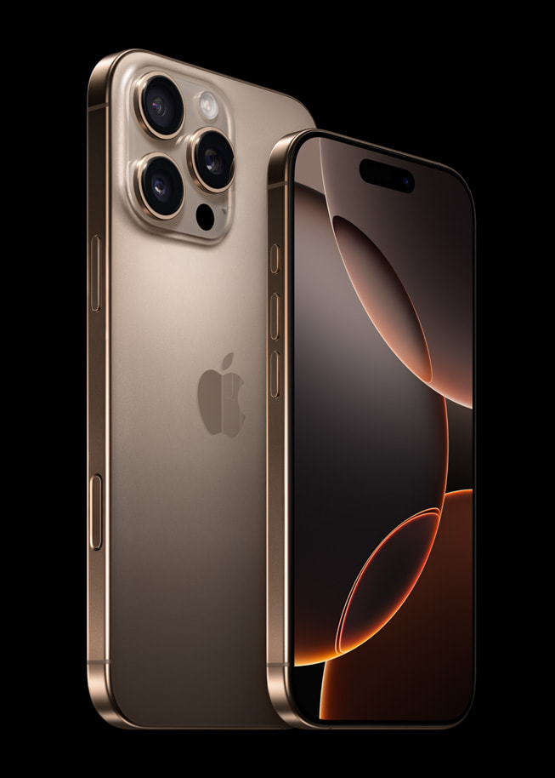

Slide 22
Growth Story of Samsung
Founded in 1938 in South Korea.
Originally started as a small trading company selling groceries and dried fish.
In the 1960s, Samsung entered the electronics industry.
Growth Factors:
• Heavy investment in research and development
• Manufacturing its own components
• Offering products in all price ranges
• Strong global distribution network
Today Samsung is one of the largest smartphone manufacturers in the world.

Slide 23
Growth Story of Apple
Founded in 1976 by Steve Jobs and Steve Wozniak.
Started in a garage making personal computers.
In 2007, Apple launched the iPhone, which changed the smartphone industry completely.
Growth Factors:
• Premium branding strategy
• Unique iOS ecosystem
• Focus on innovation and design
• Strong customer loyalty
• High profit margins
Apple focuses on quality over quantity.

Slide 24
Growth Story of Oppo
Founded in 2004 in China.
Oppo focused on stylish design and strong camera features.
Growth Factors:
• Heavy marketing campaigns
• Focus on young customers
• Affordable pricing strategy
• Strong presence in Asian markets
Oppo became popular especially in developing countries.

Slide 25
Growth Story of Huawei
Founded in 1987 in China.
Initially started as a telecommunications equipment company.
Growth Factors:
• Strong investment in research
• Government support
• Advanced technology
• Global expansion strategy
Huawei became one of the top smartphone brands in the world.

Slide 26
How Did These Companies Grow So Fast?
The main reasons behind rapid growth:
• Continuous innovation
• Massive investment in research and development
• Strong branding
• Global market expansion
• Economies of scale (large production reduces cost)
• Customer-focused strategy
• Effective supply chain management
Technology and smart strategy made them successful.

Slide 27
Conclusion
Unicorn companies show how innovation and technology can create billion-dollar businesses quickly.
Phones have evolved from simple wired communication tools into powerful pocket supercomputers that manage almost every part of our lives.
Their journey shows how technology keeps improving and the future will bring even smarter innovations.
Major smartphone companies like Samsung, Apple, Oppo, and Huawei succeeded because of innovation, strategy, branding, and global expansion.
In modern business, success depends on:
Innovation + Strategy + Technology + Customer Satisfaction

