Slide 1
Heart Attack Risk Prediction Using Machine Learning Muhammad Akhtar Nadeem Akhuwat College & University Kasur

Slide 2
Introduction
Objective:
The goal of this project is to predict heart attack risk using machine learning. By analyzing patient data, we aim to help in early detection and better healthcare decisions.
Problem Statement:
Heart attacks are a serious health problem, and traditional methods of diagnosis can be slow or less accurate. Detecting them early can save lives and improve treatment.

Slide 3
Outlines
Dataset Overview
Preprocessing
Model Training
Models Comparision

Slide 4
Dataset Overview
Total records: 8763
Dataset Source:
Kaggle
https://surl.li/uozysm
Total Features:
No. 26
Target Variable:
Heart Attack Risk
Class Distribution:
0 64.2%
1 35.8%
Purpose:
Enable heart attack risk prediction and analysis of contributing factor

Slide 5
Key Features
Demographics
Age: Patient`s age
Sex: Gender of the patient
Lifestyle Factors
Smoking:
Medical Information
Cholesterol:
Economic Information
Income:
Country, Continent, Hemisphere: Geographic location of the patient
Obesity:
Alcohol Consumption:
Exercise Hours Per Week:
Diet:
Physical Activity Days Per Week
Stress Level:
Sleep Hours Per Week:
Sedentary Hours Per Day:
Blood Pressure:
Heart Rate:
Triglycerides:
Diabetes:
Pervious Heart Problem:

Slide 6
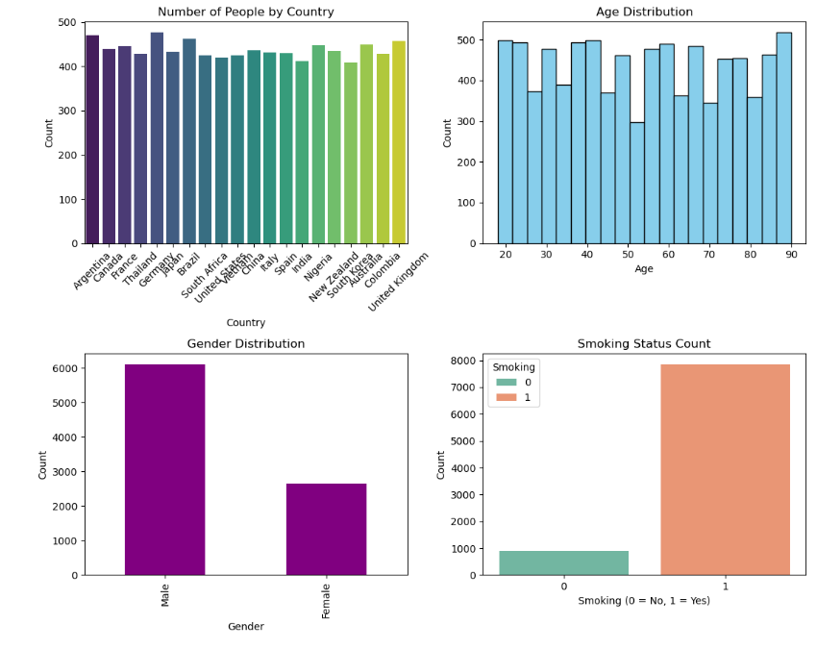
Data Insights

Slide 7
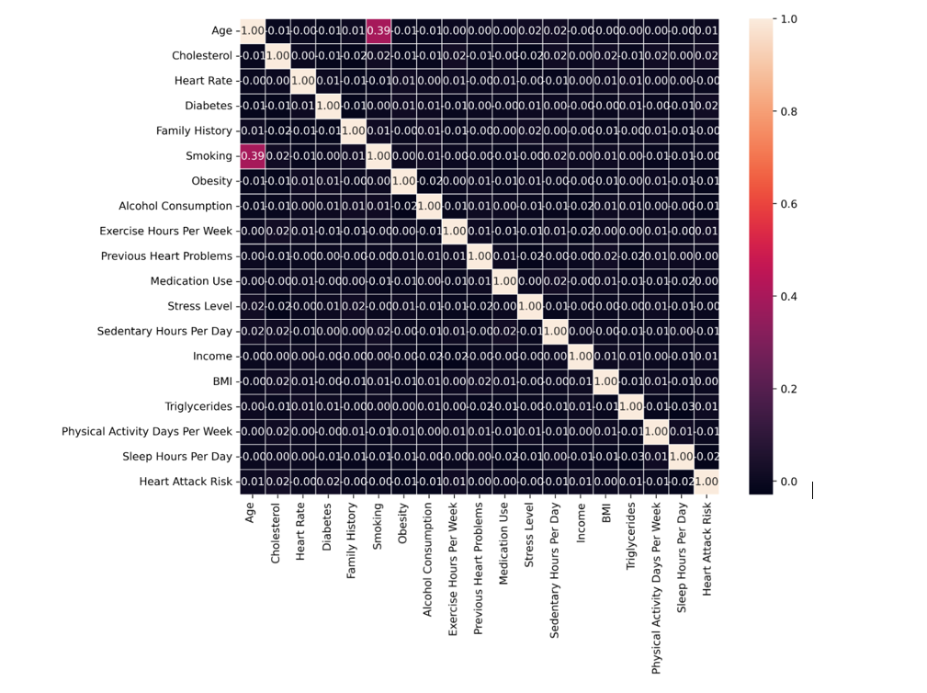
Data Preprocessing
Correlation Between Dataset.

Slide 8
Data Preprocessing
Convert Categorical Values to Numerical
Apply Label Encoder:
Feature: Sex
Feature: Diet
Split Blood Pressure Into Systolic and Diastolic
Decision:
Removal of Patient ID, Country, Continent, Hemisphere
Count Null Values:
0

Slide 9
Data Preprocessing
Feature Scaling
Used Robust Scalar for continuous features.
Ensures all features contribute equally and prevents dominance by high-magnitude variables.

Slide 10
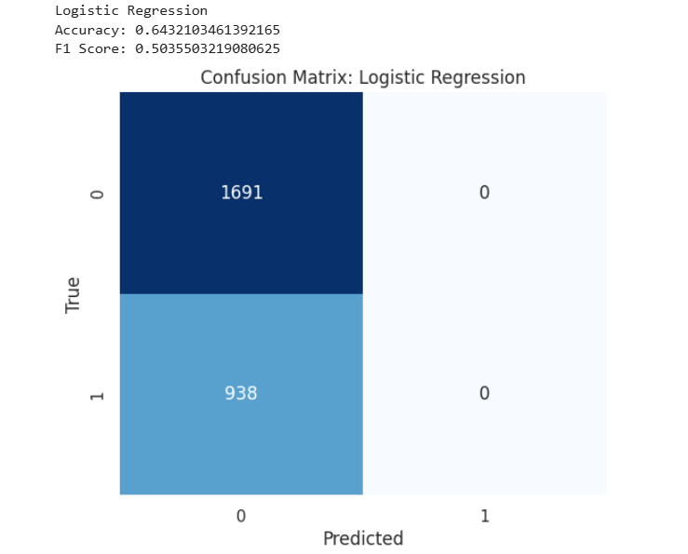
Model Training
LogisticRegration
Training Details
Split:
Training = 70%
Testing = 30%
Results
Accuracy: 64%
Notes:
True Negative (TN):
These are the cases where the model correctly predicted the negative class (0).
False Positive (FP):
These are the cases where the model incorrectly predicted the positive class (1) when the true class was actually negative (0).
False Negative (FN):
These are the cases where the model incorrectly predicted the negative class (0) when the true class was actually positive (1).
True Positive (TP):
These are the cases where the model correctly predicted the positive class (1).
Precision=TP/TP+FP
Recall=TP/TP+FN
F1_score=2× Precision×Recall/ Precision+Recall​

Slide 11

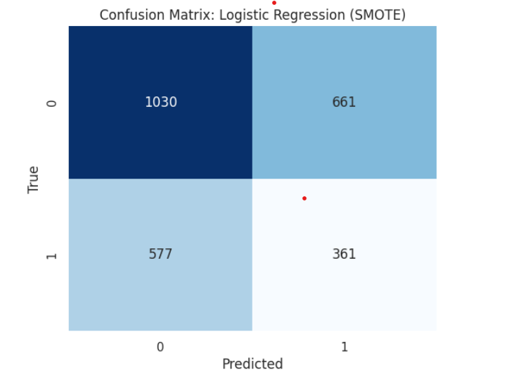
Class Imbalance Problem
Applied SMOTE to balance the dataset.
Result: 51%

Slide 12
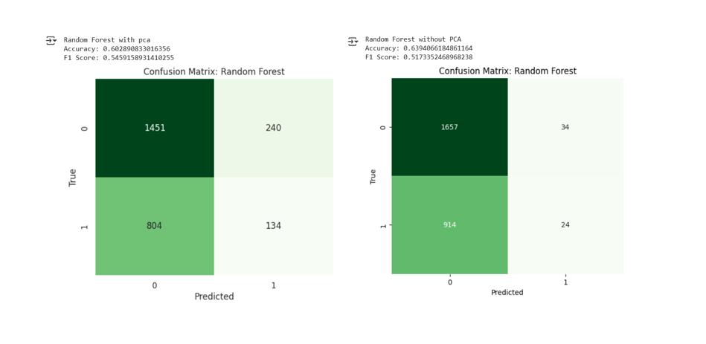
Apply Random Forest Model
Key Observations:
Without PCA:
Higher accuracy (63.94%) but lower F1 Score (51.73%).
With PCA:
Slightly lower accuracy (60.29%) but improved F1 Score (54.59%).

Slide 13
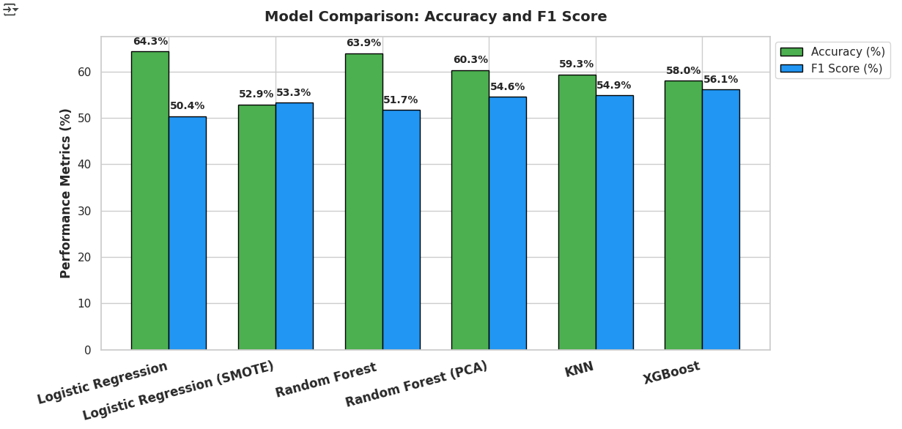
Model Comparison
Key Observations:
Logistic Regression achieved the highest accuracy (64.3%), but its low F1 Score indicates poor handling of imbalanced data.
Logistic Regression (SMOTE) showed improved F1 Score at the cost of reduced accuracy.
Random Forest (with/without PCA) delivered consistent accuracy (63.9%) but low F1 Score.
KNN achieved a balanced performance, making it moderately suitable.
XGBoost provided the highest F1 Score (56.1%), demonstrating its ability to handle imbalanced data effectively.
Notes:
Jsagu;iwq c,m\qwuidmcbuiq

Slide 14

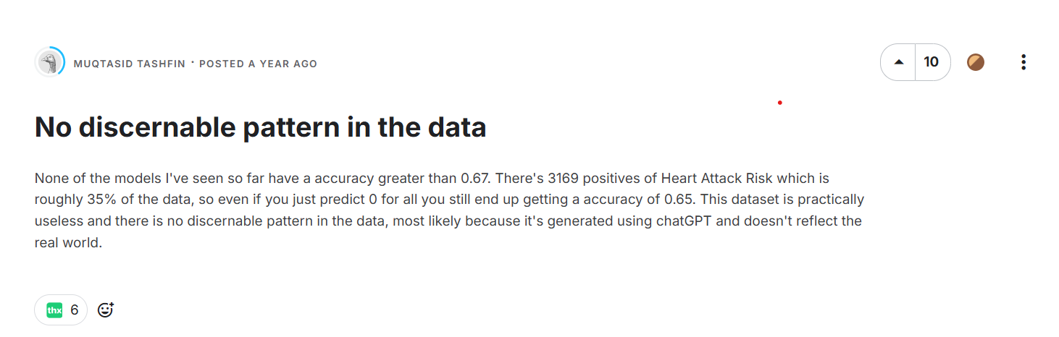
Dataset Problem

Slide 15
Conclusion
In this project, i tested different models to predict heart attack risk. The Logistic Regression model had an accuracy of 64.3%, but it missed many actual cases. Using SMOTE helped balance the data, improving the F1 Score but slightly lowering accuracy. The Random Forest model performed well, and XGBoost provided the best balance between accuracy and F1 Score. Additionally, our dataset showed minimal correlation between features.

Slide 16


