Slide 1
When does modelling the intermediate help?
Composite vs Direct, with both surrogates fitting their own hyperparameters
22 outer maps × 4 function draws × 5 initial designs, 45 evaluations each.
h drawn from Matérn-5/2, BoTorch's default kernel, so both surrogates are correctly specified about h.

Slide 2
Four findings
in order of how much they change the picture
• 1. The bijective-case advantage was an artefact of the setup.
Composite previously held the generator's true kernel while Direct estimated one, and h was RBF while both assumed Matérn. On identity the gain fell from +0.409 to +0.087 ± 0.155.
• 2. With that fixed, bijectivity does predict the gain.
All 11 non-bijective maps gain, every one significant. None of the 5 bijective maps do.
• 3. But information is not the mechanism.
n̄ is uncorrelated with the size of the gain (r = −0.12). Flatness of g at its own optimum predicts it (r = +0.78).
• 4. And none of the magnitudes survive two objectives.
The same 17 maps under hypervolume give gains uncorrelated with their single-objective ones (r = −0.19), and the plateau measure stops working (r = −0.36). The bijective split still shows, weakly.

Slide 3
The setup
f(x) = g(h(x)), x ∈ [0,1]⁶
 | Observes | Models | Predicts f by
Direct | f(xᵢ) only | a GP on f | reading off that GP
Composite | h(xᵢ) | a GP on each hⱼ | sampling h, applying g
• Same inputs, same budget, same initial design, same acquisition function.
• Both fit their own kernel hyperparameters by maximum likelihood — this is what changed.
• h is a draw from the surrogates' own prior, so Composite's model of h is correct by construction and every difference is attributable to g.

Slide 4
What is excluded, and why
stated up front, because it flatters the result
Map | Why excluded | Gain | p
relu | kink at 0, constant below | -0.154 | 0.881
abs | kink at 0 | +0.098 | 0.333
clip_c2 | constant outside [−1,1] | -0.003 | 0.508
cos_w4 | deferred — ω·sd(h) ≈ 2.6 rad | -0.014 | 0.515
root1 | affine; identical to identity | +0.087 | 0.291
The three non-smooth maps are exactly the three non-bijective maps with no effect.
Excluding them takes the non-bijective group from 11 significant rows out of 13 to 10 out of 10. The criterion is smoothness of g, decided independently of the result — but both versions are reported.

Slide 5
Bijective maps: no effect
final log₁₀ regret over 20 runs; gain = Direct − Composite; one-sided paired t-test
Problem | n̄ | Direct | Composite | Gain | p
exp_b1 | 1.00 | -2.594 | -2.742 | +0.148 | 0.109
identity | 1.00 | -1.027 | -1.114 | +0.087 | 0.291
mono3 | 1.00 | +0.093 | +0.012 | +0.081 | 0.235
sinh_b1 | 1.00 | +0.245 | +0.164 | +0.081 | 0.220
mono5 | 1.00 | +0.745 | +0.793 | -0.048 | 0.618
All five show nothing. The largest gain in the group is +0.148, and it is not significant.

Slide 6
Non-bijective maps: every row gains
same convention
Problem | n̄ | Direct | Composite | Gain | p
root2 | 2.00 | -4.975 | -8.395 | +3.420 | <0.001
shiftsq_c1 | 1.95 | -5.357 | -8.218 | +2.861 | <0.001
shiftsq_c0 | 2.00 | -5.140 | -7.949 | +2.809 | <0.001
shiftsq_c2 | 1.37 | -5.620 | -8.400 | +2.780 | <0.001
shiftsq_c0.5 | 2.00 | -5.398 | -7.811 | +2.413 | <0.001
shiftsq_c3 | 1.01 | -4.694 | -7.053 | +2.359 | <0.001
root4 | 3.75 | -4.805 | -7.131 | +2.326 | <0.001
cos_w1 | 2.03 | -4.361 | -5.794 | +1.433 | 0.004
cos_w2 | 5.04 | -4.938 | -5.997 | +1.059 | 0.004
root5 | 4.50 | +1.691 | +1.266 | +0.424 | 0.004
root3 | 2.82 | +0.541 | +0.279 | +0.262 | 0.030
mean gain: non-bijective +2.01 vs bijective +0.07 shiftsq_c3 (red) has n̄ = 1.01 — a real fold, rarely hit

Slide 7
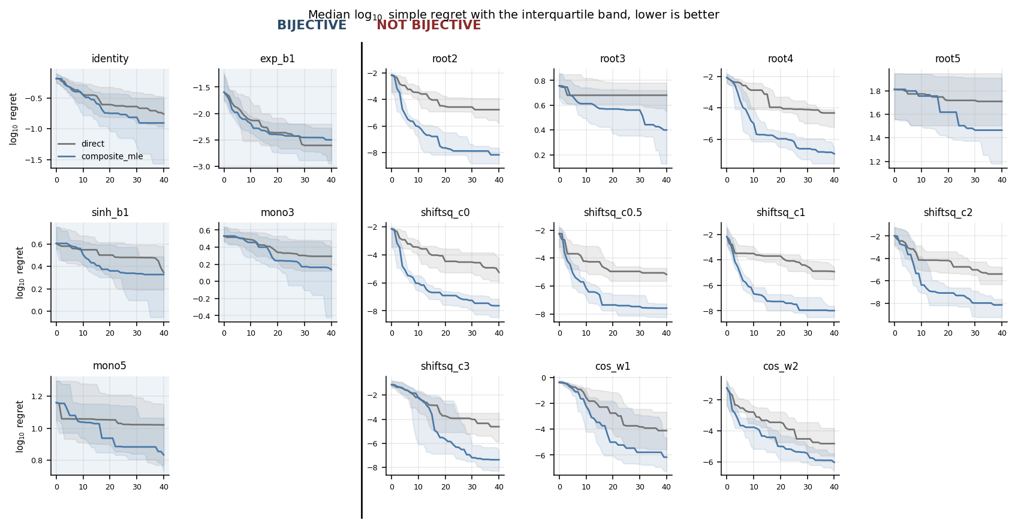
Convergence
median log₁₀ regret, interquartile band; bijective left of the rule

Slide 8
The linear control: sum
g(h₁,h₂) = h₁ + h₂
• Observing y = h₁ + h₂ tells you the sum but not the split, so information genuinely IS destroyed.
• Gain: -0.230 ± 0.662 (p = 0.932) — in Direct's favour.
• A linear combination of Gaussian processes is a Gaussian process, so Direct's model is correctly specified and loses nothing.
• Information loss with no misspecification buys Composite nothing.

Slide 9
n̄ does not order the gain
plateau width = fraction of h's reachable range within 10⁻⁶ of min g
Problem | Bijective? | Plateau width | Gain
root4 | no | 3.5e-03 | +2.326
shiftsq_c3 | no | 1.7e-03 | +2.359
shiftsq_c2 | no | 1.5e-03 | +2.780
shiftsq_c1 | no | 1.2e-03 | +2.861
shiftsq_c0.5 | no | 1.1e-03 | +2.413
root2 | no | 1.0e-03 | +3.420
shiftsq_c0 | no | 1.0e-03 | +2.809
cos_w1 | no | 9.7e-04 | +1.433
cos_w2 | no | 4.8e-04 | +1.059
exp_b1 | yes | 4.6e-04 | +0.148
identity | yes | 1.5e-06 | +0.087
mono3 | yes | 5.0e-07 | +0.081
mono5 | yes | 5.0e-07 | -0.048
root3 | no | 5.0e-07 | +0.262
root5 | no | 5.0e-07 | +0.424
sinh_b1 | yes | 5.0e-07 | +0.081
plateau present: mean gain +2.16 • no plateau: +0.15 • r = +0.78, against −0.12 for n̄

Slide 10
The mechanism
• Near a flat optimum, a small error in h produces a very small error in f — so an accurate model of h converts into enormous depth in objective space.
• Direct, looking at f alone, sees a nearly constant region and cannot resolve within it. Where g is steep at its optimum there is no leverage and both arms do the same thing.
bijective ⇒ monotone ⇒ optimum at an endpoint ⇒ steep there ⇒ no plateau ⇒ no gain
• Bijectivity forecloses a flat optimum. That is why the prediction holds — and it is not an information argument at any step.
• Bijectivity and the plateau agree on the sign everywhere, so they separate on magnitude: root3 and root5 are non-bijective with high n̄ and no plateau, and gain +0.26 and +0.42 against +2.05 for the maps that have one.
• shiftsq_c3 = (h−3)² shows it in reverse: n̄ = 1.01, so it hides almost nothing — but its minimum is exactly at the fold, where g is flat, and it gains +2.36.

Slide 11
Regression error and optimisation gain come apart
80 train / 20 held out, 60 fits per map, no optimiser anywhere; RMSE normalised so 1.0 = predicting the mean
Problem | Direct on f | Composite on h | Composite on f | BO gain
identity | 0.786 | 0.786 | 0.786 | +0.087
mono3 | 1.110 | 0.786 | 0.976 | +0.081
mono5 | 1.996 | 0.786 | 1.570 | −0.048
root3 | 1.253 | 0.786 | 1.086 | +0.262
shiftsq_c0 | 1.106 | 0.786 | 0.996 | +2.809
shiftsq_c3 | 0.794 | 0.786 | 0.782 | +2.359
• mono3: real misspecification (1.110 → 0.976), no BO gain (+0.081).
• shiftsq_c3: no misspecification (0.794 → 0.782), huge BO gain (+2.359).
• Average predictive accuracy and optimisation gain are decoupled. What matters is resolution at the optimum.

Slide 12
The same maps, as one of two objectives
f₁ = g₁(h₁), f₂ = h₂ — measured by hypervolume
• Objective 2 is the identity, so both arms model it with the same GP and every difference has to come from g₁ — the same isolation the single-objective design uses.
• 21 maps × 4 draws × 5 designs. 17 of the 21 are the SAME functions measured single-objective, verified identical to machine precision.
• So the two settings can be compared map by map.

Slide 13
Two-objective results
top 10 of 21 by gain
Problem | Bijective? | HV gain % | p
root5 | no | +31.24 | 0.013
root3 | no | +5.28 | 0.024
spr2s050 | no | +4.15 | 0.009
shiftsq_c0.5 | no | +3.53 | 0.048
mono5 | yes | +2.91 | 0.160
shiftsq_c0 | no | +2.70 | 0.023
cos_w2 | no | +2.01 | 0.014
shiftsq_c3 | no | +1.69 | 0.082
spr3s050 | no | +1.59 | 0.141
mono3 | yes | +1.58 | 0.204

Slide 14
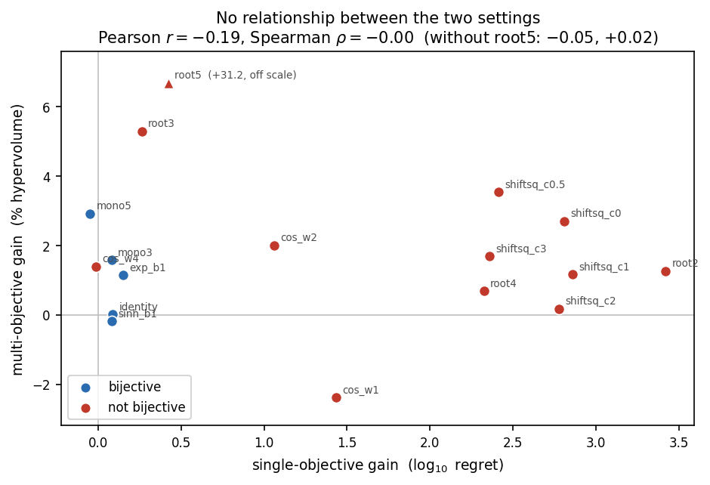
The two settings do not agree
the 17 maps measured in both
• Pearson r = −0.19, Spearman ρ = −0.00
(without root5: −0.05, +0.02)
• root5: +0.42 regret, +31% HV
• shiftsq_c2: +2.78 regret, +0.17% HV
•
• The plateau measure does not
• transfer: r = +0.78 single-objective,
• r = −0.36 against hypervolume.
•
• shiftsq_c3: 1st of 17 by regret,
• 8th of 21 by hypervolume.

Slide 15
What survives, and one trap
 | Single objective | Multi objective
bijective (n=5) | +0.07, 0 of 5 significant | +1.09%, 0 of 5 significant
not bijective (n=12) | +1.84, 11 of 12 | +4.06%, 5 of 12
• The grouping carries over — same direction, much weaker. The qualitative prediction survives; the quantitative structure behind it does not.
• root5's +31% is a scale artefact. Its objective stays extremely heavy-tailed after percentile normalisation (ratio 256 against a typical 2–10), so one lucky evaluation moves the hypervolume.
• And it nearly fooled the analysis: tail-heaviness appears to explain the gains at r = +0.94 — which collapses to −0.02 once that single point is removed.

Slide 16
What this means
• The proposition's prediction holds. Bijective g: no gain, in all 5 cases. Non-bijective g: a gain every time. The same split appears with two objectives, weaker.
• Its stated reason does not. n̄ is uncorrelated with the gain: sum destroys information and gains nothing, root3 and root5 have the highest n̄ in their group and the smallest gains in it, and shiftsq_c3 hides almost nothing and gains a great deal.
• The operative property is flatness of g at its optimum — in the single-objective setting. Bijectivity predicts the gain because it rules that out.
• None of the magnitudes survive two objectives: gains uncorrelated with the single-objective ones, and the plateau measure stops working.
• The earlier three-channel decomposition is withdrawn — it was measured on a grid where Composite held the true kernel.
• Still open: cos_w4 — most preimages of any map, has a plateau, gains nothing. Likely ω·sd(h) spanning most of a half-period.

