Slide 1

Road Monitoring System Using Machine Learning
Group members:
Muhammad Ali (P180089)
Ali Ajmal (P180041)
Supervisor:
Mr. Usama Musharaf

Slide 2
INTRODUCTION
An Embedded system-based project is proposed to identify potholes using some of the Machine Learning techniques. The project will be able to detect potholes using images captured by a camera connected to the Raspberry Pi. The information that captures the image will be communicated to the cloud storage for further actions. This project holds immense worth in the improvement of the road infrastructure by providing smart solutions for the potholes detection to road development authorities.

Slide 3
Problem Statement
About 70% of the road accidents in big cities take place due to improper construction of roads.
With our system irregularities in inroads can be detected and informed, therefore road accidents can be reduced to a certain extent.

Slide 4
Our Motivation
Physically Road assessment is not an easy job.
We will give a smart solution to monitor road conditions.

Slide 5
Objectives
To identify potholes with the least human effort
To submit potholes information to a cloud storage
To visualize potholes data
To Alarm the driver about the pothole
To visualize road health

Slide 6
Benefits
Improvement of the road infrastructure using smart detection solutions.
Support the road development authorities in terms of data collection about potholes

Slide 7
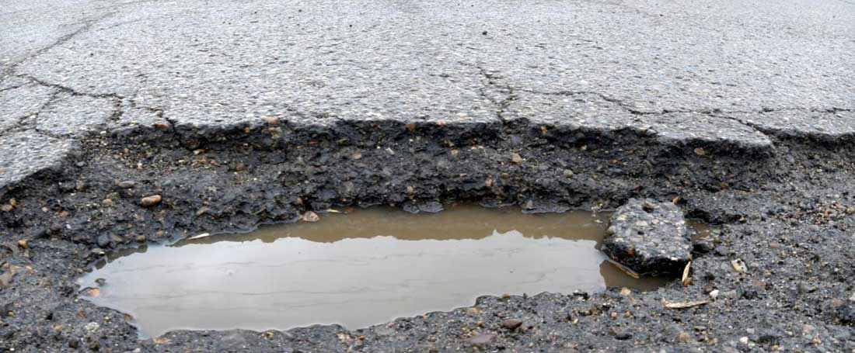
CNN Model
Pothole Image
Convolution
Pooling
Convolution
Pooling
Feature

Slide 8
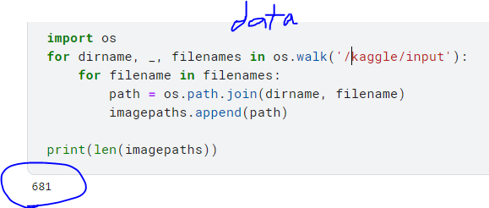
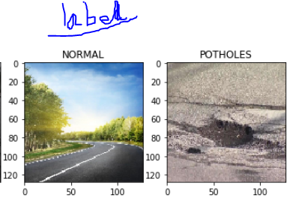
dataset and labeling :

Slide 9
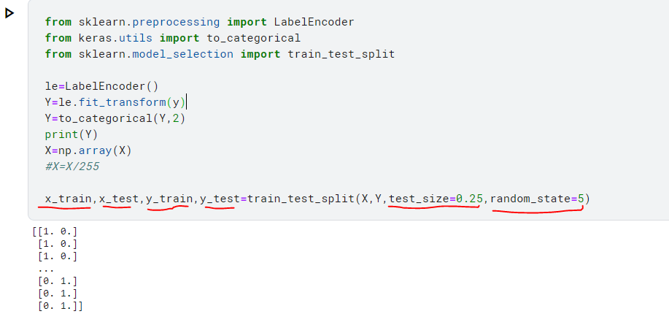
Training and testing

Slide 10
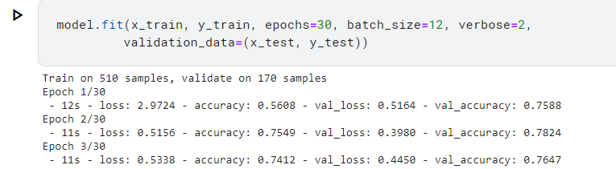
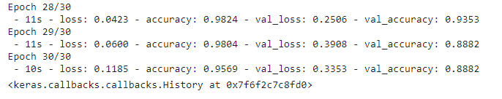
Model Training

Slide 11
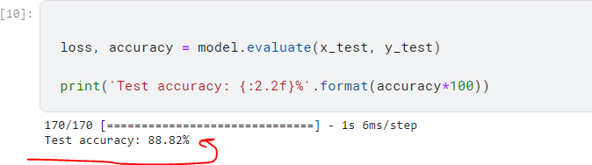
Result:

Slide 12
FYP 2 Goals:
First of all, we shall get the road conditions.
Then we will alarm the driver before a pothole would come by detecting it earlier on.
We shall then submit the pothole's information to cloud storage to visualize the pothole's data.
Doing this through Raspberry pi, it's not only not cheap but also very effective.

Slide 13
Thanks for Your time
Any Question?

