Slide 1
Group member: Ali Ajmal (p180041) Muhammad Ali(p180089)
Road Monitoring system
Supervisor : Sir Usama Musharaf

Slide 2
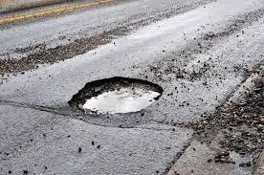
Introduction
Potholes are symptoms of a poorly maintained road, which could point to an underlying structural issue.
A well developed and maintained highway infrastructure is essential for the economic and social prosperity of modern societies.

Slide 3
Our Motivation.
Physically Road assessment is not an easy job.
A smart solution to monitor road conditions would help road development authorities to improve infrastructure.

Slide 4
Literature Review
S_No | Title | Author Name | Methodology | Merits | Demerits
1 | Detection of Potholes using Machine Learning and Image Processing | Kishor Jadav B , Prof. Vijayalakshmi B , Kiran P,Manoj KS, | Visual approach is proposed | This technique for distinguishing mounds and potholes | absence of light or over the top light makes it hard
2 | Convolution neural networks for pothole detection of critical road infrastructure | Anup Kumar Pandey a, Rahat Iqbal b, Tomasz Maniak c, Charalampos Karyotis c, | novel application of Convolutional Neural Networks on accelerometer data | Advantage Good accuracy and computational complexity | Costly because of smartphone using for data collection

Slide 5
Literature review
S_No | Title | Author Name | Methodology | Merits | Demerits
3 | An Automated Machine-Learning Approach for Road Pothole Detection | Chao Wu , Zhen Wang , Simon Hu , Julien Lepine , Daniel Ainalis and Marc Stettler | built-in vibration sensors and global positioning system | Random Forest method exhibited the best classification performance | Its not deploy over the raspberry pi
4 | Image-Based Pothole Detection System for ITS Service and Road Management System | Seung-Ki Ryu,Taehyeong Kim, and Young-Ro Kim | pothole detection method using various features in 2D images | Its not only for road maintenance its take immediate action for repair and alert the driver too. | Its not deploy over the raspberry pi

Slide 6
Problem Statement
Physically Road assessment is a laborious job.
A smart lightweight solution is required to deploy it on cars to collect data about road health that can be then provided to road development authorities.

Slide 7
Use case diagram
System Diagram
Capture image
Camera
Identify location
ML: algorithms for pothole detection
Raspberry pi
GPS
Transfer data to the cloud
Display Road condition
View information
System
Road Authority
Search Information

Slide 8
System Design
Activity Diagram with swinlane.
Camera
Raspberry pi
GPS
Transfer input to the cloud
No
Capture image
Yes
Yes
ML: algorithm for pothole detection
No
Identify location
No
Yes

Slide 9

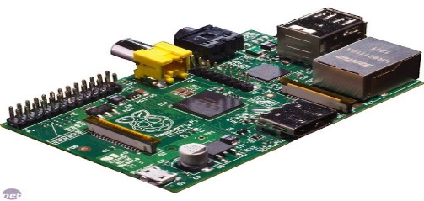
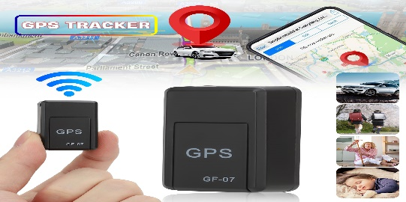



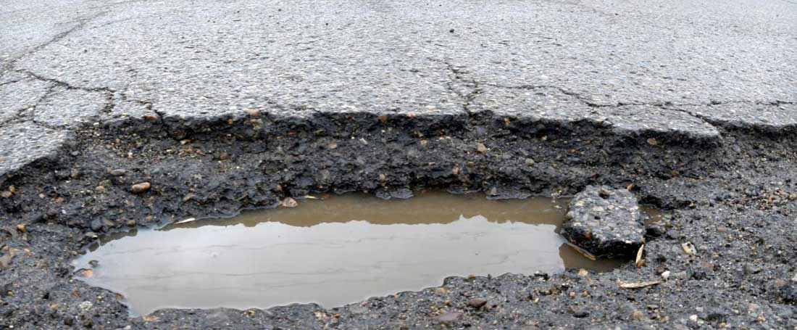
Our proposed solution
ML: algorithm
Cloud
Raspberry pi
GPS Module
Road Authority
Car
Camera
Pothole

Slide 10
References
Miller, John S., and William Y. Bellinger. Distress identification manual for the long-term pavement performance program. No. FHWA-RD-03-031. United States. Federal Highway Administration. Office of Infrastructure Research and Development, 2003.
Wu, Chao, et al. "An automated machine-learning approach for road pothole detection using smartphone sensor data." Sensors 20.19 (2020): 5564.
Gayathri, K., and S. Thangavelu. "Novel deep learning model for vehicle and pothole detection." Indones. J. Electr. Eng. Comput. Sci 23.3 (2021): 1576-1582.
Vigneshwar, K., and B. Hema Kumar. "Detection and counting of pothole using image processing techniques." 2016 IEEE International Conference on Computational Intelligence and Computing Research (ICCIC). IEEE, 2016.

