Slide 1
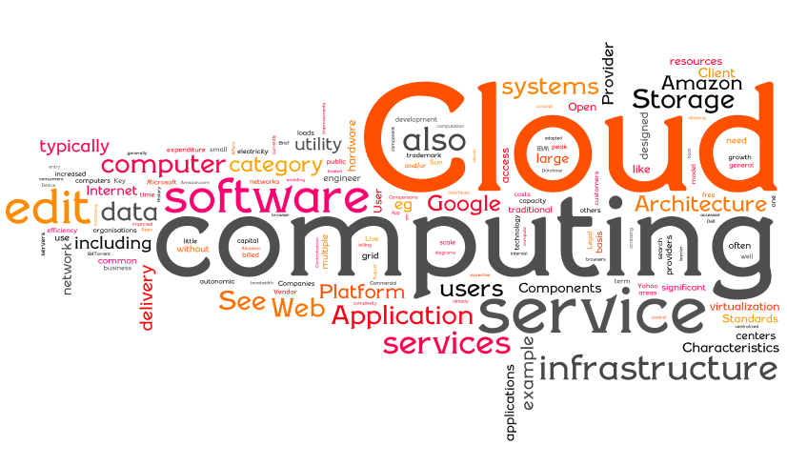

Slide 2
About myself.
08/06/2022
Muhammad Ali (P18-0089)
Personal Website: https://m-ali-personal-website.netlify.app/
LinkedIn profile: linkedin.com/in/muhammad-ali-ma786
GitHub profile: https://github.com/someoneidea
Hackerrank profile: https://www.hackerrank.com/muhammadali92192
:

Slide 3
What is Cloud Computing?
Cloud computing is internet-based computing in which large groups of remote servers are networked to allow the centralized data storage, and online access to computer services or resources. Clouds can be classified as public, private or hybrid.
Cloud Computing is a general term used to describe a new class of network based computing that takes place over the Internet,
Using the Interbasically a step on from Utility Computing a collection/group of integrated and networked hardware, software and Internet infrastructure is called a platform.
These platforms hide the complexity and details of the underlying infrastructure from users and applications by providing very simple graphical interface or API (Applications Programming Interface).

Slide 4
Cloud Summary outline
Cloud computing is an umbrella term used to refer to Internet based development and services
Introduction to cloud context
Technology context: multi-core, virtualization, 64-bit processors, parallel computing models, big-data storages…
Cloud models: IaaS (Amazon AWS), PaaS (Microsoft Azure), SaaS (Google App Engine)
A number of characteristics define cloud data, applications services and infrastructure:
Remotely hosted: Services or data are hosted on remote infrastructure.
Ubiquitous: Services or data are available from anywhere.
Commodified: The result is a utility computing model similar to traditional that of traditional utilities, like gas and electricity - you pay for what you would want!

Slide 5
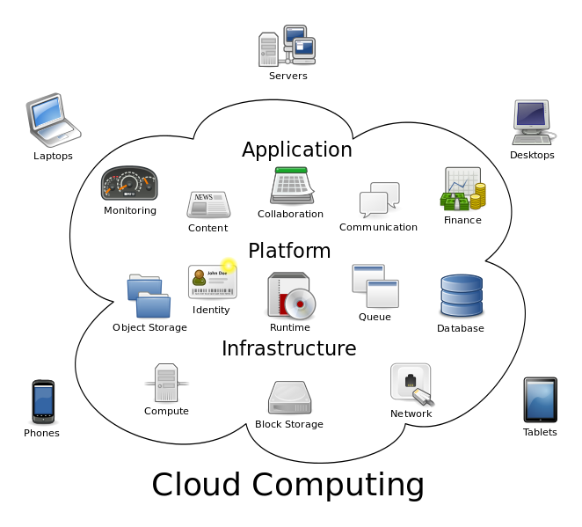
Cloud computing metaphor: For a user, the network elements representing the provider-rendered services are invisible, as if obscured by a cloud.

Slide 6
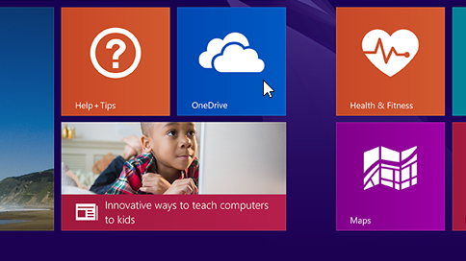
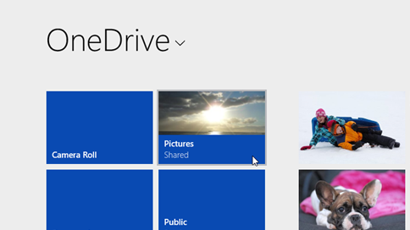
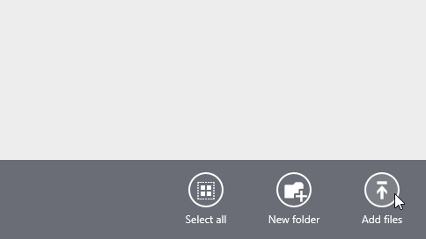
How to use a Cloud storage ? … (ex: One Drive)
Step 1
On the Start screen, tap or clickOneDrive to open the OneDrive app.
Step 2
Tap or click folders to browse to the location on OneDrive where you want to add the files.
Step 3
Swipe in from the top or bottom edge of the screen or right-click to open the app commands, and then tap or clickAdd files.

Slide 7
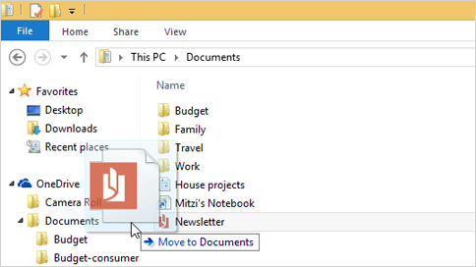
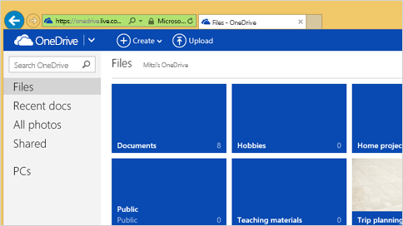
Moving and Downloading your files….
To move files to OneDrive using File Explorer
When you move files, you're removing them from your PC and adding them to OneDrive. Drag files from the file list in the right pane to OneDrive in the left pane.
Getting to your files from anywhere
When your files are in OneDrive, you can get to them from any device, even if something happens to your PC. You can go to the OneDrive website, or you can use one of the mobile apps for Android, iOS, or Windows Phone.

Slide 8
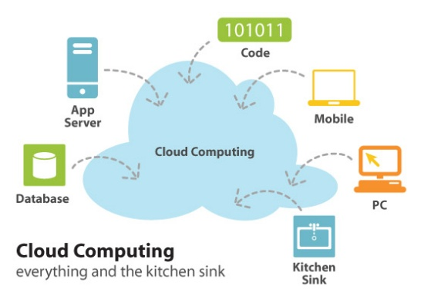
Benefits of Cloud Computing
On-demand self-service
Broad network access
Rapid elasticity
Measured service
Lower costs
Reliability

Slide 9
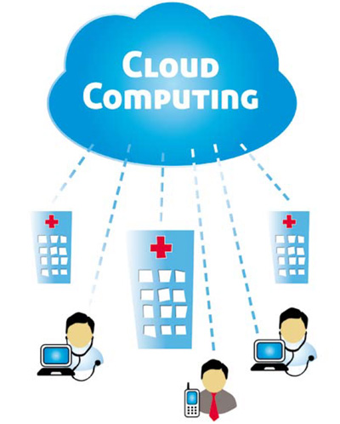
On-demand Self-Service
Clients can provision computer resources without the need for interaction with cloud service provider personnel.

Slide 10
Thanks, Everyone

