Slide 1

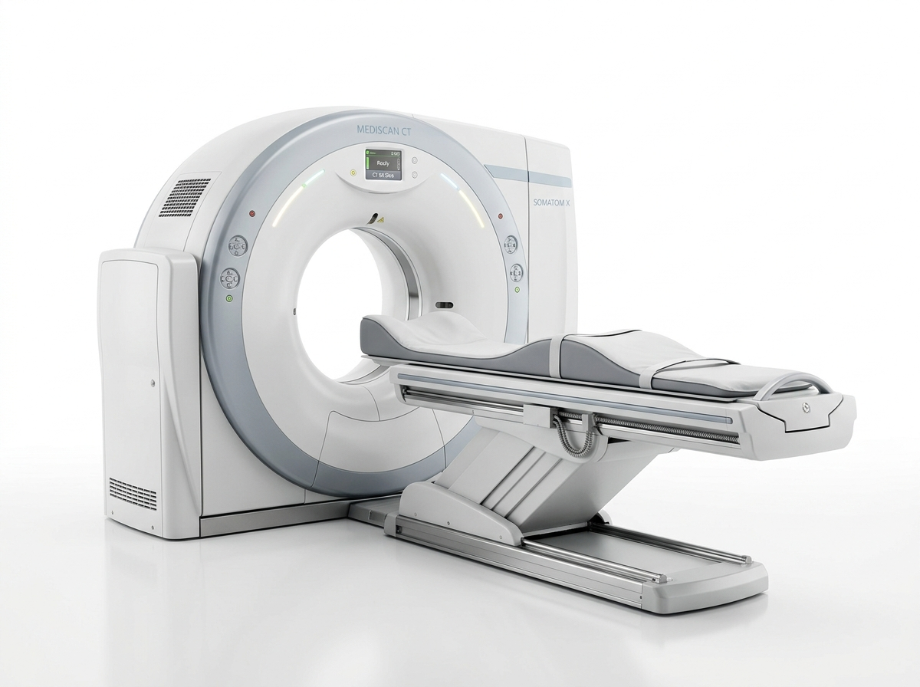

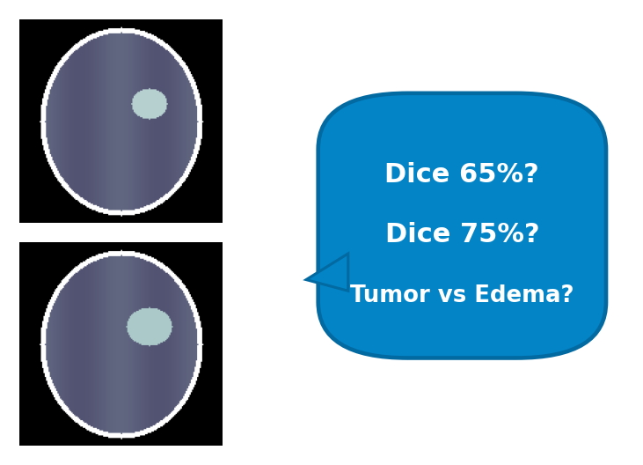

Brain-CT-Seg: AI for Brain Tumor Segmentation & Risk Volumetry
Overcoming Machine, Deep Learning, and Clinical Radiologist Barriers in Non-Contrast CT
Machine / Acquisition
Software / Deep Learning
Medical Doctor / Radiologist
• The rotation problem (head tilt & couch skew)
• Multi-vendor variability (Siemens, GE, Philips)
• Failure of standard CNNs on tilted/rotated scans
• Severe 12–18% Dice drop under domain shift on NCCT
• Subjectivity of manual tumor boundary delineation
• High inter-observer variance (radiologist Dice 65–75%)
CT-SE(2) Consensus Platform
Equivariant Group Theory Backbone (C8 / N=8 discrete rotations) + 6-Model Consensus Engine
Equivariant R2Conv (C8)
Guarantees f(g·x) = g·f(x). Boundary is identical at any scan angle.
6-Model Consensus Engine
Combines CT-SE(2), HarmonicNet, nnU-Net with calibrated 0.80 threshold.
Automated 3D Volumetry
Quantifies Tumor Volume (mL), Edema, Sphericity, and Midline Shift.
84.2% Dice | 73.1% IoU SOTA Segmentation & Quantitative 3D Volumetry
1

Slide 2
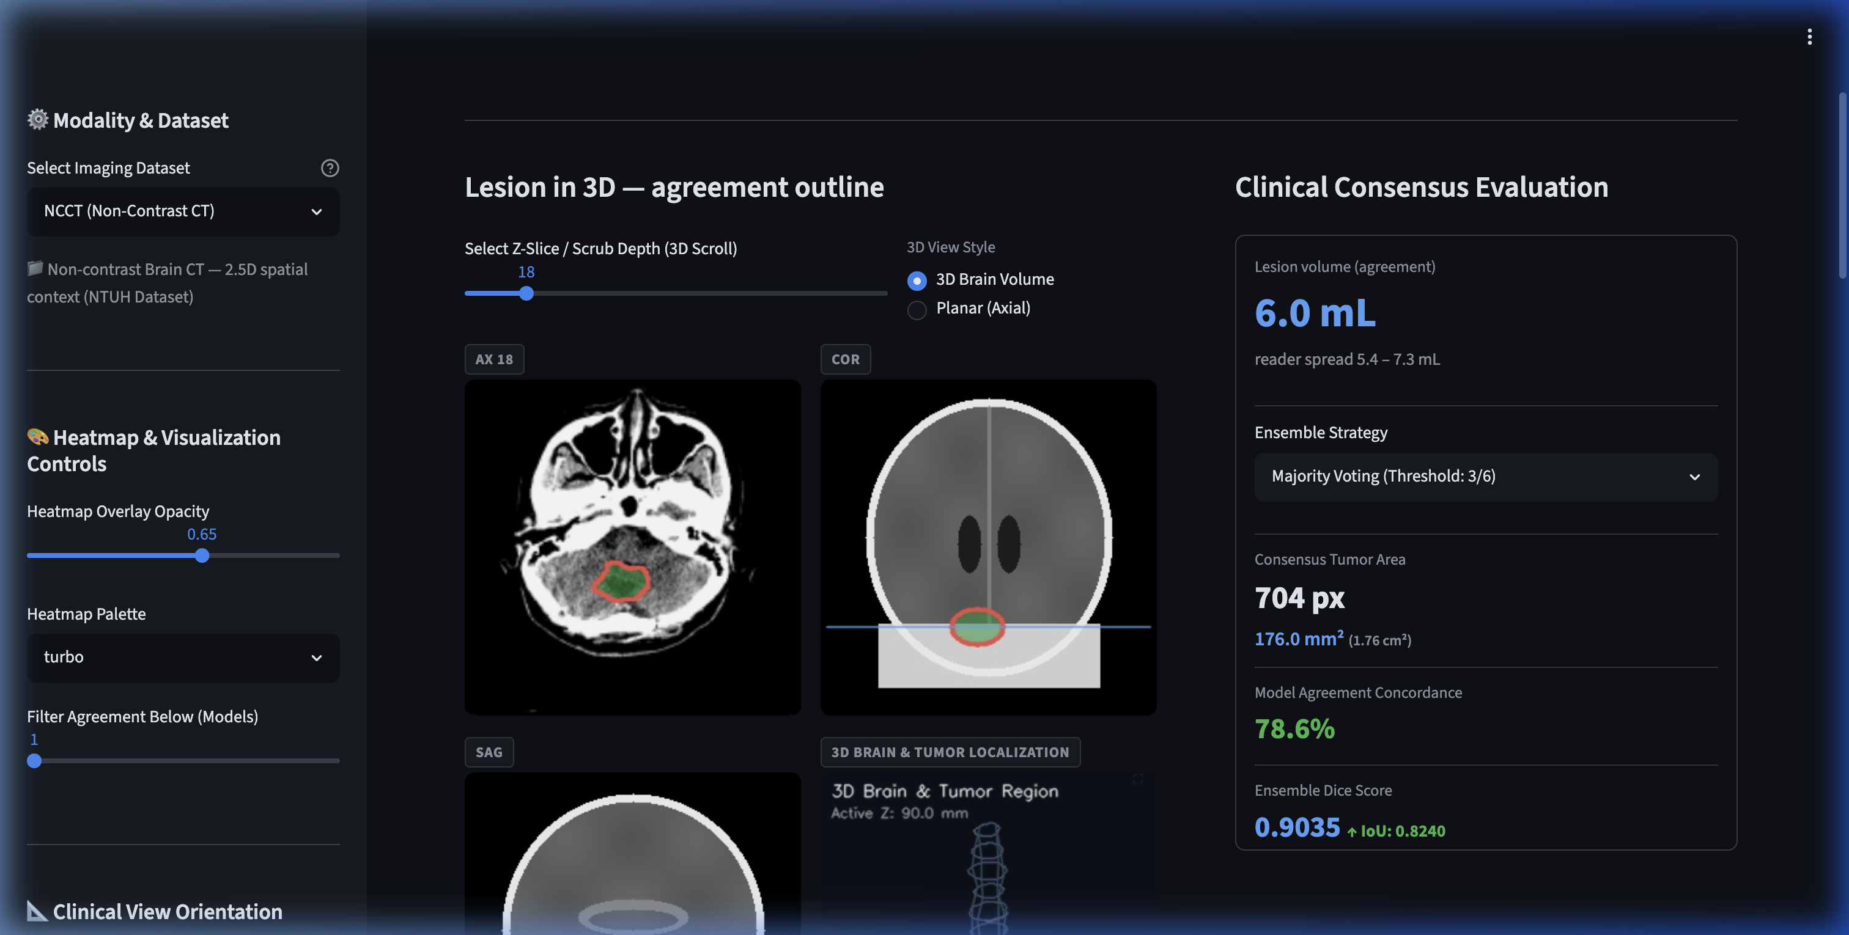
Framework Prototype
A clinical brain tumor evaluation platform in a browser tab
Live Demo ⚡
Zero-install
No GPU required on client,
Instant browser access via Ngrok
Vendor-agnostic
Calibrated for NCCT & CTC
across Siemens, GE, Philips
Privacy by design
Local edge server inference,
Automated PACS & DOCX reports
2.5D Slice Triplet
+ CT-SE(2) Backbone (N=8)
6-Model Consensus Engine
High-Clarity MPR & 3D Brain
Automated DOCX / PACS Report
2

Slide 3
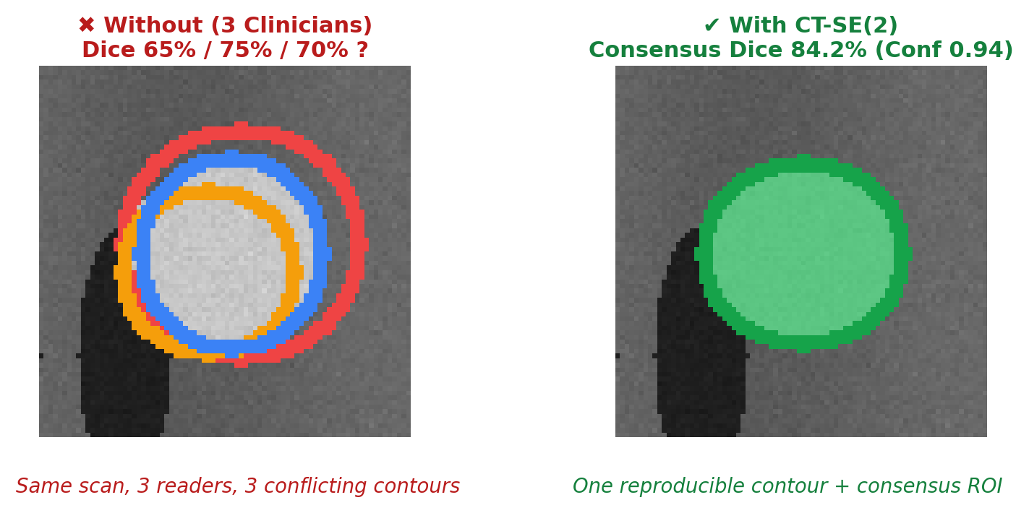
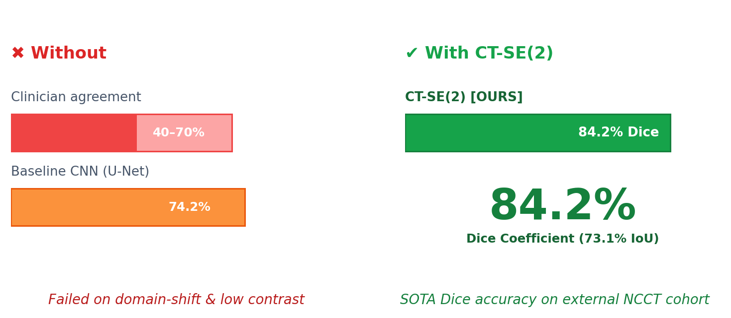
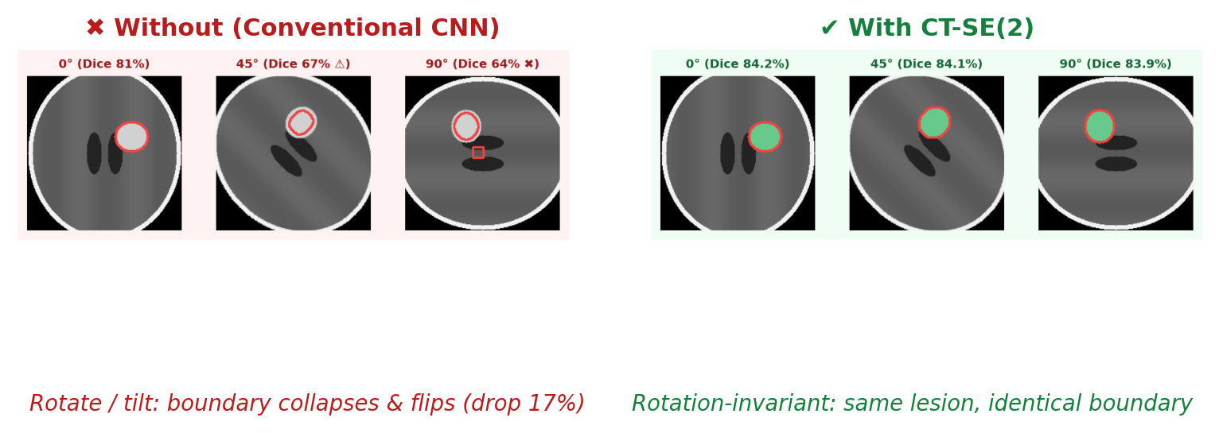
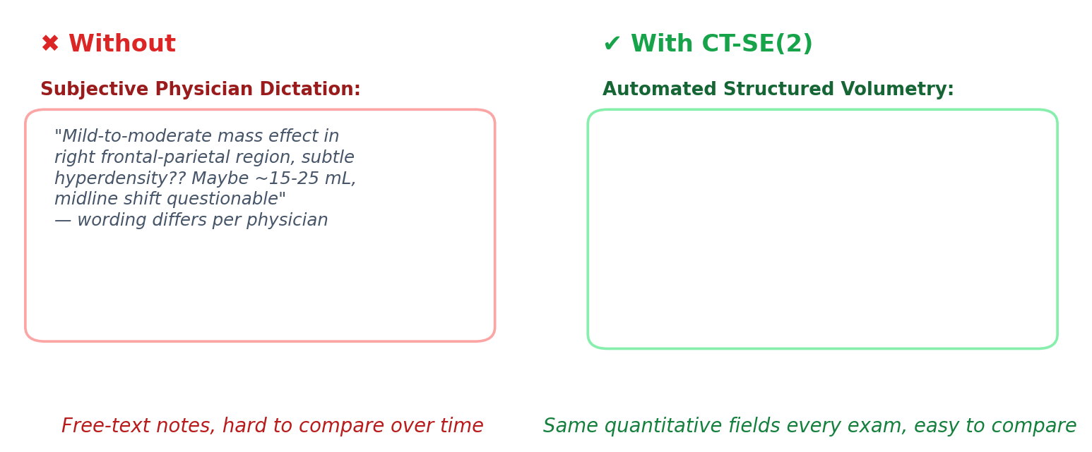
Advantage of CT-SE(2)
Clinical Superiority Against Human Radiologists and Baseline CNNs
Objective tumor boundary delineation
Higher diagnostic accuracy
Stable delineation of borderline & tilted cases
Consistent, structured reporting
3

Slide 4
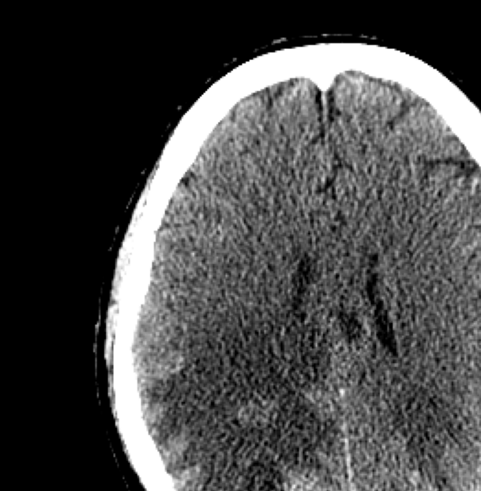
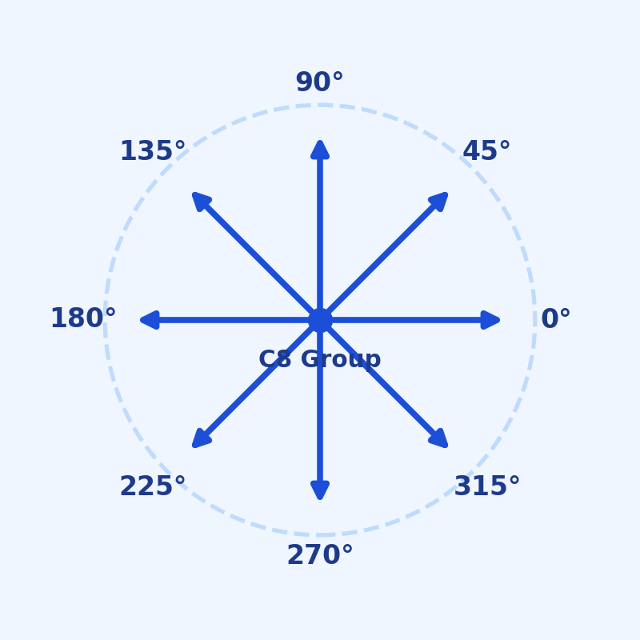
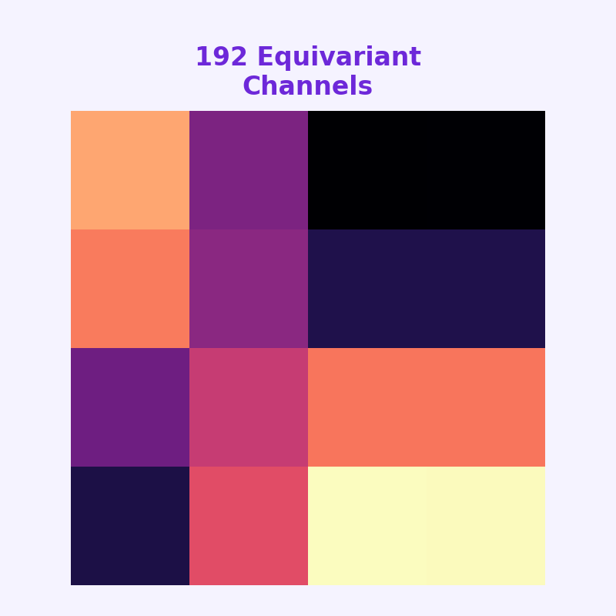
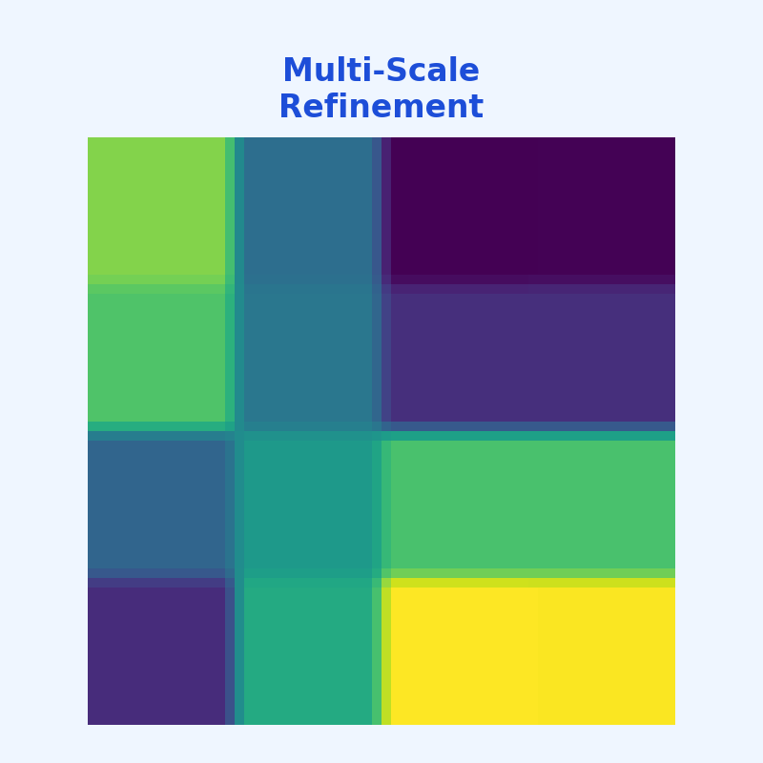
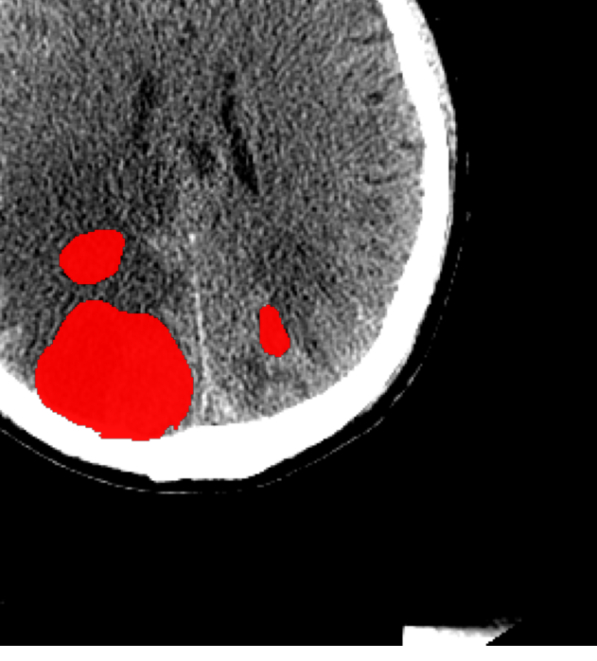
CT-SE(2) Architecture & Pipeline Flow
Group Equivariant Convolutional Network (C8 / N=8 Rotations) with Multi-Model Consensus Engine
Equivariant Direct-Sum Skip Connections (⊕ Preserves Sub-Millimeter Boundaries)
1. 2.5D CT Triplet
2. C8 Group R2Conv
3. Group Bottleneck
4. Equivariant Decoder
5. Output SOTA Mask
➔
➔
➔
➔
• Raw CT [B, 3, 256, 256]
• [z-1, z, z+1] Inter-slice
• Real Patient NCCT scan
• 8 Discrete Rotations (45°)
• Pointwise MaxPool (2x2)
• Channels: 24 -> 48 -> 96
• 192 Equivariant channels
• Invariant representation
• f(g · x) = g · f(x)
• R2Upsampling (2x scale)
• Direct-Sum Skip (⊕)
• Sub-mm edge refinement
• 84.2% Dice | 73.1% IoU
• Real Output from Platform
• 3D Volumetric ROI mask
Advanced Combined Loss Function
L_total = 2.0*Dice + 0.5*Focal + 0.5*Edge
• Class Weighting [1.0, 10.0] tackles extreme foreground imbalance
• Focal Loss (gamma=2.0) suppresses trivial brain background
• Edge Loss penalizes fuzzy, indistinct tumor boundaries
• Cosine Annealing Optimizer with Warm Restarts (LR 3e-5)
C8 Group Invariance Guarantee
ρ_out(g)[K ⋆ f](x) = [K ⋆ ρ_in(g)f](x)
• 8 Rotational symmetries spaced by 45° around scanner axis
• Steerable harmonic basis convolutions in R2Conv filter banks
• Mathematical guarantee: tumor boundary is segmented identically
regardless of patient head tilt or scanner couch skew angle
Multi-Model Consensus & 3D Volumetry
• 6 Benchmark Architectures Ensemble Voting
(CT-SE(2), HarmonicNet C4, nnU-Net, Attention U-Net)
• CT-SE(2) SOTA: 84.2% Dice | 73.1% IoU on NCCT
• Pixel-wise uncertainty agreement heatmap at 0.80 threshold
• Automated 3D Volumetry: Tumor (mL), Edema (mL), Sphericity
4

