Slide 1
ColonoMind System Architecture & Results
Adaptive Ensemble & Unified Dataset Backbone
August 2026

Slide 2
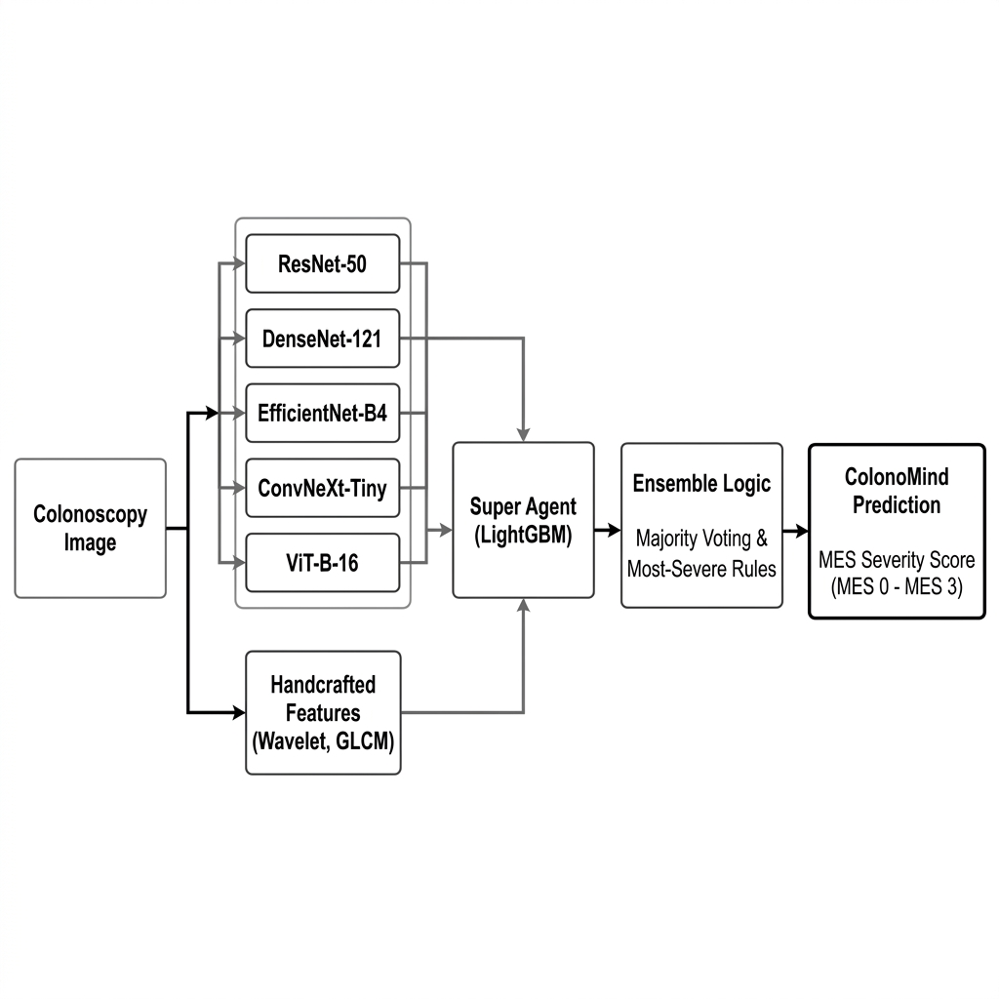
System Architecture Overview

Slide 3
Unified Dataset Backbone
The system is now powered by a 'Unified' training scenario.
Combines 3 Massive Datasets:
TMC-UCM, NTUH, and LIMUC
Advantages:
Increases generalization across different patient demographics and camera hardware.

Slide 4
Smart Ensemble & Decision Logic
Multi-Model Fusion:
Uses 5 distinct deep learning models (ResNet, DenseNet, EfficientNet, ConvNeXt, ViT) alongside LightGBM.
Majority Voting & Average Probability:
Final consensus requires at least 3 out of 5 models to agree on the severity score.
Fallback Most-Severe MES Rules:
When models deeply disagree (Consensus < Threshold), the system prioritizes patient safety by highlighting the Most-Severe prediction.

Slide 5
Experimental Results: Intra TMC-UCM
Model | Base Acc | Hyb Acc | Prec | Recall | F1 | QWK
EfficientNet-B4 | 79.44% | 78.47% | 77.20% | 76.07% | 76.32% | 0.9018
ResNet-50 | 81.79% | 80.57% | 79.82% | 79.13% | 79.42% | 0.9051
ViT-B-16 | 79.84% | 75.02% | 74.58% | 74.15% | 74.32% | 0.8476
ConvNeXt-Tiny | 80.35% | 78.53% | 77.89% | 76.66% | 77.19% | 0.8899
DenseNet-121 | 79.63% | 75.86% | 74.23% | 74.24% | 74.23% | 0.8702

Slide 6
Experimental Results: Intra Unified
Model | Base Acc | Hyb Acc | Prec | Recall | F1 | QWK
ConvNeXt-Tiny | 79.06% | 79.50% | 78.19% | 75.65% | 76.63% | 0.9000
ResNet-50 | 77.33% | 78.34% | 76.15% | 74.32% | 75.16% | 0.8950
ViT-B-16 | 77.82% | 78.22% | 75.22% | 75.69% | 75.41% | 0.8939
EfficientNet-B4 | 76.41% | 76.73% | 73.52% | 73.51% | 73.43% | 0.8871
DenseNet-121 | 76.46% | 76.39% | 75.12% | 71.74% | 73.22% | 0.8751

Slide 7
Experimental Results: Intra LIMUC
Model | Base Acc | Hyb Acc | Prec | Recall | F1 | QWK
EfficientNet-B4 | 74.43% | 69.69% | 57.87% | 57.02% | 57.22% | 0.7070
ResNet-50 | 75.91% | 74.67% | 66.85% | 65.68% | 66.14% | 0.8179
ViT-B-16 | 74.37% | 68.62% | 58.91% | 58.72% | 58.59% | 0.7058
ConvNeXt-Tiny | 76.86% | 71.41% | 61.15% | 61.27% | 61.09% | 0.7353
DenseNet-121 | 75.74% | 71.05% | 62.51% | 61.78% | 62.08% | 0.7182

Slide 8
Experimental Results: Intra NTUH
Model | Base Acc | Hyb Acc | Prec | Recall | F1 | QWK
EfficientNet-B4 | 62.81% | 64.32% | 61.22% | 61.98% | 61.06% | 0.7238
ResNet-50 | 67.83% | 66.33% | 62.26% | 61.35% | 60.55% | 0.7421
ViT-B-16 | 65.82% | 67.33% | 64.19% | 63.47% | 63.11% | 0.7424
ConvNeXt-Tiny | 68.84% | 66.33% | 63.60% | 64.35% | 63.68% | 0.7446
DenseNet-121 | 69.84% | 68.34% | 64.63% | 65.35% | 64.47% | 0.7892

