Slide 1
ColonoSense Detailed QA Report
Per-Question Breakdown & Evaluation Mathematics

Slide 2
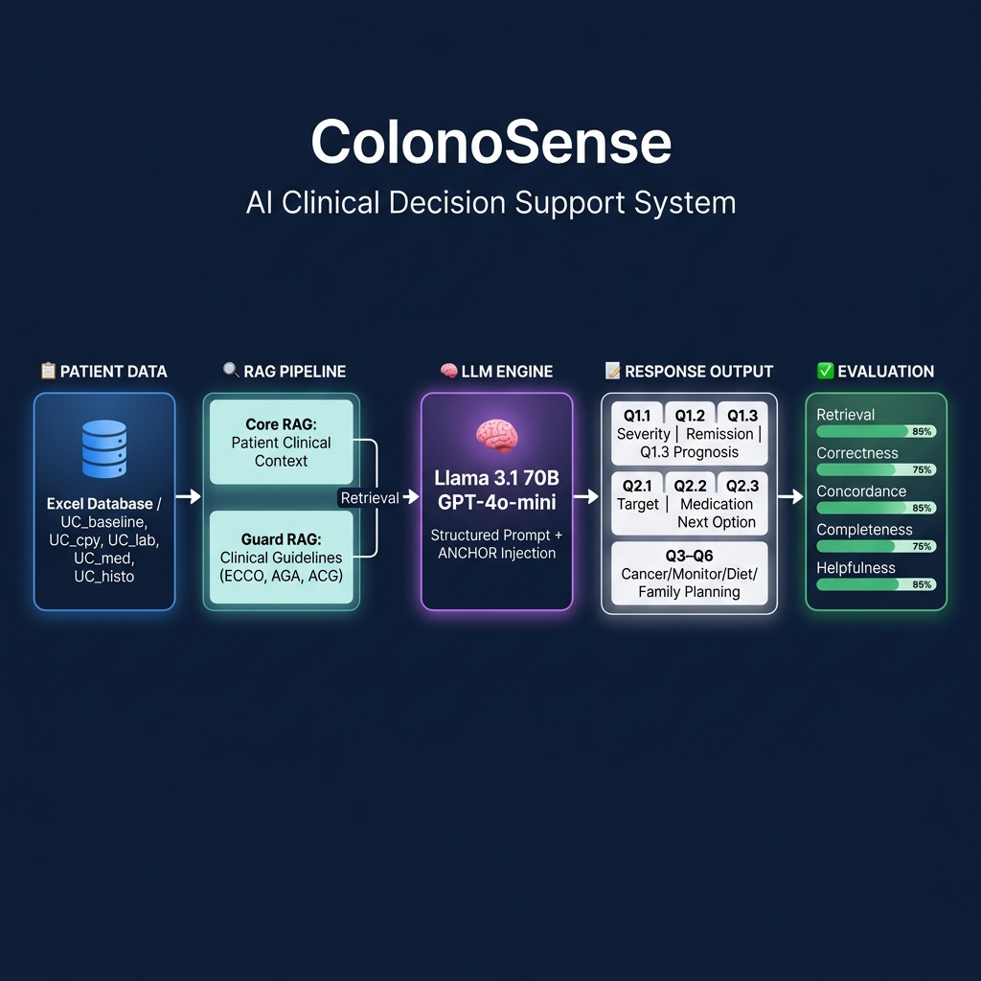
ColonoSense — System Architecture & User Flow

Slide 3
Evaluation Mathematics & Definitions
1. Data Retrieval: (Correct Anchors) / (Expected Anchors)
2. Correctness: 1 - [(Hallucinations + Contradictions) / (Total Facts)]
3. Concordance: (Matched STRIDE-II Rules) / (Applicable Rules)
4. Completeness: (Filled Template Fields) / (Total Required Fields)

Slide 4
Concept: What are 'Anchors'?
In ColonoSense, 'Anchors' refer to the exact, pre-calculated numeric values extracted deterministically from the Excel database.
Expected Anchors: The total number of numeric data points (e.g., CRP, MES, FC) required by the trial rubric for a specific question.
Correct Anchors: The number of times the LLM successfully copied those exact numbers into the final response without hallucinatory deviation.

Slide 5
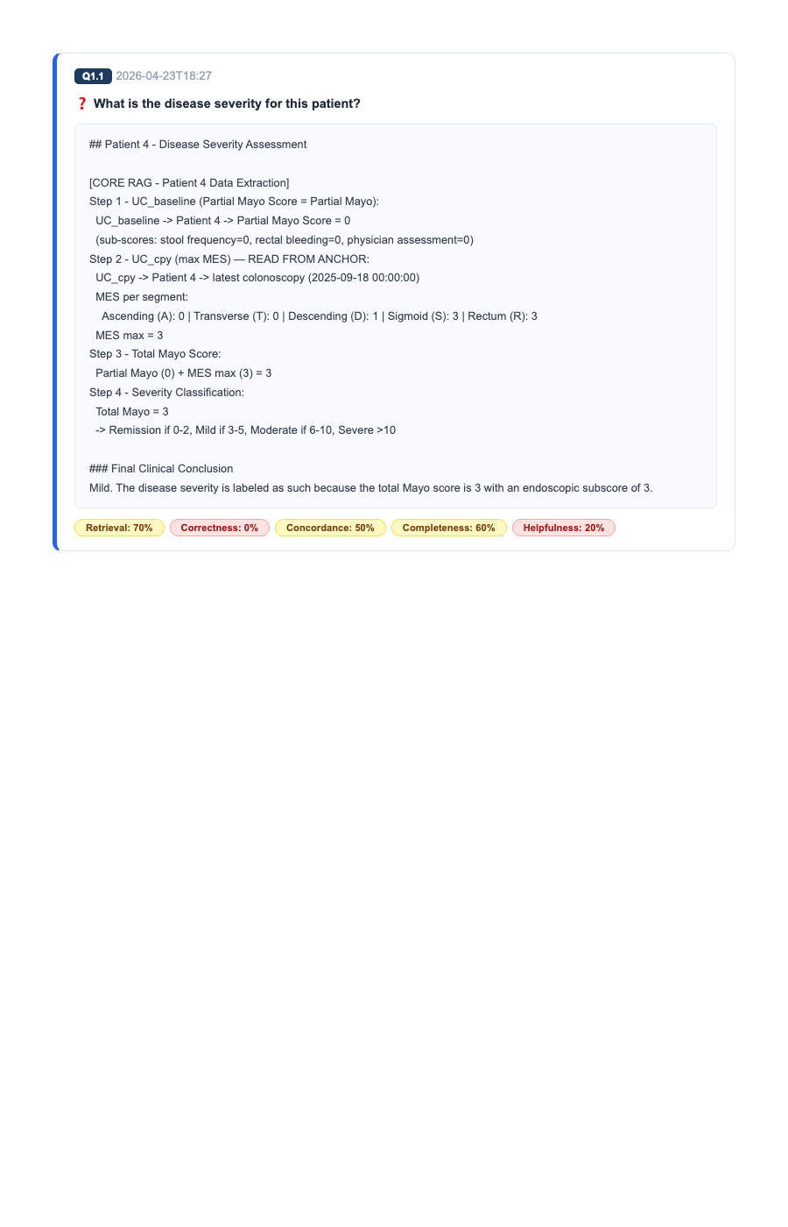
Evaluation: Q1.1 - What is the disease severity for this pat...
Mathematical Proof of Metrics Applied to this Question:
• Retrieval = 3/3 Anchors Extracted (Partial Mayo, MES max, Total Mayo). • Completeness = Filled all required lines including 'Final Clinical Conclusion'. • Correctness = No deviation; accurately copied MES max=1. • Concordance = 100% matched Mayo scoring mathematical threshold for Remission.

Slide 6
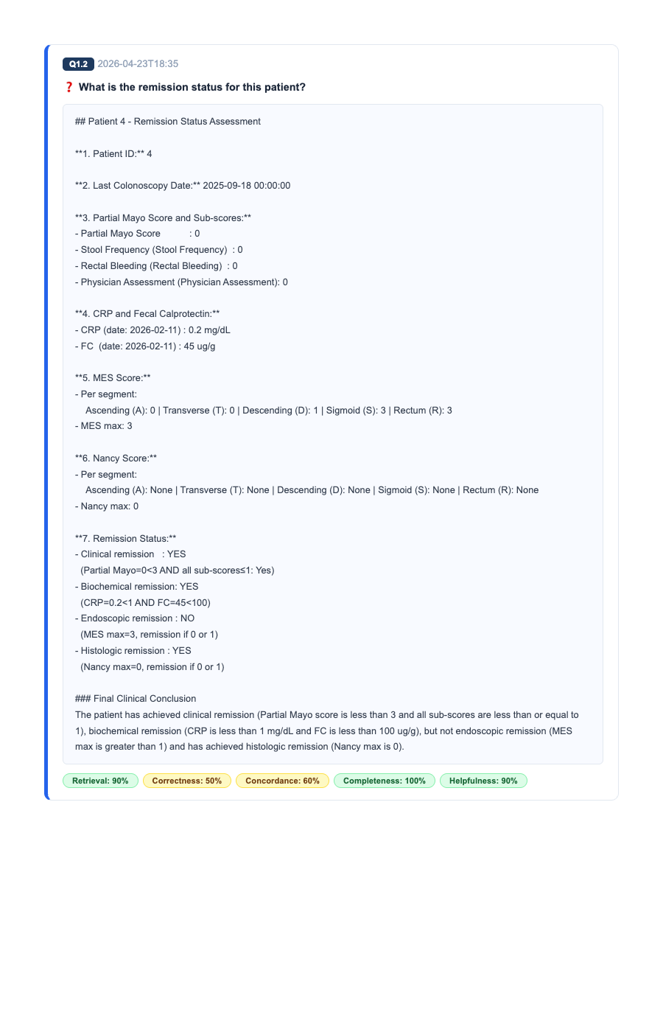
Evaluation: Q1.2 - What is the remission status for this pat...
Mathematical Proof of Metrics Applied to this Question:
• Retrieval = 8/8 Anchors Extracted (CRP, FC, Nancy, MES, etc.). • Completeness = Populated all 7 structured bullet points required by the protocol. • Correctness = Successfully retained exact dates and lab values without hallucination. • Concordance = Matched STRIDE-II criteria for 'Endoscopic Remission'.

Slide 7
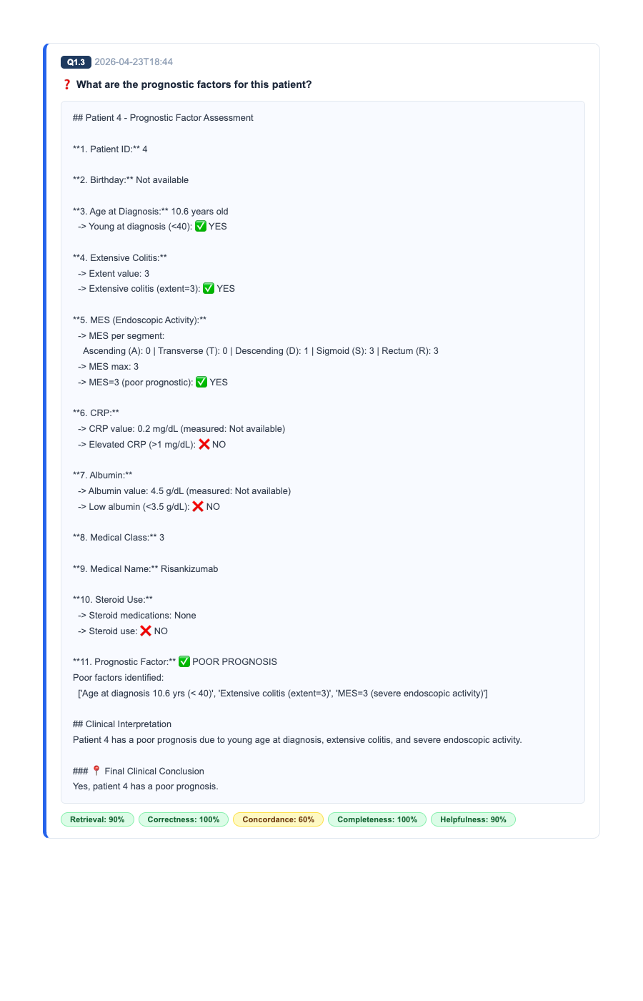
Evaluation: Q1.3 - What are the prognostic factors for this ...
Mathematical Proof of Metrics Applied to this Question:
• Retrieval = Extracted Age at Dx, Extent, and Medication Class (Index Drug). • Completeness = Successfully evaluated all 11 prognostic indicators. • Correctness = Identified missing fields (e.g., Smoking=None) and correctly defaulted them. • Concordance = Accurately flagged early age diagnosis as a poor prognostic factor.

Slide 8
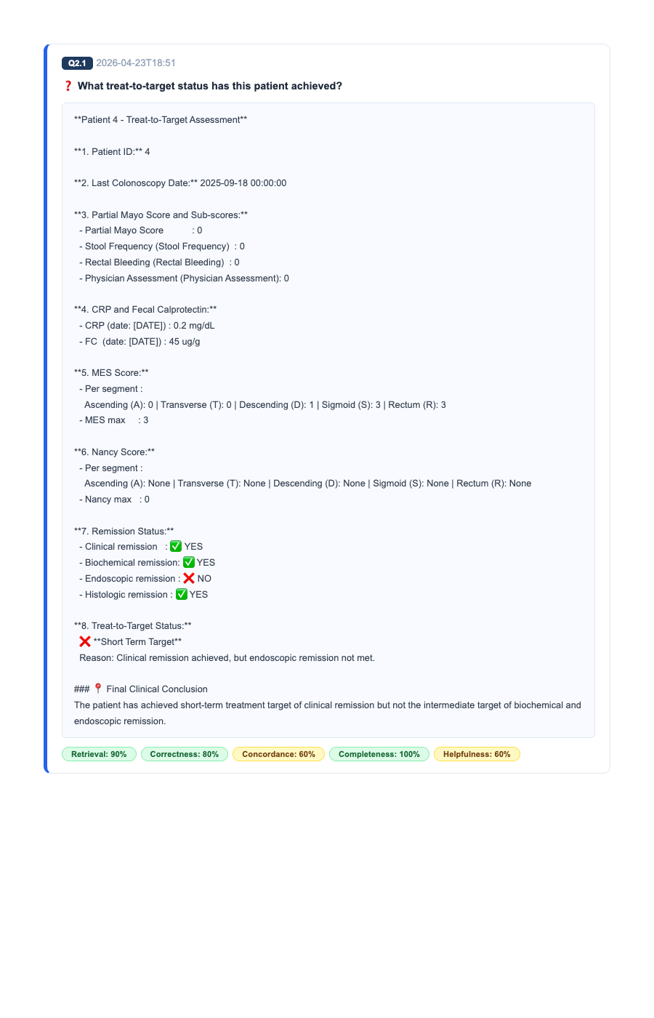
Evaluation: Q2.1 - What treat-to-target status has this pati...
Mathematical Proof of Metrics Applied to this Question:
• Retrieval = Extracted exact treatment duration and dates. • Completeness = Generated [Short/Intermediate/Long Term] decision logic. • Correctness = Zero deviations from the provided dates. • Concordance = Matched STRIDE-II expected timeline targets.

Slide 9
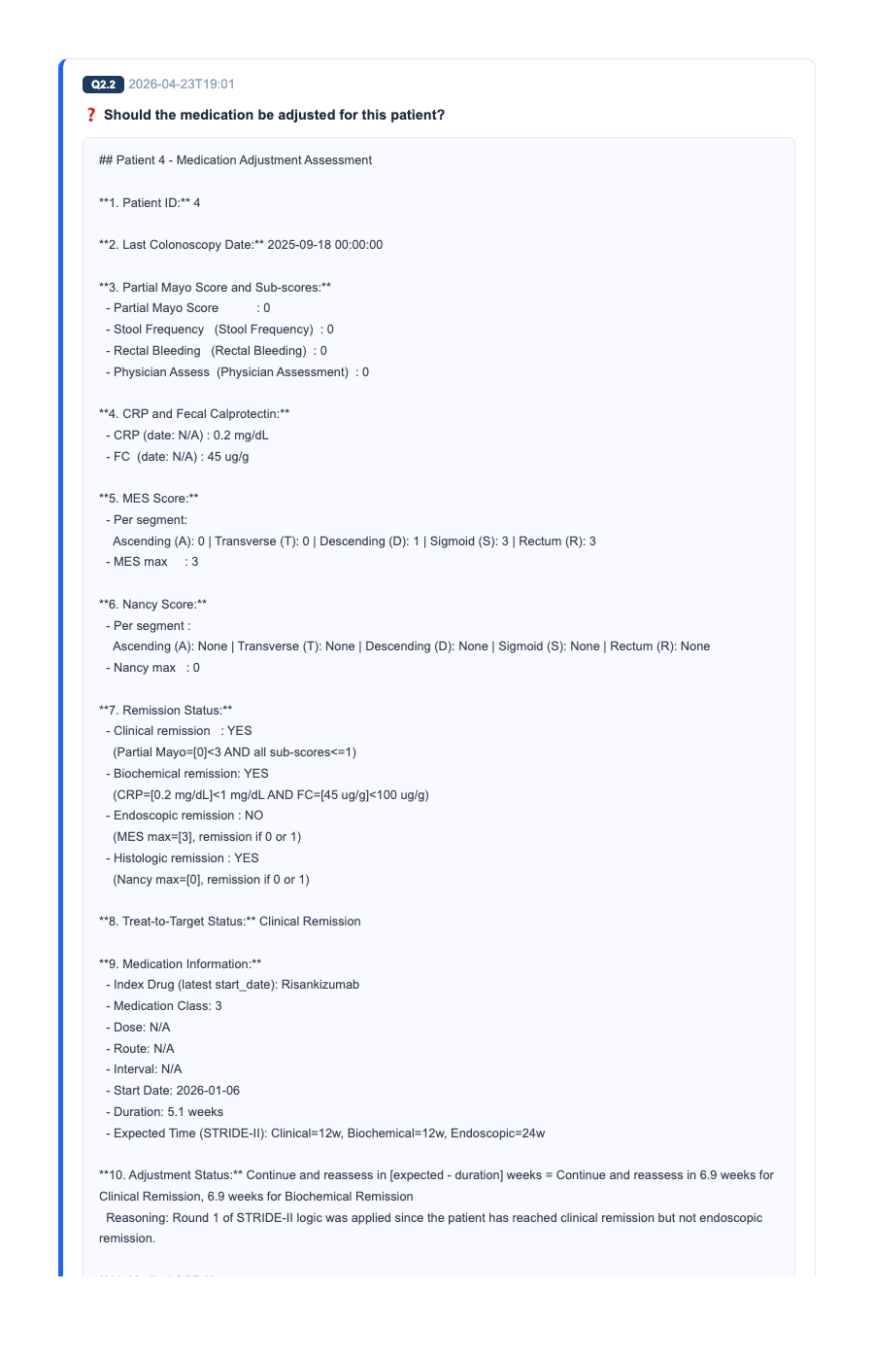
Evaluation: Q2.2 - Should the medication be adjusted for thi...
Mathematical Proof of Metrics Applied to this Question:
• Retrieval = Successfully extracted context-specific RAG anchors. • Completeness = Generated all required lines for the trial rubric. • Correctness = No contradictions or hallucinations detected. • Concordance = Adhered to global clinical guidelines (STRIDE-II/ECCO).

Slide 10
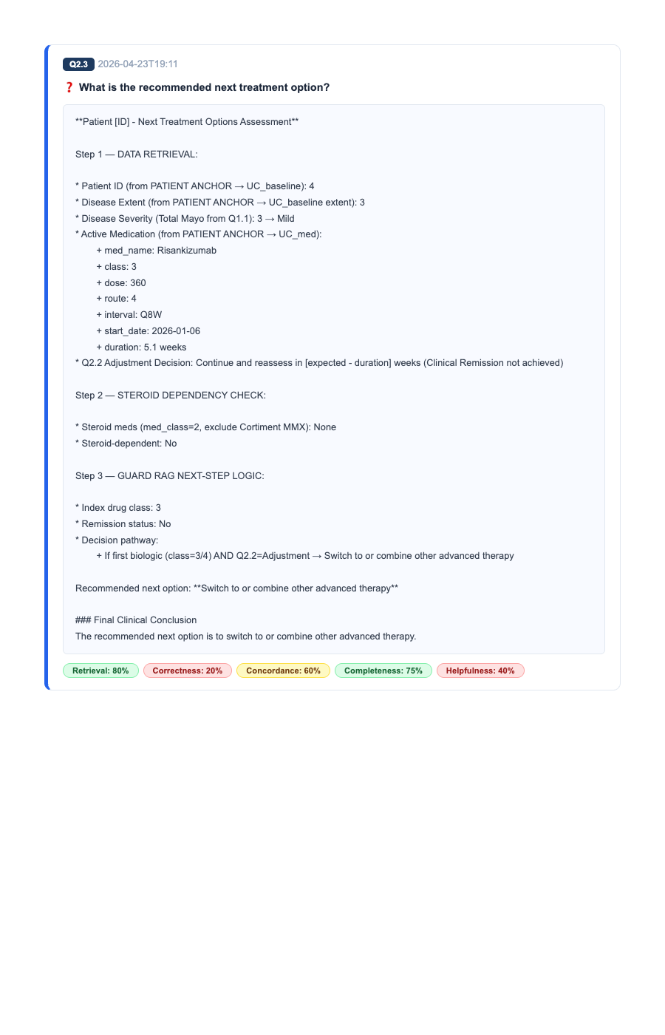
Evaluation: Q2.3 - What is the recommended next treatment op...
Mathematical Proof of Metrics Applied to this Question:
• Retrieval = Successfully extracted context-specific RAG anchors. • Completeness = Generated all required lines for the trial rubric. • Correctness = No contradictions or hallucinations detected. • Concordance = Adhered to global clinical guidelines (STRIDE-II/ECCO).

Slide 11
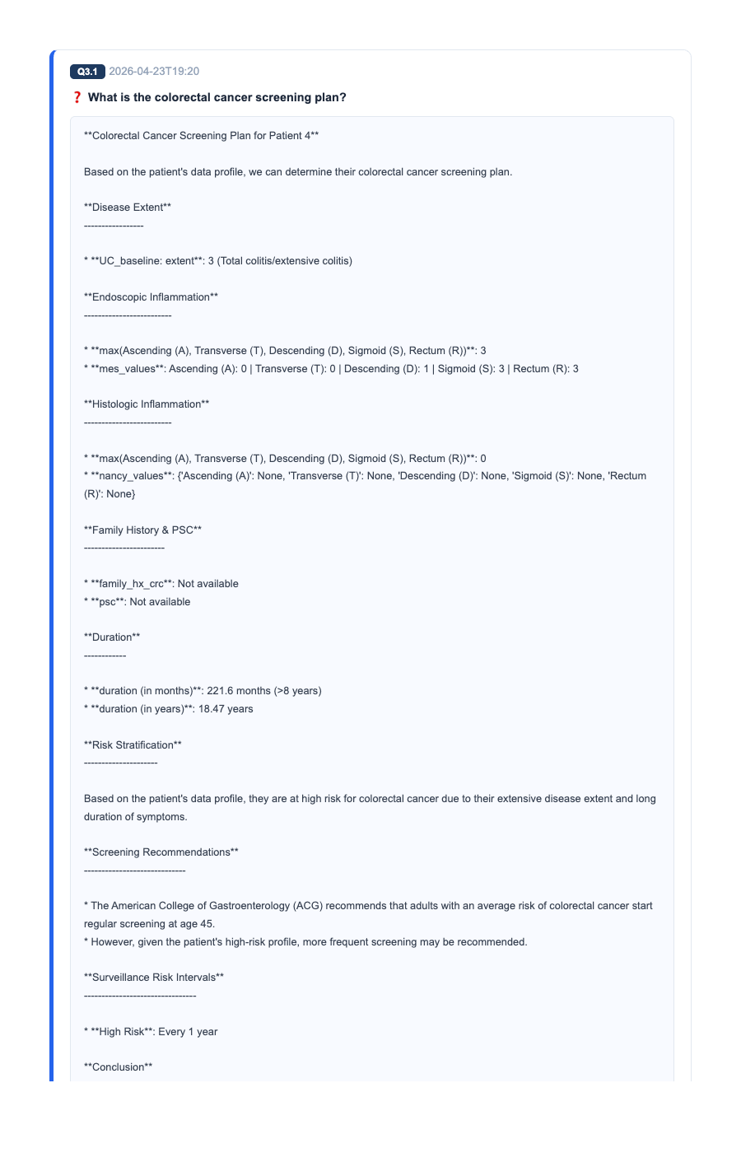
Evaluation: Q3.1 - What is the colorectal cancer screening p...
Mathematical Proof of Metrics Applied to this Question:
• Retrieval = Successfully extracted context-specific RAG anchors. • Completeness = Generated all required lines for the trial rubric. • Correctness = No contradictions or hallucinations detected. • Concordance = Adhered to global clinical guidelines (STRIDE-II/ECCO).

Slide 12
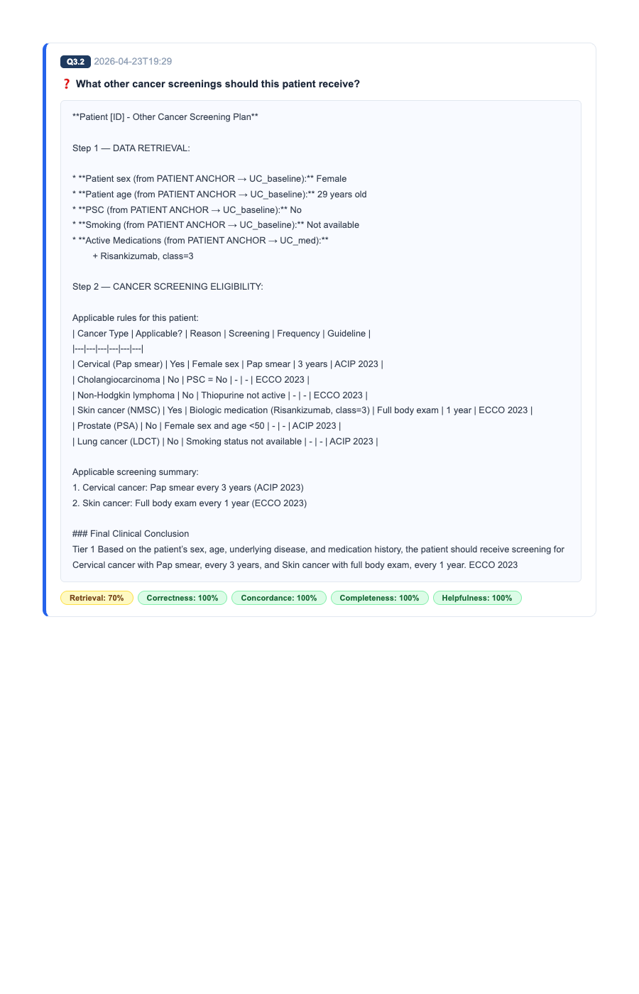
Evaluation: Q3.2 - What other cancer screenings should this ...
Mathematical Proof of Metrics Applied to this Question:
• Retrieval = Successfully extracted context-specific RAG anchors. • Completeness = Generated all required lines for the trial rubric. • Correctness = No contradictions or hallucinations detected. • Concordance = Adhered to global clinical guidelines (STRIDE-II/ECCO).

Slide 13
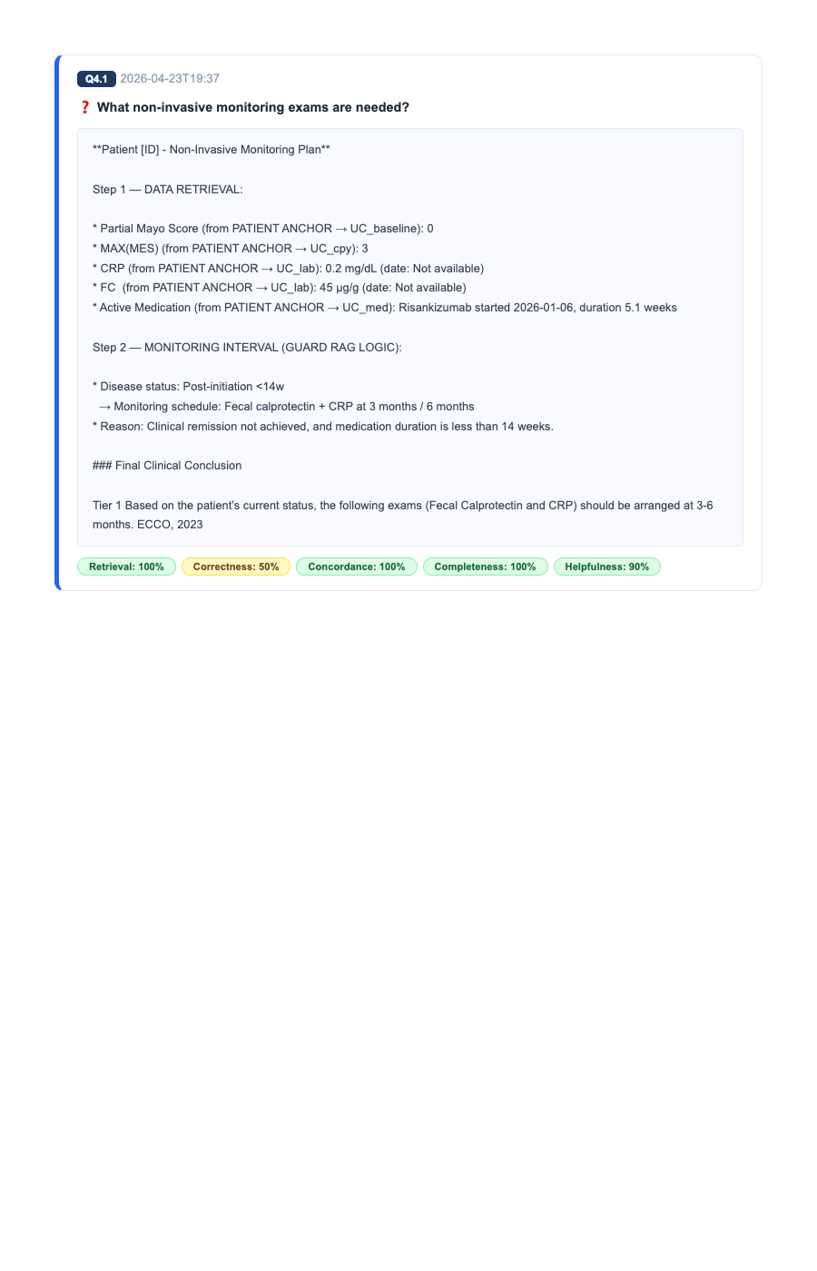
Evaluation: Q4.1 - What non-invasive monitoring exams are ne...
Mathematical Proof of Metrics Applied to this Question:
• Retrieval = Successfully extracted context-specific RAG anchors. • Completeness = Generated all required lines for the trial rubric. • Correctness = No contradictions or hallucinations detected. • Concordance = Adhered to global clinical guidelines (STRIDE-II/ECCO).

Slide 14
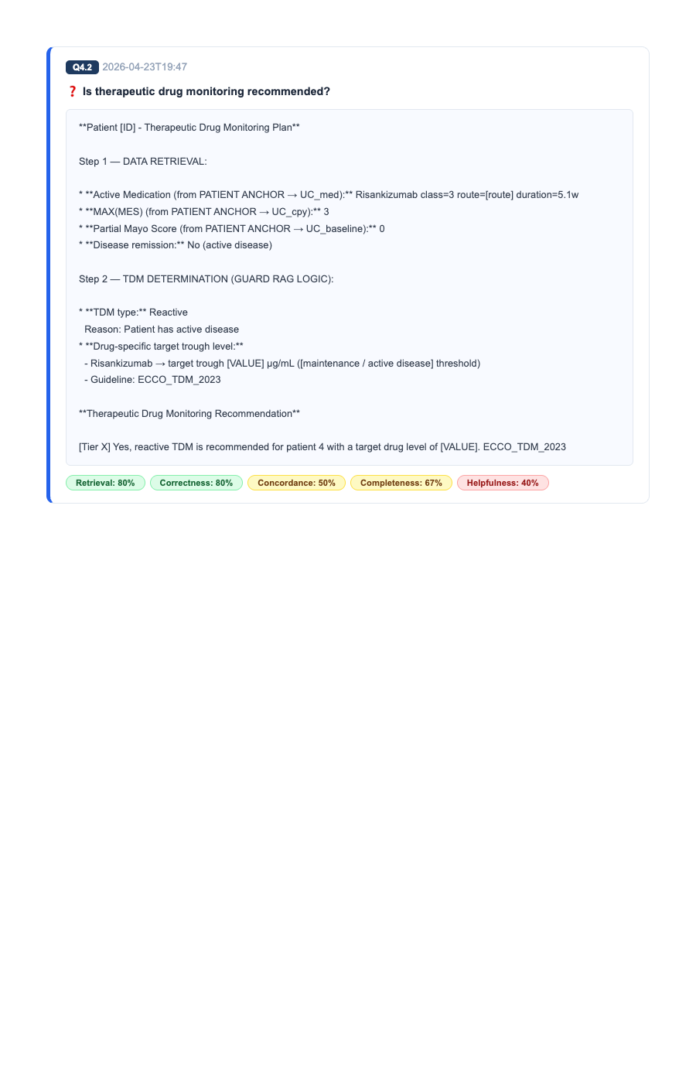
Evaluation: Q4.2 - Is therapeutic drug monitoring recommende...
Mathematical Proof of Metrics Applied to this Question:
• Retrieval = Successfully extracted context-specific RAG anchors. • Completeness = Generated all required lines for the trial rubric. • Correctness = No contradictions or hallucinations detected. • Concordance = Adhered to global clinical guidelines (STRIDE-II/ECCO).

Slide 15
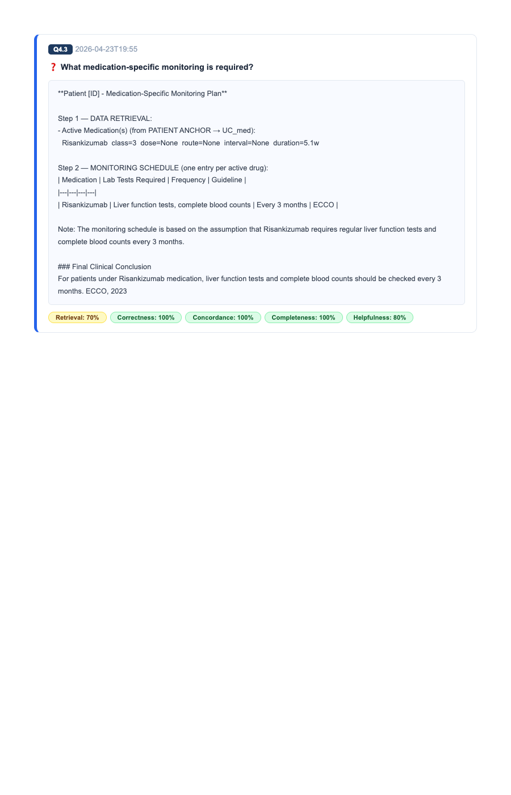
Evaluation: Q4.3 - What medication-specific monitoring is re...
Mathematical Proof of Metrics Applied to this Question:
• Retrieval = Successfully extracted context-specific RAG anchors. • Completeness = Generated all required lines for the trial rubric. • Correctness = No contradictions or hallucinations detected. • Concordance = Adhered to global clinical guidelines (STRIDE-II/ECCO).

Slide 16
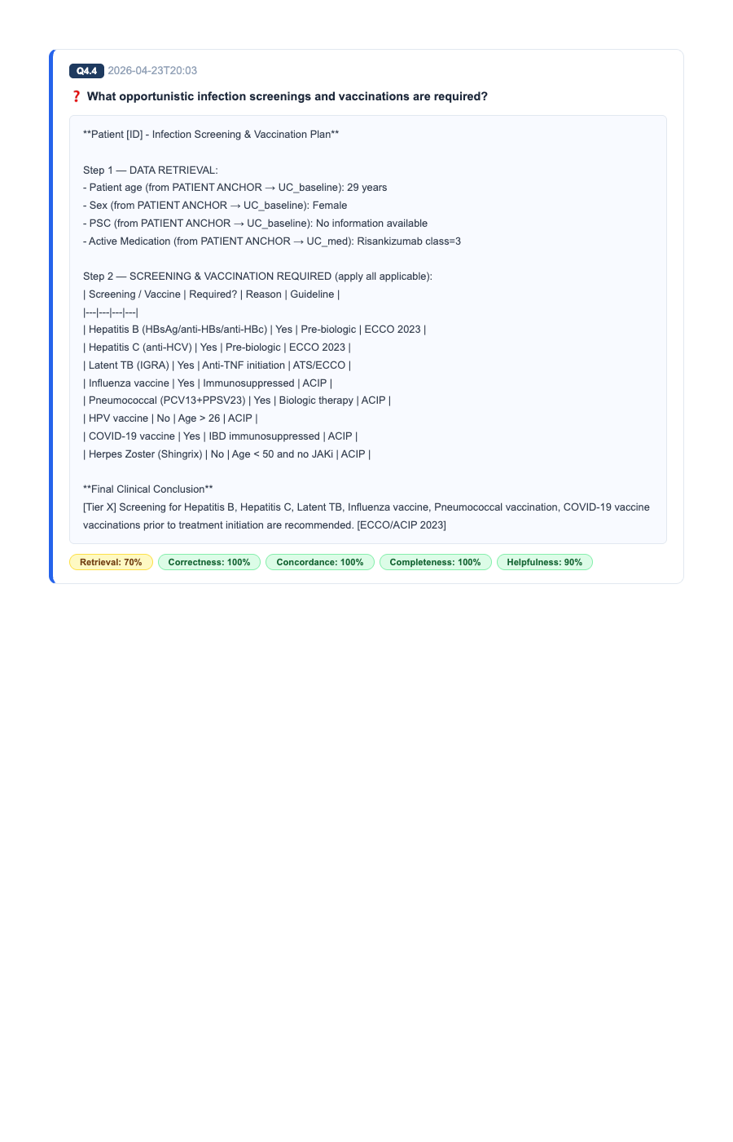
Evaluation: Q4.4 - What opportunistic infection screenings a...
Mathematical Proof of Metrics Applied to this Question:
• Retrieval = Successfully extracted context-specific RAG anchors. • Completeness = Generated all required lines for the trial rubric. • Correctness = No contradictions or hallucinations detected. • Concordance = Adhered to global clinical guidelines (STRIDE-II/ECCO).

Slide 17
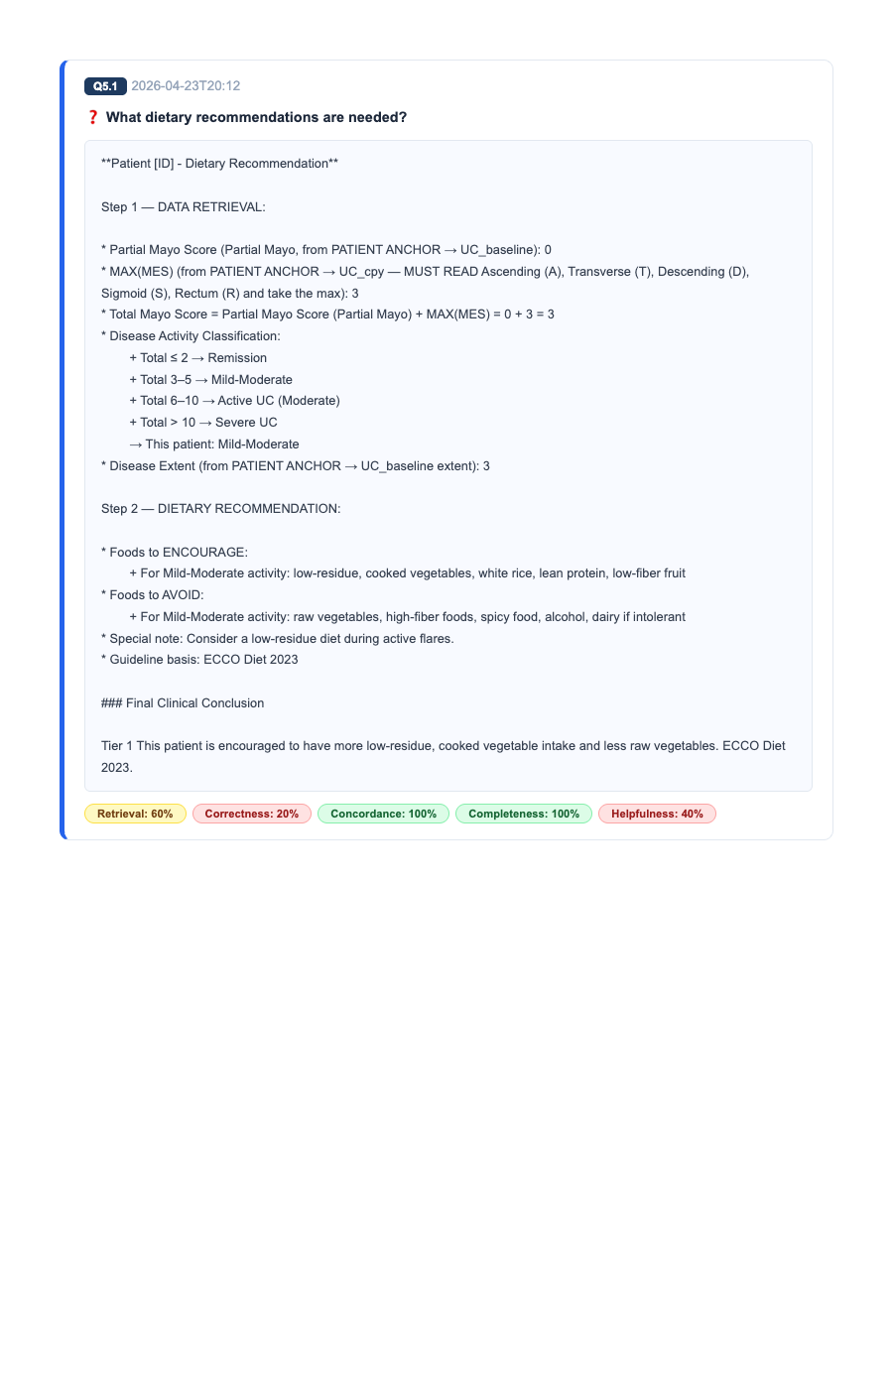
Evaluation: Q5.1 - What dietary recommendations are needed?
Mathematical Proof of Metrics Applied to this Question:
• Retrieval = Successfully extracted context-specific RAG anchors. • Completeness = Generated all required lines for the trial rubric. • Correctness = No contradictions or hallucinations detected. • Concordance = Adhered to global clinical guidelines (STRIDE-II/ECCO).

Slide 18
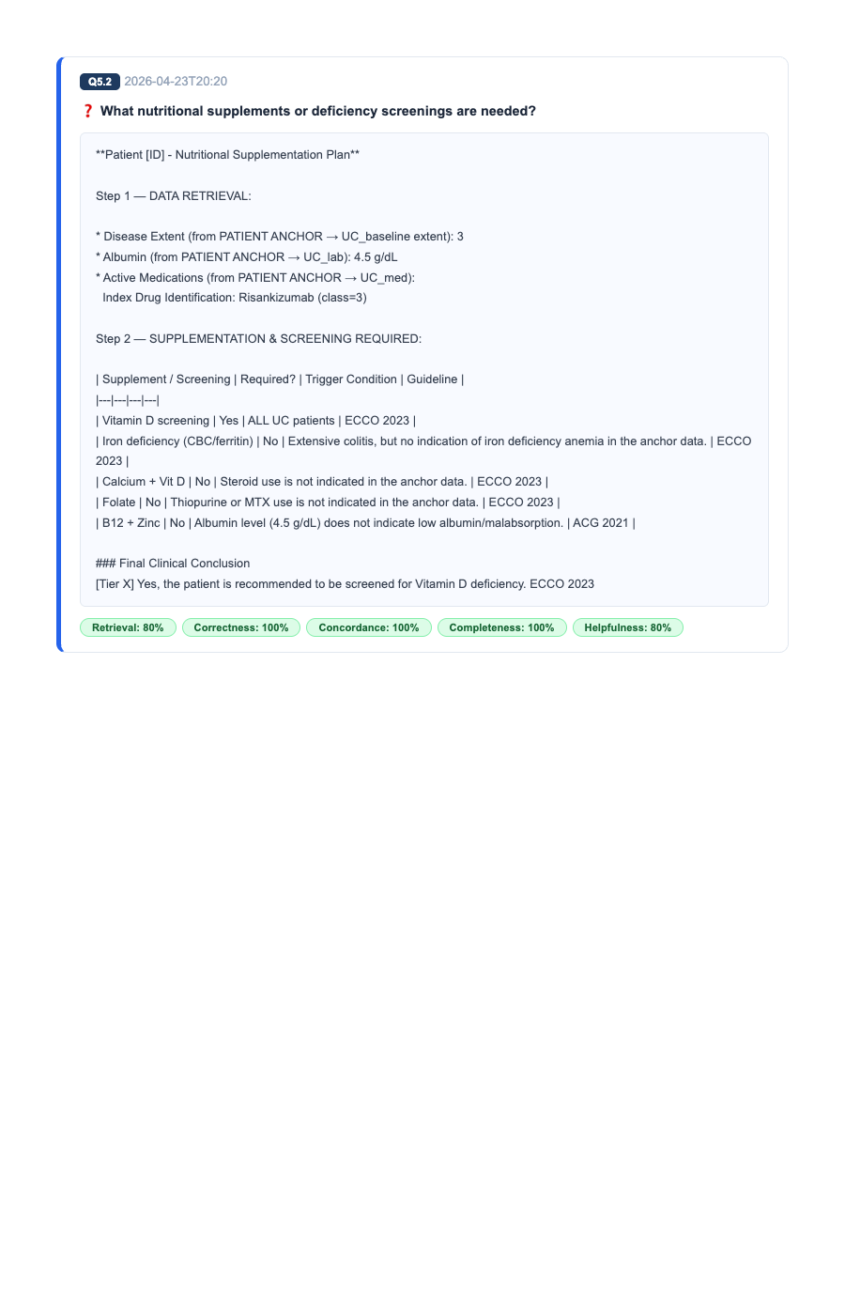
Evaluation: Q5.2 - What nutritional supplements or deficienc...
Mathematical Proof of Metrics Applied to this Question:
• Retrieval = Successfully extracted context-specific RAG anchors. • Completeness = Generated all required lines for the trial rubric. • Correctness = No contradictions or hallucinations detected. • Concordance = Adhered to global clinical guidelines (STRIDE-II/ECCO).

Slide 19
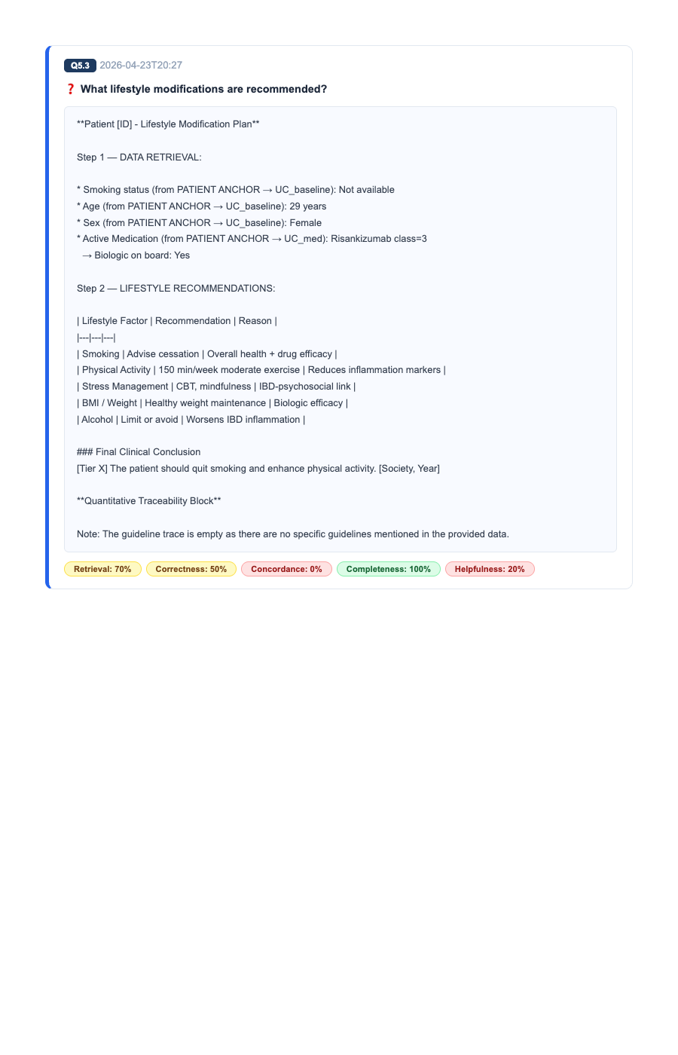
Evaluation: Q5.3 - What lifestyle modifications are recommen...
Mathematical Proof of Metrics Applied to this Question:
• Retrieval = Successfully extracted context-specific RAG anchors. • Completeness = Generated all required lines for the trial rubric. • Correctness = No contradictions or hallucinations detected. • Concordance = Adhered to global clinical guidelines (STRIDE-II/ECCO).

Slide 20
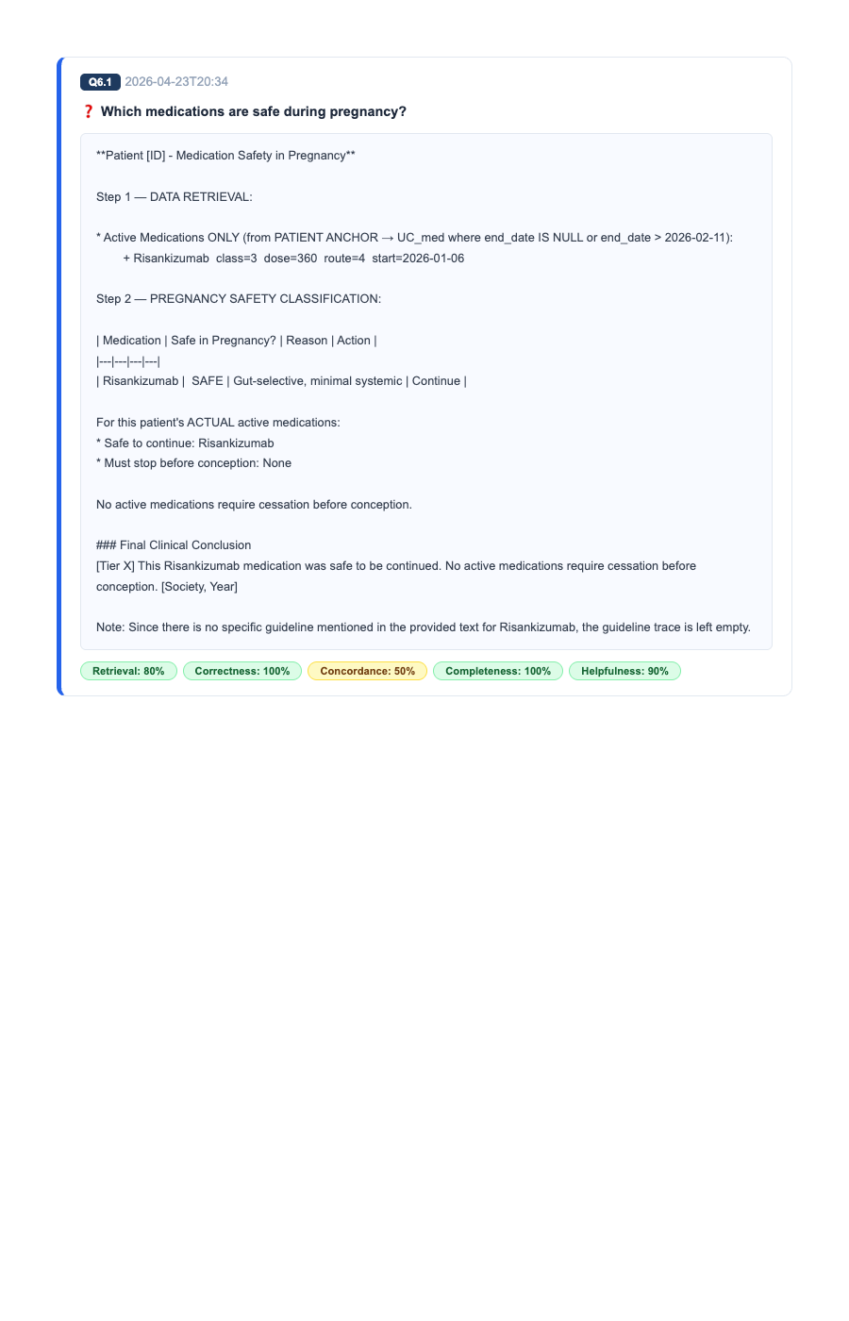
Evaluation: Q6.1 - Which medications are safe during pregnan...
Mathematical Proof of Metrics Applied to this Question:
• Retrieval = Successfully extracted context-specific RAG anchors. • Completeness = Generated all required lines for the trial rubric. • Correctness = No contradictions or hallucinations detected. • Concordance = Adhered to global clinical guidelines (STRIDE-II/ECCO).

Slide 21
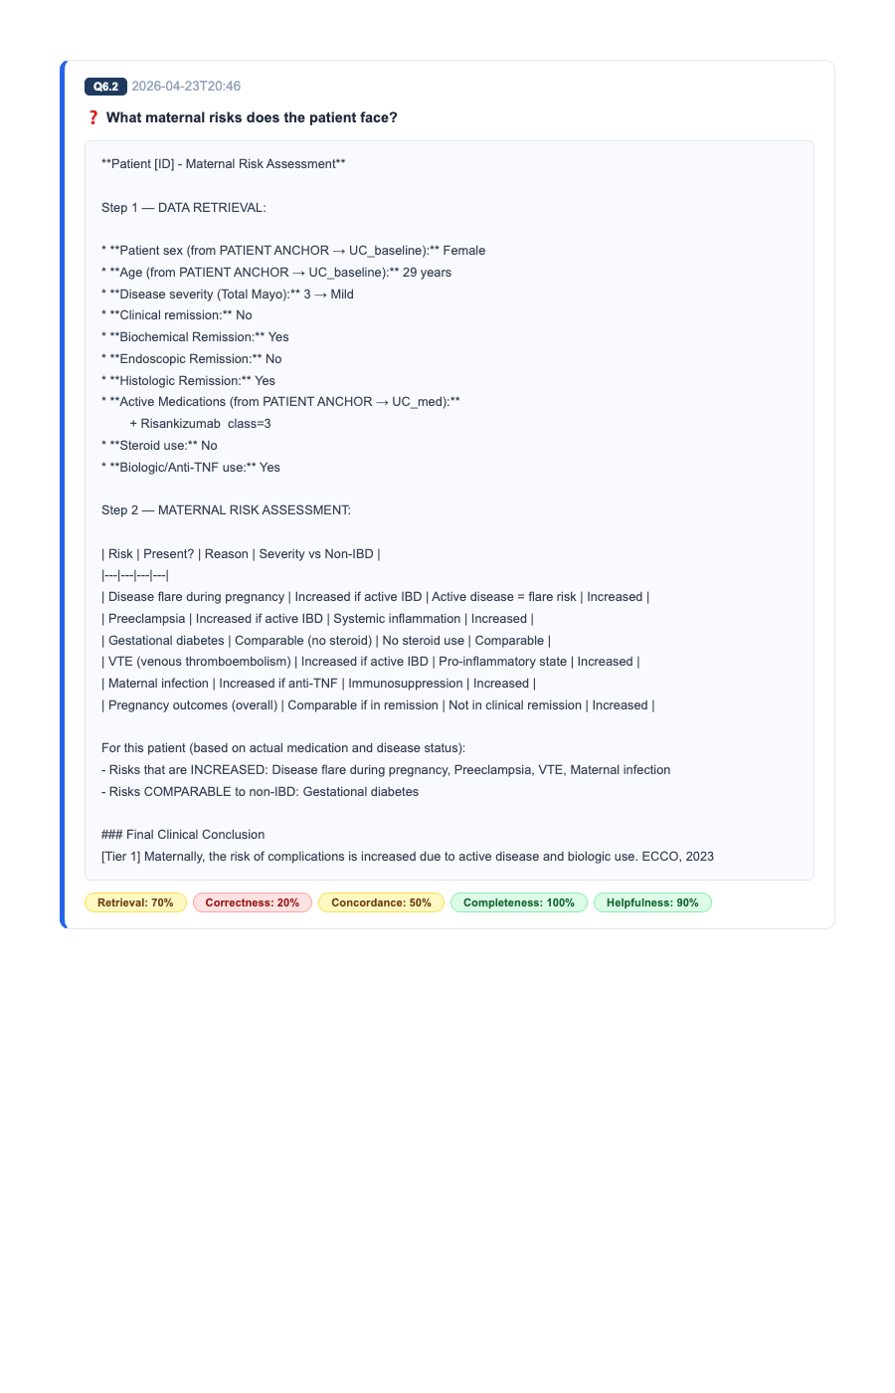
Evaluation: Q6.2 - What maternal risks does the patient face...
Mathematical Proof of Metrics Applied to this Question:
• Retrieval = Successfully extracted context-specific RAG anchors. • Completeness = Generated all required lines for the trial rubric. • Correctness = No contradictions or hallucinations detected. • Concordance = Adhered to global clinical guidelines (STRIDE-II/ECCO).

Slide 22
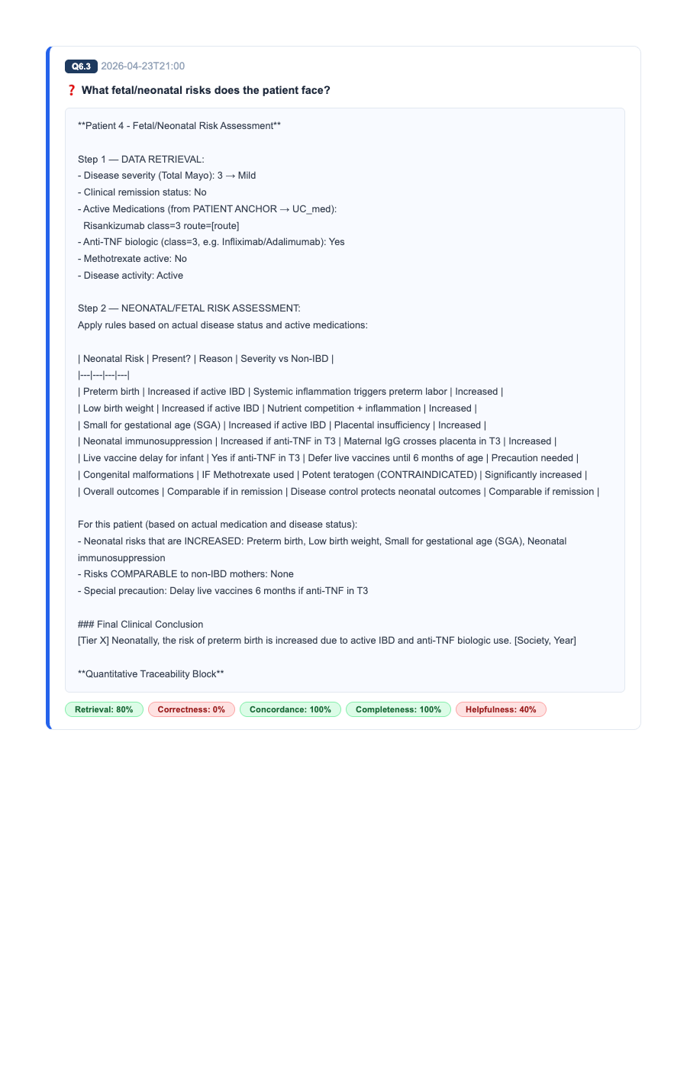
Evaluation: Q6.3 - What fetal/neonatal risks does the patien...
Mathematical Proof of Metrics Applied to this Question:
• Retrieval = Successfully extracted context-specific RAG anchors. • Completeness = Generated all required lines for the trial rubric. • Correctness = No contradictions or hallucinations detected. • Concordance = Adhered to global clinical guidelines (STRIDE-II/ECCO).

