Slide 1
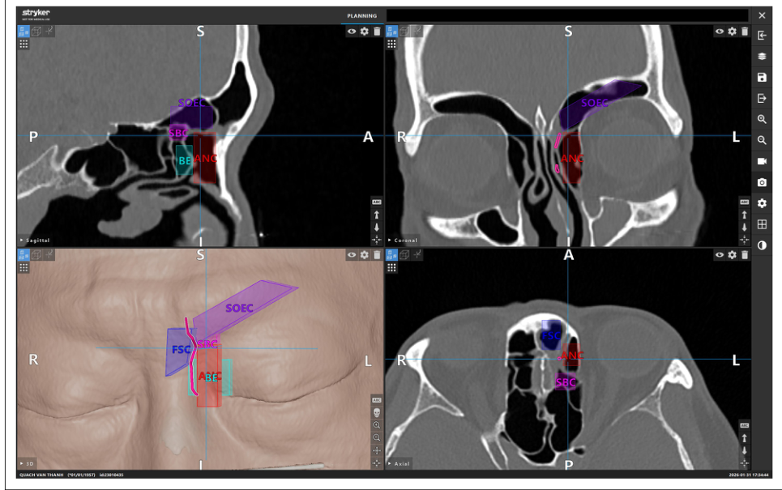
Frontal Sinus Drainage Pathway
Doctor viewpoint: know the route before entering a narrow, angled, high‑risk surgical corridor
Why this matters clinically
The drainage pathway is the true surgical target—not just the sinus cavity.
Current problem
2D CT requires surgeons to mentally reconstruct a patient‑specific 3D route; frontal recess cells can redirect or narrow it.
If the pathway is not known
Dissection becomes uncertain: incomplete opening, restenosis/recurrent disease, and avoidable trauma near orbit/skull base.
When the pathway is known
It becomes a personalized roadmap: identify IFAC cells → predict the route → choose the surgical extent → cannulate and open safely.
3D CT mapping converts a hidden outflow route into a visible surgical plan
Evidence anchor
3D planning improved challenging frontal sinusotomy preparation, atraumatic handling, sinus cannulation, and drainage‑pathway identification.
Core message for doctors: uncertainty in drainage anatomy increases operative ambiguity; pathway mapping turns CT anatomy into a safe, reproducible surgical strategy.
Sources: Wormald et al., IFAC/EFSS, 2016; Kelly et al., 3D surgical planning education, 2026; Ngo & Tran, 3D FSDP mapping with surgical validation, 2026.
Notes:
This introduction slide explains the clinical need from the surgeon's perspective. The frontal sinus drainage pathway is the functional route that must be opened during frontal sinusotomy. The problem is that the route is not directly visible in the operative field and can be shifted by patient-specific frontal recess cells. If the surgeon does not clearly know the pathway beforehand, the operation becomes a difficult angled dissection in a narrow area close to the orbit, anterior skull base, anterior ethmoid artery, and cribriform plate; this can lead to incomplete clearance, recurrent obstruction, and unnecessary trauma. Once the pathway is known from CT-based 3D mapping, it becomes a patient-specific surgical roadmap: the surgeon can identify IFAC cells, anticipate the safest route, choose the correct extent of surgery, cannulate the frontal sinus more confidently, and communicate the plan with trainees. This motivates our work: automatic or assisted drainage pathway mapping can support safer and more reproducible planning.

Slide 2
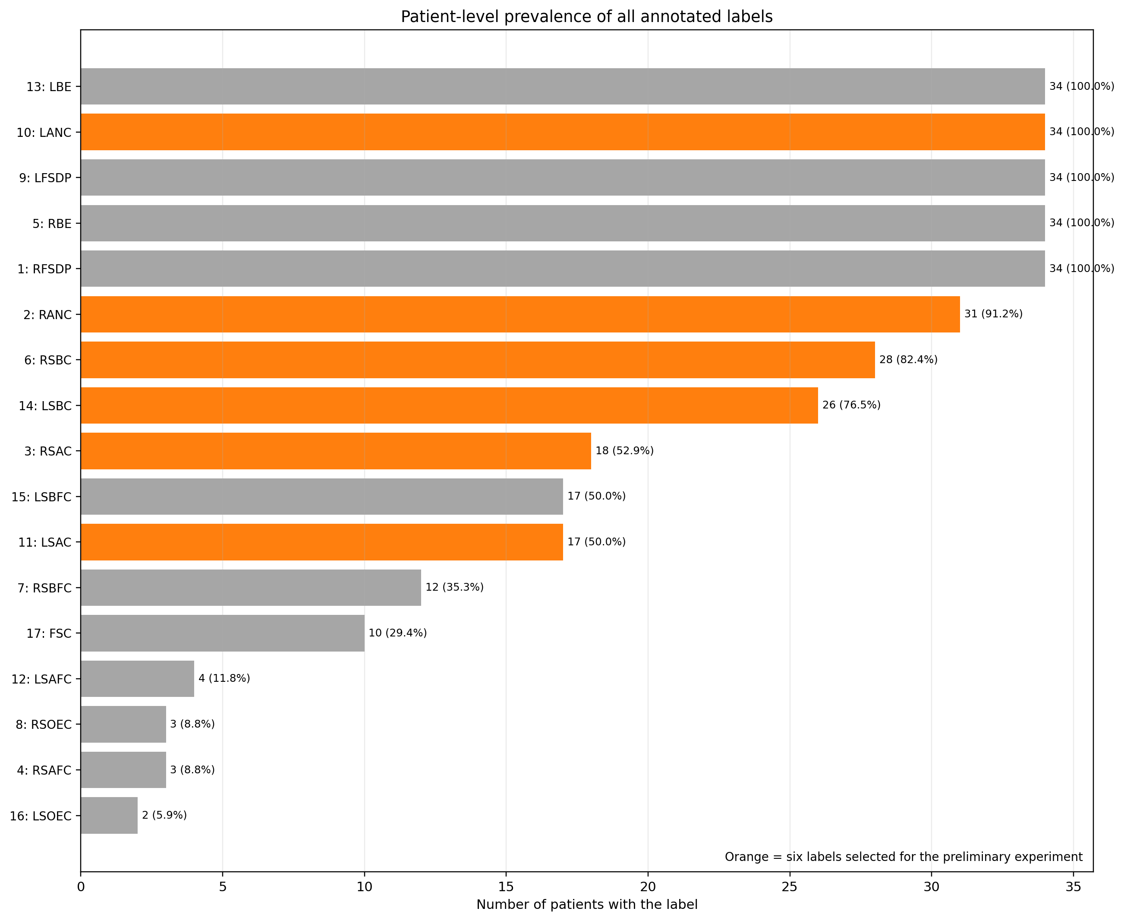

Annotation Check
03
Notes:
$G_{8}$ denotes the discrete roto-translation group used in the model, and $C_{8}$ denotes the cyclic group containing eight sampled rotations.
Quantity, quality, modality, and the relationship between them

Slide 3

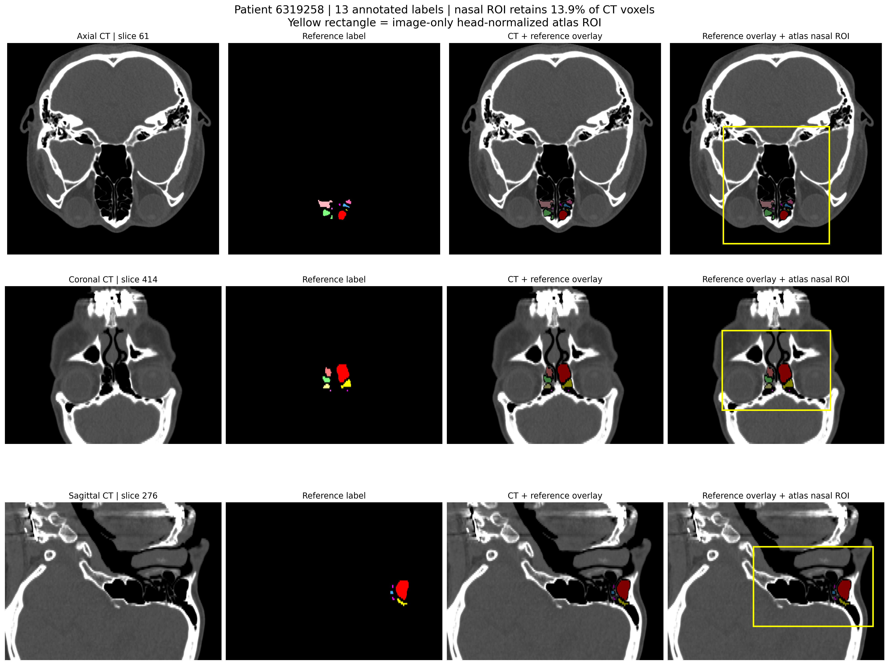
ROI
04

Slide 4
Experiment Design
Experiment | New output classes | Original structures merged
Exp 1 | Anterior | RANC + RSAC + RSAFC + LANC + LSAC + LSAFC
 | Posterior | RBE + RSBC + RSBFC + RSOEC + LBE + LSBC + LSBFC + LSOEC
Exp 2 | Right Anterior | RANC + RSAC + RSAFC
 | Left Anterior | LANC + LSAC + LSAFC
 | Right Posterior | RBE + RSBC + RSBFC + RSOEC
 | Left Posterior | LBE + LSBC + LSBFC + LSOEC
Exp 3 | Right Anterior | RANC + RSAC + RSAFC
 | Left Anterior | LANC + LSAC + LSAFC
 | Right Posterior | RBE + RSBC + RSBFC + RSOEC
 | Left Posterior | LBE + LSBC + LSBFC + LSOEC
 | FSC | original FSC

Slide 5
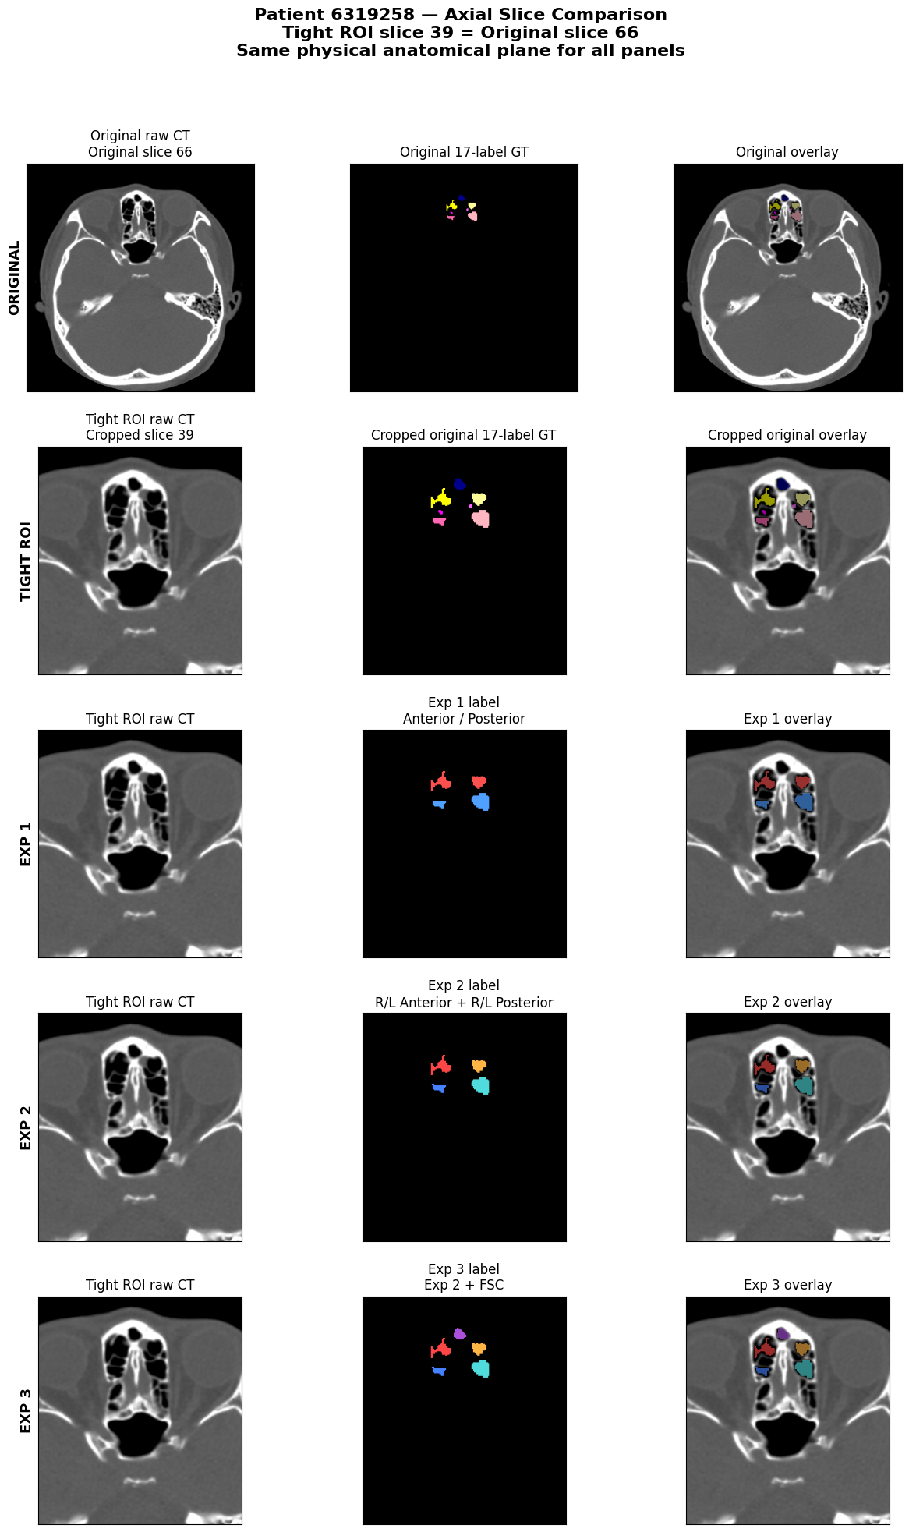
Patient 6319258 (Axial Slice 39)
Raw Image
Label
Overlay
Raw Image
Label
Overlay
Exp 1
Original
Exp 2
Nasal ROI
Exp 3

Slide 6
Link to the dataset: https://drive.google.com/drive/folders/193_1ABszK4mLQScXwUZvtFmlgsvzx6Fc?usp=drive_link (sudah ada di GPU dengan nama folder normal case_86)
Caution:
Please make sure the ROI is in the correct position
The maximum label is 18 but not every patient has it all. Thats why we reduce the experiment currently just to 3 experiment first. The most important is finding the Drainage Pathway later.
Before start the experiment, make sure all the image file have a same spacing and/or same size with the label. If they do not have the same spacing, leave it. Make notes on it.
Use pretrained model (3 model) and just use 70% of the dataset for fine tuning. The rest 30% will be for testing.
There is a dataset name NasalSeg. They can be used as an additional test dataset. They did not have the same label so we can just predict and give the prediction to the doctor to judge. Blind model test.

