Slide 1
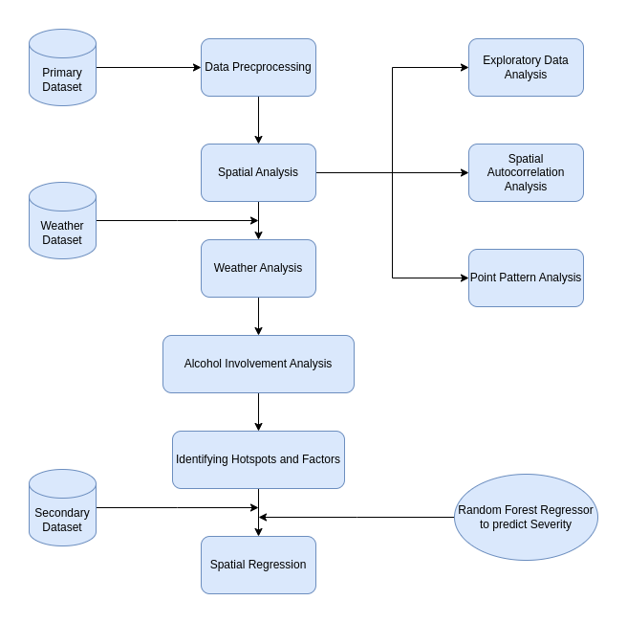
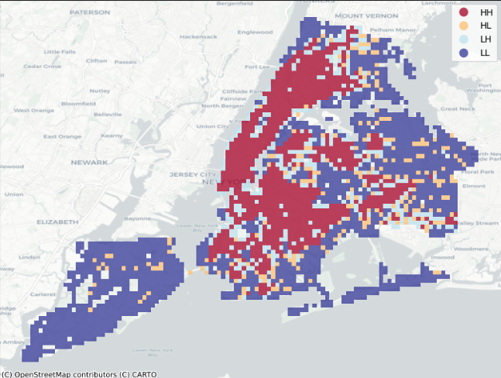
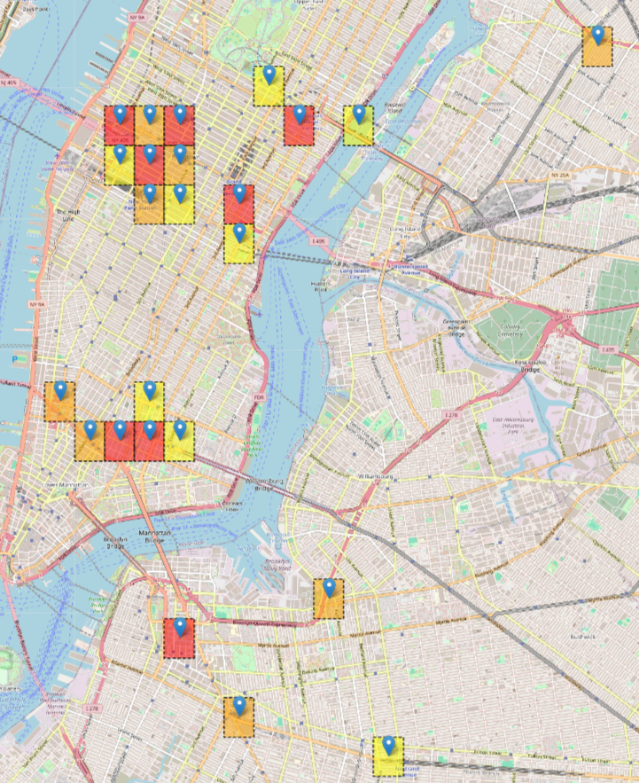
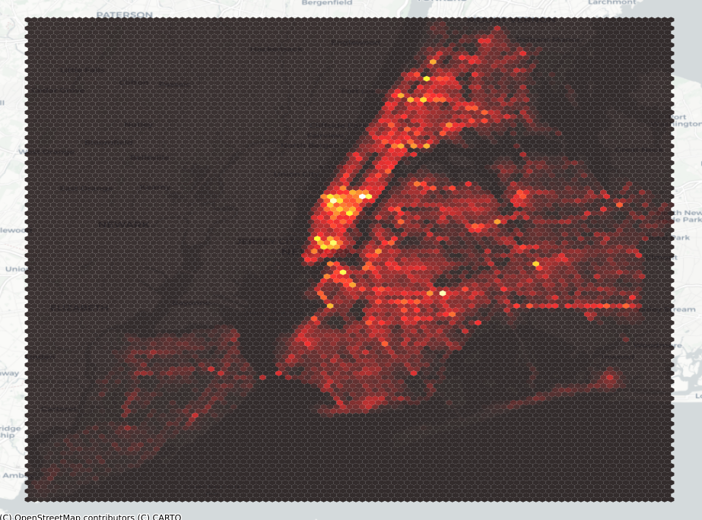
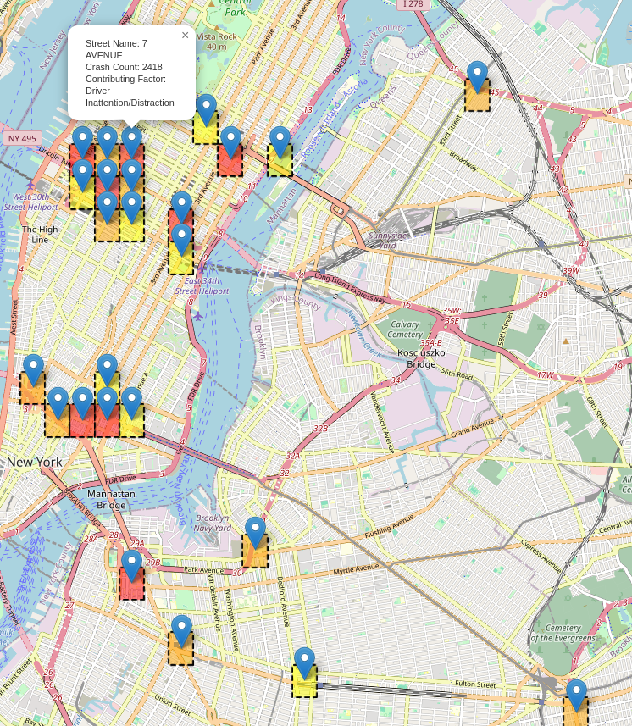
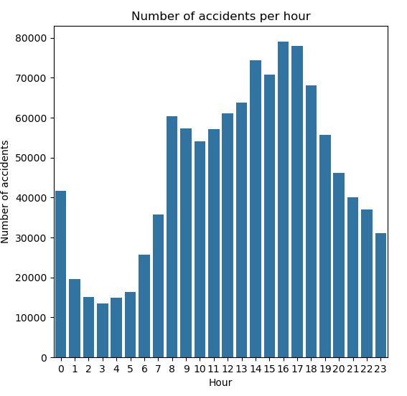
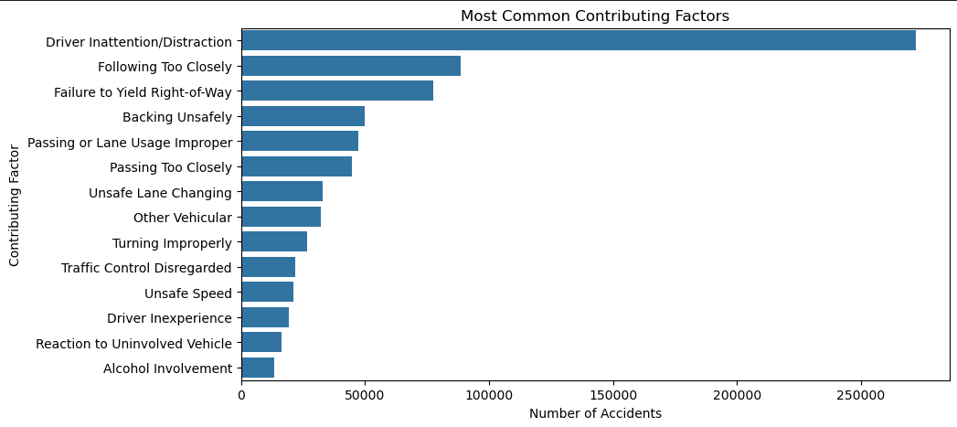
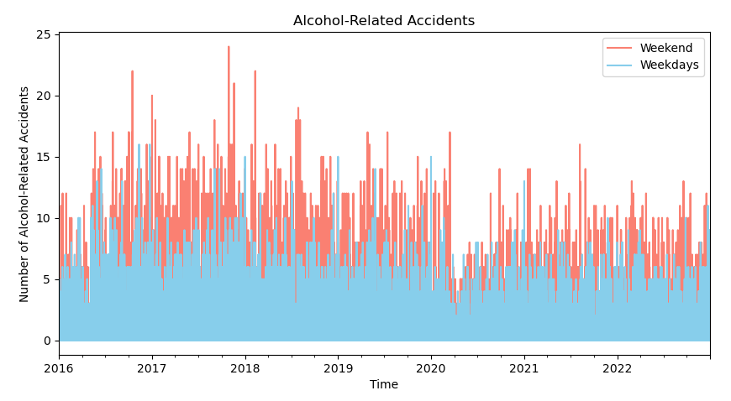
Spatial Analysis of Traffic Accidents in New York City: Identifying Hotspots and Contributing Factors
Muhammad Amin Yahya (BSCS21049)
Session: Spring 2024
Supervisor: Dr. Adnan Siddique
Course: Spatial Data Science
1. Introduction
4. Methodology
Traffic accidents are a significant public safety concern in urban areas like New York City.
NYC, the most populated city in the US, experiences some of the worst traffic, ranking 3rd nationally.
In 2018, NYC reported 228,047 traffic accidents, including 44,300 injury-causing collisions.
Traffic accidents result in severe economic and social impacts, including medical costs, property damage, and stress.
Fig. 2: Left: Google Earth snapshot of the observed area. The yellow line shows the approximate projection of the slant-range vector on ground. Right: An initial PSI solution obtained with IPTA. The dots mark the detected persistent scatterers. Their color represents the estimated deformation in mm/y. The red line shows the extent of an azimuth line whose tomographic inversion is presented in Fig. 5.
2. Problem Statement
This study aims to conduct a detailed spatial analysis of traffic accidents in New York City from 2016 to 2022. By identifying high-risk areas and contributing factors, we seek to provide actionable insights for enhancing road safety and reducing the incidence of traffic accidents.
5. Results & Discussion
3. Data
Traffic crashes in NYC showed an upward trend from 2016 to 2019 but sharply declined with the onset of Covid-19 in late 2019.
The peak hours for accidents are between 2-6 pm, coinciding with office and school dismissal times,
Driver inattention or distraction is identified as the leading cause of most traffic accidents in the city.
Strong positive spatial autocorrelation was observed indicating traffic crashes tend to aggregate in specific locations across the city.
Rainy conditions marginally increase accidents by 3.6%, while alcohol-related crashes surge by 122% on weekends.
Hotspots for accidents are concentrated in Manhattan, particularly along the 1st to 10th Avenue corridor.
Dataset retrieved from official US government repository, "Motor Vehicle Collisions - Crashes," comprises over 1M incidents spanning 2016 to 2022
Contains geographical data and contributing factors
Supplementary weather and secondary traffic crash data obtained from Kaggle provides annotations for nearby Points of Interest (POI)
Data Preprocessing involved:
Dropping irrelevant columns such as vehicle code and cyclist injuries
Using spatial interpolation to address missing weather data
Imputing missing numerical data with mean and missing string data with mode
Filtering out data points beyond NYC's
geographical boundary
Acknowledgments: Data.gov Motor Vehicle Collisions - Crashes , Weather Data , Secondary Crash Dataset

