Slide 1
AdVanced Calculator
A Programming Fundamentals Project
Muhammad Ammar-ul-Haq CYS232014

Slide 2
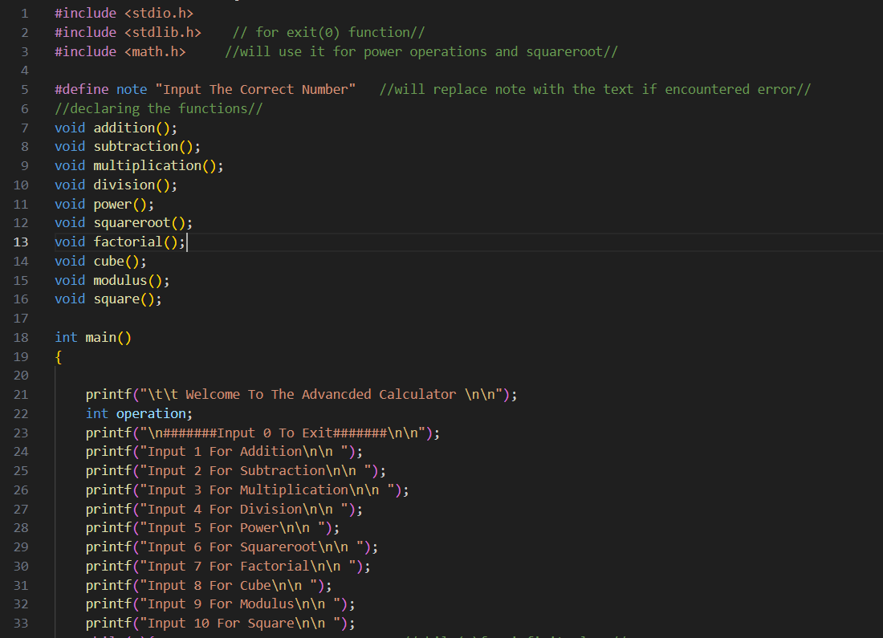
Header Files
Declaring Functions
Statements

Slide 3
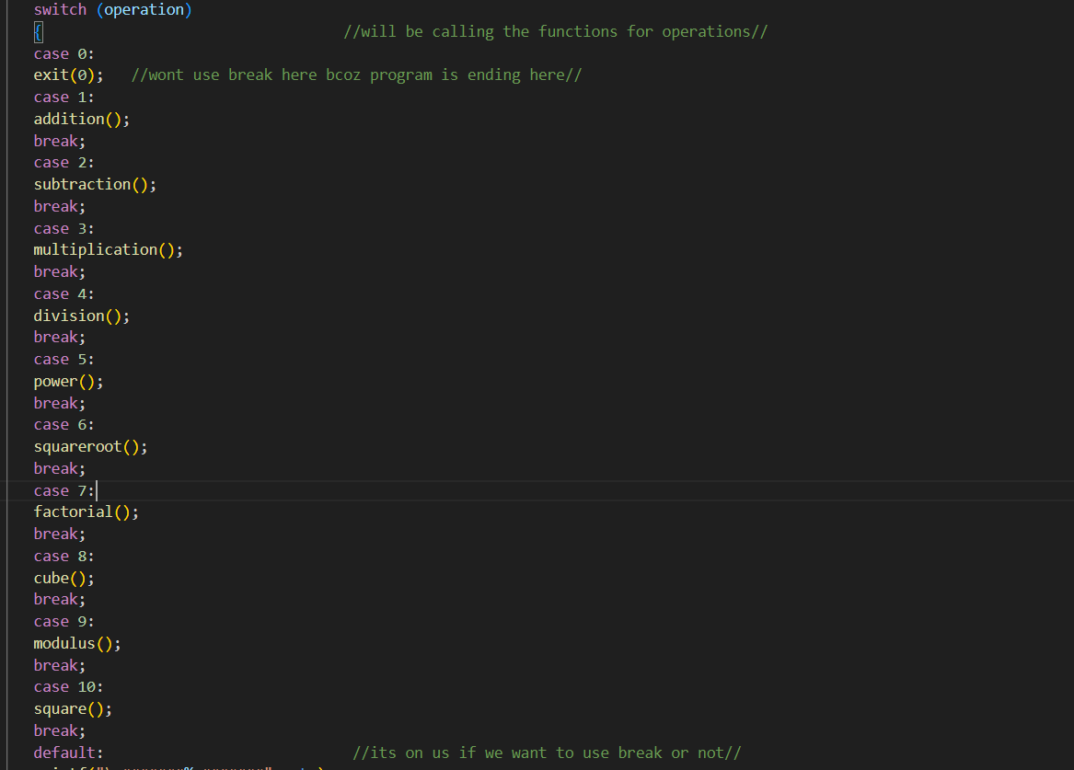
Switch Case For The Selection Of Operation
Addition, Subtraction, Multiplication, Division, Power, Square Root, Factorial, Cube, Modulus, Square

Slide 4
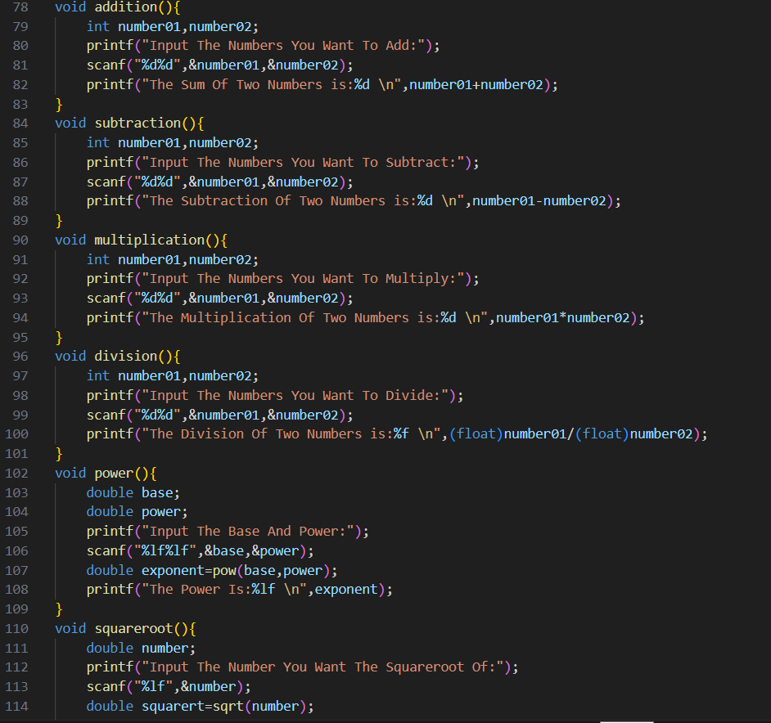
Defining Called Functions

Slide 5
Conclusion: The program has been created to take out complex arithmetic operations efficiently, using multiple libraries and employing switch-case statements for dynamic operation selection.

