Slide 1
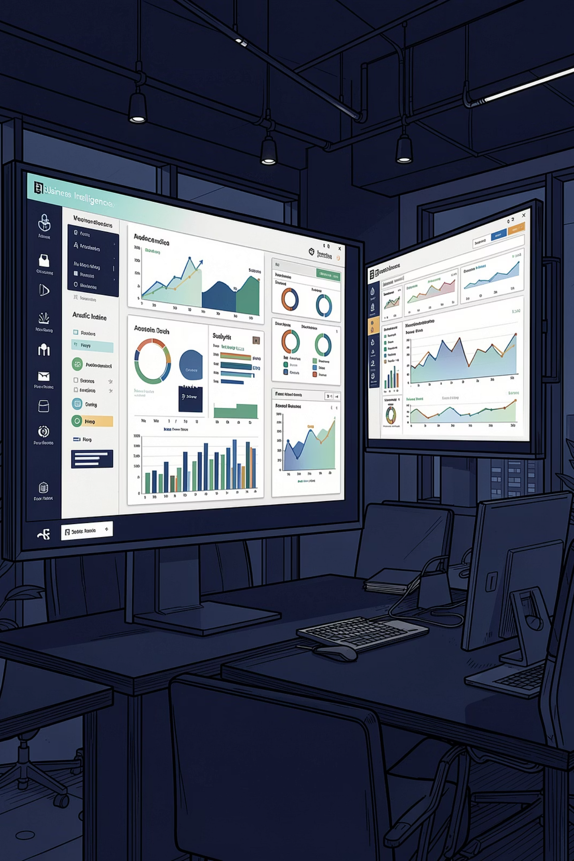
SaaS Analytics Dashboard
End-to-End Business Intelligence Solution using Power BI, PostgreSQL, SQL & DAX
By : Areeb Zahid

Slide 2







PROJECT OVERVIEW
Turning Raw Data into Strategic Insight
SaaS companies generate vast data but lack structured reporting. This project builds a complete BI pipeline — from ingestion to executive-ready dashboards — enabling data-driven decisions at scale.
Raw Data
PostgreSQL
Power Query
Data Model
DAX
Power BI Dashboard
Business Insights

Slide 3






TECHNOLOGY STACK
Enterprise-Grade Tools, Purposefully Selected
Every technology was chosen for its proven role in modern BI pipelines — from data ingestion to visualization.
Power BI
PostgreSQL
Primary visualization and reporting platform
Relational database for structured data storage
SQL
Power Query
Query language for data extraction and transformation
ETL engine for data cleaning and shaping
DAX
Git & GitHub
Formula language for advanced calculated metrics
Version control and collaborative code management

Slide 4
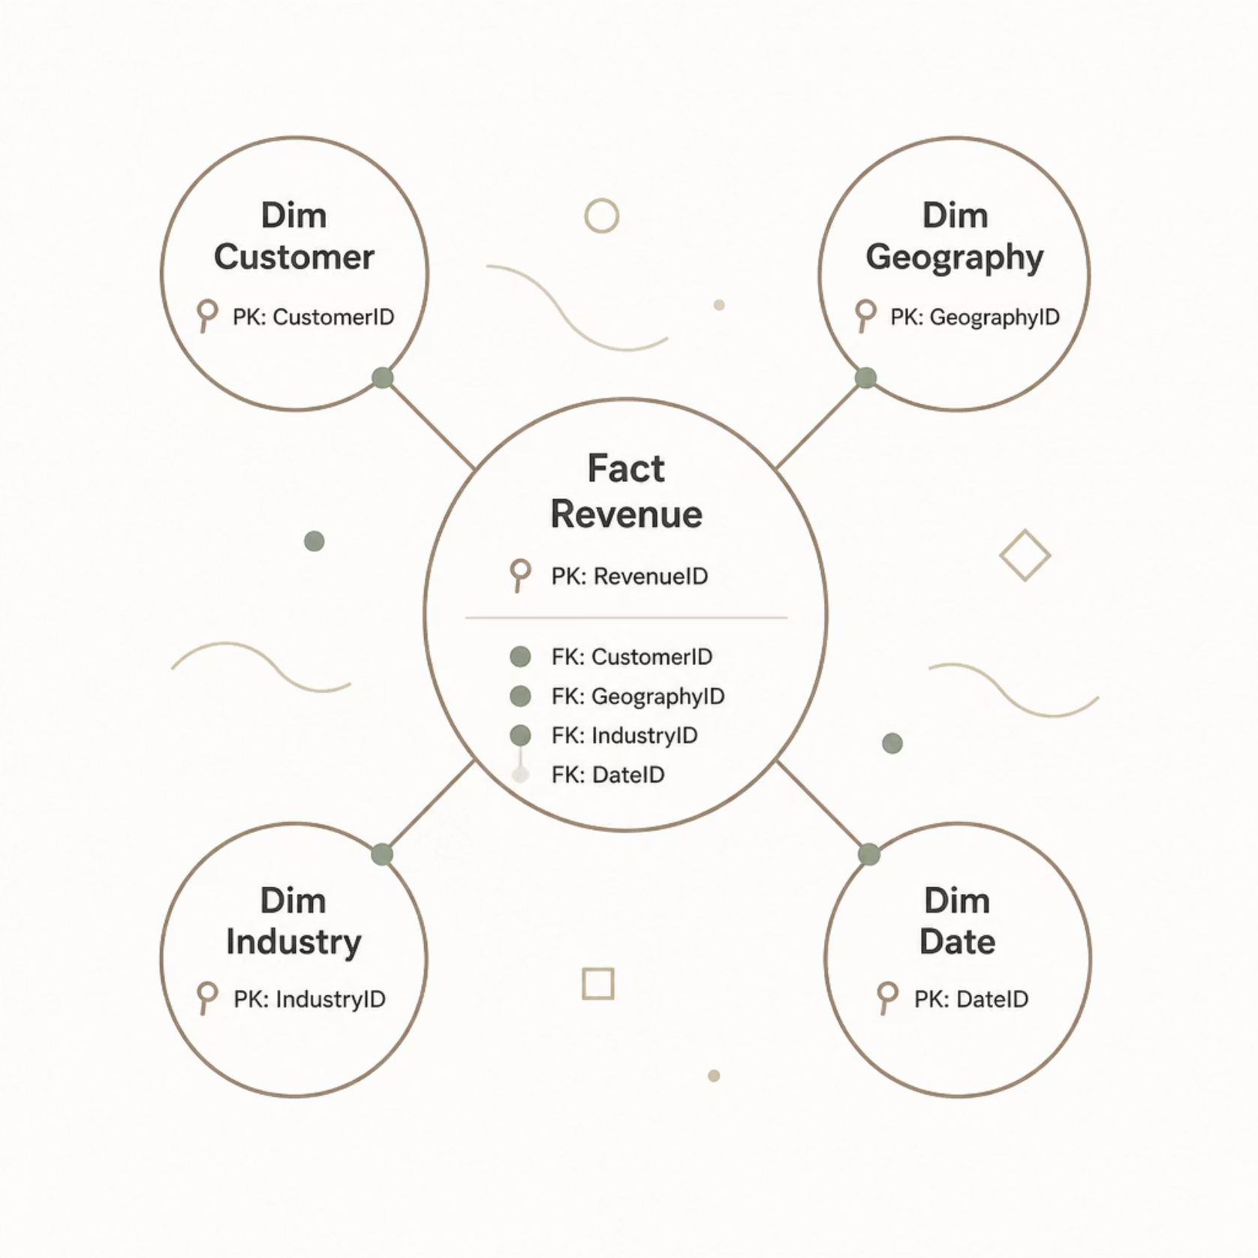
DATA ARCHITECTURE
Star Schema: Optimized for Analytical Performance
A star schema organizes data into a central fact table surrounded by dimension tables, minimizing joins and accelerating query performance at scale.
Fact Tables
Dimension Tables
Relationships
Measurable events — revenue, transactions, subscriptions
Descriptive attributes — customer, geography, industry
Primary & foreign keys enforce referential integrity
📸 Placeholder: INSERT DATA MODEL IMAGE — star schema ERD screenshot

Slide 5
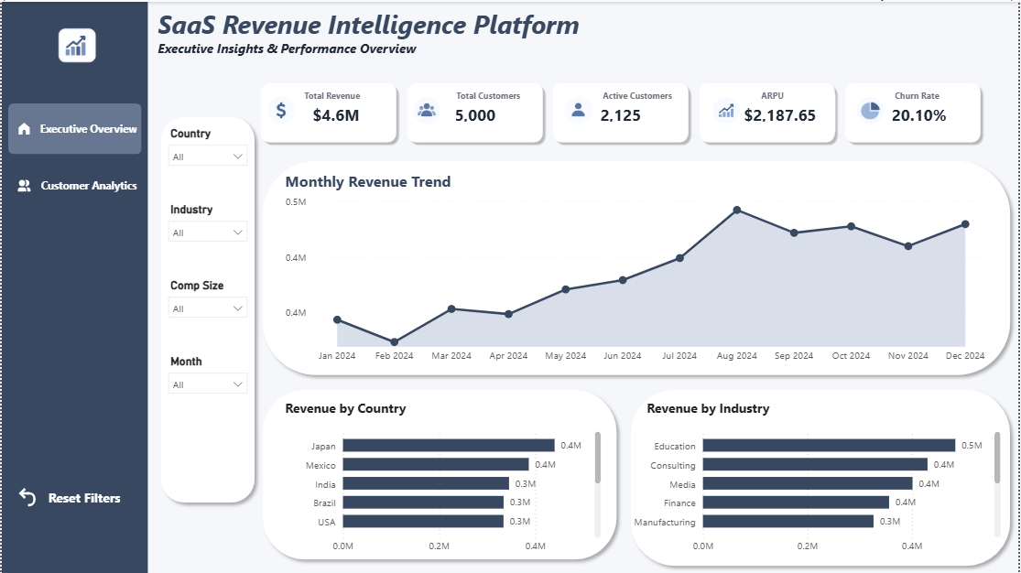

DASHBOARD 1
Executive Overview: Revenue at a Glance
What This Dashboard Delivers
KPI Cards
Revenue, customers, ARPU — instant performance snapshot
Revenue Trend
Time-series line chart revealing growth trajectory
Geo & Industry Breakdown
Revenue by country and industry for market prioritization
Interactive Filters & Nav
Self-service exploration with page navigation

Slide 6
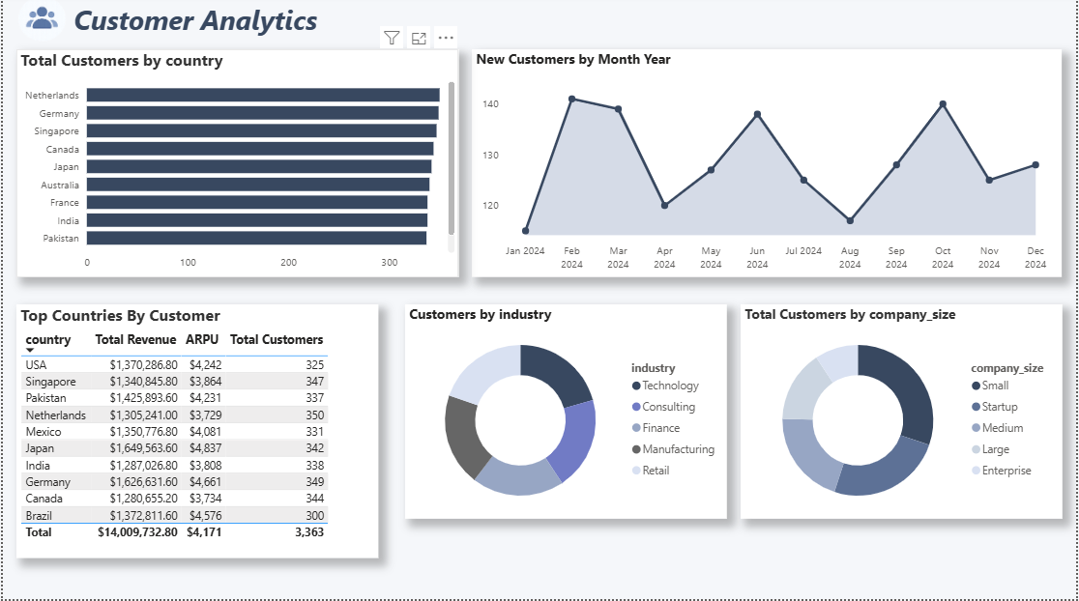

DASHBOARD 2
Customer Analytics: Know Your Base
Segmentation That Drives Decisions
Industry & Company Size
New Customer Trend
Distribution by segment for targeting and positioning
Acquisition velocity over time
Top Countries
Performance Table
Geographic concentration and expansion opportunities
Granular customer-level data for account reviews

Slide 7
PERFORMANCE METRICS
Key Performance Indicators
Six KPIs form the analytical backbone — each tied to a specific business decision.
Total Revenue
Total Customers
Gross revenue across all segments — primary growth indicator
Full customer base — market reach and scale
Active Customers
ARPU
Currently subscribed — engagement and retention health
Average revenue per user — pricing and upsell efficiency
Churn Rate
Revenue Growth %
Subscription loss rate — retention and satisfaction signal
Period-over-period growth — momentum and trajectory

Slide 8





BUSINESS INTELLIGENCE
Key Insights: What the Data Reveals
Consistent Revenue Growth
Upward trajectory confirms product-market fit and pricing effectiveness
Geographic Concentration
One dominant market reveals expansion opportunities in underpenetrated regions
Leading Industry Vertical
A primary customer segment guides go-to-market and sales focus
Strong Active Rate
High active-to-total ratio signals strong retention and product stickiness

Slide 9
CAPABILITIES
Skills Demonstrated Across the Project
Technical Skills
Business & Analytical Skills
Power BI — reports, data modeling, DAX
SQL & PostgreSQL — queries, schema design, optimization
DAX — time intelligence, calculated measures
Power Query — ETL, data transformation
Git & GitHub — version control, collaboration
Dashboard Design — UX, layout, visual hierarchy
Business Intelligence — KPI frameworks, metrics
Data Storytelling — narrative-driven insights
Data Visualization — chart selection, best practices
Problem Solving & Analytical Thinking

Slide 10

SUMMARY
What This Project Delivers
✅ End-to-End Pipeline
📊 Executive Dashboards
🚀 Future Roadmap
Full BI workflow — ingestion to insight — production-ready
Two interactive reports with KPIs, trends, and segmentation
Power BI Service deployment, forecasting, and row-level security
Thank You
This project demonstrates the ability to design and deliver enterprise-grade BI solutions — from data engineering to executive storytelling.
Areeb Zahid · Business Analytics Portfolio
Questions? Available for portfolio reviews, technical interviews, and project discussions.

