Slide 1


Final Year Project
Raidware
Supervised By: MR. Muhammad Osama Raza (senior lecturer )

Slide 2
Project Team
Hafiz Muhammad Arhum Javid (44889)
Akrash Bashir (47571)

Slide 3
Table of Content
Background and Introduction
Literature Review
Problem Statement
Project Scope
Proposed Solution
Requirements Summary
Design Summary
Methodology
Implementation Summary
Experiments and Results Summary
Testing Summary
Conclusion and Outlook

Slide 4
BACKGROUND AND INTRODUCTION

Slide 5
Background and Introduction
What is Raidware?
Raidware is a Security-as-a-Service(SECaaS) platform for IoT devices
It wraps every IoT device in a full security system from the moment it boots Built on low-cost ESP32 hardware no expensive equipment needed
Covers: Encrypted communication, device authentication, and AI-based intrusion detection

Slide 6
Background and Introduction
Market Opportunity:
IoT security market was $6.7 billion in 2023
Expected to reach $37 billion by 2030 (25% growth every year)
Over 15 billion IoT devices connected worldwide right now
No affordable platform currently covers all security layers in one place

Slide 7
Background and Introduction
Who Needs Raidware?
Companies :secure their office and warehouse IoT devices
Government: protect smart city and surveillance infrastructure
Small Businesses (SMEs):get enterprise-level security at low cost
Factories: Need 24/7 uptime, can't afford network failures

Slide 8
Background and Introduction
Why Raidware is Different?
Other platforms (AWS, Azure, Cisco) cover only one or two security layers
Raidware is the only platform combining all four in one

Slide 9
Background and Introduction
Feature | AWS Greengrass | Azure IoT Hub | Cisco IoT | Raidware
Mesh Networking | No | No | Partial | Yes
AES-256 Encryption | Yes | Yes | Yes | Yes
Post-Quantum Crypto | No | No | No | Yes
Mutual Authentication | Partial | Yes | Yes | Yes
On-Device IDS | No | No | No | Yes
Data Sovereignty | Limited | Limited | Limited | Yes
Cost Accessibility | Medium | Medium | High | Low

Slide 10
Literature Review

Slide 11
Literature Review
Studied existing IoT security platforms, research papers, and market trends
Goal: find what already exists and what gaps are still there
Conclusion: no single platform covers the full IoT security stack

Slide 12
Literature Review
IoT Growth & Threat Landscape
Connected devices crossed 15 billion in 2023, expected 29 billion by 2030
More devices = bigger attack surface for hackers
Mirai Botnet attack compromised hundreds of thousands of IoT devices
Launched one of the biggest DDoS attacks in history using those devices

Slide 13
Literature Review
Technology 1: ESP-WIFI-MESH
Normal Wi-Fi connects all devices to one central point (single point of failure)
ESP-WIFI-MESH lets devices self-organize and self-heal automatically
If one node goes down, network reroutes itself no human needed
Challenge: video streaming over mesh loses bandwidth at every hop

Slide 14
Literature Review
Technology 2: TinyML on Edge Devices
Traditional Intrusion Detection Systems (IDS) run on powerful servers
TinyML runs machine learning directly on small devices like ESP32
Research proved: quantized neural networks work on as little as 80KB RAM
Detects network attacks with 90%+ accuracy, uses 78% less energy than cloud-based IDS

Slide 15
PROBLEM STATEMENT

Slide 16
Problem Statement
The Core Problem
Most IoT devices ship with zero proper security
No encryption, no authentication, no intrusion detection
One node fails → entire network goes down (single point of failure)
Attackers harvest encrypted data today to decrypt later with quantum computers

Slide 17
Problem Statement
What Existing Solutions Are Missing
AWS, Azure, Cisco too expensive, too cloud dependent
No platform combines mesh + encryption + authentication + AI detection together
Small organizations cannot afford enterprise-grade security
Data sovereignty is compromised when everything goes to third-party cloud

Slide 18
ENDEAVOUR

Slide 19
Endeavour
Akrash Bashir (47571)
Trained and deployed LightGBM IDS model
Worked on CICIDS2017 dataset preprocessing and SMOTE
Built ReactJS dashboard with live video streaming
Designed real time alert and telemetry UI
Wrote complete project documentation and report

Slide 20
Endeavour
Muhammad Arhum (44889)
Built complete Node.js and Express backend API
Configured MongoDB and Redis for data and caching
Done all ESP32 firmware and mesh network programming and Kyber Encryption
Set up CI/CD pipelines using GitHub and Docker
Handled full system integration end to end

Slide 21
Project Scope

Slide 22
Project Scope
What is IN Scope:
ESP32 mesh network setup and firmware development
AES-256 encryption and post-quantum (Kyber) key exchange
Mutual authentication (mTLS) for all devices
Cloud VPS backend with MongoDB and Redis

Slide 23
Project Scope
What is IN Scope:
ReactJS dashboard for live monitoring
Multi-tenant device management panel
TinyML Intrusion Detection System on edge devices
Live testing node failure and attack simulations

Slide 24
Project Scope
What is OUT of Scope:
Large-scale commercial deployment
Mobile app development
Third-party SIEM integration
Official compliance certification (ISO 27001, GDPR)

Slide 25
PROPOSED SOLUTION

Slide 26
Proposed Solution
Cryptographic Security (AES-256 + Khyber)
Every packet encrypted with AES-256-CBC before leaving the device
Fresh random IV generated for every single packet
Kyber post-quantum key exchange safe against future quantum attacks
Hardware accelerator on ESP32 used so no speed loss

Slide 27
Proposed Solution
Mutual Authentication (mTLS)
Both device and server verify each other's certificate
No unauthorized device can join the network
ECC certificates used faster and lighter than RSA
Session resumption reduces repeated handshake overhead

Slide 28
Proposed Solution
IDS Layer:
LightGBM model trained on CICIDS2017 dataset
99.85% accuracy in detecting attacks
Auto-blocks suspicious IPs via iptables
Runs in real-time on the server

Slide 29
Requirements Summary
Functional Requirements Admin:
Register and manage tenant organizations
View all devices across all tenants
Remotely revoke compromised device credentials
Configure cryptographic policies and key rotation
Monitor system health and audit logs

Slide 30
Requirements Summary
Functional Requirements Tenant (User):
Register and manage their own ESP32 devices
Monitor real-time telemetry and mesh status
Receive instant alerts from IDS
Access historical logs and generate reports

Slide 31
Requirements Summary
Non-Functional Requirements:
Security AES-256, mTLS, post-quantum on all communications
Performance Dashboard latency under 2 seconds
Reliability Mesh auto-recovers without manual help

Slide 32
Requirements Summary
Non-Functional Requirements:
Scalability New tenants and devices add without any changes
Usability Simple enough for non-technical admins
Data Sovereignty All data stays on private VPS, no third-party cloud

Slide 33
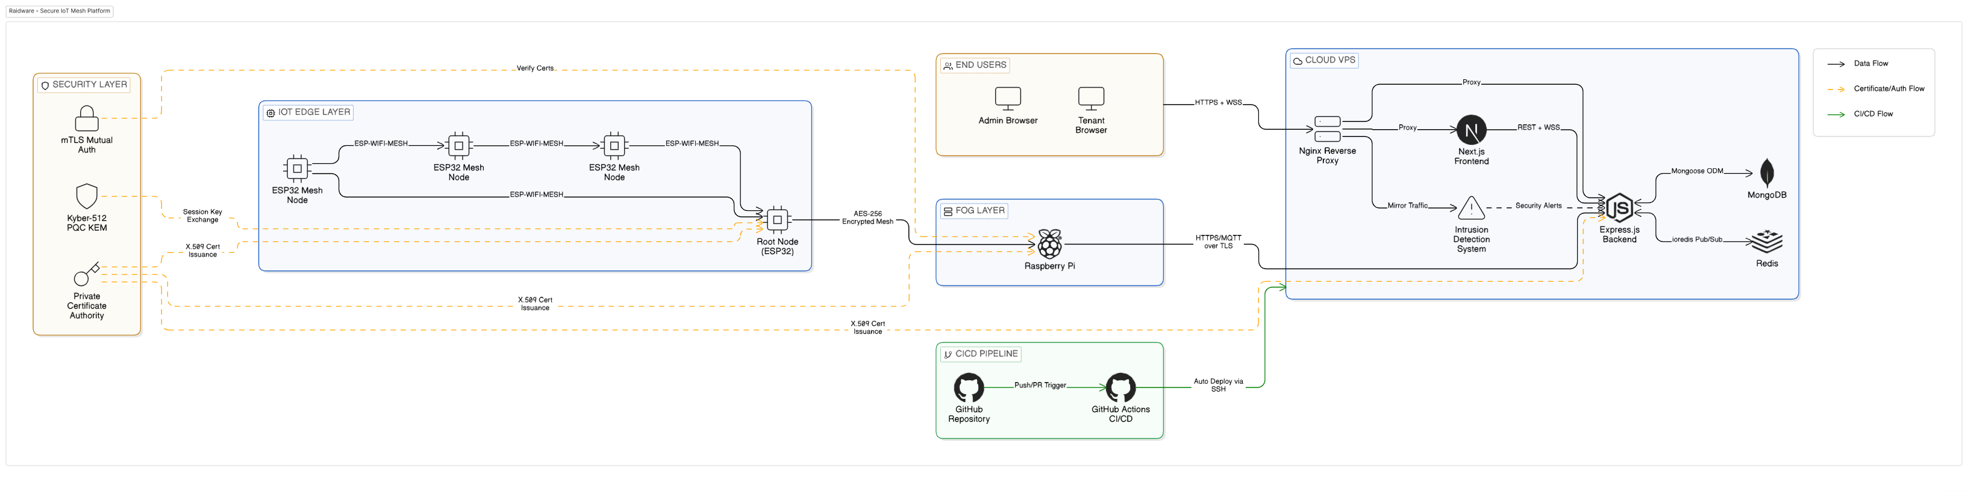
Design Summary
System Architecture:

Slide 34
Methodology
Phase 1 Mesh Network Setup:
ESP32 nodes configured using ESP-IDF framework
ESP-WIFI-MESH protocol used for self-organizing topology
RSSI-based parent selection node pic strongest signal parent
If parent signal drops below -75 dBm, node switches automatically

Slide 35
Methodology
Phase 2 Cryptographic Implementation:
AES-256-CBC implemented using ESP32 hardware accelerator
PKCS#7 padding applied for block alignment
Unique IV generated per packet using hardware RNG
Kyber512 library integrated for post-quantum key exchange

Slide 36
Methodology
Phase 3 Mutual Authentication:
mTLS handshake implemented using Mbed TLS library
Private CA created on cloud VPS
Each device flashed with unique certificate and private key
Certificate Revocation List maintained on backend

Slide 37
Methodology
Phase 4 Backend and Dashboard:
Node.js + Express REST API and WebSocket server
MongoDB for data storage, Redis for real-time caching
ReactJS dashboard with live video via Secure WebSockets
JWT and RBAC for multi-tenant access control

Slide 38
Methodology
IDS Training and Deployment:
CICIDS2017 dataset used 2.27 million network flow records
SMOTE applied to fix class imbalance
LightGBM trained 500 estimators, learning rate 0.05
Model deployed with three-tier response BLOCK, FLAG, ALLOW

Slide 39
Implementation Summary
Built a working mesh network using ESP32 modules
AES-256 encryption applied on every data packet before sending
Mutual TLS (mTLS) used so only trusted devices can join the network
React dashboard built for live video and telemetry monitoring

Slide 40
Implementation Summary
Backend made with MERN stack and Redis for fast performance
TinyML IDS model trained and tested for real-time attack detection
Deployed on a private cloud VPS no third-party cloud used
System tested for node failure, rogue device, and DoS attacks all passed
24-hour stress test done network stayed stable throughout

Slide 41
Experiments and Results Summary
IDS Results:
Overall Accuracy: 99.85%
Weighted F1 Score: 0.9986
ROC-AUC: 1.0000
Sample test (50 flows): 48/50 correct = 96%
BLOCK action triggers at confidence ≥ 0.70 auto blocks IP in firewall
FLAG action for lower confidence sent for human review ALLOW for clean/benign traffic

Slide 42
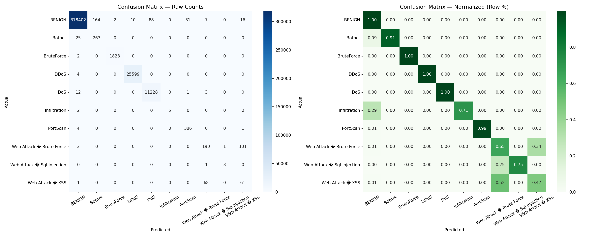
Experiments and Results Summary
Confusion Matrix:

Slide 43
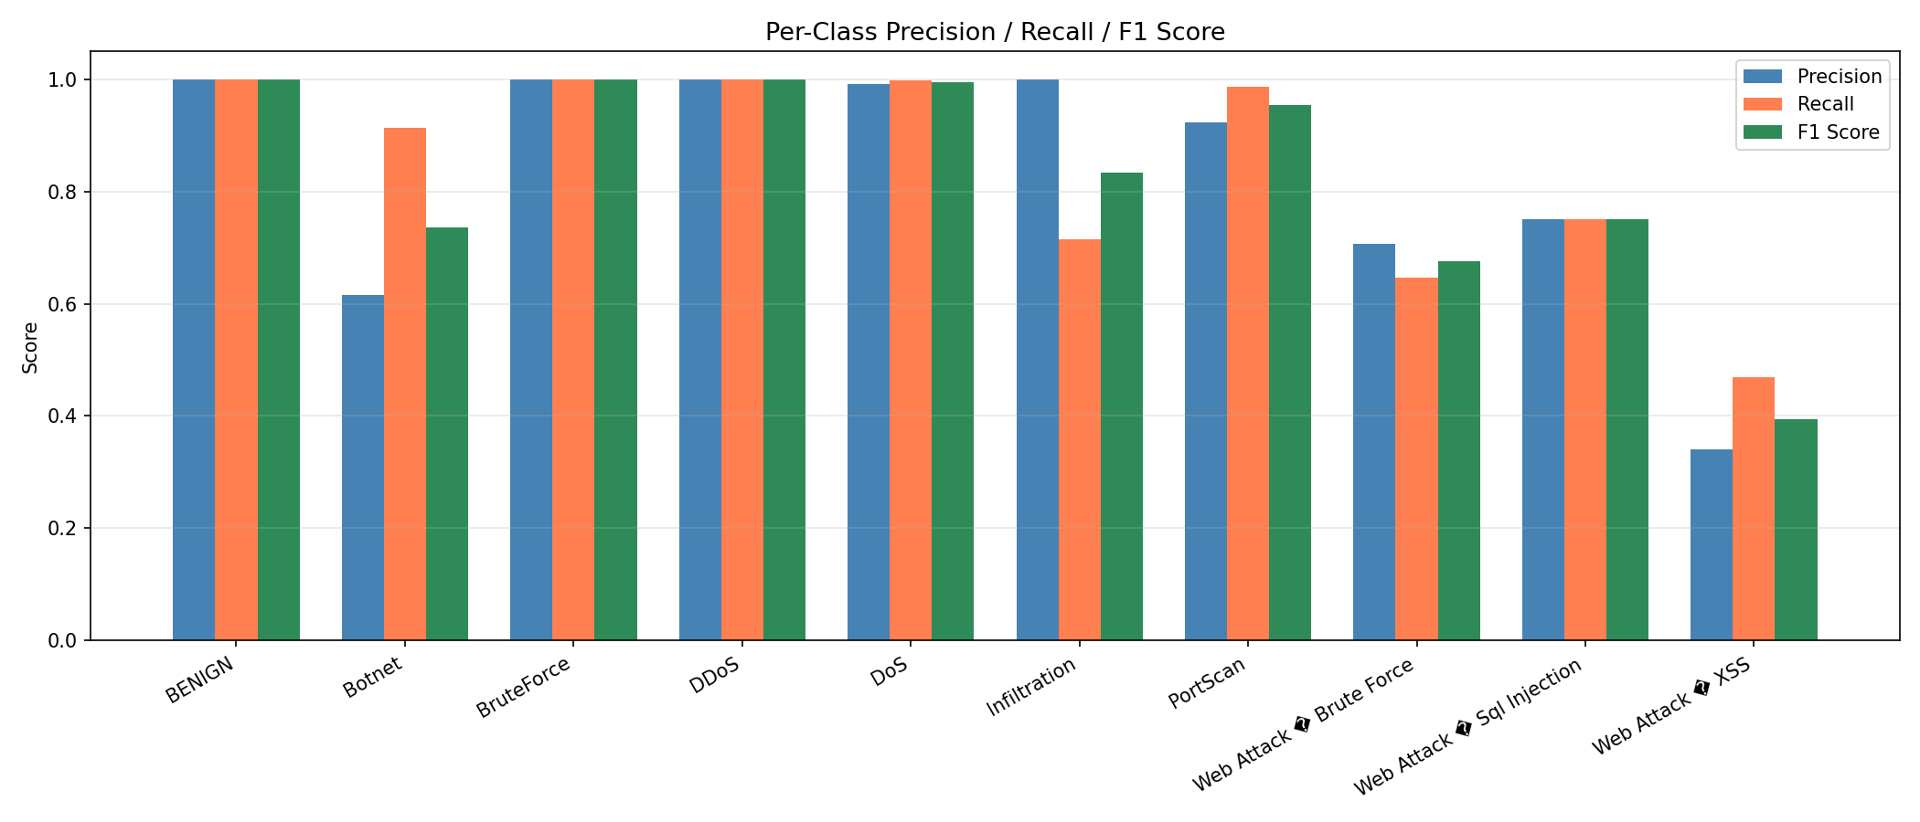
Experiments and Results Summary
F1 Score:

Slide 44
Testing Summary

Slide 45
CONCLUSION AND OUTLOOK

Slide 46
Conclusion & Outlook
Successfully built a secure IoT platform using low-cost ESP32 hardware
Proved that enterprise-level security is possible without expensive equipment
AES-256 encryption, mTLS authentication, and mesh networking all working together
IDS model achieved 99.85% accuracy:real-time attack detection confirmed

Slide 47
Conclusion & Outlook
Future Work:
Add computer vision to cameras so they can detect suspicious activity like loitering or unauthorized access
Combine camera alerts with network IDS alerts for a unified cyber and physical security view
Integrate LoRaWAN so critical alerts still reach admin even if Wi-Fi is jammed

Slide 48
Conclusion & Outlook
System passed all test cases: node failure, rogue device, DoS, replay attack
24-hour stress test completed: network stayed stable throughout
Data sovereignty maintained: no third-party cloud used, private VPS only

Slide 49
Conclusion & Outlook
Build Secure OTA updates so firmware and keys can be updated remotely without touching hardware
Migrate video from MJPEG to H.264 for better quality and less bandwidth usage
Make device provisioning simpler for large scale deployment

Slide 50
References
Zscaler ThreatLabz, "2024 Enterprise IoT and OT Threat Report: A Deep Dive into the Attack Landscape," Zscaler Inc., San Jose, CA, 2024. [Online]. Available: https://www.zscaler.com/resources/industry-reports/2024-enterprise-iot-ot-threat-report.pdf
Starfleet Research, "The 2024 Benchmark Report on IoT Security," Starfleet Media, 2024.
Espressif Systems, "ESP-WIFI-MESH Programming Guide," Espressif Documentation, v5.1, 2024. [Online]. Available: https://docs.espressif.com/projects/esp-idf/en/latest/esp32/api-guides/esp-wifi-mesh.html
National Institute of Standards and Technology (NIST), "Advanced Encryption Standard (AES)," U.S. Department of Commerce, Washington, D.C., FIPS PUB 197, Nov. 2001.
Microsoft, "The STRIDE Threat Model," Microsoft Security Development Lifecycle, 2023. [Online]. Available: https://learn.microsoft.com/en-us/azure/security/develop/threat-modeling-tool-threats

