Slide 1
Data Structure & Algorithms
Maryam Imtiaz Malik
maryam.imtiaz@numl.edu.pk

Slide 2
Books
Recommended Textbook(s) | Data Structures and Algorithm Analysis in C++, Mark Allen Weiss, 4th edition, 2013
Referenced Books | C++ Plus Data Structures, Nell Dale, 5th edition C++ Programming: Program Design including Data Structures, D. S. Malik, 7th edition Data Structures and Program Design in C++, Robert L. Kruse and Alexander J. Ryba Introduction to Algorithms, Thomas, MIT Press; 2nd edition, 2007

Slide 3
Data
Data is a raw and unorganized fact that required to be processed to make it meaningful.
Example:
Red color
87, 76, 90, 70, 82

Slide 4
Information
Information is a set of data which is processed in a meaningful way according to the given requirement.
DLROW
Processing
WORLD

Slide 5
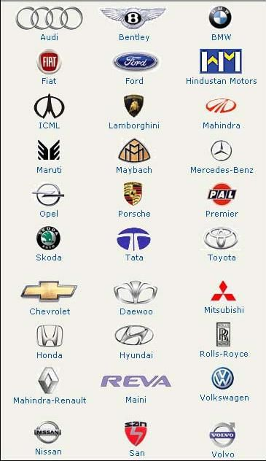

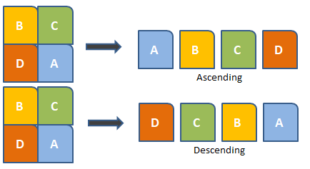
Data Structure
Data Structures are a specialized means of organizing and storing data in computers in such a way that we can perform operations on the stored data more efficiently

Slide 6
Arrays
marks[0]
marks[1]
marks[2]
marks[3]
marks[4]
marks[5]
marks
80 | 90 | 78 | 77 | 87 | 88

Slide 7
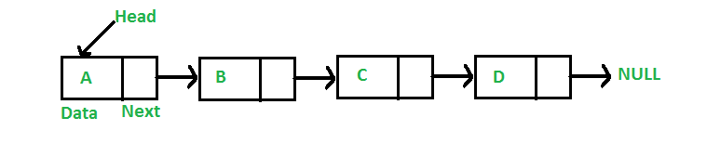
Linked List

Slide 8
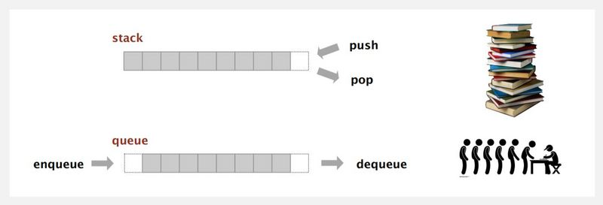
Stack & Queue

Slide 9
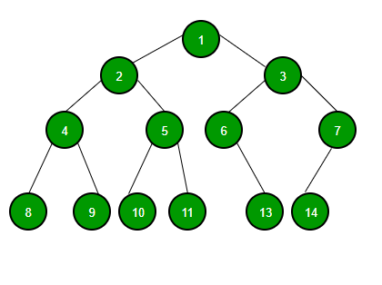
Graph & Tree

Slide 10
Algorithm
An Algorithm is a step-by-step procedure to solve a problem.
The performance of an algorithm is measured on the basis of following properties:
Time Complexity
Space Complexity

