Slide 1
Data Structure & Algorithms
Maryam Imtiaz Malik
maryam.imtiaz@numl.edu.pk

Slide 2
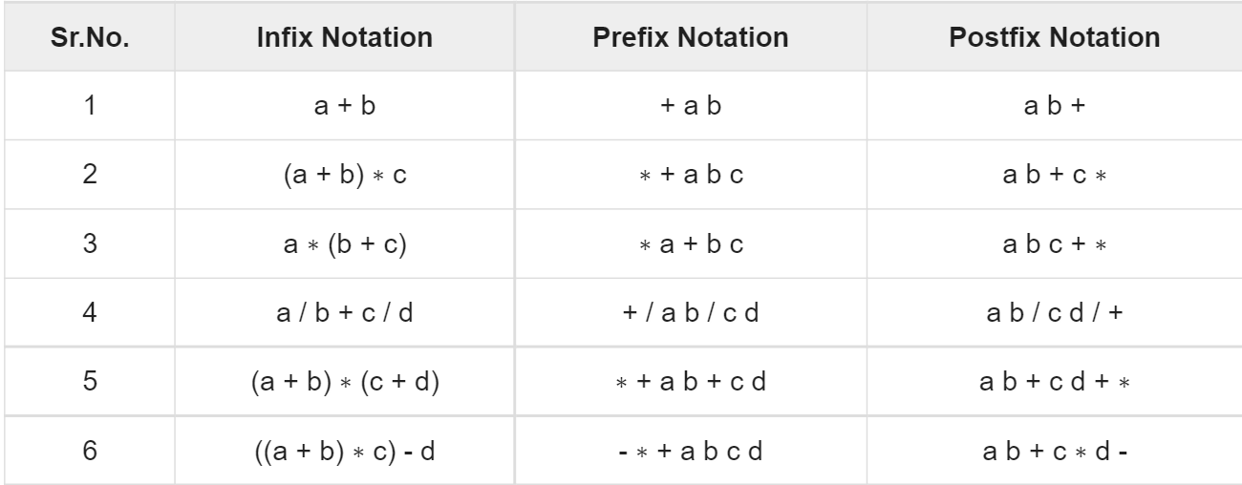
Example

Slide 3
Evaluation of Postfix Expression
Step 1: Create an empty stack used for storing the operands.
Step 2: Scan each element of an expression one be one and do the following:
If the element is an operand then push it into the stack.
If the element is an operator then pop two operands from the stack. Perform operation on these operands. Push the final result into the stack.

Slide 4
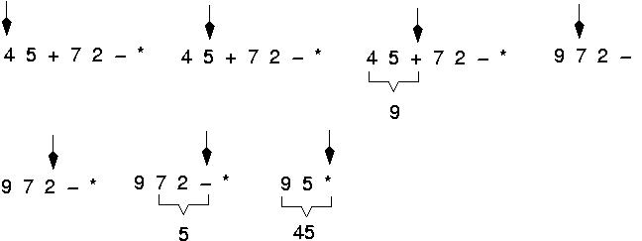
Evaluate Postfix Expression
Expressions are evaluated from left to right.

Slide 5
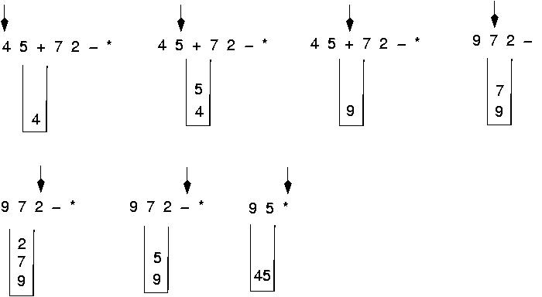
Postfix Expression

