Slide 1
Data Structure & Algorithms
Maryam Imtiaz Malik
maryam.imtiaz@numl.edu.pk

Slide 2
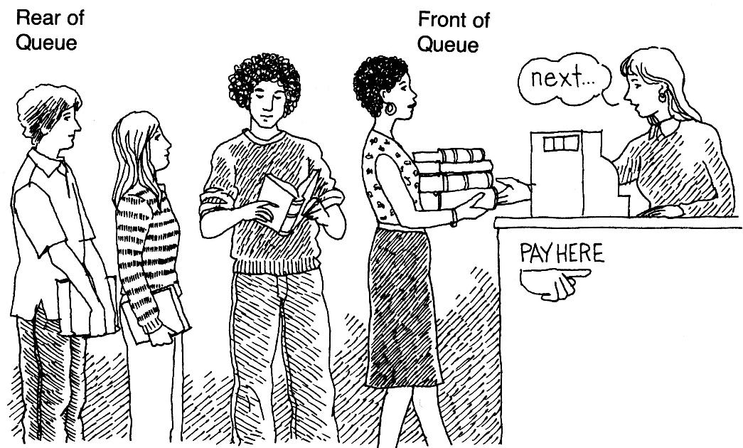
Linear Queue
It is an ordered group of homogeneous items.
Queues have two ends:
Items are added at one end.
Items are removed from the other end.
FIFO property: First In, First Out
The item added first is also removed first

Slide 3
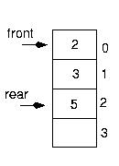
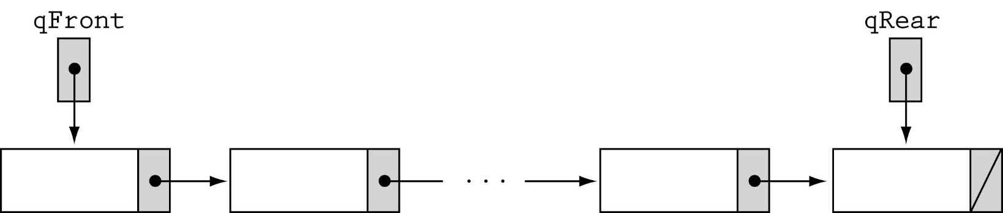
Queue Implementation
Array-based
Linked-list-based

Slide 4
Array-based Implementation
class QueueType {
public:
QueueType(int);
~QueueType();
void MakeEmpty();
bool IsEmpty() const;
bool IsFull() const;
void Enqueue(int);
void Dequeue();
int peek();
void Display();
private:
int front, rear;
int* items;
int maxQue;
};

Slide 5
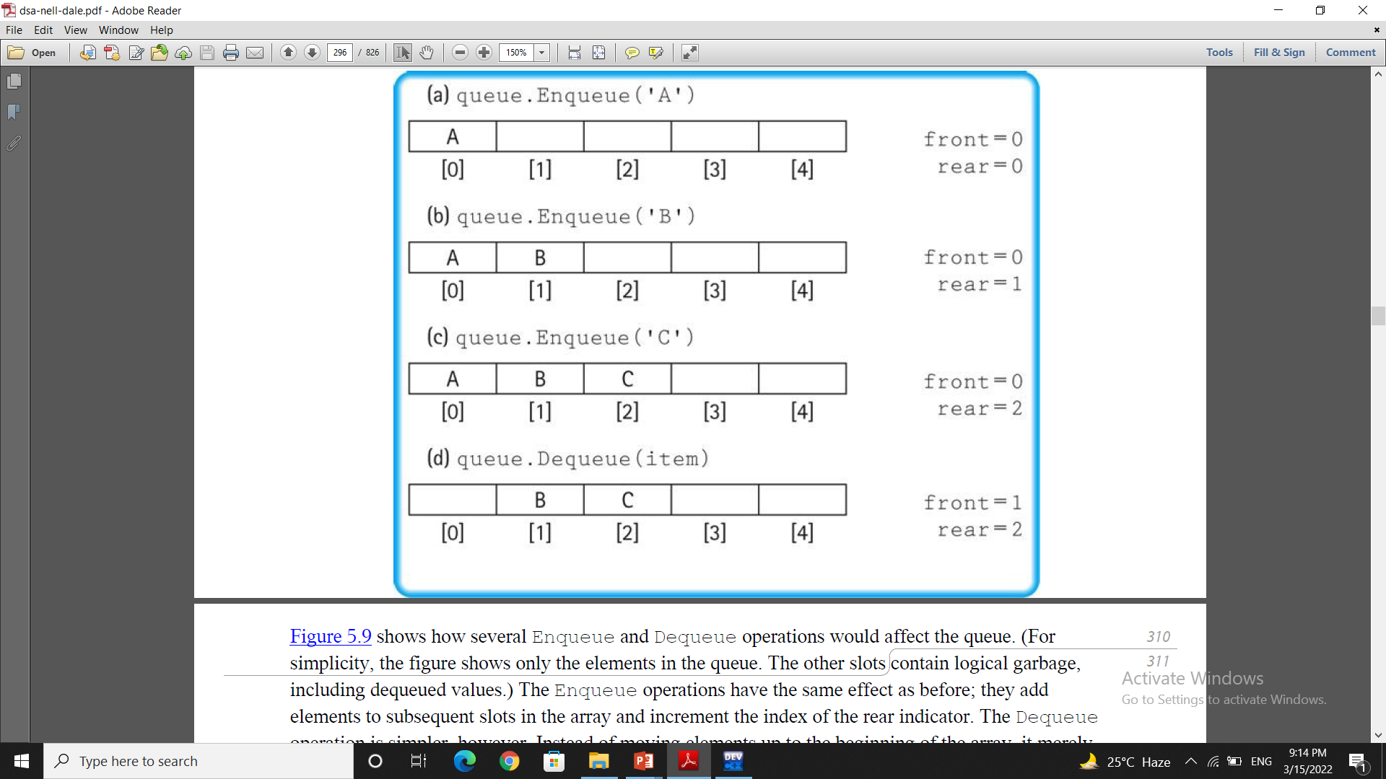
Queue

Slide 6
Array-based Implementation
QueueType::QueueType(int max)
{
maxQue = max;
front = -1;
rear = -1;
items = new int[maxQue];
}
O(1)

Slide 7
Array-based Implementation (cont.)
QueueType::~QueueType()
{
delete [] items;
}
O(1)

Slide 8
Array-based Implementation (cont.)
void QueueType::MakeEmpty()
{
front = - 1;
rear = - 1;
}
O(1)

Slide 9
Array-based Implementation (cont.)
bool QueueType::IsEmpty() const
{
return (front == -1);
}
bool QueueType::IsFull() const
{
return ( rear == maxQue-1);
}
O(1)
O(1)

Slide 10
Enqueue (ItemType newItem)
Function: Adds newItem to the rear of the queue.
Preconditions: Queue has been initialized and is not full.
Postconditions: newItem is at rear of queue.

Slide 11
Queue overflow
The condition resulting from trying to add an element onto a full queue.
if(!q.IsFull())
q.Enqueue(item);

Slide 12
Array-based Implementation (cont.)
void QueueType::Enqueue (int newItem)
{
if (front == -1)
front = 0;
rear = rear + 1;
items[rear] = newItem;
}

Slide 13
Dequeue (ItemType& item)
Function: Removes front item from queue and returns it in item.
Preconditions: Queue has been initialized and is not empty.
Postconditions: Front element has been removed from queue and item is a copy of removed element.

Slide 14
Queue underflow
The condition resulting from trying to remove an element from an empty queue.
if(!q.IsEmpty())
q.Dequeue(item);

Slide 15
Array-based Queue Implementation (cont.)
void QueueType::Dequeue ()
{
front = front + 1;
}
O(1)

Slide 16
Array-based Queue Implementation (cont.)
int QueueType::peek()
{
return items[front];
}
O(1)

Slide 17
Array-based Queue Implementation (cont.)
void QueueType::Display()
{
if (IsEmpty())
{
cout << "Empty Queue"<<endl;
return;
}
if (IsFull())
{
cout << "Full Queue"<<endl;
return;
}
for (int i = front; i <= rear; i++)
cout<<items[i]<<" ";
}

