Slide 1
Data Structure & Algorithms
Maryam Imtiaz Malik
maryam.imtiaz@numl.edu.pk

Slide 2
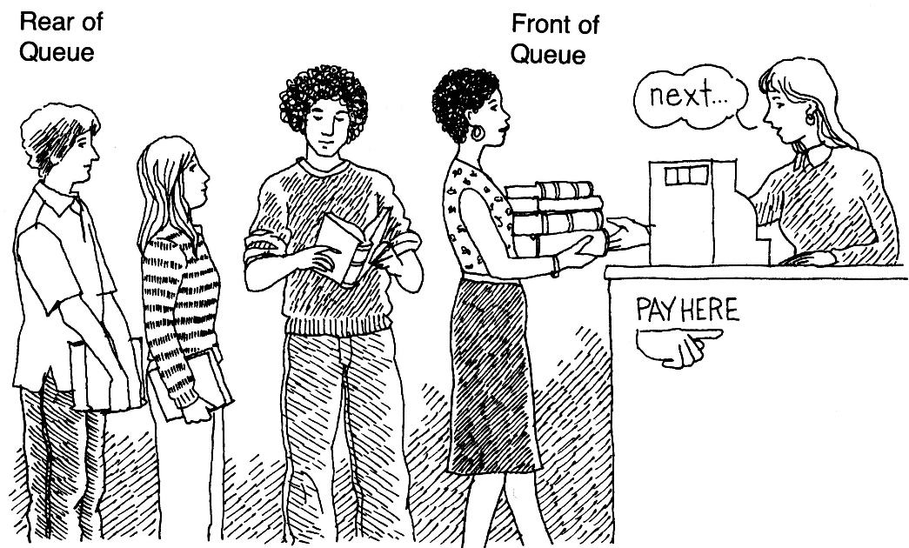
Queue
It is an ordered group of homogeneous items.
Queues have two ends:
Items are added at one end.
Items are removed from the other end.
FIFO property: First In, First Out
The item added first is also removed first

Slide 3
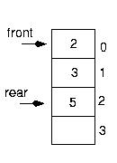
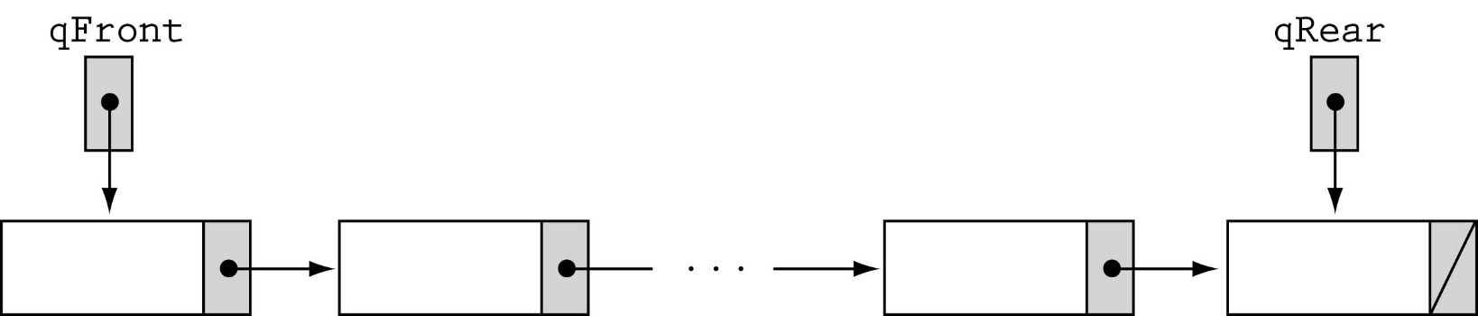
Queue Implementation
Array-based
Linked-list-based

Slide 4
Array-based Implementation
class QueueType {
public:
QueueType(int);
~QueueType();
void MakeEmpty();
bool IsEmpty() const;
bool IsFull() const;
void Enqueue(int);
void Dequeue();
int peek();
void Display();
private:
int front, rear;
int* items;
int maxQue;
};

Slide 5
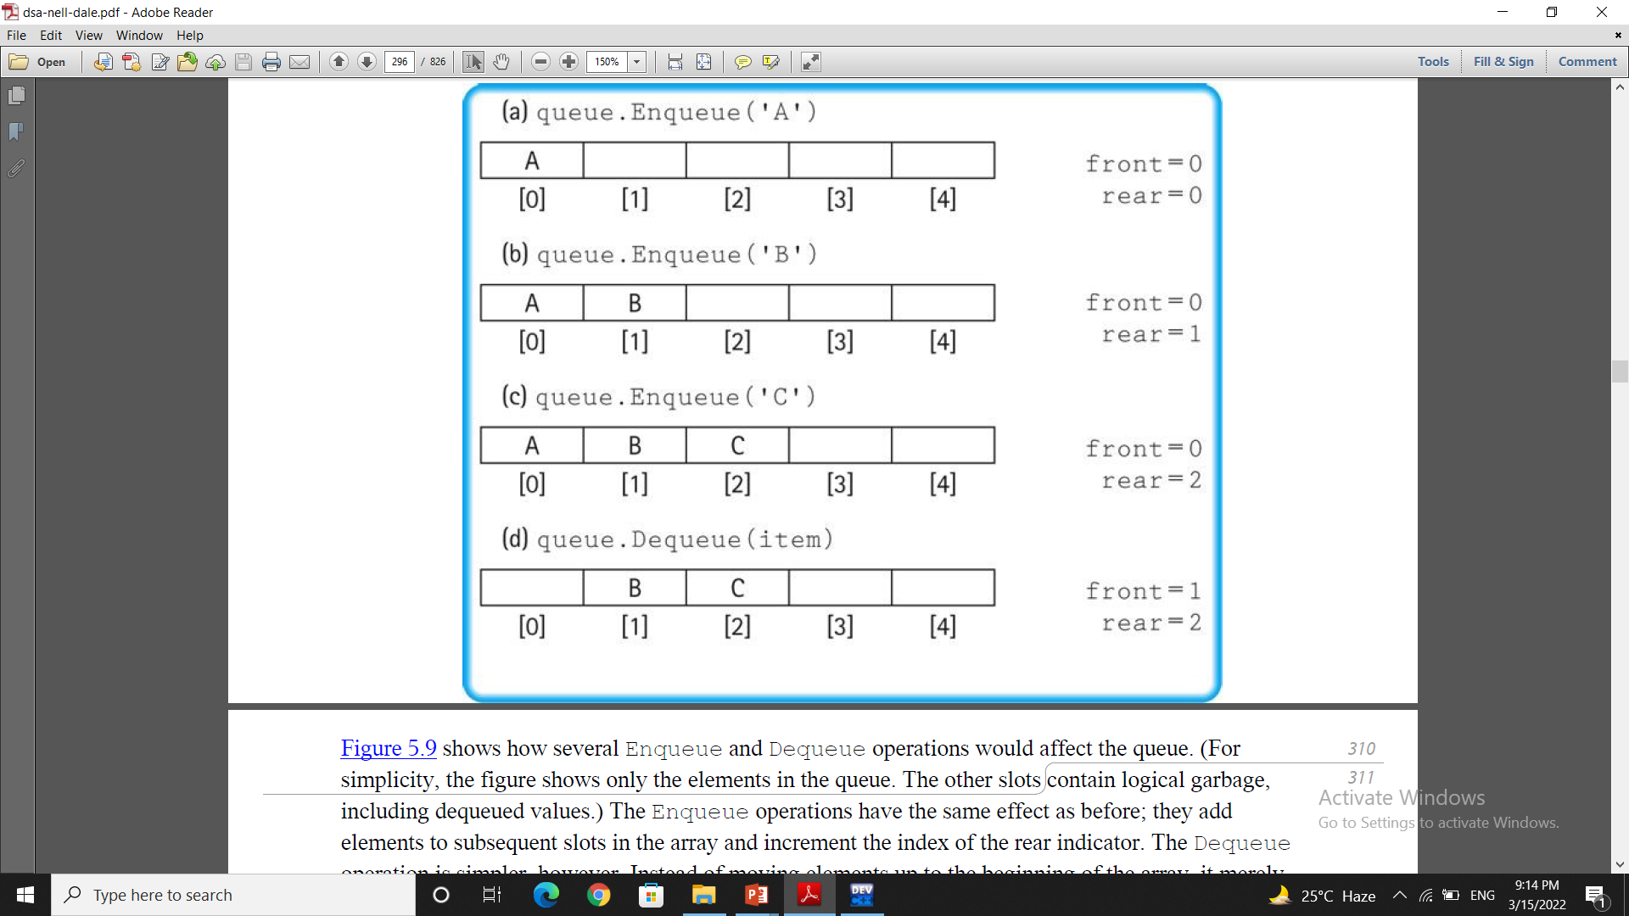
Queue

Slide 6
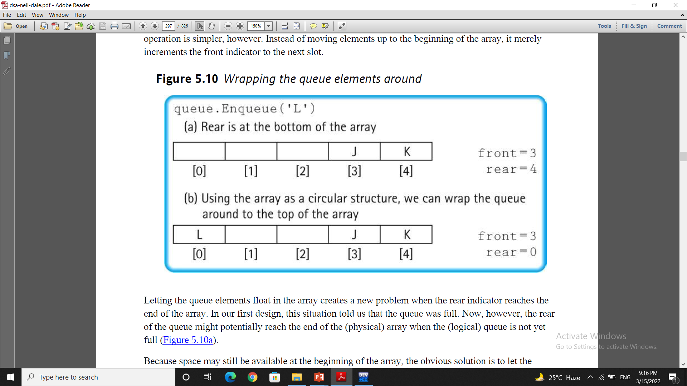
Wrapping the queue elements around
if (rear == maxQue - 1)
rear = 0;
else
rear = rear + 1
Or
rear = (rear + 1) % maxQue;

Slide 7
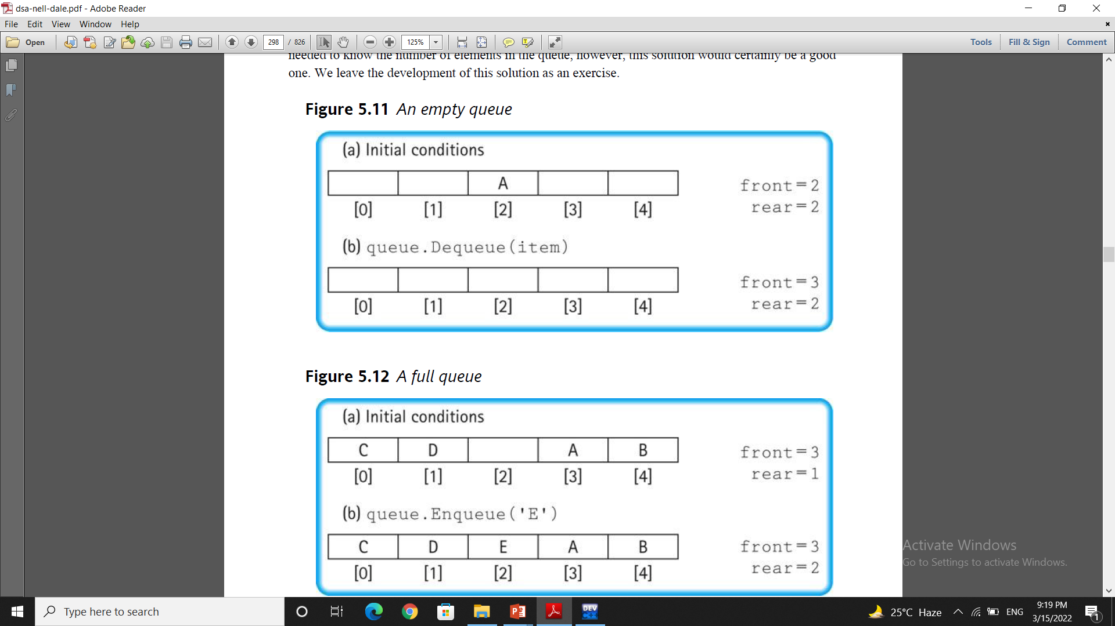
Empty & Full Queue

Slide 8
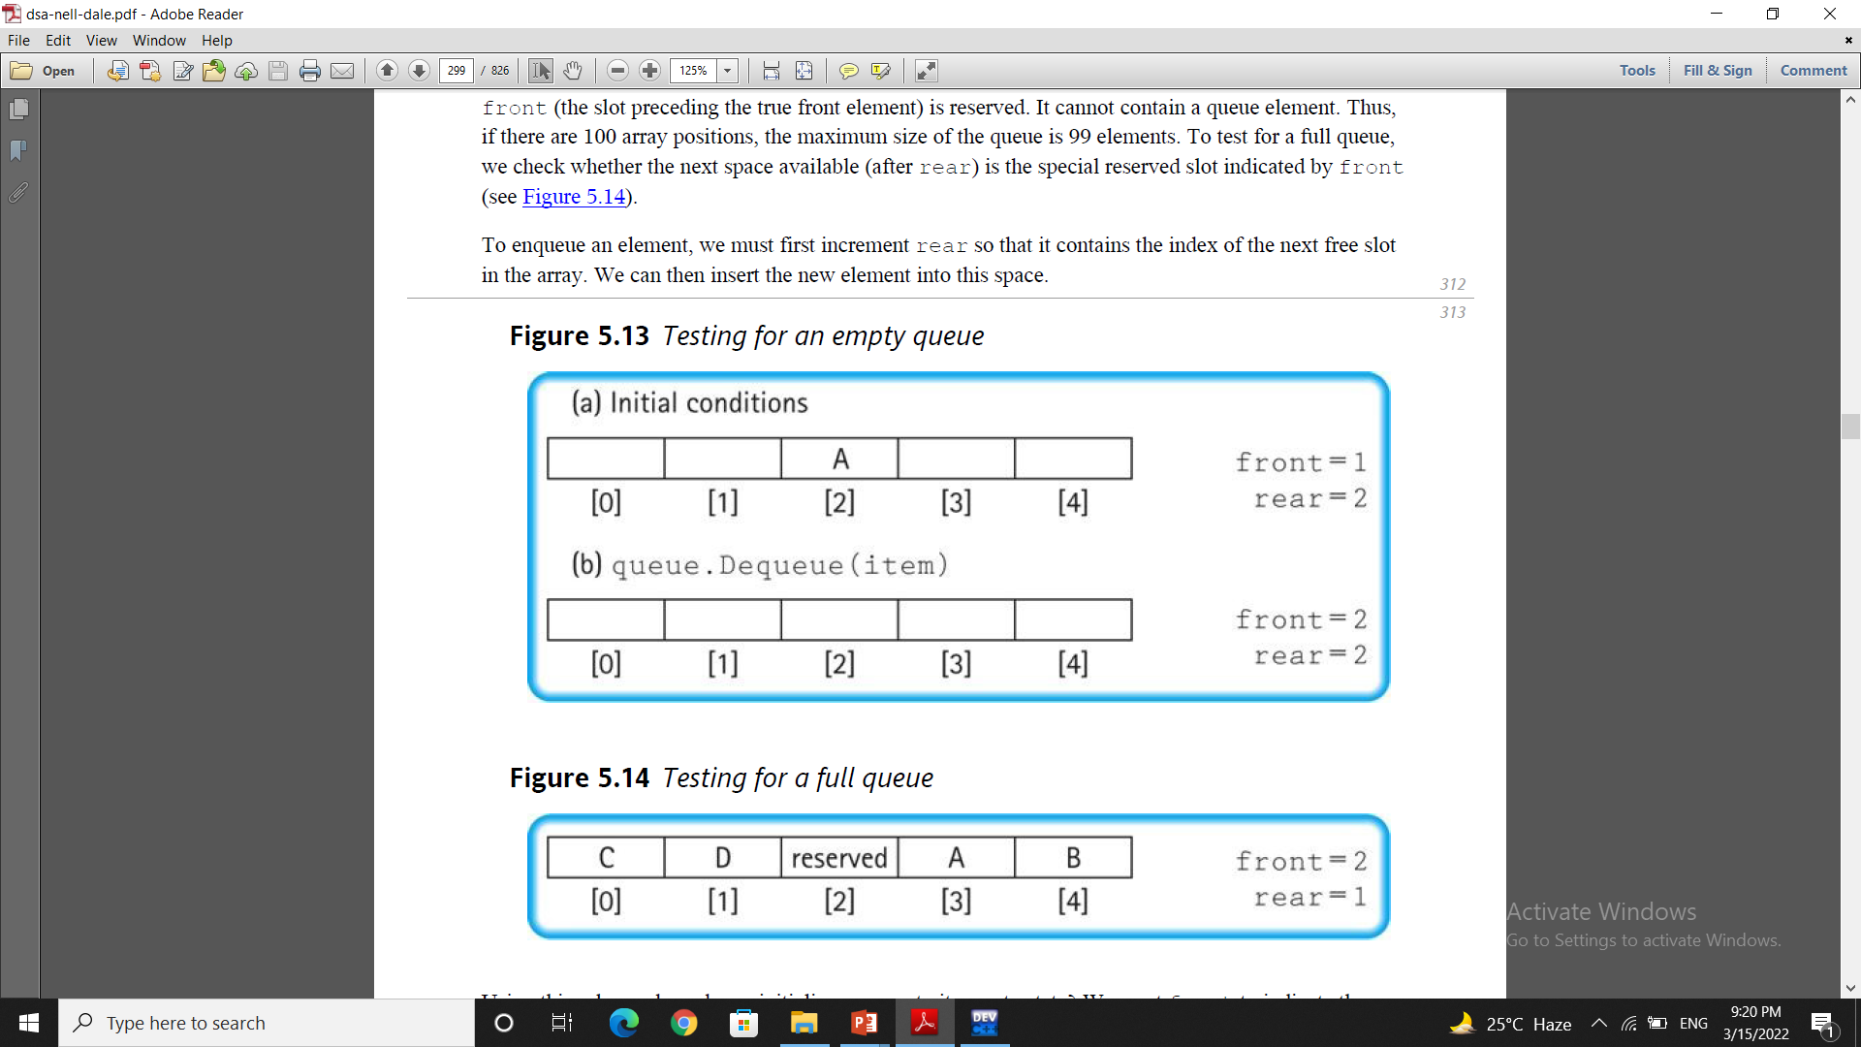
Empty & Full Queue
Full
(rear + 1) % maxQue == front
Empty
rear == front

Slide 9
Array-based Implementation
QueueType::QueueType(int max)
{
maxQue = max + 1;
front = maxQue - 1;
rear = maxQue - 1;
items = new int[maxQue];
}
O(1)

Slide 10
Array-based Implementation (cont.)
QueueType::~QueueType()
{
delete [] items;
}
O(1)

Slide 11
Array-based Implementation (cont.)
void QueueType::MakeEmpty()
{
front = maxQue - 1;
rear = maxQue - 1;
}
O(1)

Slide 12
Array-based Implementation (cont.)
bool QueueType::IsEmpty() const
{
return (rear == front);
}
bool QueueType::IsFull() const
{
return ( (rear + 1) % maxQue == front);
}
O(1)
O(1)

Slide 13
Enqueue (ItemType newItem)
Function: Adds newItem to the rear of the queue.
Preconditions: Queue has been initialized and is not full.
Postconditions: newItem is at rear of queue.

Slide 14
Queue overflow
The condition resulting from trying to add an element onto a full queue.
if(!q.IsFull())
q.Enqueue(item);

Slide 15
Array-based Implementation (cont.)
void QueueType::Enqueue (int newItem)
{
if (front == maxQue -1)
front = (front + 1) % maxQue;
rear = (rear + 1) % maxQue;
items[rear] = newItem;
}

Slide 16
Dequeue (ItemType& item)
Function: Removes front item from queue and returns it in item.
Preconditions: Queue has been initialized and is not empty.
Postconditions: Front element has been removed from queue and item is a copy of removed element.

Slide 17
Queue underflow
The condition resulting from trying to remove an element from an empty queue.
if(!q.IsEmpty())
q.Dequeue(item);

Slide 18
Array-based Queue Implementation (cont.)
void QueueType::Dequeue ()
{
front = (front + 1) % maxQue;
}
O(1)

Slide 19
Array-based Queue Implementation (cont.)
int QueueType::peek()
{
return items[front];
}
O(1)

Slide 20
Array-based Queue Implementation (cont.)
void QueueType<ItemType>::Display()
{
if (IsEmpty())
{
cout << "Empty Queue"<<endl;
return;
}
if (IsFull())
{
cout << "Full Queue"<<endl;
return;
}
if (rear >= front)
{
for (int i = front; i <= rear; i++)
cout<<items[i]<< “ ”;
}
else
{
for (int i = front; i < maxQue; i++)
cout<<items[i]<<“ ”;
for (int i = 0; i <= rear; i++)
cout<<items[i]<<“ ”;
}
}

