Slide 1
Data Structure & Algorithms
Maryam Imtiaz Malik
maryam.imtiaz@numl.edu.pk

Slide 2
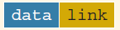
Linked List
Linked List is a linear data structure which is made up of nodes connected by pointers.
Dynamic Data Structure
Non Contiguous Memory Location
Each node has two parts:
Data: To store information (data)
Link: To store address of next node
Structure of a node

Slide 3
Linear Data Structure
Data structure where data elements are arranged sequentially or linearly where each and every element is attached to its previous and next adjacent is called a linear data structure.
In linear data structure, single level is involved. Therefore, we can traverse all the elements in single run only.
Array, Stack, Queue, Linked List

Slide 4
Application of Linked List in Computer Science
Dynamic Memory Allocation
Implementing advanced data structures
Manipulating polynomials: We can do polynomials manipulation with the help of a linked list by storing the constants in the nodes of the linked list
Arithmetic operations on long integers
Graph Adjacency list Representation: Linked List helps in storing the adjacent vertices of a graph in adjacency list representation.

Slide 5
Application of Linked List in real world
Image viewer – Previous and next images are linked, hence can be accessed by next and previous button.
Previous and next page in web browser – We can access previous and next url searched in web browser by pressing back and next button since, they are linked as linked list.
Music Player – Songs in music player are linked to previous and next song.

Slide 6
Linked List
Singly Linked List
Doubly Linked List
Circular Linked List

Slide 7
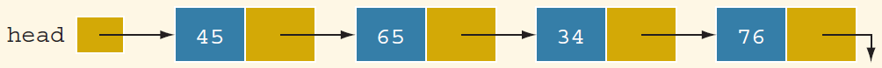
Linked List
The arrow in each node indicates that the address of the node to which it is pointing is stored in that node.
The down arrow in the last node indicates that this link field is nullptr.

Slide 8
Singly Linked List
Each node has only the address of next node.
It can be visited in one direction i.e from the start till the end.

Slide 9
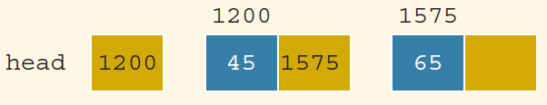
Linked list and values of the links
Note: In computer memory, the memory addresses are in binary.

Slide 10
Representation of Linked List in Memory
The nodes of linked list are stored in scattered form but these are linked together through pointer.
Each node is declared as a class or struct.
The data type of each node depends on the specific application—that is, what kind of data is being processed.
Link component of each node is a pointer.
The data type of this pointer variable is the node type itself.
struct node
{
int info;
node* link;
};

Slide 11
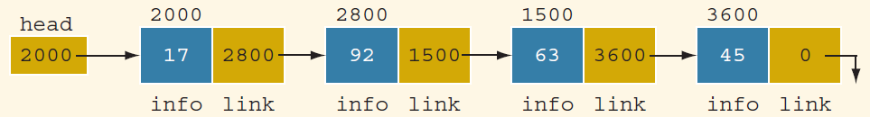
Linked List: Some Properties

Slide 12
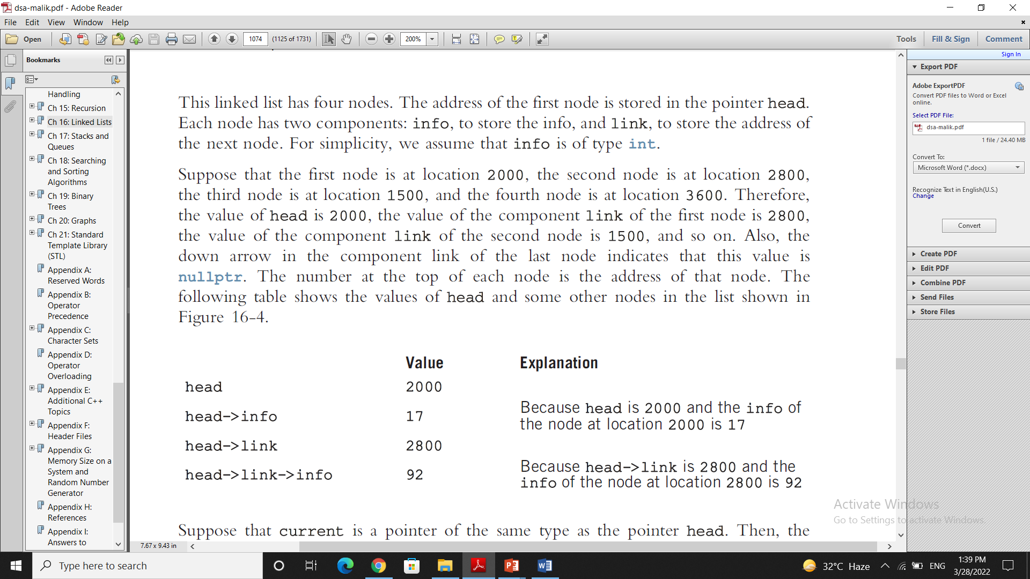
Linked List: Some Properties

Slide 13
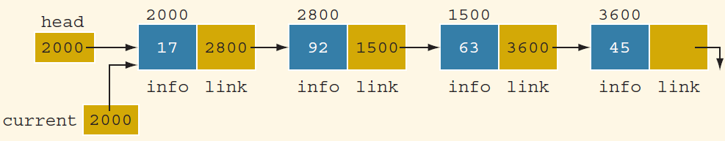
Linked List: Some Properties
node *head, *current;
current = head;

Slide 14
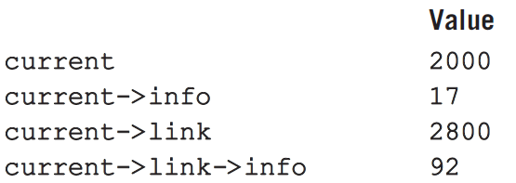
Linked List: Some Properties

Slide 15
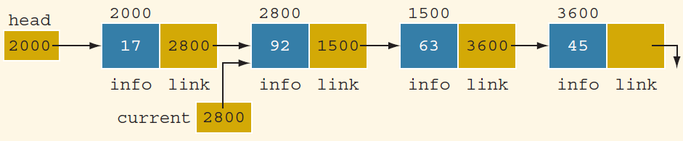
Linked List: Some Properties
current = current->link;

Slide 16
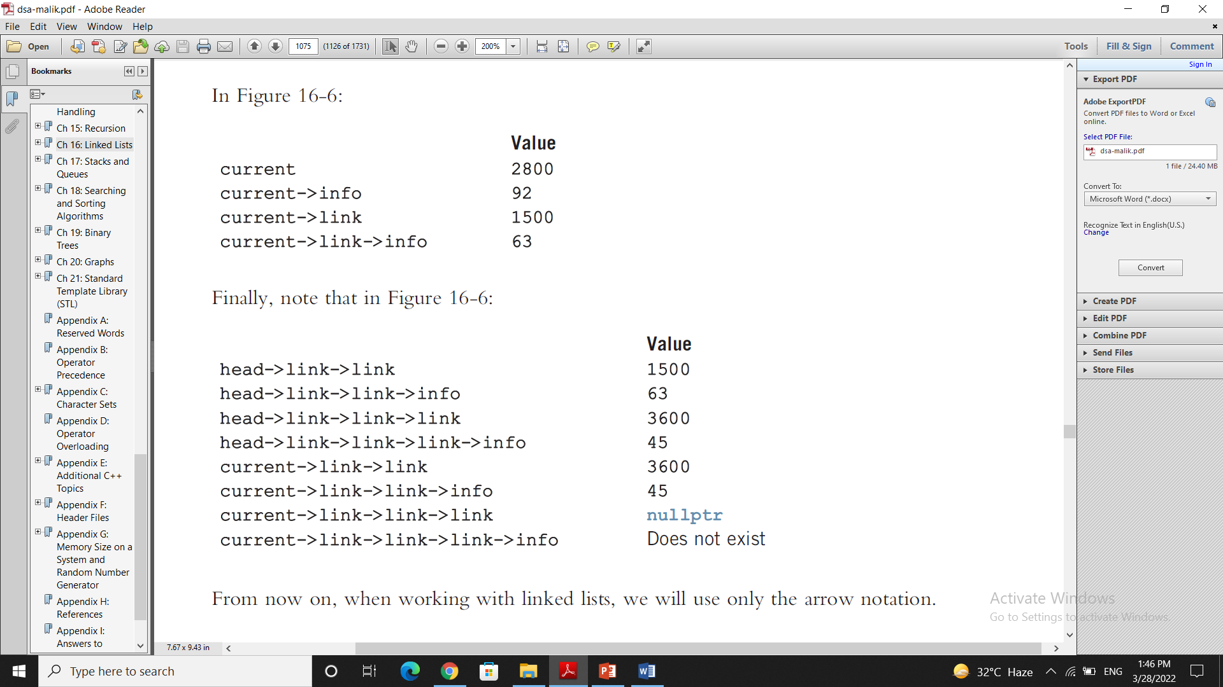
Linked List: Some Properties

Slide 17
Insert at Beginning
250
4
101
5
200
2
Head
250
101
200

Slide 18
Insert at Beginning
node* newNode = new node;
250
4
101
5
200
2
Head
250
101
200
NewNode

Slide 19
Insert at Beginning
newNode->info = data;
250
4
101
5
200
2
Head
250
101
200
NewNode
45
600

Slide 20
Insert at Beginning
newNode->info = data;
newNode->link = head;
250
4
101
5
200
2
Head
250
101
200
NewNode
45
250
600

Slide 21
Insert at Beginning
head = newNode;
600
4
101
5
200
2
Head
250
101
200
NewNode
45
250
600

Slide 22
Insert at Beginning
void insertBeg(int data)
{
node* newNode = new node;
newNode->info = data;
newNode->link = head;
head = newNode;
count++;
}

