Slide 1
Data Structure & Algorithms
Maryam Imtiaz Malik
maryam.imtiaz@numl.edu.pk

Slide 2
Insert at End
250
4
101
5
200
2
Head
250
101
200

Slide 3
Insert at End
node* newNode = new node;
250
4
101
5
200
2
Head
250
101
200
newNode

Slide 4
Insert at End
newNode->info = data;
250
4
101
5
200
2
Head
250
101
200
45
newNode
500

Slide 5
Insert at End
newNode->info = data;
newNode->link = NULL;
250
4
101
5
200
2
Head
250
101
200
45
NULL
newNode
500

Slide 6
Insert at End
node* temp = head;
temp
250
4
101
5
200
2
Head
250
101
200
45
NULL
newNode
500

Slide 7
Insert at End
/* traverse till the last node */
while (temp->link != NULL)
temp = temp->link;
temp
250
4
101
5
200
2
Head
250
101
200
45
NULL
newNode
500

Slide 8
Insert at End
/* traverse till the last node */
while (temp->link != NULL)
temp = temp->link;
temp
250
4
101
5
200
2
Head
250
101
200
45
NULL
newNode
500

Slide 9
Insert at End
/* traverse till the last node */
while (temp->link != NULL)
temp = temp->link;
temp
250
4
101
5
200
2
Head
250
101
200
45
NULL
newNode
500

Slide 10
Insert at End
temp->link = newNode;
temp
250
4
101
5
200
2
500
Head
250
101
200
45
NULL
newNode
500

Slide 11
Insert at End
void insertend(int data) {
node* newNode = new node;
newNode->info = data;
newNode->link = NULL;
if (head == NULL)
head = newNode;
else
{
node* temp = head;
while (temp->link != NULL)
temp = temp->link;
temp->link = newNode;
}
count++;
}

Slide 12
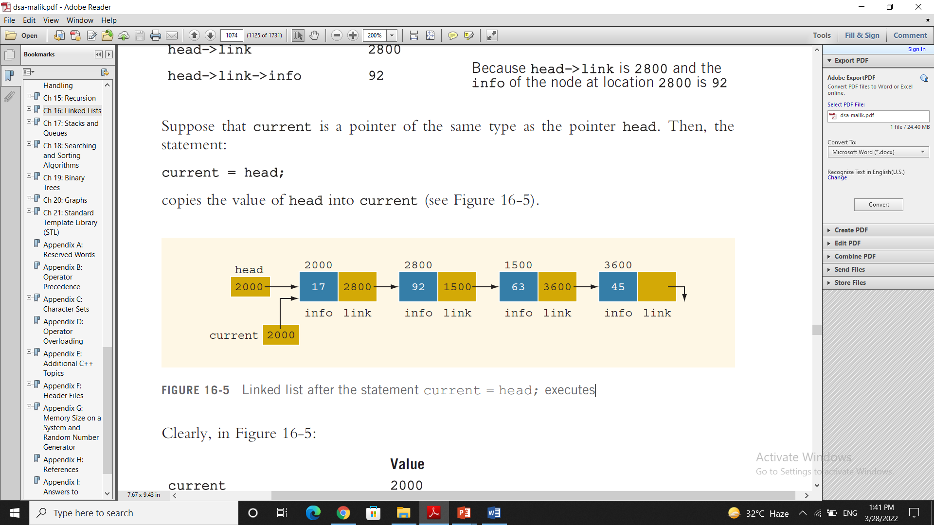
Display
void display()
{
node *current = head;
while(current!=NULL)
{
cout<<current->info<<"\t";
current=current->link;
}
cout<<endl;
cout<<"Value of count = "<<count<<endl;
}

Slide 13
Insert at Middle
250
4
101
98
200
5
106
2
Head
250
101
200
106

Slide 14
Insert at Middle
node* newNode = new node;
250
4
101
98
200
5
106
2
Head
250
101
200
106
newNode

Slide 15
Insert at Middle
newNode->info = data;
250
4
101
98
200
5
106
2
Head
250
101
200
106
NewNode
56
newNode
300

Slide 16
Insert at Middle
newNode->info = data;
newNode->link = NULL;
250
4
101
98
200
5
106
2
Head
250
101
200
106
NewNode
56
NULL
newNode
300

Slide 17
Insert at Middle
int mid = count/2; -> count = 4 , mid = 2
node* temp = head;
temp
250
4
101
98
200
5
106
2
Head
250
101
200
106
NewNode
56
NULL
newNode
300

Slide 18
Insert at Middle
int c = 1;
while (c != mid)
{
temp = temp->link;
c++;
}
temp
250
4
101
98
200
5
106
2
Head
250
101
200
106
NewNode
56
NULL
newNode
300

Slide 19
Insert at Middle
int c = 1;
while (c != mid)
{
temp = temp->link;
c++;
}
temp
c = 2
250
4
101
98
200
5
106
2
Head
250
101
200
106
NewNode
56
NULL
newNode
300

Slide 20
Insert at Middle
newNode->link = temp->link;
temp
250
4
101
98
200
5
106
2
Head
250
101
200
106
NewNode
56
200
newNode
300

Slide 21
Insert at Middle
temp->link = newNode;
temp
250
4
101
98
300
5
106
2
Head
250
101
200
106
NewNode
56
200
newNode
300

Slide 22
Insert at Middle
void insertmiddle(int data)
{
node* newNode = new node;
newNode->info = data;
newNode->link = NULL;
if (head == NULL)
{
head = newNode;
}
else
{
int mid = count/2;
node* temp = head;
int c = 1;
while (c != mid)
{
temp = temp->link;
c++;
}
newNode->link = temp->link;
temp->link = newNode;
}
count++;
}

