Slide 1
Data Structure & Algorithms
Maryam Imtiaz Malik
maryam.imtiaz@numl.edu.pk

Slide 2
Arrays
Group of consecutive memory locations with same name and type.
The memory locations in the array are known as the elements of array.
marks
80
75
65 | 85 | 90 | 78
grade
a | b | c | d | f

Slide 3





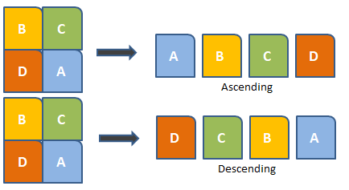
Uses of Arrays

Slide 4
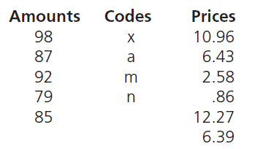
One-Dimensional Array
List of related values with the same data type that’s stored with a single group name.
It is also called single dimensional array.

Slide 5
Declaring One-Dimensional Array
The process of specifying array name, length and data type is called array declaration.
Syntax
dataType arrayName[numberOfItems];
Example
int marks[6];
0 1 2 3 4 5
marks

Slide 6
Accessing Array Elements
Elements in the arrays are stored sequentially.
Each single element can be accessed using:
Array’s Name
Element's Index
Syntax
arrayName[index];
Example
marks[0] = 80;

Slide 7
Example
marks[0] = 80;
marks[1] = 90;
marks[2] = 78;
marks[3] = 77;
marks[4] = 87;
marks[5] = 88;
marks[0]
marks[1]
marks[2]
marks[3]
marks[4]
marks[5]
marks
80 | 90 | 78 | 77 | 87 | 88

Slide 8
Accessing Array Elements using loop
for (int i = 0; i <=5; i++)
arr[i] = i;
arr[0]
arr[1]
arr[2]
arr[3]
arr[4]
arr[5]
arr
0 | 1 | 2 | 3 | 4 | 5

Slide 9
Input & Output of Array Values
cout<<“Enter Marks = ”;
cin>>marks[0]>>marks[1]>>marks[2]>>marks[3]>>marks[4]>>marks[5];
cout<<“Marks = ”<<endl;
cout<<marks[0]<<endl;
cout<<marks[1]<<endl;
cout<<marks[2]<<endl;
cout<<marks[3]<<endl;
cout<<marks[4]<<endl;
cout<<marks[5];

Slide 10
Array Initialization
The process of assigning values to array elements at the time of array deceleration.
Syntax:
dataType arrayName[numberOfItems] = { List of values };
Example:
double width[7] ={10.96, 6.43, 2.58, 0.86, 5.89, 7.56, 8.22};
double width[7] ={10.96, 6.43, 2.58, 0.86};

Slide 11
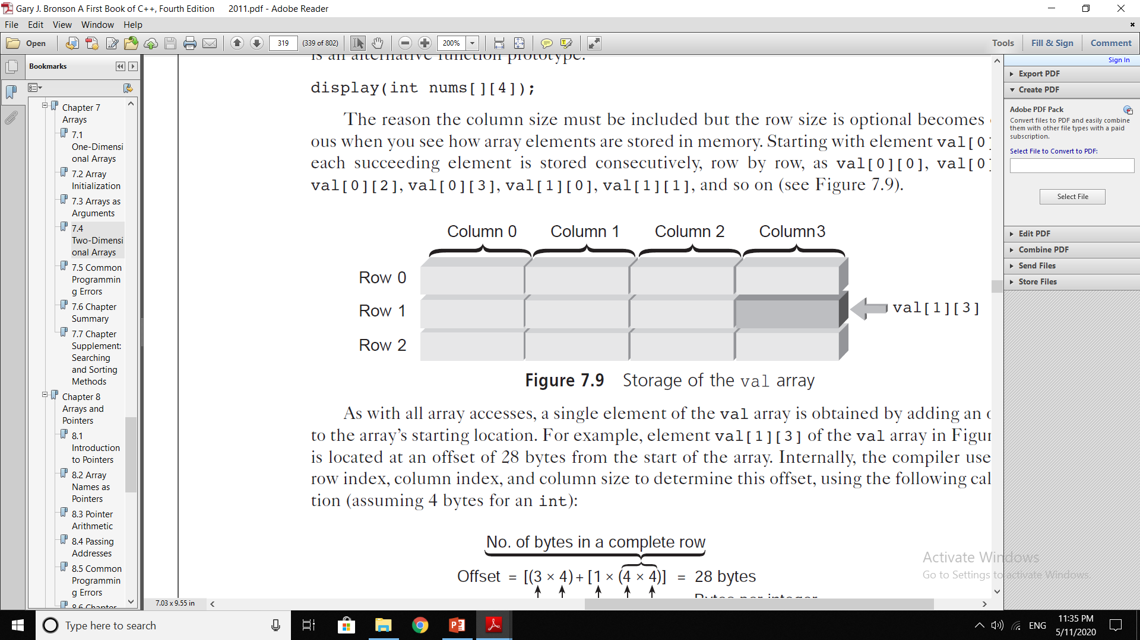
Two-Dimensional Array
Sometimes referred to as a table, consists of both rows and columns of elements.
It is useful for storing multiple sets of data.

Slide 12
Declaring Two-Dimensional Array
Syntax:
dataType arrayName[Rows][Cols];
Example:
int val[3][4];

Slide 13
Accessing Array Elements of 2-D Array
Each single element of 2-D Array can be accessed using:
Array’s Name
Element's Index
Syntax
arrayName[row][col];
Example
val[1][3] = 6;

Slide 14
Array Operations
Traversal
Insertion
Deletion
Update
Search
Sort

Slide 15
Element Insertion
int element, initial_length = 6 ;
int arr[] = {2,7,8,1,3};
cout << "Elements of array = " << endl;
for(int i = 0; i<initial_length-2; i++)
cout<<arr[i]<<endl;
cout<<"Insert element at end of array = ";
cin>> element;
arr[initial_length-1] = element ;
cout<<"Display elements of array after insertion" << endl;
for(int j = 0; j<initial_length; j++)
cout<<arr[j]<<endl;
i | arr[i]
0 | 2
1 | 7
2 | 8
3 | 1
4 | 3
5 | 21

Slide 16
Insertion at Specific Position
i | arr[i]
0 | 2
1 | 7
2 | 8
3 | 1
4 | 3
i | arr[i]
0 | 2
1 | 7
2 | 45
3 | 8
4 | 1
5 | 3
int element, position, i, initial_length = 5 ;
int arr[] = {2,7,8,1,3};
cout<<"Enter element & position = ";
cin>> element >> position;
for (int i = initial_length; i >= position; i--)
arr[i] = arr[i -1];
arr[position -1] = element;
cout<<"Display elements of array after insertion" << endl;
for(i = 0; i<=initial_length; i++)
cout<<arr[i]<<endl;
Notes:
5 i>=3 5 4 3 2

