Slide 1
Data Structure & Algorithms
Maryam Imtiaz Malik
maryam.imtiaz@numl.edu.pk

Slide 2
Degree of Node
In the tree data structure, the total number of children of a node is called the degree of the node.
The highest degree of the node among all the nodes in a tree is called the Degree of Tree.
A
Degree of Node D is 2.
B
C
D
E
F
G
H
I
J
K

Slide 3
Level
In tree data structures, the root node is said to be at level 0, and the root node's children are at level 1, and the children of that node at level 1 will be level 2, and so on.
A
Level 0
B
C
Level 1
D
E
F
G
H
Level 2
I
J
K
Level 3

Slide 4
Height of Node
The number of edges on the longest path from that node to a leaf.
In the tree, the height of the root node is called "Height of Tree".
The tree height of all leaf nodes is 0.
A
Height of Node A is 3
Height of Node D is 1
Height of Node J is 0
B
C
D
E
F
G
H
I
J
K

Slide 5
Depth of Node
The count of edges from the root to the node.
In the tree, the total number of edges from the root node to the leaf node in the longest path is known as "Depth of Tree".
In the tree data structures, the depth of the root node is 0.
A
Depth of Node A is 0
Depth of Node D is 2
Depth of Node J is 3
B
C
D
E
F
G
H
I
J
K

Slide 6
Ancestor of Node
Any predecessor nodes on the path of the root to that node.
A
Nodes A and B are ancestor of E.
B
C
D
E
F
G
H
I
J
K

Slide 7
Descendent
Any successor node on the path from the leaf node to that node.
A
Node K is descendent of nodes A, C and G
B
C
D
E
F
G
H
I
J
K

Slide 8
Sibling
Children of the same parent node are called siblings.
A
Nodes D, E and F are Siblings.
B
C
D
E
F
G
H
I
J
K

Slide 9
Subtree
Any node of the tree along with its descendant
A
B
C
D
E
F
G
H
I
J
K

Slide 10
Types of Trees
Binary Tree
Binary Search Tree
AVL Tree
B-Tree

Slide 11
Binary Tree
A tree data structure in which each parent node has maximum two child nodes.
A unique path exist from root to every other node.
A
B
C
D
F
G
H
I
J
K

Slide 12
Binary Search Tree
It is a tree data structure in which each node has a maximum of two children's.
All nodes of left subtree are less than the root node.
All nodes of right subtree are more than the root node.
Both subtrees of each node are also BSTs i.e. they have the above two properties.

Slide 13
Binary Search Tree
15
13
18
10
14
17
19
6
11
16

Slide 14
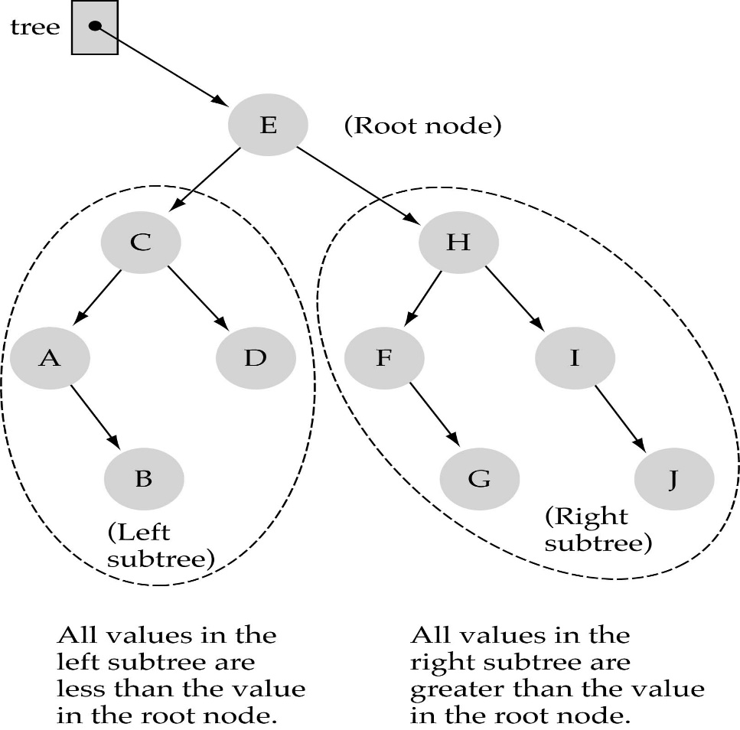
Binary Search Trees (BSTs)
Binary Search Tree Property:
The value stored at a node is greater than
the value stored at its left child and less than
the value stored at its right child

Slide 15

Binary Search Trees (BSTs)
In a BST, the value stored at the root of a subtree is greater than any value in its left subtree and less than any value in its right subtree!

Slide 16
Binary Search Trees (BSTs)
Where is the smallest element?
Ans: leftmost element
Where is the largest element?
Ans: rightmost element

Slide 17
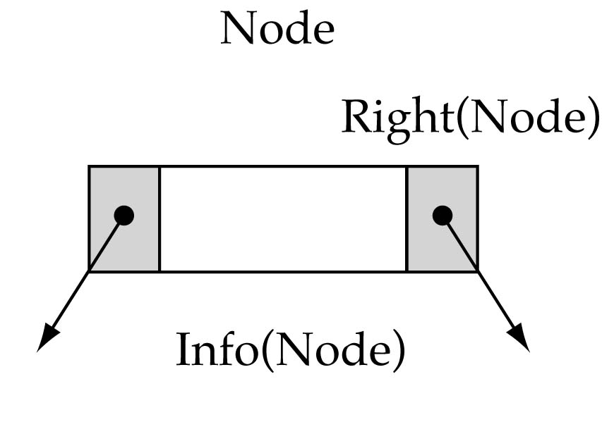
Tree Node Structure
struct TreeNode
{
int info;
TreeNode* left;
TreeNode* right;
};

Slide 18

How to search a binary search tree?
if (root == NULL) // base case 2
found = false;
else if(item < root->info)
Retrieve(root->left, item);
else if(item > root->info)
Retrieve(root->right, item);
else { // base case 1
item = root->info;
found = true;
}

Slide 19

How to search a binary search tree?
Is this better than searching
a linked list?
Yes !! ---> O(logN)

