Slide 1
Data Structure & Algorithms
Maryam Imtiaz Malik
maryam.imtiaz@numl.edu.pk

Slide 2
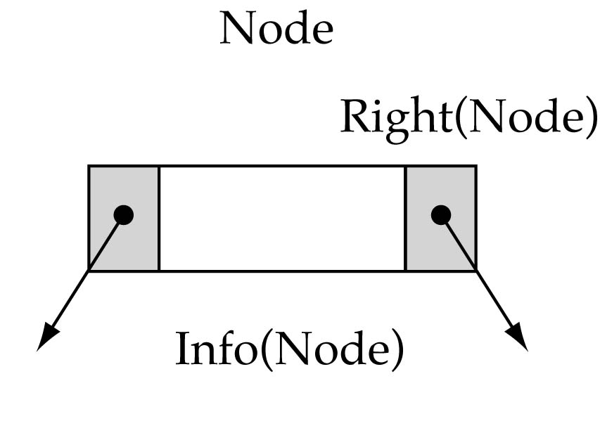
Tree Node Structure
struct TreeNode
{
int info;
TreeNode* left;
TreeNode* right;
};

Slide 3
Tree Node Structure
250
root
120
6
101
250
280
4
151
190
8
201
120
101
NULL
1
NULL
NULL
5
NULL
NULL
7
NULL
NULL
9
NULL
280
151
190
201

Slide 4
Insertion in Binary Search Tree
if(root == NULL) { // base case
TreeNode *newNode = new TreeNode;
newNode->right = NULL;
newNode->left = NULL;
newNode->info = item;
root = newNode;
}
NULL
root

Slide 5
Insertion in Binary Search Tree
if(root == NULL) { // base case
TreeNode *newNode = new TreeNode;
newNode->right = NULL;
newNode->left = NULL;
newNode->info = item;
root = newNode;
}
NULL
root
NULL
6
NULL
newNode
250

Slide 6
Insertion in Binary Search Tree
if(root == NULL) { // base case
TreeNode *newNode = new TreeNode;
newNode->right = NULL;
newNode->left = NULL;
newNode->info = item;
root = newNode;
}
Insert(NULL, 6)
250
root
NULL
6
NULL
newNode
250

Slide 7
Insertion in Binary Search Tree
if(root == NULL) {
TreeNode *newNode = new TreeNode;
newNode->right = NULL;
newNode->left = NULL;
newNode->info = item;
root = newNode;
}
else if(item < root->info)
root->left = Insert(root->left, item);
root = 250
Insert(250, 4)
250
root
NULL
6
NULL
250
4 < 6
Insert (NULL, 4)

Slide 8
Insertion in Binary Search Tree
if(root == NULL) {
TreeNode *newNode = new TreeNode;
newNode->right = NULL;
newNode->left = NULL;
newNode->info = item;
root = newNode;
}
else if(item < root->info)
root->left = Insert(root->left, item);
root = NULL
Insert(250, 4)
250
root
NULL
6
NULL
250
newNode
NULL
4
NULL
120

Slide 9
Insertion in Binary Search Tree
if(root == NULL) {
TreeNode *newNode = new TreeNode;
newNode->right = NULL;
newNode->left = NULL;
newNode->info = item;
root = newNode;
}
else if(item < root->info)
root->left = Insert(root->left, item);
root = NULL
root = Insert(250, 4)
250
root
120
6
NULL
250
NULL
4
NULL
120

Slide 10
Insertion in Binary Search Tree
if(root == NULL) {
TreeNode *newNode = new TreeNode;
newNode->right = NULL;
newNode->left = NULL;
newNode->info = item;
root = newNode;
}
else if(item < root->info)
root->left = Insert(root->left, item);
else
root->right = Insert(root->right, item);
root = NULL
root = Insert(250, 8)
250
root
120
6
NULL
250
NULL
4
NULL
120

Slide 11
Insertion in Binary Search Tree
if(root == NULL) {
TreeNode *newNode = new TreeNode;
newNode->right = NULL;
newNode->left = NULL;
newNode->info = item;
root = newNode;
}
else if(item < root->info)
root->left = Insert(root->left, item);
else
root->right = Insert(root->right, item);
root = 250
root = Insert(250, 8)
250
root
120
6
NULL
250
8 < 6 False
NULL
4
NULL
120
Insert(NULL, 8)

Slide 12
Insertion in Binary Search Tree
if(root == NULL) {
TreeNode *newNode = new TreeNode;
newNode->right = NULL;
newNode->left = NULL;
newNode->info = item;
root = newNode;
}
else if(item < root->info)
root->left = Insert(root->left, item);
else
root->right = Insert(root->right, item);
root = NULL
root = Insert(250, 8)
250
root
120
6
NULL
250
NULL
4
NULL
NULL
8
NULL
120
101

Slide 13
Insertion in Binary Search Tree
if(root == NULL) {
TreeNode *newNode = new TreeNode;
newNode->right = NULL;
newNode->left = NULL;
newNode->info = item;
root = newNode;
}
else if(item < root->info)
root->left = Insert(root->left, item);
else
root->right = Insert(root->right, item);
root = NULL
root = Insert(250, 8)
250
root
120
6
101
250
NULL
4
NULL
NULL
8
NULL
120
101

Slide 14
Insertion in Binary Search Tree
TreeNode* Insert(TreeNode* root, int item)
{
if(root == NULL) { // base case
TreeNode *newNode = new TreeNode;
newNode->right = NULL;
newNode->left = NULL;
newNode->info = item;
root = newNode;
}
else if(item < root->info)
root->left = Insert(root->left, item);
else
root->right = Insert(root->right, item);
return root;
}

Slide 15
Search in BST
bool Retrieve(TreeNode* root, int item)
{
if (root == NULL) // base case 2
found = false;
else if(item < root->info)
Retrieve(root->left, item);
else if(item > root->info)
Retrieve(root->right, item);
else { // base case 1
item = root->info;
found = true;
}
return found;
}

Slide 16
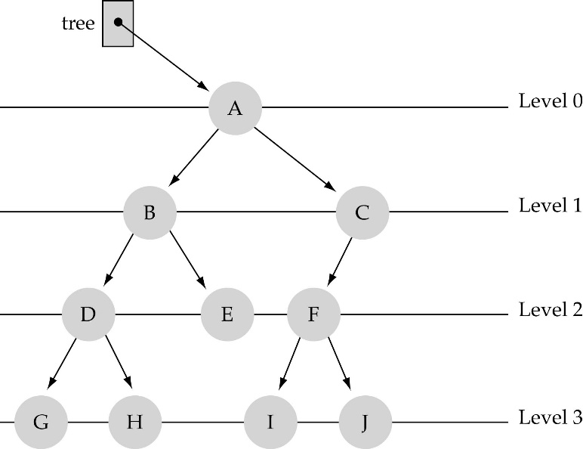
What is the max #nodes at some level l?
The max #nodes at level is
where l=0,1,2, ...,L-1

Slide 17
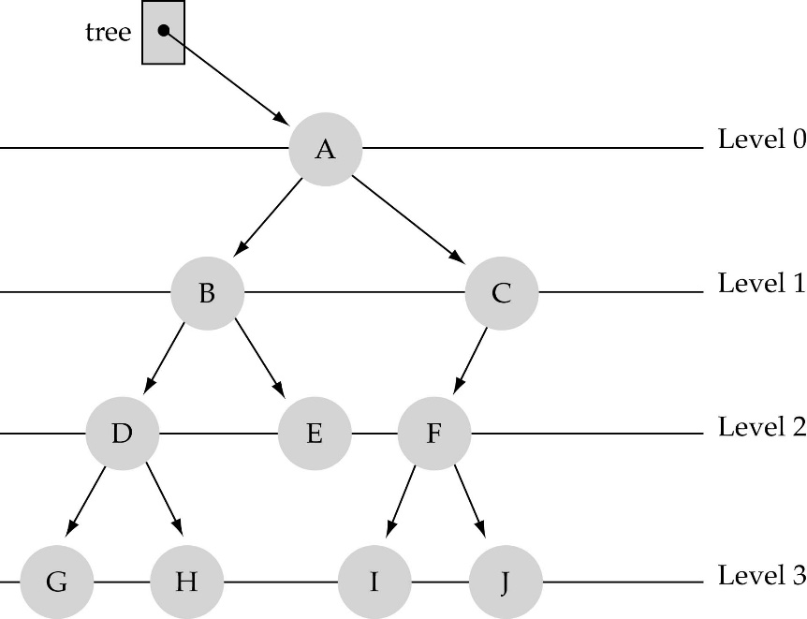
Full Tree
Every node has exactly two children and all the leaves are on the same level.
Not Full Tree

Slide 18
Tree Traversal
Inorder Traversal
Postorder Traversal
Preorder Traversal

Slide 19
Inorder Traversal
tree
Visit second
A E H J M T Y
‘J’
‘E’
‘T’
‘A’
‘H’
‘M’
‘Y’
Visit left subtree first
Visit right subtree last

Slide 20
Inorder Traversal
a
b
e
c
d
f
c b d a e f

Slide 21
Inorder Traversal
30
20
40
15
25
35
50
5
18
45
60
5 15 18 20 25 30 35 40 45 50 60

Slide 22
Inorder Traversal
void Inorder(TreeNode* root)
{
if (root==NULL) {
return;
}
Inorder(root->left);
cout << root->info << " ";
Inorder(root->right);
}

Slide 23
Preorder Traversal
Visit first
tree
J E A H T M Y
‘J’
‘E’
‘T’
‘A’
‘H’
‘M’
‘Y’
Visit left subtree second
Visit right subtree last

Slide 24
Preorder Traversal
a
b
e
c
d
f
a b c d e f

Slide 25
Preorder Traversal
30
20
40
15
25
35
50
5
18
45
60
30 20 15 5 18 25 40 35 50 45 60

Slide 26
Postorder Traversal
Visit last
tree
A H E MY T J
‘J’
‘E’
‘T’
‘A’
‘H’
‘M’
‘Y’
Visit left subtree first
Visit right subtree second

Slide 27
Postorder Traversal
a
b
e
c
d
f
c d b f e a

Slide 28
Postorder Traversal
30
20
40
15
25
35
50
5
18
45
60
5 18 15 25 20 35 45 60 50 40 30

