Slide 1
Data Structure & Algorithms
Maryam Imtiaz Malik
maryam.imtiaz@numl.edu.pk

Slide 2
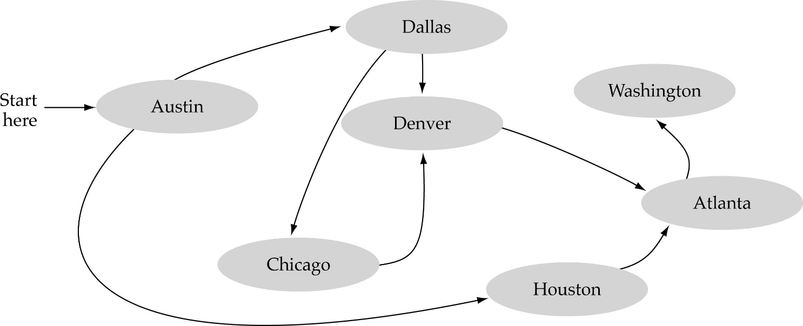
Graph
A data structure that consists of a set of nodes (vertices) and a set of edges between the vertices.
The set of edges describes relationships among the vertices.

Slide 3
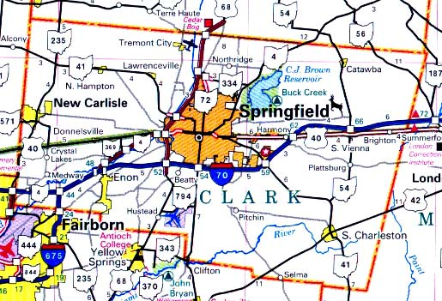

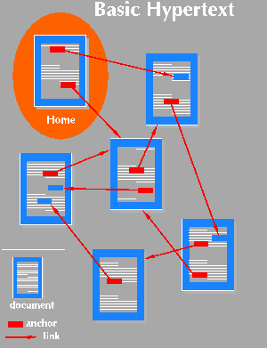
Applications
Computer networks
Maps
Hypertext
Circuits

Slide 4
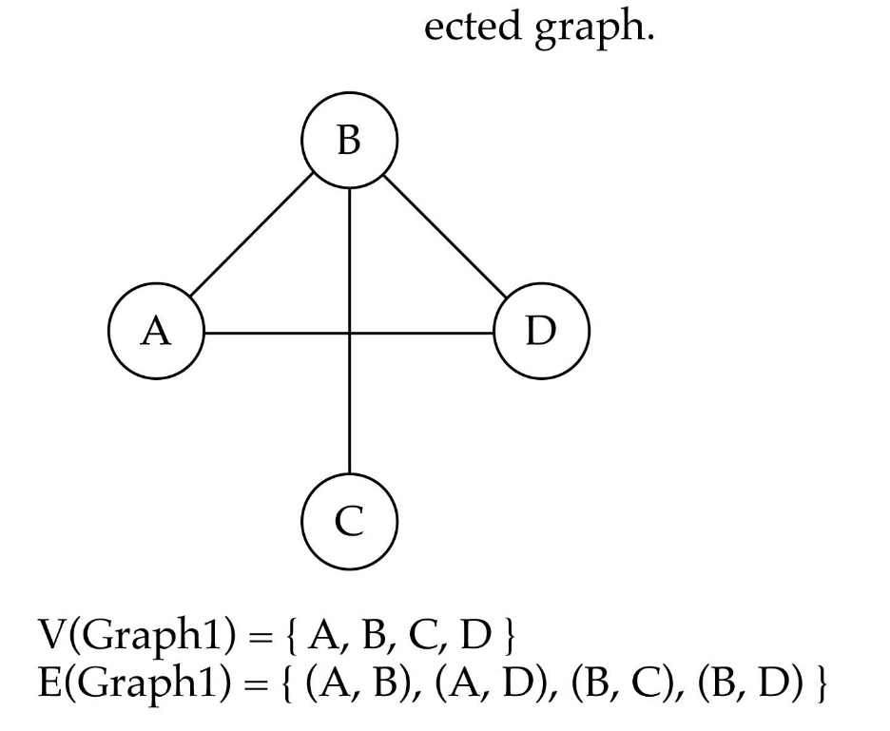
Undirected Graph
When the edges in a graph have no direction, the graph is called undirected.
undirected graph
The order of vertices in E
is not important for
undirected graphs!!

Slide 5

Directed Graph
When the edges in a graph have a direction, the graph is called directed.
The order of vertices in E
is important for
directed graphs!!
E(Graph2) = {(1,3) (3,1) (5,9) (9,11) (5,7)

Slide 6

Trees vs graphs
Trees are special cases of graphs!!
I

Slide 7
Graph Terminology
Adjacent nodes: two nodes are adjacent if they are connected by an edge
7 is adjacent from 5
or
5 is adjacent to 7
5
7
7 is adjacent from/to 5
or
5 is adjacent from/to 7
5
7

Slide 8
Graph Terminology
Path: a sequence of vertices that connect two nodes in a graph.
The length of a path is the number of edges in the path.
1
2
e.g., a path from 1 to 4:
<1, 2, 3, 4>
3
4

Slide 9
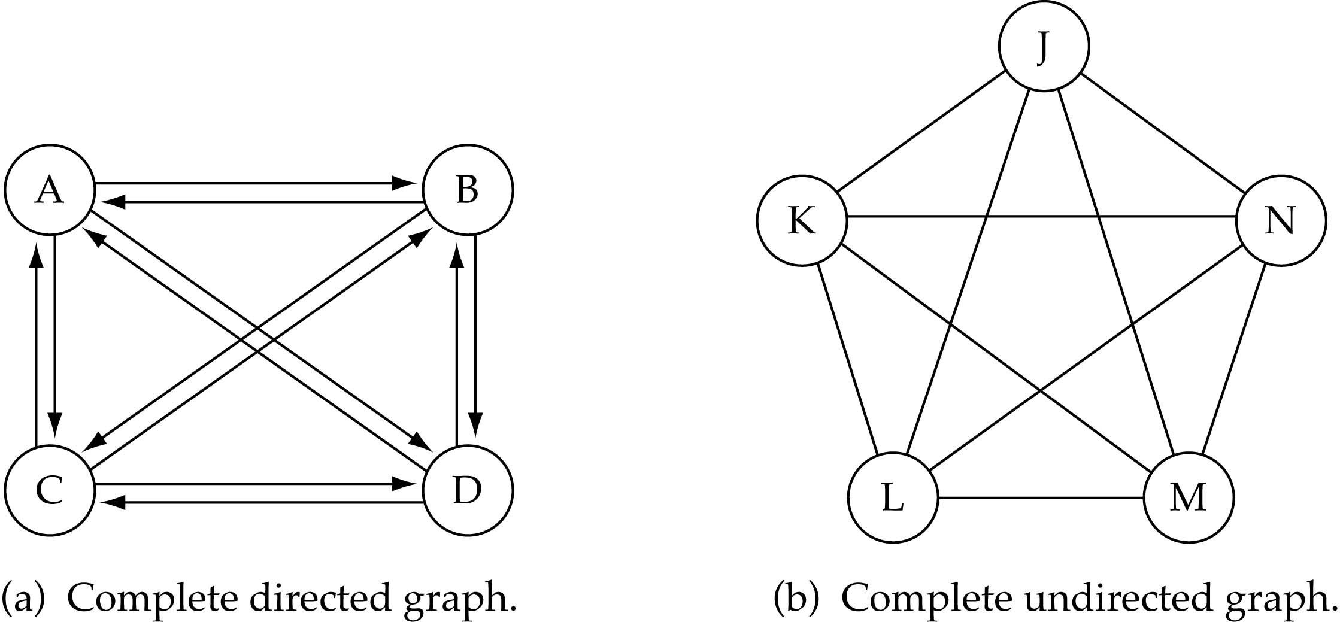
Graph terminology
Complete graph: a graph in which every vertex is directly connected to every other vertex

Slide 10
Graph terminology (cont.)
What is the number of edges E in a complete directed graph with V vertices?
E=V * (V-1)
or E=O(V²)

Slide 11
Graph terminology (cont.)
What is the number of edges E in a complete undirected graph with V vertices?
E=V* (V-1) / 2
or E=O(V²)

Slide 12
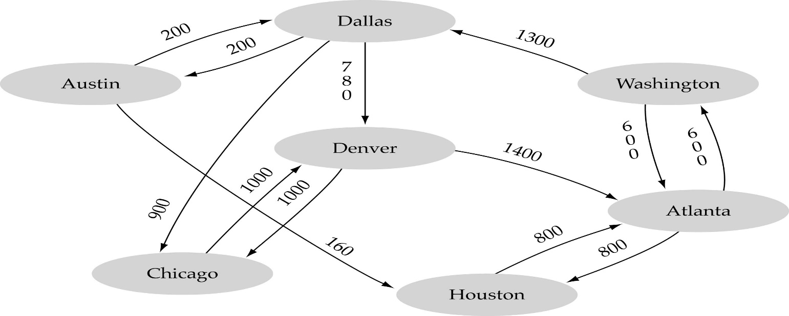
Graph terminology (cont.)
Weighted graph: a graph in which each edge carries a value

Slide 13
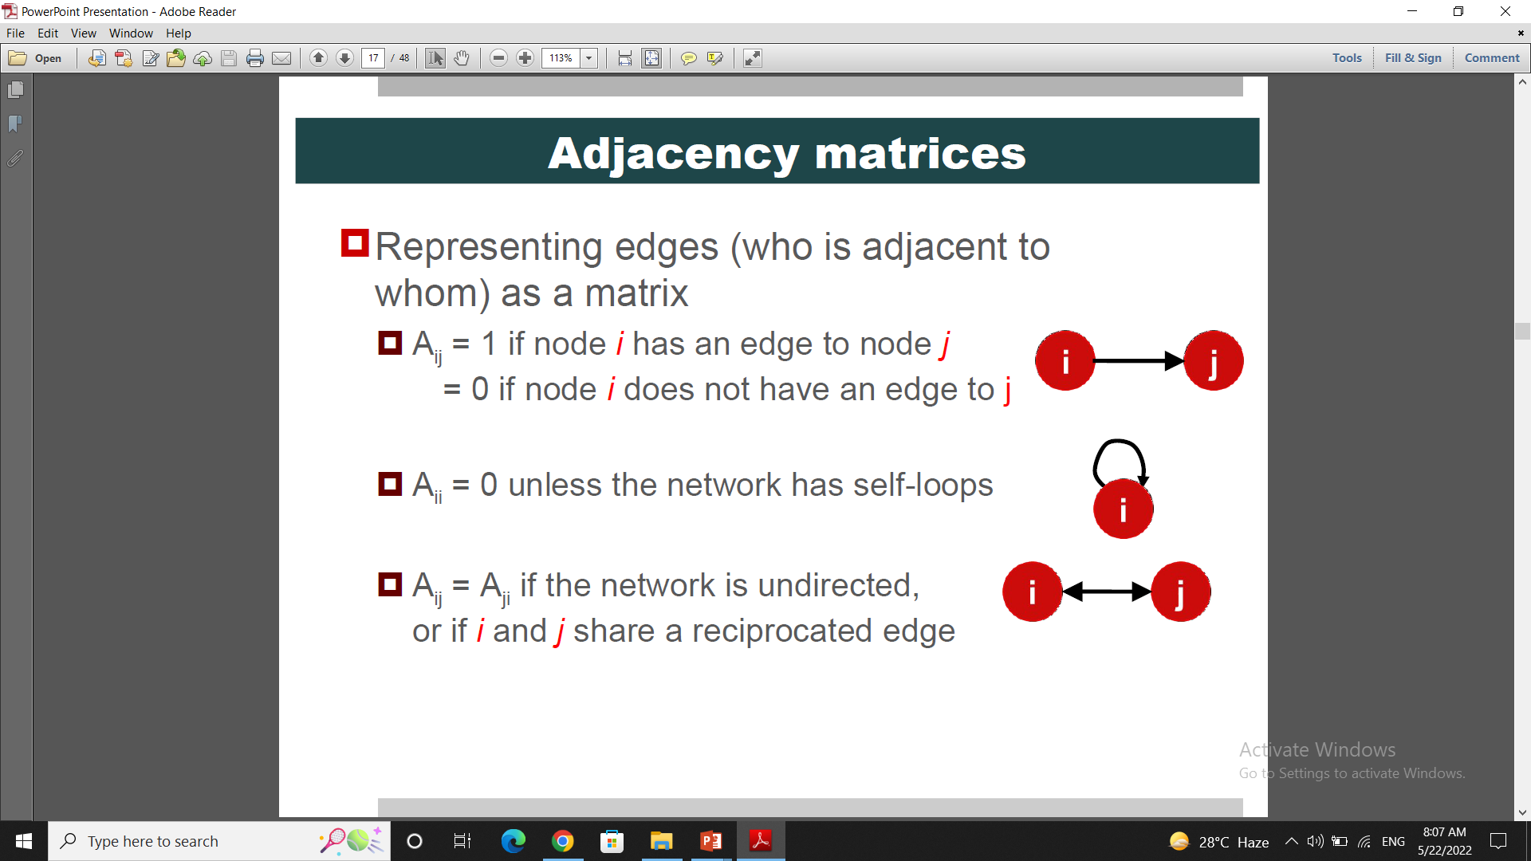
Adjacency Matrix
Representing edges (who is adjacent to whom) as a matrix
Aij = 1 if node i has an edge to node j
Aij = 0 if node i does not have an edge to j
Aii = 0 unless the network has self-loops
Aij = Aji if the network is undirected

Slide 14
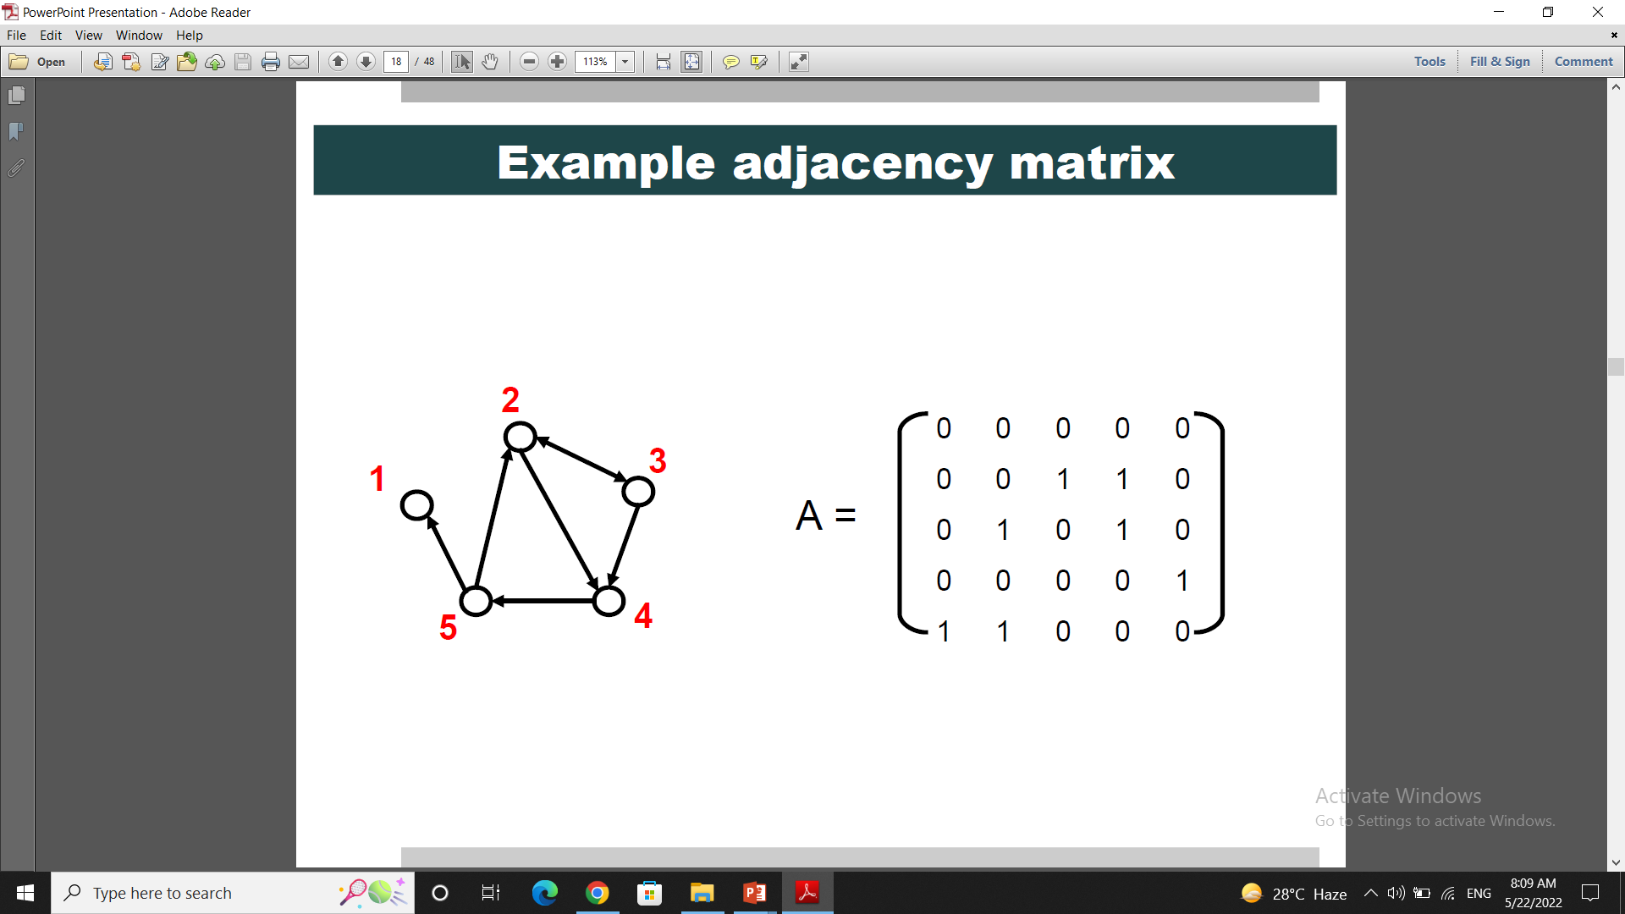
Example

Slide 15
Adjacency List
Adjacency list is easier to work with if network is
Large
Sparse
It quickly retrieve all neighbours for a node

Slide 16
Example
1:
2: 3 4
3: 2 4
4: 5
5: 1 2

Slide 17

Graph Searching
Problem: Find if there is a path between two vertices of the graph (e.g., Austin and Washington)
Methods: Depth-First-Search (DFS) or Breadth-First-Search (BFS)

Slide 18
Depth-First-Search (DFS)

Slide 19
Depth First Search
for all v in V[G] do
visited[v] := false
S := EmptyStack
Push(S,s)
while not Empty(S) do
u := Pop(S)
if not visited[u] then
visted[u] := true
for all w in Adj[u] do
if not visited[w] then
Push(S,w)

Slide 20
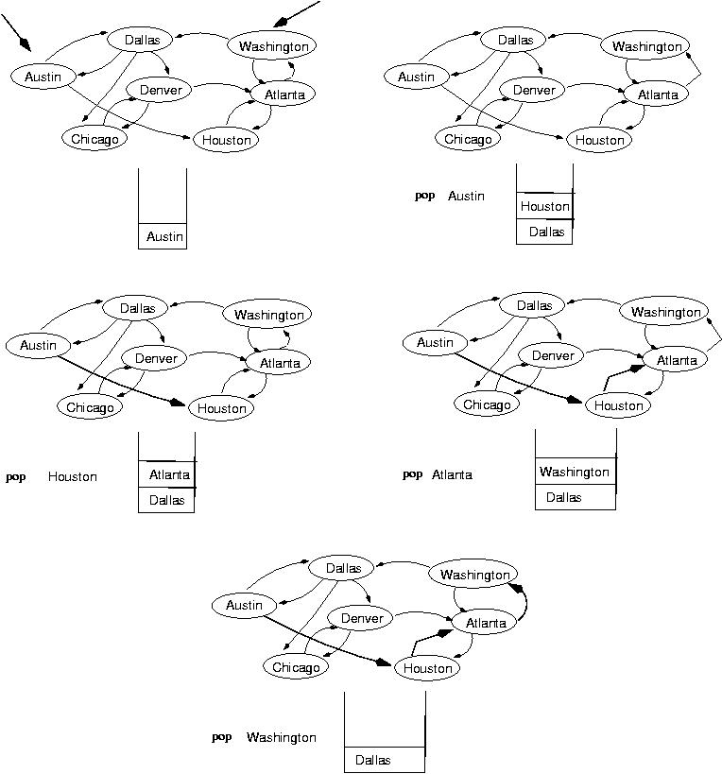
Example: DFS
startVertex
Visited: Autin

Slide 21
Example: DFS contd.
Visited: Autin, Houston
Visited: Autin, Houston, Atlanta

Slide 22
Example: DFS contd.
Visited: Autin, Houston, Atlanta, Washington

Slide 23
Example: DFS contd.
Dallas
Chicago
Denver
Visited: Autin, Houston, Atlanta, Washington, Dallas

Slide 24
Example: DFS contd.
Chicago
Denver
Visited: Autin, Houston, Atlanta, Washington, Dallas, Chicago

Slide 25
Example: DFS contd.
Denver
Visited: Autin, Houston, Atlanta, Washington, Dallas, Chicago, Denver

