Slide 1
Data Structure & Algorithms
Maryam Imtiaz Malik
maryam.imtiaz@numl.edu.pk

Slide 2
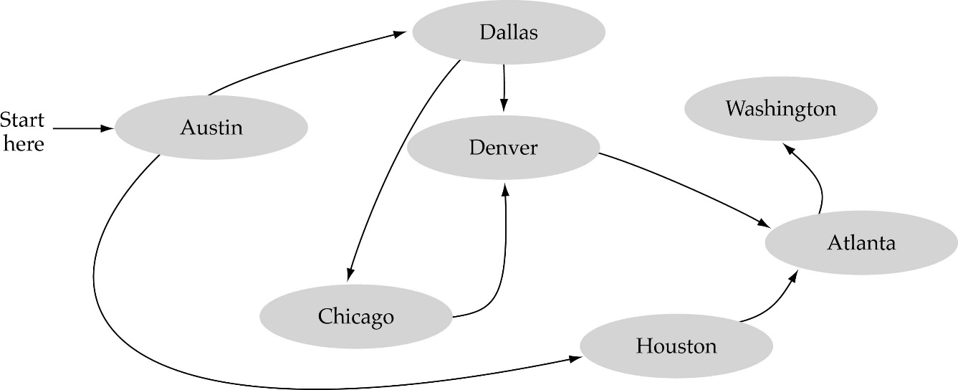
Graph Searching
Problem: Find if there is a path between two vertices of the graph (e.g., Austin and Washington)
Methods: Depth-First-Search (DFS) or Breadth-First-Search (BFS)

Slide 3
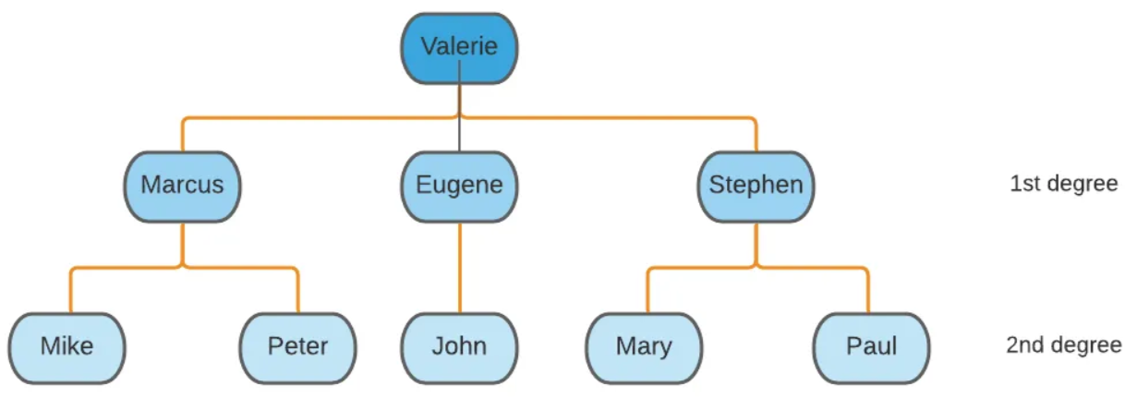
Breadth First Search

Slide 4
Breadth First Search
for all v in V[G] do
visited[v] := false
Q := EmptyQueue
Enqueue(Q,s)
while not Empty(Q) do
u := Dequeue(Q)
if not visited[u] then
visted[u] := true
for all w in Adj[u] do
if not visited[w] then
Enqueue(Q,w)

Slide 5
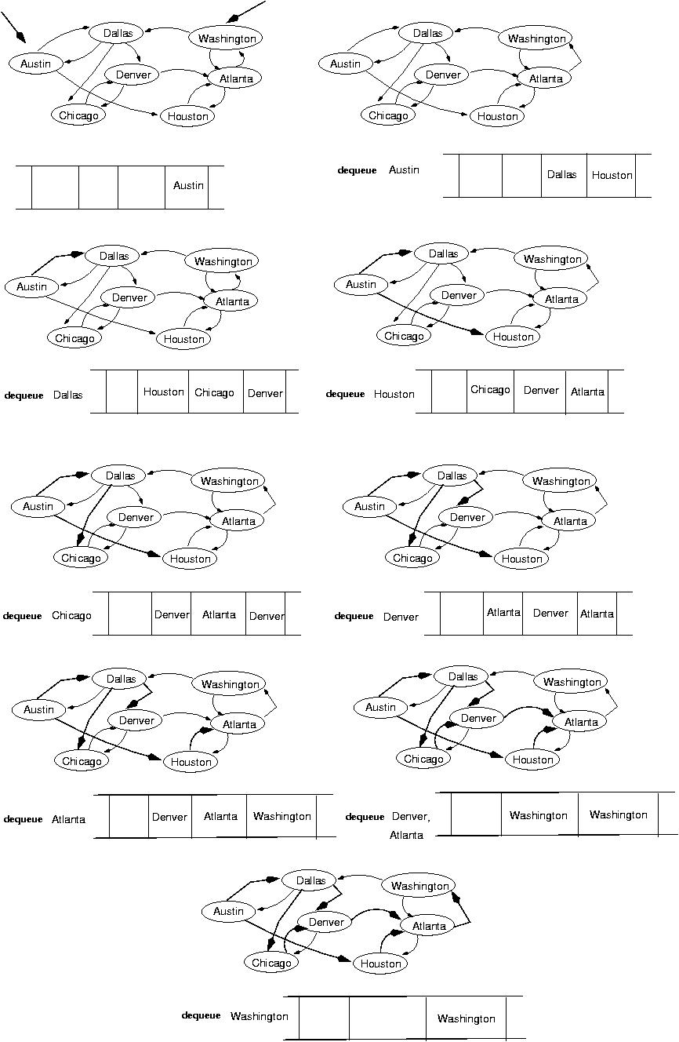
Example: BFS
startVertex
Visited: Autin

Slide 6
Example: BFS contd.
Visited: Autin, Dallas

Slide 7
Example: BFS contd.
Visited: Autin, Dallas, Houston

Slide 8
Example: BFS contd.
Visited: Autin, Dallas, Houston, Chicago

Slide 9
Example: BFS contd.
Visited: Autin, Dallas, Houston, Chicago, Denver

Slide 10
Example: BFS contd.
Visited: Autin, Dallas, Houston, Chicago, Denver, Atlanta

Slide 11
Example: BFS contd.
Visited: Autin, Dallas, Houston, Chicago, Denver, Atlanta, Washington

