Slide 1
Analysis of Algorithms
Course Instructor: Maryam Imtiaz Malik
maryam.Imtiaz@numl.edu.pk

Slide 2
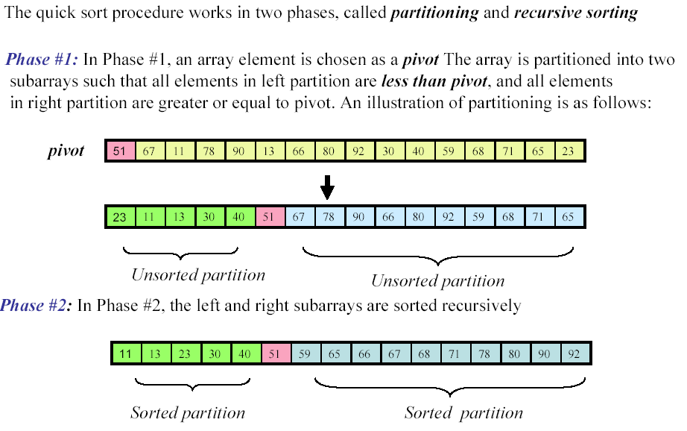
Quick Sort

Slide 3
Algorithm: QuickSort
QUICKSORT(A, p, r)
if p < r
then q ← PARTITION(A, p, r)
QUICKSORT(A, p, q-1)
QUICKSORT(A, q+1, r)
To sort an entire array A, the initial call is QUICKSORT(A, 1, A.length)
It means initially p = 1 and r = A.length

Slide 4
Algorithm: Partition
PARTITION (A, p, r)
x ← A[r]
i ← p-1
for j ← p to r-1
do if A[j] <= x
then i ← i+1
exchange A[i] ↔ A[j]
exchange A[i+1] ↔ A[r]
return i+1

Slide 5
Dry Run (Example)
2 | 8 | 7 | 1 | 3 | 5 | 6 | 4
p = 1, r = 8
QUICKSORT(A, 1, 8)
if p < r -> 1< 8 Yes
q -> PARTITION(A, 1, 8)

Slide 6
Dry Run (Example)
2 | 8 | 7 | 1 | 3 | 5 | 6 | 4
PARTITION(A, 1, 8)
x <- A[r] = x <- A[8] = 4
i <- p -1 = 0
for (j = p to r -1)
for (j = 1 to 7)
2 | 8 | 7 | 1 | 3 | 5 | 6 | 4
2 < 4 True
i = 0 j =1

Slide 7
Dry Run (Example)
2 | 8 | 7 | 1 | 3 | 5 | 6 | 4
2 < 4 True
i = 0 j =1
2 | 8 | 7 | 1 | 3 | 5 | 6 | 4
i ++
i = 1 j =1
2 | 8 | 7 | 1 | 3 | 5 | 6 | 4
A[i] <-> A[j]
Nothing
i = 1 j =1
2 | 8 | 7 | 1 | 3 | 5 | 6 | 4
8 < 4 False
i = 1 j =2

Slide 8
Dry Run (Example)
2 | 8 | 7 | 1 | 3 | 5 | 6 | 4
7 < 4 False
i = 1 j = 3
2 | 8 | 7 | 1 | 3 | 5 | 6 | 4
1 < 4 True
i = 1 j = 4
2 | 8 | 7 | 1 | 3 | 5 | 6 | 4
i++
i = 2 j = 4
2 | 1 | 7 | 8 | 3 | 5 | 6 | 4
Swap 1 and 8
i = 2 j = 4

Slide 9
Dry Run (Example)
2 | 1 | 7 | 8 | 3 | 5 | 6 | 4
3 < 4 True
i = 2 j = 5
2 | 1 | 7 | 8 | 3 | 5 | 6 | 4
i ++
i = 3 j = 5
2 | 1 | 3 | 8 | 7 | 5 | 6 | 4
Swap 3 and 7
i = 3 j = 5
2 | 1 | 3 | 8 | 7 | 5 | 6 | 4
5 < 4 False
i = 3 j = 6

Slide 10
Dry Run (Example)
2 | 1 | 3 | 8 | 7 | 5 | 6 | 4
5 < 4 False
i = 3 j = 6
Loop End
2 | 1 | 3 | 8 | 7 | 5 | 6 | 4
6 < 4 False
i = 3 j = 7
2 | 1 | 3 | 8 | 7 | 5 | 6 | 4
Swap 8 and 4
i + 1

Slide 11
Dry Run (Example)
2 | 1 | 3 | 4 | 7 | 5 | 6 | 8
Swapped
i
return i + 1 -> 4
QUICKSORT(A, 1, 3) QUICKSORT(A,5,8)
QUICKSORT(A, 1, 3)
if (1 < 3)
q -> PARTITION (A,1,3)

Slide 12
Dry Run (Example)
PARTITION (A,1,3)
2 | 1 | 3
2 < 3
i = 0 j = 1
2 | 1 | 3
i ++
i = 1 j = 1
2 | 1 | 3
No Swapping
i = 1 j = 1

Slide 13
Dry Run (Example)
PARTITION (A,1,3)
2 | 1 | 3
1 < 3 True
i = 1 j = 2
2 | 1 | 3
No Swapping
2 | 1 | 3
i = 2 j = 2
i = 2 j = 2
2 | 1 | 3
No Swapping
2 | 1 | 3
i + 1
i + 1
return i + 1 = 3

Slide 14
Dry Run (Example)
QUICKSORT(A, 1, 2) QUICKSORT(A,4,3)
QUICKSORT(A, 1, 2)
if (1 < 2)
q -> PARTITION (A,1,2)
PARTITION (A,1,2)
x <- 1 , j = 1 to 1
2 | 1
2 < 1 False
i = 0 j = 1

Slide 15
Dry Run (Example)
PARTITION (A,1,2)
return i + 1 -> 1
QUICKSORT(A, 1, 0) QUICKSORT(A,2,2)
if ( p < r ) False False
2 | 1
Swap 2 and 1
i +1
1 | 2
Swapped

Slide 16
Dry Run (Example)
QUICKSORT(A, 5, 8)
if (5 < 8)
q -> PARTITION (A,5,8)
7 | 5 | 6 | 8

Slide 17
Dry Run (Example)
PARTITION (A,5,8)
x <- 8
j <- 5 to 7
7 | 5 | 6 | 8
7 < 8 True
i = 4 j = 5
7 | 5 | 6 | 8
Nothing Swap
i = 5 j = 5

Slide 18
Dry Run (Example)
PARTITION (A,5,8)
7 | 5 | 6 | 8
5 < 8 True
i = 5 j = 6
7 | 5 | 6 | 8
i ++
Nothing Swap
i = 6 j = 6
7 | 5 | 6 | 8
6 < 8 True
i = 6 j = 7
7 | 5 | 6 | 8
Nothing Swap
i = 7 j = 7

Slide 19
Dry Run (Example)
PARTITION (A,5,8)
return i + 1 = 8
QUICKSORT(A, 5, 7) QUICKSORT(A,9,8) - False
7 | 5 | 6 | 8
Nothing Swap
i + 1

Slide 20
Dry Run (Example)
QUICKSORT(A, 5, 7)
if ( 5 < 7) True
q <- PARTITION (A,5,7)
x <- 6 , j = 5 to 6
7 | 5 | 6
7 | 5 | 6
7 < 6 False
i = 4, j = 5
7 | 5 | 6
5 < 6 True
i = 4 j = 6

Slide 21
Dry Run (Example)
PARTITION (A,5,7)
Return 6
QUICKSORT(A, 5, 5) QUICKSORT(A,7,7) - False
7 | 5 | 6
Swap 5 and 7
i = 5 j = 6
5 | 7 | 6
Swap 5 and 7
i = 5 j = 6
5 | 7 | 6
Swap 6 and 7
i + 1
5 | 6 | 7

Slide 22
Dry Run (Example)
Swapped
1 | 2 | 3 | 4 | 5 | 6 | 7 | 8

