Slide 1
Data Structure & Algorithms
Maryam Imtiaz Malik
maryam.imtiaz@numl.edu.pk

Slide 2
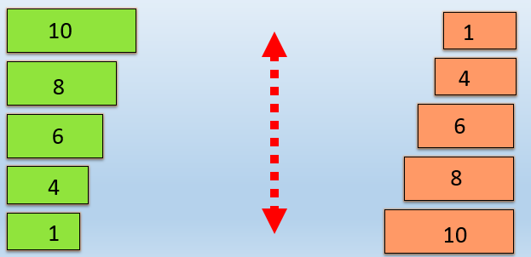
Bubble Sort
In an exchange sort, adjacent elements of the list are exchanged with one another so that the list becomes sorted.

Slide 3
Bubble Sort: Pass 1
10 | 20 | 6 | 3 | 15
10 | 20 | 6 | 3 | 15
10 | 6 | 20 | 3 | 15
10 | 6 | 3 | 20 | 15
10 | 6 | 3 | 15 | 20

Slide 4
Bubble Sort: Pass 2
10 | 6 | 3 | 15 | 20
6 | 10 | 3 | 15 | 20
6 | 3 | 10 | 15 | 20
6 | 3 | 10 | 15 | 20

Slide 5
Bubble Sort: Pass 3
6 | 3 | 10 | 15 | 20
3 | 6 | 10 | 15 | 20
3 | 6 | 10 | 15 | 20

Slide 6
Bubble Sort: Pass 4
3 | 6 | 10 | 15 | 20
3 | 6 | 10 | 15 | 20

Slide 7
Algorithm
Start
Input arr
n -> length of arr
for (i = 0; i < n-1; i++)
for (j = 0; j < n-i-1; j++)
if (arr[j] > arr[j+1])
swap(arr[j], arr[j+1])
end if
end for
end for
Print arr
End

