Slide 1
Data Structure & Algorithms
Maryam Imtiaz Malik
maryam.imtiaz@numl.edu.pk

Slide 2
Example
Suppose you are designing a website to process user data (e.g., financial records).
Suppose program A takes f_{A}(n)=30n+8 microseconds to process any n records, while program B takes f_{B}(n)=n²+1 microseconds to process the n records.
Which program would you choose, knowing you’ll want to support millions of users?
Compare rates of growth:
30n+8 ~ n and n²+1 ~ n²

Slide 3
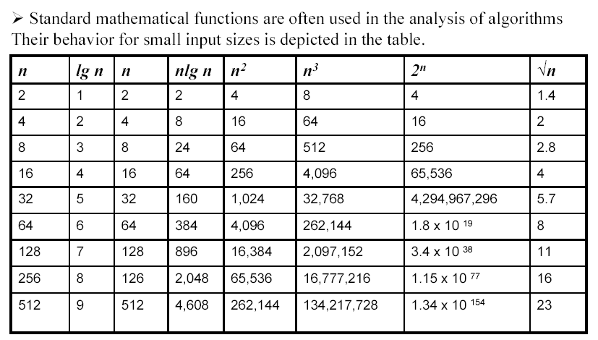
Standard Growth Functions
256

Slide 4
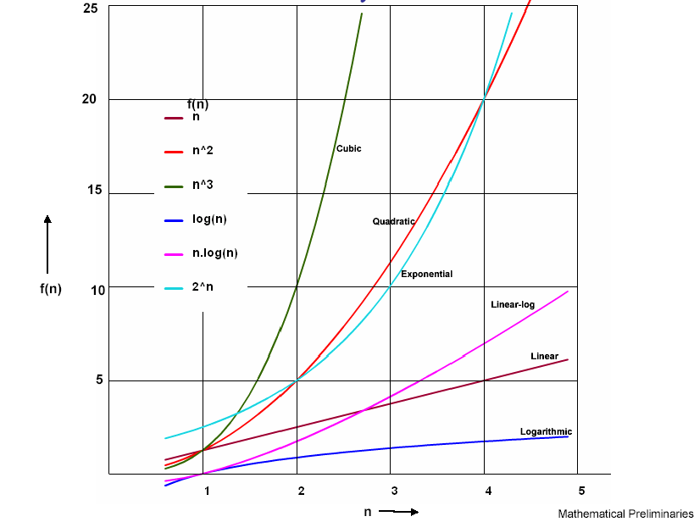
Growth Functions - Initially

Slide 5
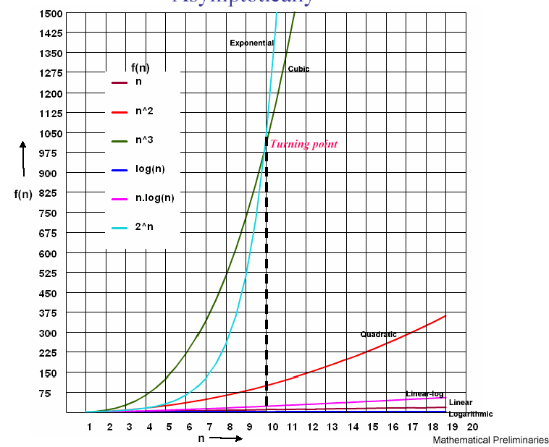
Growth Functions - Asymptotically

Slide 6
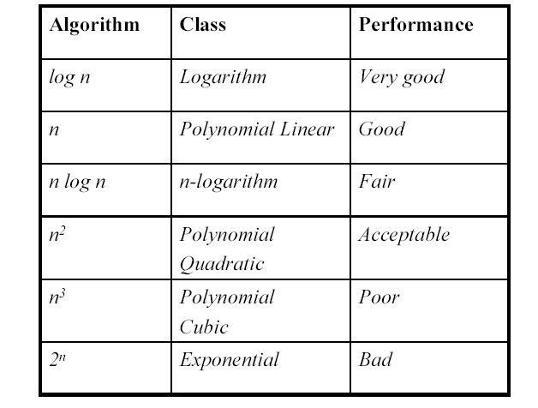
Growth Functions - Ranking

Slide 7
Visualizing Orders of Growth
On a graph, as you go to the right, a faster growing function eventually becomes larger...
f_{A}(n)=30n+8
Value of function →
f_{B}(n)=n²+1
Increasing n →

Slide 8
Rate of Growth ≡Asymptotic Analysis
Using rate of growth as a measure to compare different functions implies comparing them asymptotically (i.e., as n → )
If f(x) is faster growing than g(x), then f(x) always eventually becomes larger than g(x) in the limit (i.e., for large enough values of x).

Slide 9
Asymptotic Notation
O notation: asymptotic “less than”:
f(n)=O(g(n)) implies: f(n) “≤” c g(n) in the limit*
c is a constant

Slide 10
Asymptotic Notation
Ω notation: asymptotic “greater than”:
f(n)= Ω (g(n)) implies: f(n) “≥” c g(n) in the limit*
c is a constant
*formal definition in CS477/677

Slide 11
Asymptotic Notation
Θ notation: asymptotic “equality”:
f(n)= Θ (g(n)) implies: f(n) “=” c g(n) in the limit*
c is a constant
(provides a tight bound of running time)
*formal definition in CS477/677

Slide 12
Big-O Notation - Examples
f_{A}(n)=30n+8
f_{B}(n)=n²+1
10n³ + 2n²
n³ - n²
1273
is O(n)
is O(n²)
is O(n³)
is O(n³)
is O(1)

Slide 13
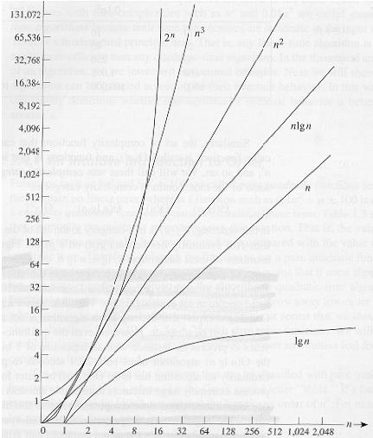
Common orders of magnitude

Slide 14
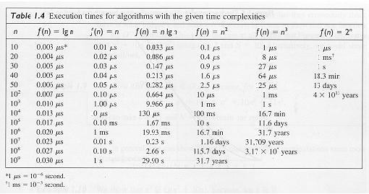

Slide 15
Algorithm speed vs function growth
An O(n²) algorithm will be slower than an O(n) algorithm (for large n).
But an O(n²) function will grow faster than an O(n) function.
f_{A}(n)=30n+8
Value of function →
f_{B}(n)=n²+1
Increasing n →

Slide 16
Estimating running time
Algorithm 1 Algorithm 2
Cost Cost
arr[0] = 0; c1 for(i=0; i<N; i++) c2
arr[1] = 0; c1 arr[i] = 0; c1
arr[2] = 0; c1
...
arr[N-1] = 0; c1
----------- -------------
c1+c1+...+c1 = c1 x N (N+1) x c2 + N x c1 =
(c2 + c1) x N + c2
O(N)

Slide 17
Estimate running time (cont.)
Cost
sum = 0; c1
for(i=0; i<N; i++) c2
for(j=0; j<N; j++) c2
sum += arr[i][j]; c3 ------------
c1 + c2 x (N+1) + c2 x N x (N+1) + c3 x N x N
O(N²)

Slide 18
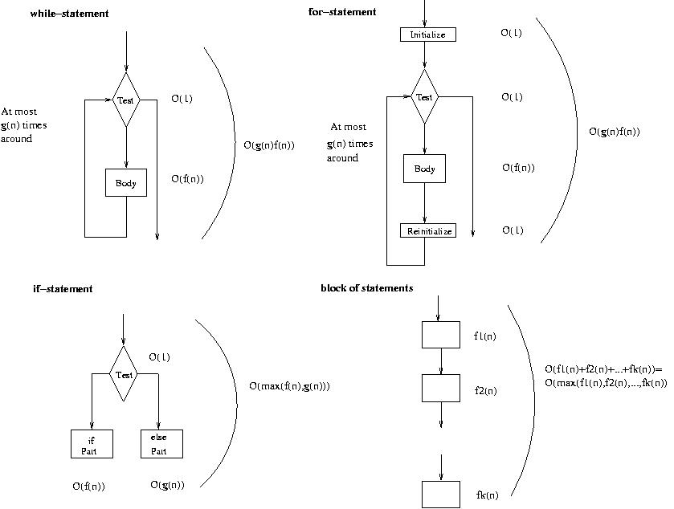
Running time of various statements

