Slide 1
Data Structure & Algorithms
Maryam Imtiaz Malik
maryam.imtiaz@numl.edu.pk

Slide 2
Examples
i = 0;
while (i<N) {
X=X+Y; // O(1)
result = mystery(X); // O(N), just an example...
i++; // O(1)
}
The body of the while loop: O(N)
Loop is executed: N times
N x O(N) = O(N²)

Slide 3
Examples (cont.’d)
if (i<j)
for ( i=0; i<N; i++ )
X = X+i;
else
X=0;
Max ( O(N), O(1) ) = O (N)
O(N)
O(1)

Slide 4
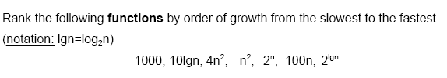

Examples (cont.’d)

Slide 5
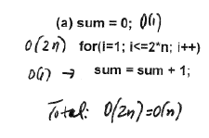
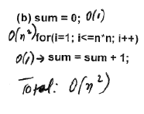
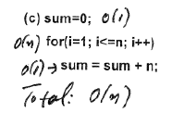
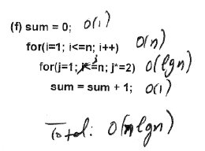
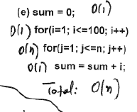
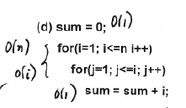
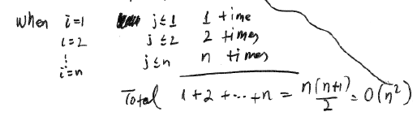
Examples
Analyze the complexity of the following code segments:
O(nlgn)

Slide 6
Time Complexity
Algorithm | Best Case | Worst Case
Linear Search | O(1) | O(n)
Binary Search | O(1) | O(log n)
Bubble Sort | O(n) | O(n²)
Selection Sort | O(n²) | O(n²)
Insertion Sort | O(n) | O(n²)

Slide 7
Sorting Algorithms
Algorithm | Usage
Bubble Sort | Extremely small or nearly sorted set of data. With large datasets where the items are almost sorted.
Selection Sort | When list is small and memory space is limited
Insertion Sort | If the data is nearly sorted or when the list is small. Space complexity is O(1)

Slide 8
Size of Array
To find the length of an array is to divide the size of the array by the size of each element (in bytes).
arraySize = sizeof(arr)/sizeof(arr[0]);

Slide 9
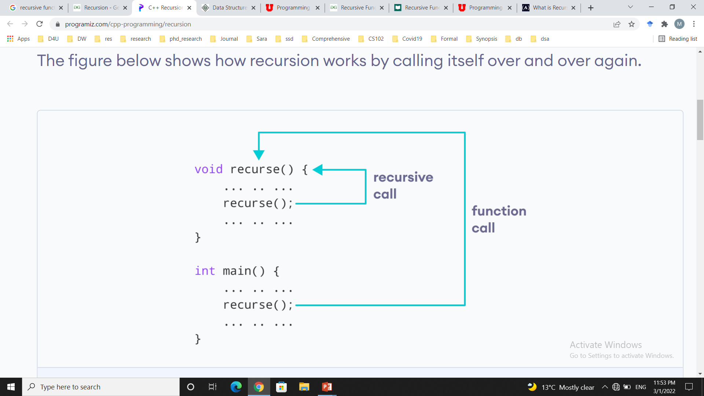
Recursion
The process in which a function calls itself directly or indirectly is called recursion and the corresponding function is called as recursive function.

Slide 10
Parts of Recursion
Base criteria − There must be at least one base criteria or condition, such that, when this condition is met the function stops calling itself recursively.
Progressive approach − The recursive calls should progress in such a way that each time a recursive call is made it comes closer to the base criteria.
(1) Decompose Problem into one or more similar, strictly smaller subproblems: SP1, SP2, ... , SPN
(2) Recursively call Solve (this method) on each subproblem: Solve(SP1), Solve(SP2),..., Solve(SPN)
(3) Combine the solutions to these subproblems into a solution that solves the original Problem

Slide 11
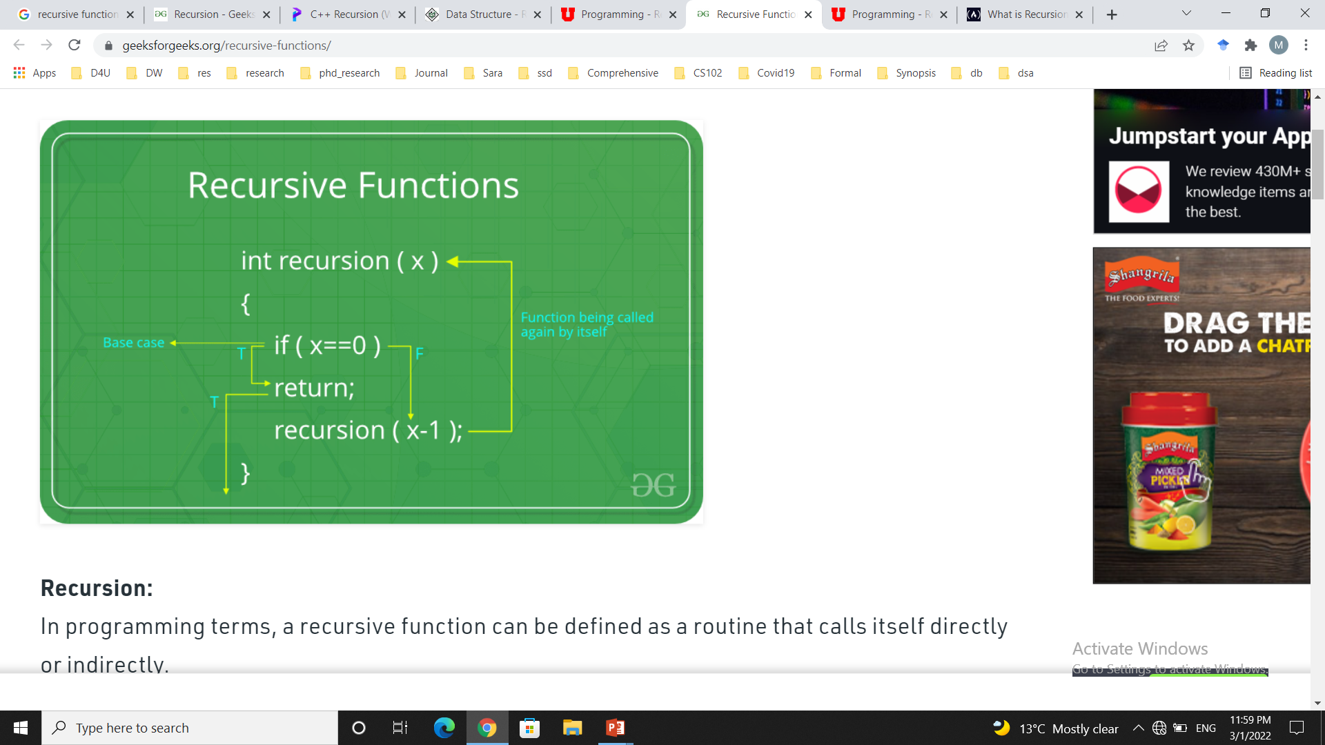
Example

Slide 12
Recursion vs Iteration
Property | Recursion | Iteration
Definition | Function calls itself. | A set of instructions repeatedly executed.
Application | For functions. | For loops.
Termination | Through base case, where there will be no function call. | When the termination condition for the iterator ceases to be satisfied.
Usage | Used when code size needs to be small, and time complexity is not an issue. | Used when time complexity needs to be balanced against an expanded code size.
Code Size | Smaller code size | Larger Code Size.
Time Complexity | Very high(generally exponential) time complexity. | Relatively lower time complexity(generally polynomial-logarithmic).

Slide 13
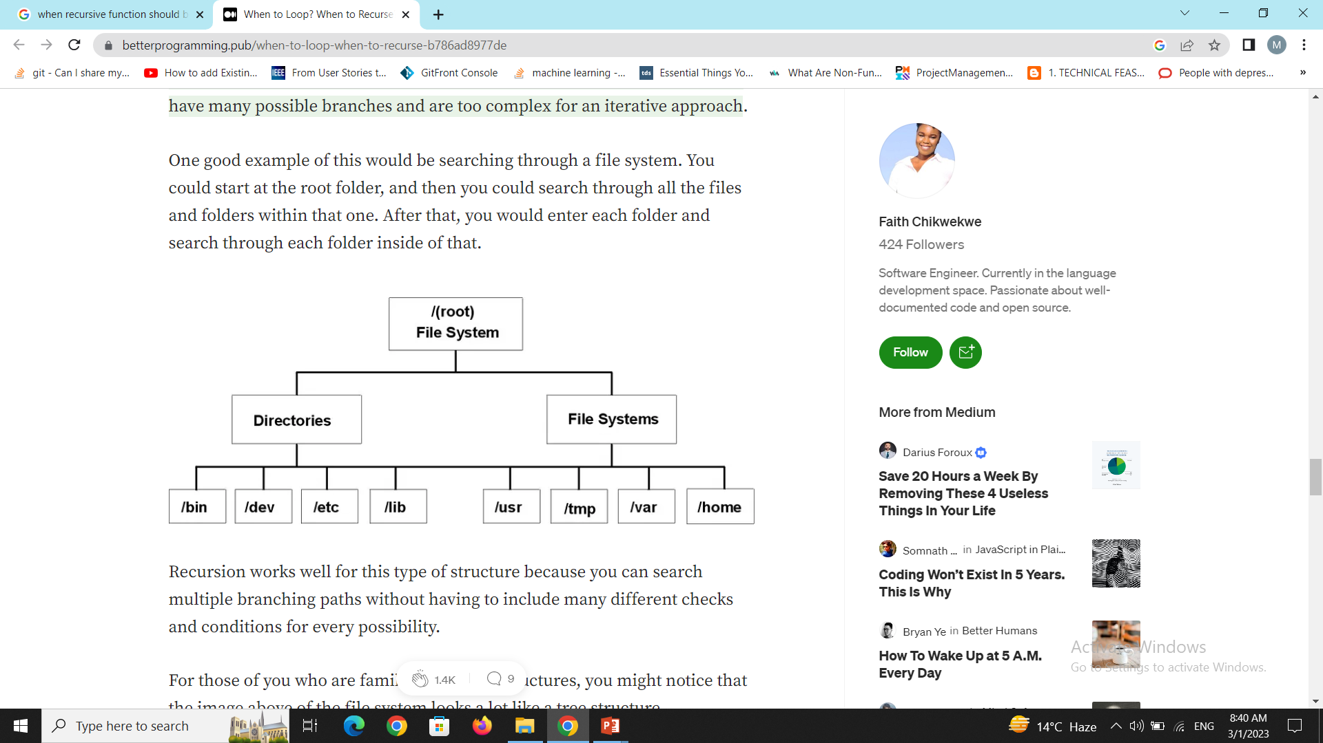
Recursion

Slide 14
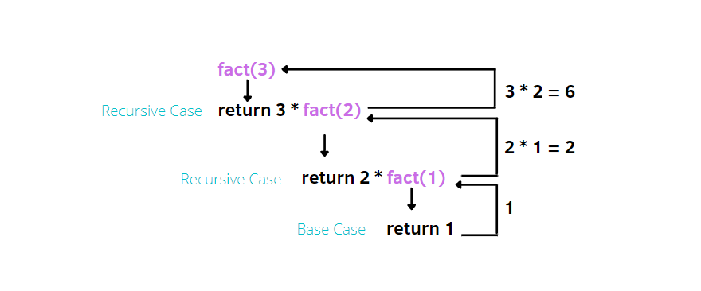
Factorial
int fact(int n)
{
if (n==0 || n==1)
return 1;
else
return n * fact(n-1);
}

Slide 15
Binary Search
int BinarySearch(int arr[], int num, int beg, int end){
int mid;
if (beg > end)
return -1;
else {
mid = (beg + end) / 2;
if(arr[mid] == num)
return mid;
else if (num > arr[mid])
BinarySearch (arr, num, mid+1, end);
else if (num < arr[mid])
BinarySearch (arr, num, beg , mid-1);
} }

