Slide 1
Data Structure & Algorithms
Maryam Imtiaz Malik
maryam.imtiaz@numl.edu.pk

Slide 2
Generic Class
Generic Programming enables the programmer to write a general algorithm which will work with all data types. It eliminates the need to create different algorithms if the data type is an integer, string or a character.
Template

Slide 3
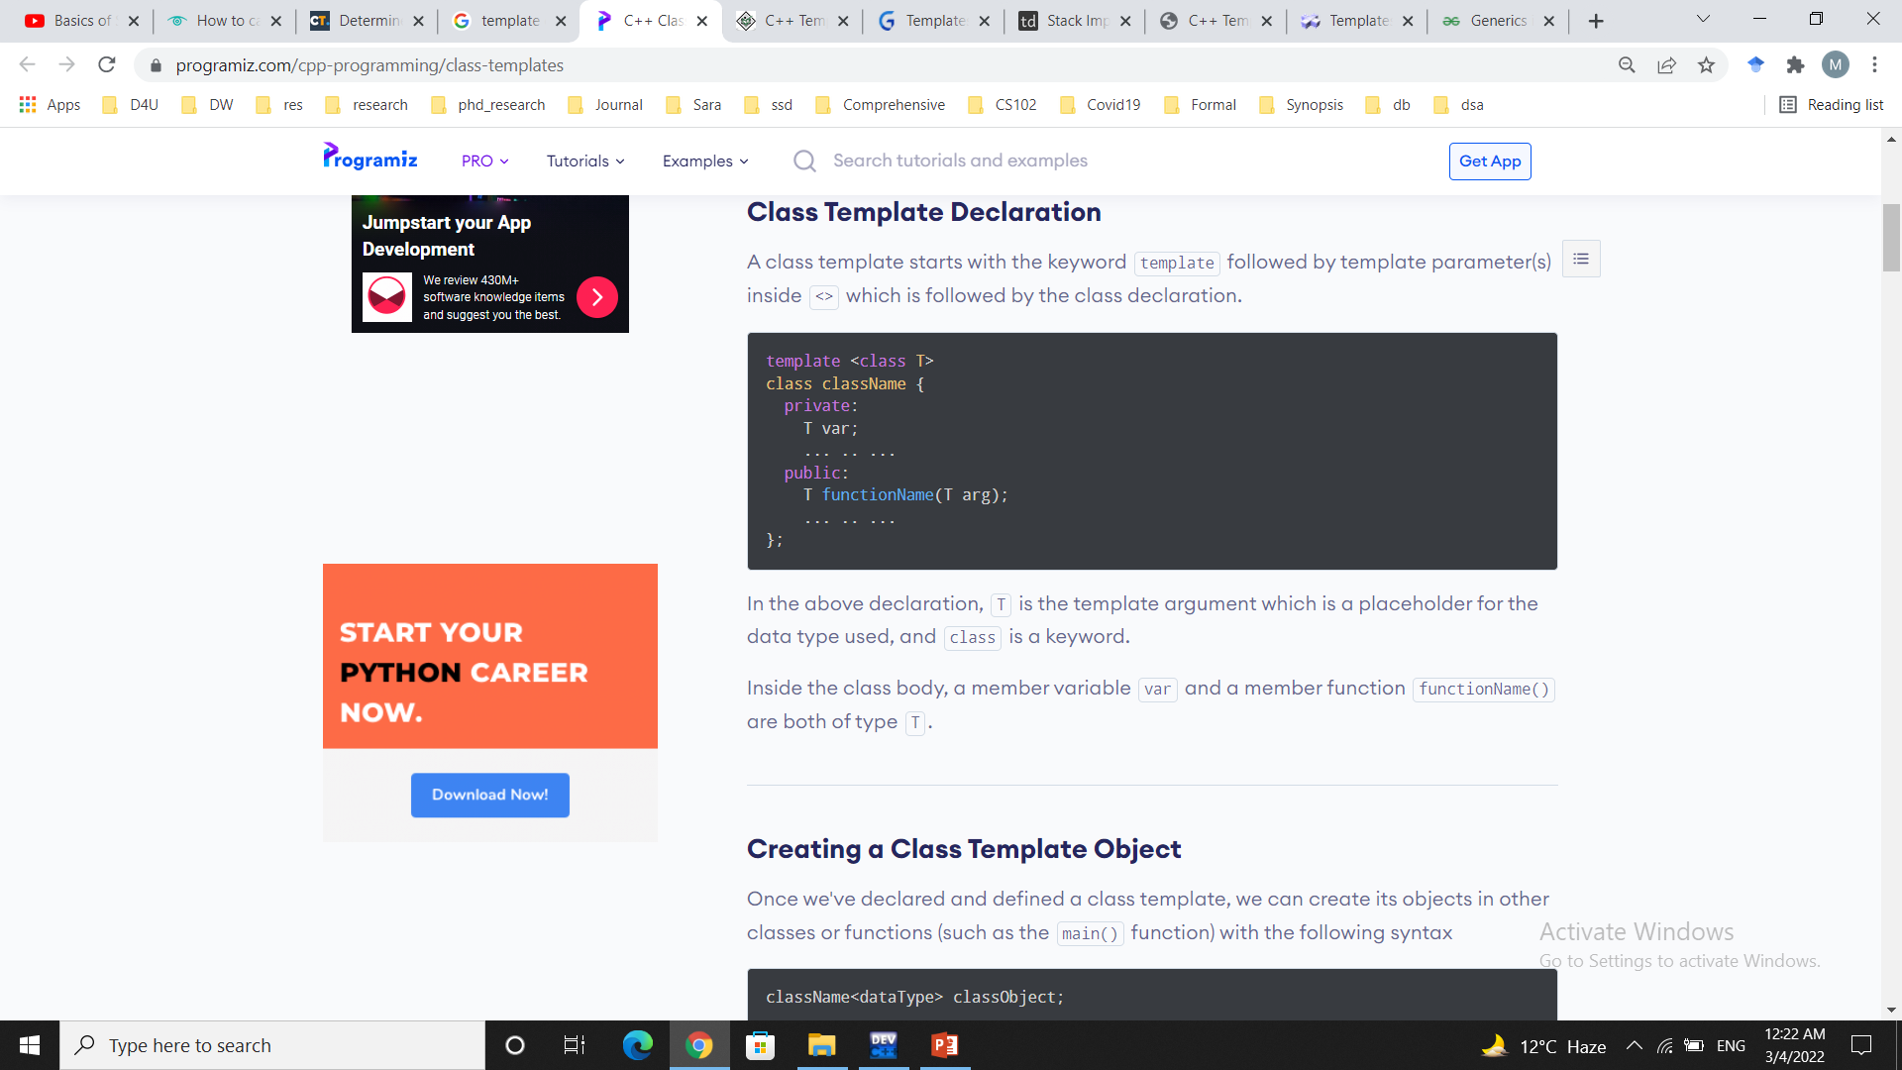
Template
Templates in C++ is defined as a blueprint or formula for creating a generic class or a function.
We can create a single function or single class to work with different data types using templates.

Slide 4
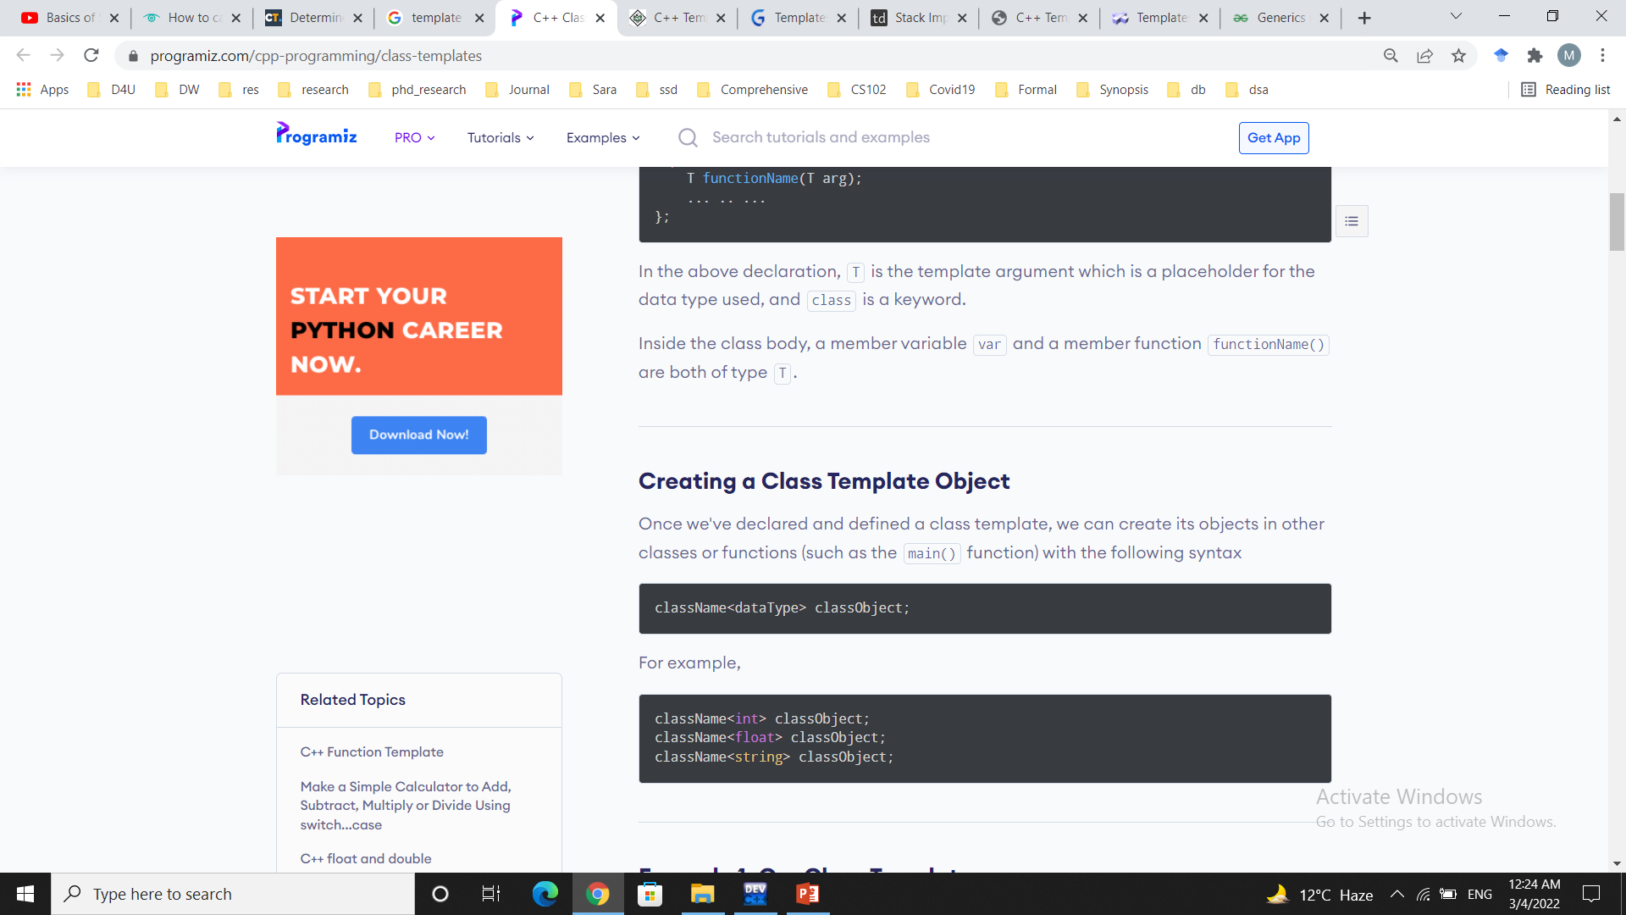
Creating a Class Template Object

Slide 5
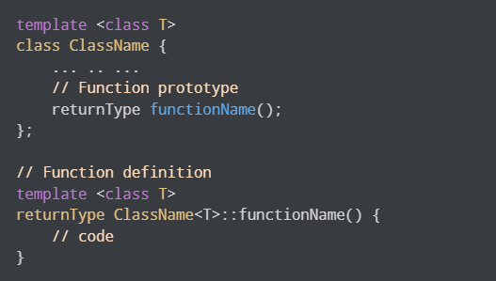
Defining a Class Member Outside the Class Template

Slide 6
Example
template <class type>
class Addition{
private:
type a,b;
public:
Addition(type x, type y);
void show();
type add();
};

Slide 7
Example
template <class type>
Addition<type>::Addition(type x,type y){
a=x;
b=y;
}
template <class type>
void Addition<type>::show()
{
cout<<"The Addition of "<<a<<" and "<<b<<" is "<<add()<<endl;
}
template <class type>
type Addition<type>::add(){
type c=a+b;
return c;
}

Slide 8
Example
int main(){
Addition<int> obj1(8,6);
Addition<double> obj2(8.2,6.4);
obj1.show();
obj2.show();
return 0;
}

Slide 9
Pointers
Pointers helps to dynamically set the size of an array based on an external input not known beforehand to the compiler or you may want to change the size of the array in runtime.
Arrays must have a constant size which can't be changed, but with pointers, you can allocate just the space you need, allowing you to improve your program's space efficiency and make the shape of your data as flexible as the user needs.

Slide 10
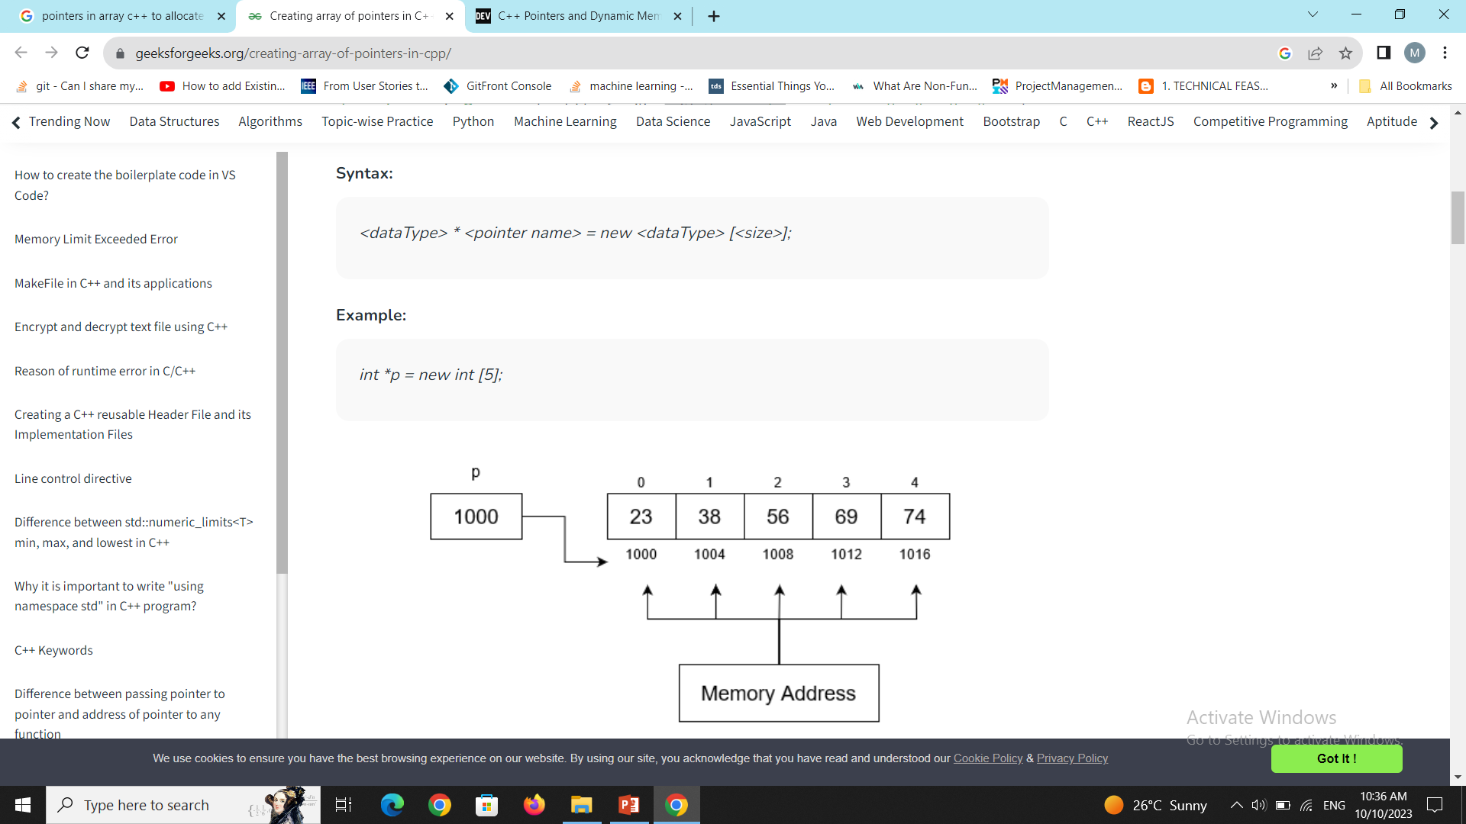
Pointers

