Slide 1
Firewalls
Network Security

Slide 2
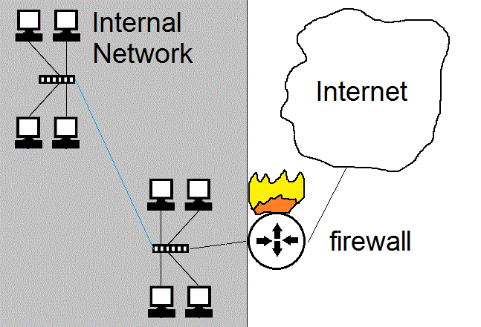
Firewall 553

Slide 3
Firewalls - 553
Enforce network policy.
Usually firewalls are put on the perimeter of a network and allow or deny traffic based on company or network policy.
MUST have IP forwarding turned off*
Firewalls are often used to create a DMZ.
Generally are dual/multi homed*
Types of firewalls
Packet filtering
State full
Proxy
Dynamic packet filtering

Slide 4
Packet filter - 555
Uses Access control lists (ACLs), which are rules that a firewall applies to each packet it receives.
Not state full, just looks at the network and transport layer packets (IP addresses, ports, and “flags”)
Do not look into the application, cannot block viri etc.
Generally do not support anything advanced or custom

Slide 5
Packet Filter
Packet filters keep no state*
Each packet is evaluated own it’s own without regard to previous traffic
Advantages
Disadvantages
fragments
Rule based access control
Packet filters are still used on the edge of the network before a statefull firewall for performance reasons.

Slide 6
State full firewall - 556
router keeps track of a connections in a table. It knows which conversations are active, who is involved etc.
It allows return traffic to come back where a packet filter would have to have a specific rule to define returned traffic
More complex, and can launch DoS against by trying to fill up all the entries in the state tables/use up memory.
If rebooted can disrupt conversation that had been occurring.
Context dependant access control*

Slide 7
Proxy firewalls - 557
Two types of proxies
Circuit level*
Application*
Both types of Proxies hide the internal hosts/addressing from the outside world.
Talk about each of these on next slides

Slide 8
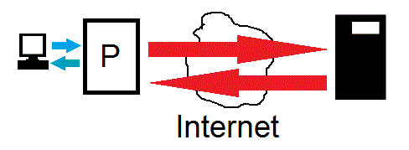
Circuit Level Proxy - 559
A middleman.
A proxy takes client information and sends it to a remote server, it also receives a response and sends it back to the client.

Slide 9
Circuit Level Proxies - 559
Main purpose is to hide internal network and stop direct communications between external machines and internal machines.
Advantages
Fairly simple
Works with all network protocols
Hides internal network addresses
When used with a firewall, stops people from directly starting conversations with internal hosts, while still allowing internal hosts to communicate with the Internet
Disadvantages
A single point of failure and performance issues
Does not analyze data does not protect from dangerous data
Cannot protect against, violations in the protocol or bad data being passed around,

Slide 10
Application Proxies - 559
Like circuit layer proxies, but actually understand the application/protocol they are proxing.
This allows for additional security as they can inspect the data for protocol violations or content.

Slide 11
Application Proxies - 559
Advantages
Application proxies understand the protocol, so they can add extra security
Can have advanced logging/auditing and access control features
Ex. Restrict users to only allowed websites
Ex. Inspect data for protocol violations
Ex. Inspect data for malware (viri etc)
Disadvantages
Extra processing requires extra CPU (slower)
Proxies ONLY understand the protocols they were written to understand. So you generally have a separate application proxy for EACH protocol you want to proxy

Slide 12
Application Proxies - 559
Examples:
Squid web proxy server
Internet Security and Acceleration Server (MS web proxy)
SMTP proxies
FTP proxies

Slide 13
NAT/PNAT
A proxy that works without special software and is transparent to the end users.
Remaps IP addresses, allowing you to use private addresses internally and map them to public IP addresses
NAT allows a one-to-one mapping of IP addresses
PAT allows multiple private address to share one public address

Slide 14
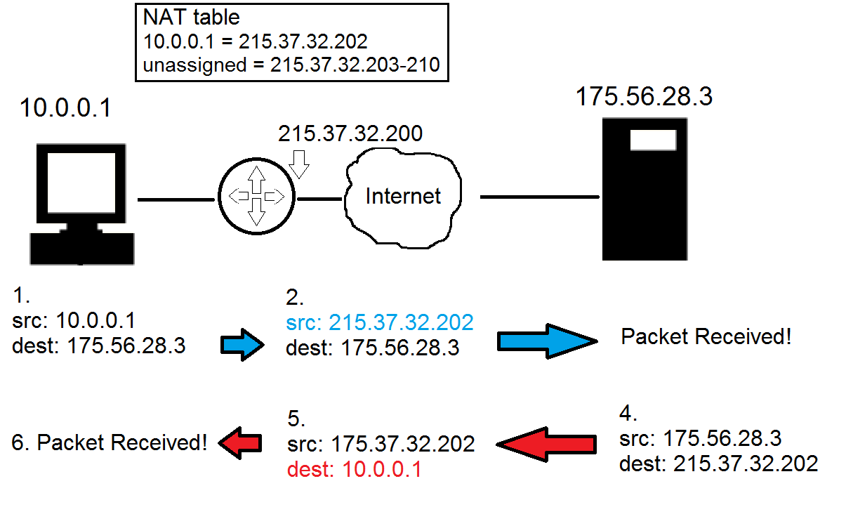
NAT

Slide 15
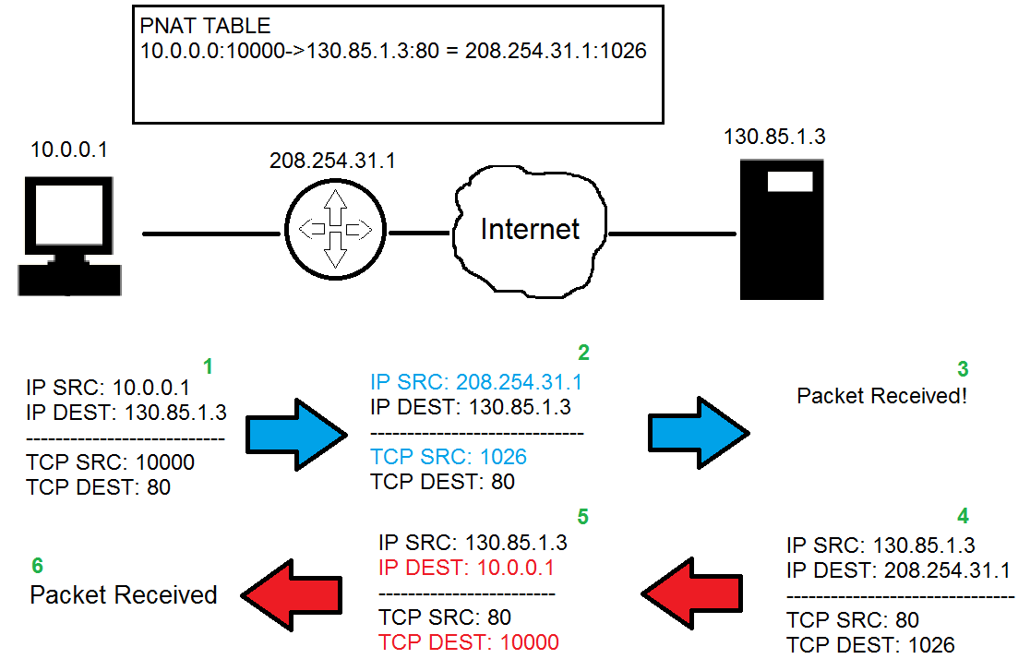
PNAT

Slide 16
NAT/PAT difference
NAT ONLY looks and rewrite the IP addresses*.
NAT requires 1 public IP for each computer that wants to access the Internet simultaneously. If you have 100 computer and you expect 20 of them to access the Internet at any time, 20 public IP addresses are required.
PAT looks at the IP and transport layer port number and rewrites both*
PAT only requires 1 public IP address and can support about 65,000 simultaneous connections for each IP public IP address.

Slide 17
NAT / PNAT
Advantages
Allows you to use private addresses Internally, you don’t need to get real public IP addresses for each computer
Protects the network by stopping external entities from starting conversations to internal machines
Hides internal network structure
Transparent, doesn’t require special software
Disadvantages
Single Point of Failure / Performance Bottleneck
Doesn’t protect from bad content

Slide 18
Overall Firewall best practices (563)
Block un-necessary ICMP packets types.
(Be careful though, know your environment)
Keep ACLS simple
Use Implicit deny*
Disallow source routed packets*
Use least privilege*
Block directed IP broadcasts
Perform ingress and egress filtering*
Enable logging
Drop fragments or re-assemble fragments

Slide 19
Overall Firewall issues
Potential bottleneck
Can restrict valid access
Often mis-configured
Except for application proxies firewalls generally do not filter out malware or improper content.
Don’t protect against internal attacks!*

Slide 20
Firewall Architecture

Slide 21
Security Zones
It is common practice in network and physical security to group different security levels into different areas or zones. Each zone is either more or less trusted then the other zones. Interfaces between zones have some type of access control to restrict movement between zones (like biometric and guard stations) or firewalls.) In Network security there is often a median zone between the Internet and internal network called a DMZ.

Slide 22
DMZ
A buffer zone between an unprotected network and a protected network that allows for the monitoring and regulation of traffic between the two.
Internet accessible servers (bastion hosts) are placed in a DMZ between the Internet and Internal network

Slide 23
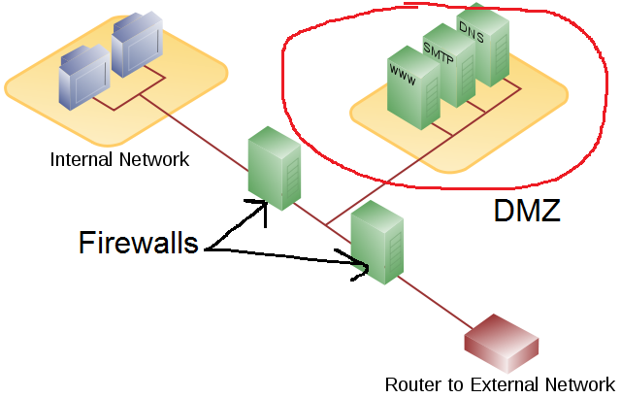
DMZ

Slide 24
DMZ architectures
Multi-homed Firewall
Screened Subnet

Slide 25
Multi Homed Firewall - 565
Multi-homed firewalls may be used to setup a DMZ with a single firewall. (see next slide)
On any multi-homed machine, IP forwarding should be disabled.*

Slide 26
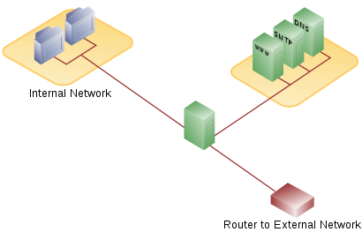
Multi-homed firewall

Slide 27
Screened Subnet - 566
In a screen subnet, there is a separate firewall on both sides of the DMZ.
When using this model it is recommended that each firewall be a different vendor/product.
Diversity of defense*

Slide 28
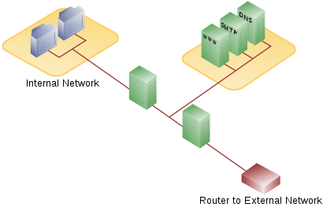
Screened Subnet

Slide 29
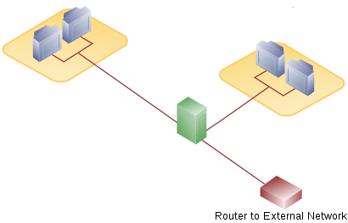
Multiple interface firewalls - 560
A firewall can be placed internally to protect internal networks from each other!

Slide 30
Other Random Network Terms

Slide 31
Other Technological security concepts (572)
Honey pot – a machine left open for attackers to attack.
Honey net – an entire network left open for attackers to attack.
Know the difference between entrapment and enticement?*

Slide 32
NOS (568)
NOS - Network Operating System. All modern OSes are NOS.
This just means they manage more than just the local computer, they usually provide or use network services in a client server architecture.

Slide 33
DNS - 574
Network software uses IP addresses, however these are difficult for users to remember (especially in IPv6). So DNS is used to help map names that we use such as www.paladingrp.com to addresses that computers use like 63.251.179.13

Slide 34
DNS
Common top level domains are
.COM
.EDU
.MIL
.GOV
.ORG
.NET
You should be aware of these above

Slide 35
DNS cache poisoning - 577
Besides authoritative name servers organizations also have caching name servers that simply do DNS resolution on behalf of clients.
One common attack is DNS cache poisoning*

Slide 36
DNS SEC
DNS sec tries to ensure integrity of DNS queries by digitally signing responses.* This attempts to defeat cache poisoning.

