Slide 1
HANGMAN
THEORY OF AUTOMATA PROJECT
Instructor:
Sir Muhammad Hussain Mughal
By:
Ayesha Noor Muhammad Asif

Slide 2
Project
Automata theory plays an important role in various areas especially in game design. We designed the hangman game using concepts of theory of Automata

Slide 3
RULES AND OVERVIEW
Hangman is a classical game where it requires the players to guess a word based on the category that they choose or the hint provided to them.
It can be played by 1 or 2 players although we will only focus on the single player game.
When player starts the game it shows a hint and based on that hint the game will generate a random word.
The player will choose a set of alphabets (A – Z) to fill in the word.

Slide 4
Cont..
The player is able to choose the alphabets as long as it is correct. However, if the player chooses the wrong alphabets, a diagram of the hangman will be drawn a little by little.
When the drawing of the hangman is complete, the player won’t be able to choose the alphabets anymore and they will lose the game. After that, the game will be ended.
If you guessed the word correctly you win the game

Slide 5
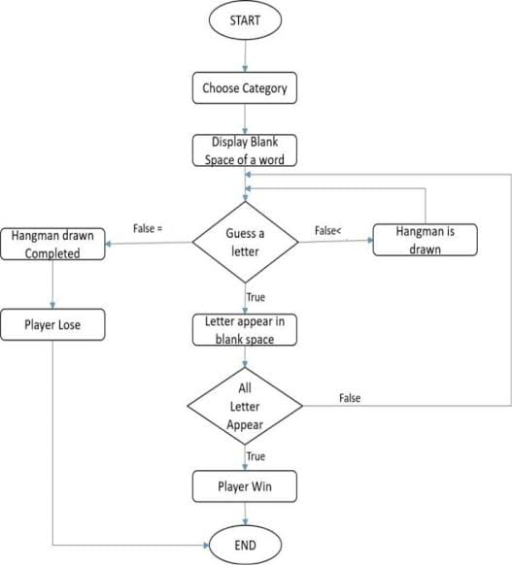
11
11

Slide 6
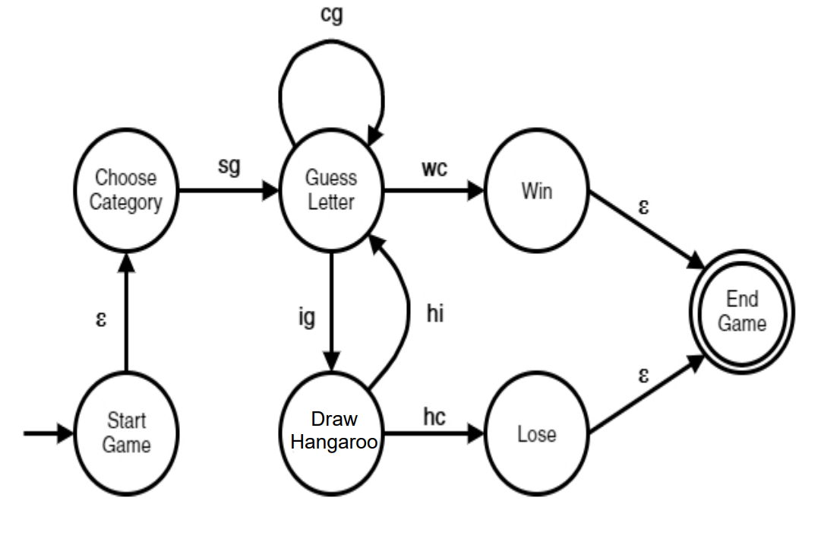
Automation of game

Slide 7
Formal definition:
Let M = (Q, ∑,δ, q0, F)
M: Q = {Start Game, Choose Category, Guess Letter, Draw Hangman, Win, Lose, End Game}
∑= {sg, cg, ig, hi, hc, wc}
q0 = {Start Game}
F = {End Game}

Slide 8
State (Q) | Description
Start game | Idle state where game starts
Hint or choose category | The player will need to choose a category from a set of categories that the game provided. Once a category is chosen, a random word/sentence related with the category will be displayed for the player to guess. In our case we provided the hint related to that word
Guess letter | Player enters a letter in order to guess the word/sentence Given
Draw Hangman | Hangman will be drawn starting from the head to its leg
Win | Word is guessed correctly
Lose | Word is incorrectly guessed
End game | Where the game ends

Slide 9
Transition description
Transition δ | Description
Sg | Start game
Cg | Correct guess
Ig | Incorrect guess
Hi | Hangman incomplete
Hc | Hangman complete
Wc | Word complete

