Slide 1


Shut down
Log off
Director (D) – Cumulative info – review/approve reports; Alert isolates; communication outside
Supervisor (S) – review/approve reports
Technologist (T) - entry
Do they need lab admin (supervisor) login separate screen?
Admin/ non-Admin : different privileges
LAB LOG IN
USERNAME
PASSWORD
OK
CANCEL
Q: Roles – backend
do they need different levels of access within the lab
Q: Internet/LIS/FTP connectivity
1/1/2023
10:10
Service log-in

Slide 2


Shut down
RACK STATUS / HOME SCREEN
Log off
Rack 1
Rack status
36C
5%
Open Bay
2
Load Cassette
Running
1
Offline
Complete
2
Reports
Bay Errors
1
Hardware and software errors
Status: Running/Error/complete
Maintenance
Order
System setup
Reader Status: OK
1/1/2023
10:10

Slide 3
Shut down
Rack Status/Rack1/Error
Log off
R-3
Rack 1
R-2
Rack status
36C
5%
Total Errors
3
Load Cassette
Error Details
Action
Error-A:
Cassette insert error (111b) – Bay -1A;
Eject cassette
Reports
Error-B:
No error - Bay -1B
Maintenance
Bay -1
Status: OK
Order
System setup
1/1/2023
10:10

Slide 4
Shut down
Rack Status/rack 1/Completed
Log off
Q: Do you need cassette type info here?
Rack 1
Rack status
36C
5%
Complete
4
Load Cassette
Complete
Accession #
Bay #
Info/Details
Result
Action
1
2
3
4
CSV title
Complete
View/Verify/modify
Reports
Maintenance
Status: OK
Order
System setup
1/1/2023
10:10

Slide 5
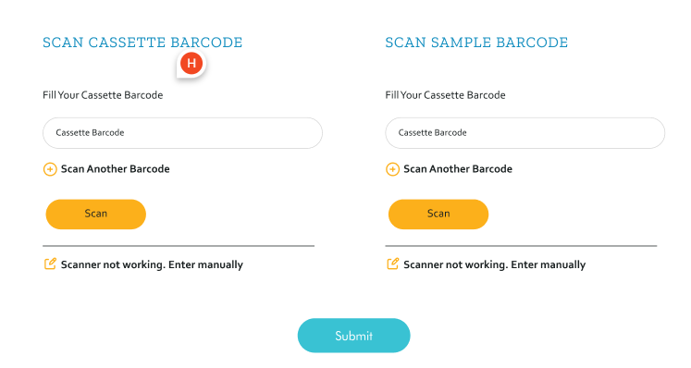
Shut down
Load Cassette
Log off
Scan multiple samples/cassette pairs (unique identifier);
Click Done after each pair scan;
Scan multiple;
Insert them one at a time; Internal Bay-A/B RFID reader will read the cassette ID again to associate each bay with cassette# and Sample #
Doesn’t activate until cassette A/B autofills
Rack status
Load Cassette
SCAN SAMPLE BARCODE
CASSETTE
Reports
Isolate #
A
B
Cassette #
Done
Clear
Free text ABC/ Rerun
1
Clear
Maintenance
Batch entry
Inactivate other icons; have sample barcode active; when scanned; then activate cassette entry; submit
Order
System setup
1/1/2023
10:10

Slide 6
Shut down
Load Cassette
Log off
Enter Sample and concentration details
Rack status
Sample Type:
Sample Strain:
Medium:
Free Text:
Load Cassette
Initial OD:
 | 1 | 2 | 3 | 4 | 5 | 6 | 7 | 8 | 9 | 10
A | Tet-0.25 | Tet-0.5 | Tet-1 | Azi-0.25 | Azi-0.5 | Azi-1 | Blank | +ve control |  | Empty
A –pre Notes
B
B - pre Notes
C
C – pre Notes
Reports
Maintenance
Order
System setup
1/1/2023
10:10

Slide 7


Shut down
Load Cassette/Batch Entry
Log off
SCAN SAMPLE BARCODE
SCAN CASSETTE BARCODE
Fill your sample barcode
Isolate #
Fill your cassette barcode
Rack status
Clear
1
A
B
Clear
Free text ABC
Done
Scan not working. Enter manually
Clear
Load Cassette
A
B
Clear
Clear
1
Free text ABC
Done
Clear
Scan not working. Enter manually
Reports
A
B
Clear
Clear
1
Free text ABC
Done
Clear
Scan not working. Enter manually
A
B
Clear
Maintenance
Clear
1
Free text ABC
Done
Clear
Scan not working. Enter manually
A
B
Clear
Clear
1
Free text ABC
Done
Order
Clear
Scan not working. Enter manually
System setup
1/1/2023
10:10

Slide 8

Shut down
REPORTS
Log off
Rack status
Load Cassette
Reports
Isolate Reports
Maintenance
Order
System setup
Reader Status: OK
1/1/2023
10:10

Slide 9
Shut down
Reports/Isolate Reports
Log off
Actively run a report when we click on it
Rack status
Sample/Accession Number | DATE | Info/Details | Reports
CSV: 123ABC/Title | 01/01/2023 | NG-AR 167 (1st line of csv) | Report
124ABC |  | NG-AR 167 | Report
Load Cassette
Reports
Maintenance
Default settings:
X axis: 0 hr – x hrs; Y axis: Auto scale;
Normalized: Yes;
Wavelength for consolidation: Green;
Order
System setup
1/1/2023
10:10

Slide 10
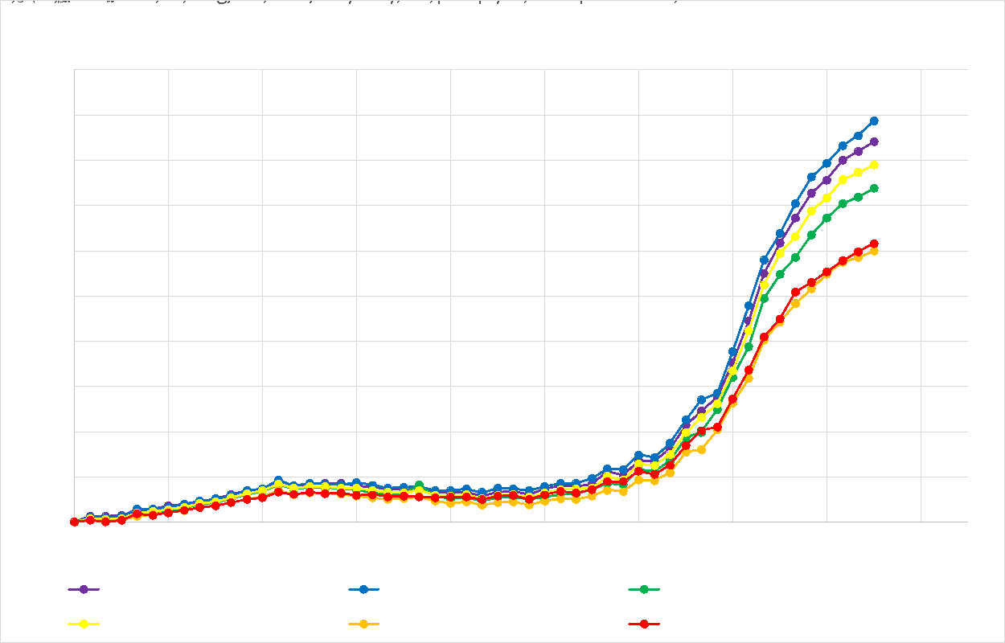
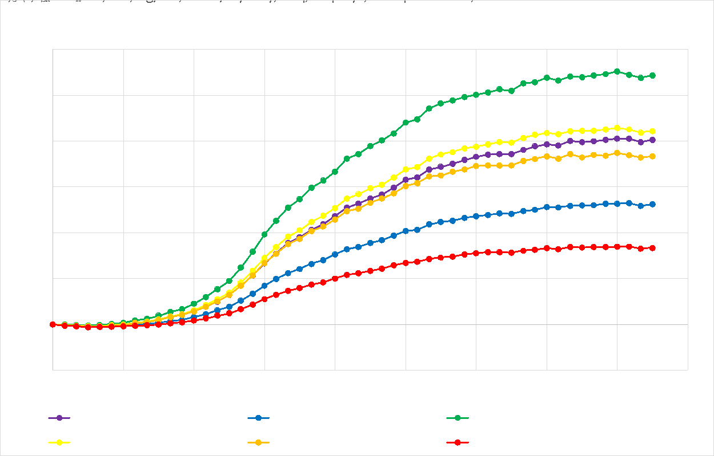
Active Report: This is one report
Change attributes
Row 1
Row 2
Row 3
Enter End results and observations

Slide 11

Attributes needed for report
Group Plots by
Group 1
Group name
Select Fav Settings
Custom
Custom
Default
Jared
Rani
Wells
Scale Graph
Data
Wavelength
A1
A2
A3
A4
A5
A6
A7
A8
A9
A10
B1 ---- B10
C1 ---- C10
X-axis
Y-axis
Raw data
Calibrated
Normalized
Violet
Blue
Green
Red
Yellow
Orange
Min Max
Min Max
OR
+ Add group
A way to save graphs;
A way to save new settings as fav settings
At most will have 3 - 4 groups
Plot graphs based on selected well groupings and settings
Cancel
APPLY
Save this setting

Slide 12
Attributes needed for report
Group Plots by
Group 2
Group name
Select Fav Settings
Custom
Custom
Default
Jared
Rani
Wells
Scale Graph
Wavelength
Data
A1
A2
A3
A4
A5
A6
A7
A8
A9
A10
B1 ---- B10
C1 ---- C10
X-axis
Y-axis
Raw data
Calibrated
Normalized
Violet
Blue
Green
Red
Yellow
Orange
Min Max
Min Max
+ Add group
A way to save graphs?
A way to save new settings as fav settings
At most will have 3 - 4 groups
Plot graphs based on selected well groupings and settings
Cancel
APPLY
Save this setting

Slide 13
Change attributes
Group 1:
Group 2:
Group 3:
Group Name
Group Name
This gives option to save things in a specific folder with a popup:
save graph as PNG
Save datafile as CSV to use that custom data for some additional processing if needed
Legend gives cell label and color codes for graphs;
Subtitle – gives grouping info – wavelengths; and Data type (raw, calibrated or normalized)
Hover over each graph to display prenotes and post notes
Save Graph
Save datafile
Save Graph
Save datafile
Take you back to SLIDE 10
Enter End results and observations
Cancel/BACK

Slide 14
Shut down
Reports
Log off
Enter End results and observations
Auto-populate the initial well entries (Rows titled A, B and C)
Rack status
Initial plate count:
 | 1 | 2 | 3 | 4 | 5 | 6 | 7 | 8 | 9 | 10
A | Tet-0.25 | Tet-0.5 | Tet-1 | Azi-0.25 | Azi-0.5 | Azi-1 | Blank | +ve |  | Empty
A - OD
A – post notes
B
B - OD
B – post Notes
C
C - OD
C – post Notes
Load Cassette
Reports
Maintenance
Order
System setup
Save the files to the Drive,
Raw system datafiles after updates;
2. Graphs
Datafiles of the graphs – in CSV ?
SAVE
1/1/2023
10:10

