Slide 1
PROJECT PRESENTATION
Prepared By:
M. Bilal Iqbal
Syed Mohsin Kazmi
Mugheera Khan
Prepared For:
Sir Abdul Ghaffar

Slide 2
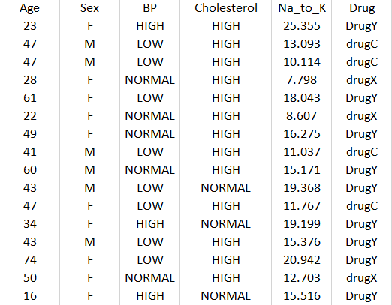
WHAT IS YOUR DATASET?
Our dataset appears to be a medical dataset with various attributes such as age, sex, blood pressure (BP), cholesterol level, sodium-to-potassium ratio (Na_to_K), and the corresponding drug administered.

Slide 3
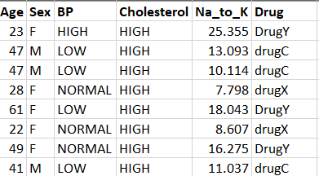
WHAT TYPE OF DECISION YOU CAN PERFORM BY USING THIS DATASET?
This dataset can be used for various types of analysis and decision-making tasks. It will suggest to us that what type of drug is required on the basis of BP and Cholesterol ratio. The appropriate drug will be used on the basis of such. We will also explore the relationships between different attributes such as BP, Cholesterol, and Na_to_K ratio with the type of drugs. We will predict on the basis of the BP attribute of a person if he will be suffering from Cholesterol problems or not and on such grounds we will suggest to him the type of drug that he will use or otherwise he will suffer from side effects from the usage of the irrelevant drug.

Slide 4
HOW DATA MINING WILL BE HELPFUL TO GET VARIOUS TYPES OF KNOWLEDGE FROM THE SAME DATASET?
Data mining techniques are used to extract knowledge from the medical dataset;
Data preprocessing involves cleaning and preprocessing the dataset, performing exploratory data analysis, identifying correlations, and visualizing the distributions of variables.
Exploratory data analysis involves visualizing the distributions of variables, identifying correlations, and examining any initial patterns or trends.
Feature selection techniques are used to identify the most relevant attributes for predicting the drug category.
Pattern discovery and association analysis are used to discover patterns and relationships within the dataset. Classification models are used to predict the drug category based on patient attributes. Evaluation metrics such as accuracy, precision, recall, and F1-score are used to assess model performance.
Cross-validation techniques are used to validate a model's generalization ability.
Clustering analysis is used to group similar patients together based on their attributes.
Outlier detection is used to identify unusual patient profiles or errors in the dataset.
Sequential pattern mining is used to uncover temporal dependencies and understand how patient characteristics relate to changes in drug treatment.
Risk assessment models are used to assess patient risk and support treatment decision-making.
A decision support system is used to provide healthcare professionals with insights and recommendations based on the patterns, associations, and risk assessments derived from the dataset.

Slide 5


