Slide 1
SHUSHCHAT
SECURE P2P COMMUNICATION
Muhammad Bin Waseem 2023403
Muhammad Shaheer 2023509
Muhammad Zaeem Nawaz 2023550

Slide 2
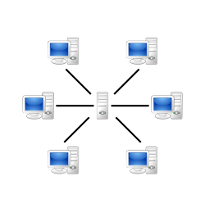


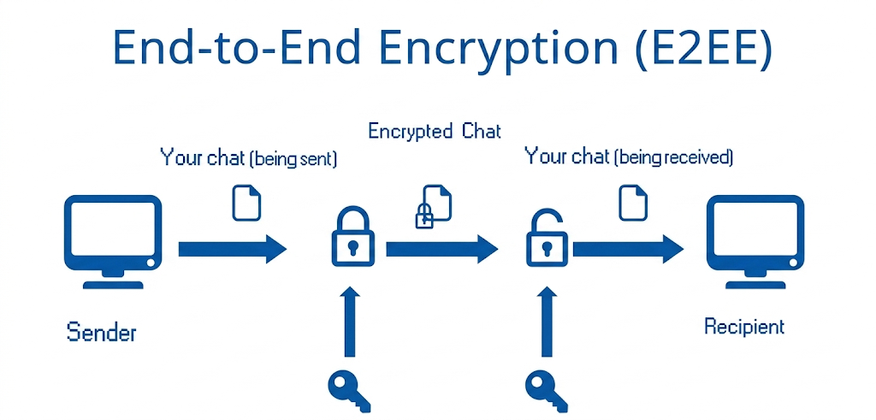
What is ShushChat?
Shushchat is a secure peer-to-peer (P2P) chat system, where messages are sent directly between peers with point-to-point encryption, eliminating the need for a central server. This system demonstrates practical networking concepts alongside core principles of secure software design, including encryption, authentication, and integrity verification.

Slide 3



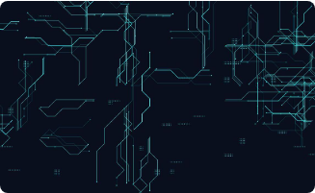





DEVELOPMENT ROADMAP
Phase-1
Phase-2
Phase-3
Security Requirements and planning
Threat Modeling
Initial Implementation
Secure Coding
Security Testing Analysis
Secure code review

Slide 4
Deliverable-1

Slide 5

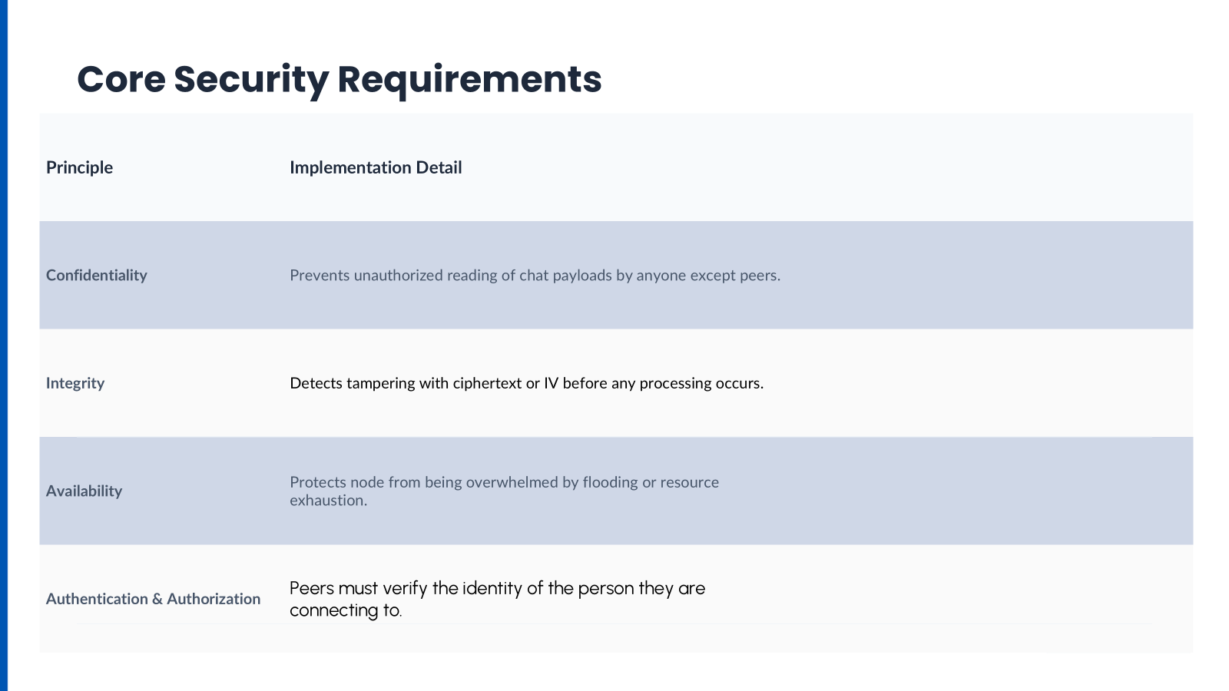
Core Security Requirements

Slide 6

Threat Modelling
Spoofing: Attackers attempting to impersonate peers by stealing private keys or spoofing public identities.
Information Disclosure: Potential leakage of credentials or chat history (PII) due to weak encryption or storage flaws.
Denial of Service (DoS): Malicious peers flooding the network to cause "broadcast storms" and exhaust system resources.
Tampering: Memory manipulation through abnormal access patterns or poisoning stored data via injection.

Slide 7
Risk Management
Category | Threat Description | Likelihood | Impact | Mitigation
Spoofing | Compromise of user accounts | Medium | Critical | Ed25519 signing
Disclosure | Sensitive data leakage (PII) | Medium | Critical | AES-256 encryption at rest
Tampering | Malicious payload manipulation | High | High | Input validation / Sanitization
DoS | Flooding-based service denial | High | High | Rate limiting & allocation

Slide 8
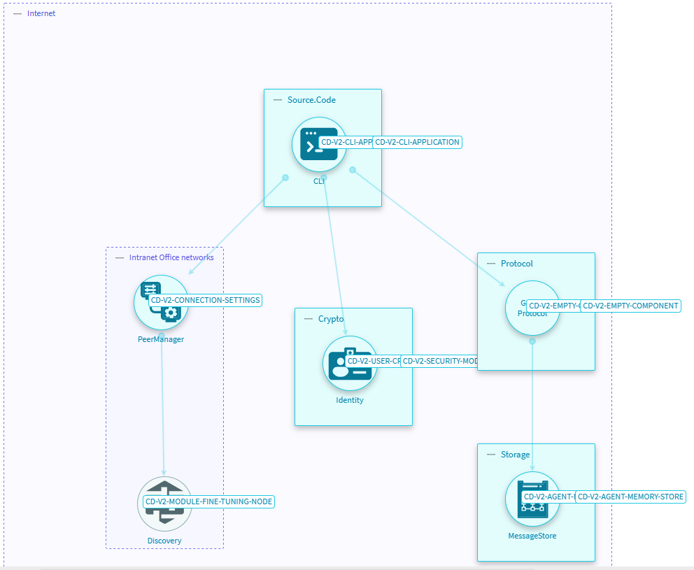
Architecture Diagram

Slide 9
Deliverable-2

Slide 10
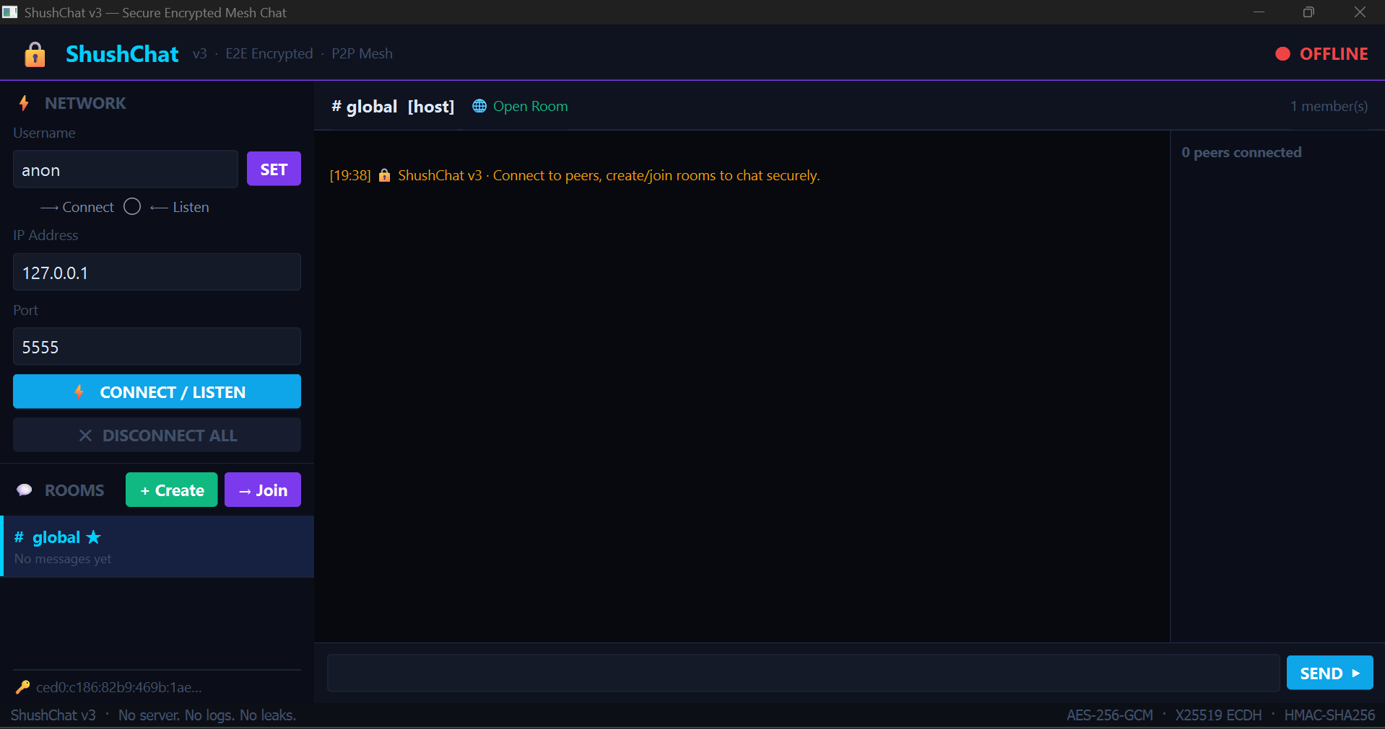
Deliverable-2
ShushChat_v1 utilizes a modular codebase for maximum security isolation:
networking.py: TCP Socket management and peer state.
crypto.py: RSA/AES hybrid encryption routines.
gui.py: TKinter-based responsive chat interface.
main.py: Threaded orchestration of the P2P lifecycle.

Slide 11







CORE SYSTEM PILLARS
Pure P2P
E2EE Logic
Fluid Interface
Direct socket-to-socket interaction between nodes. Scalability is limited only by network bandwidth.
Encryption happens at the edge. Keys never leave the local device, ensuring zero-knowledge transit.
Abstracting complex network protocols into a simple, reactive GUI built for immediate adoption.

Slide 12

CRYPTOGRAPHIC DEFENSE
The Multi-Layer Shield
We employ a Hybrid Encryption System:
○
RSA-4096: Secure key exchange for the initial handshake.
○
AES-256-CBC: High-speed encryption for the message payload.
○
SHA-256 HMAC: Ensuring message integrity and authenticity.

Slide 13
Deliverable-3

Slide 14
ADDED FEATURES
Network-layer hardening and fail-secure mechanisms.
Rate Limiting: Sliding-window limiter restricts peers to 30 messages (256 KB) per 5-second interval.
Resource Caps: Hard connection limit of 32 concurrent peers to prevent socket exhaustion attacks.
Frame Validation: Strict enforcement of MIN/MAX_MSG_SIZE (512 KB) before any memory allocation.
Fail-Secure Design: Immediate connection termination upon detecting malformed frames or decryption anomalies.
Timeouts: Integrated receive timeouts to prevent.

Slide 15
INITIAL TESTS : VULNERABILITIES
Spoofing Threats
Information Leakage
DoS Susceptibility
Lack of peer identity verification allowed Man-in-the-Middle (MitM) attacks during X25519 handshakes. Public keys were unverifiable.
Weak room password handling (unsalted SHA-256) and transmission of hashes in payloads exposed credentials to brute-force attacks.
Absence of rate limiting enabled "Broadcast Storms" where malicious nodes could flood peers and exhaust system resources.

Slide 16
OVERALL SUMMARY
The following table consolidates the key findings across all five testing tools:
Tool | Before | After | Change | Verdict
Bandit | 9 issues (7L, 2M) | 1 issue (1M) | −89% | Major Improvement
Pylint | 7.65/10 | 8.13/10 | +0.48 | Improvement
Radon MI | C (gui), A (others) | C (gui), A (others) | Minimal | Stable
Radon Raw | 1,911 total SLOC | 1,984 total SLOC | +3.8% | Minor Growth
Nmap | Handshake JSON exposed | No probe data leaked | Improved | Security Gain
Wireshark | Handshake visible | Obfuscated (inferred) | Improved | Security Gain

