Slide 1
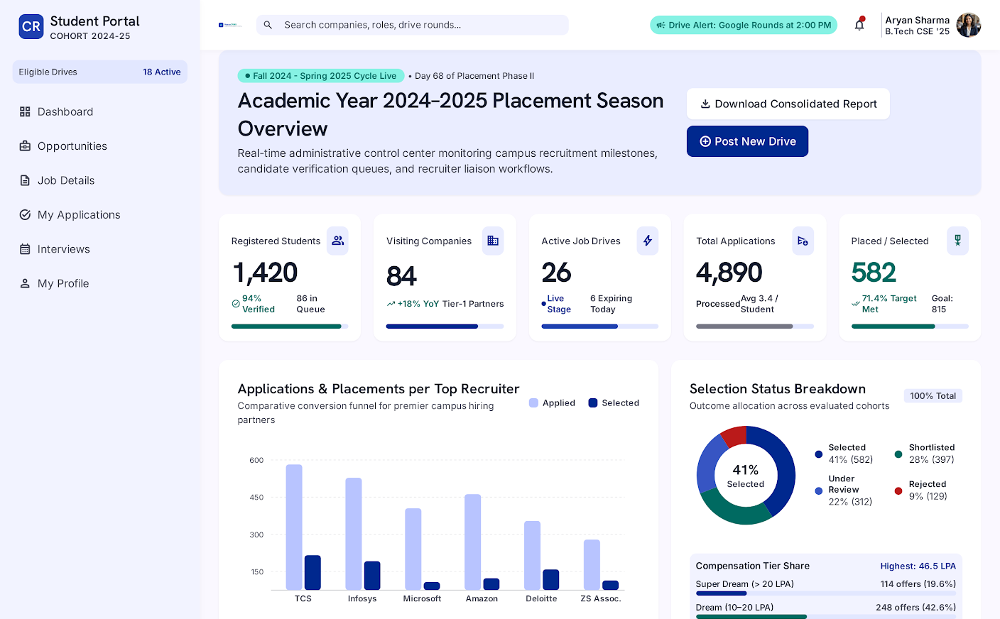
CAMPUS RECRUITMENT SYSTEM
NexusCRMS
Project Demonstration & Live Website Walkthrough
An interactive, automated platform connecting college placement cells, recruiting companies, and eligible students.
• Role-Based Access (Admin & Student)
• Real-Time CGPA & Branch Eligibility Engine
• 4-Stage Visual Application Pipeline
• Built on PHP (MVC) + MySQL + Bootstrap
🔒 localhost/crms/admin/dashboard

Slide 2
ADMINISTRATOR MODULE
Admin Placement Dashboard & Live KPIs
1. Real-Time KPI Cards
Live counters for Total Placed Candidates, Active Job Drives, Partner Companies, and Placement %.
🔒 localhost/crms/admin/dashboard
2. Recruitment Activity Feed
Monitors live application submissions and urgent stage-closing drives.
3. Fast Navigation Drawer
Instant 1-click access to candidate pools, drive creation, company lists, and analytics.

Slide 3
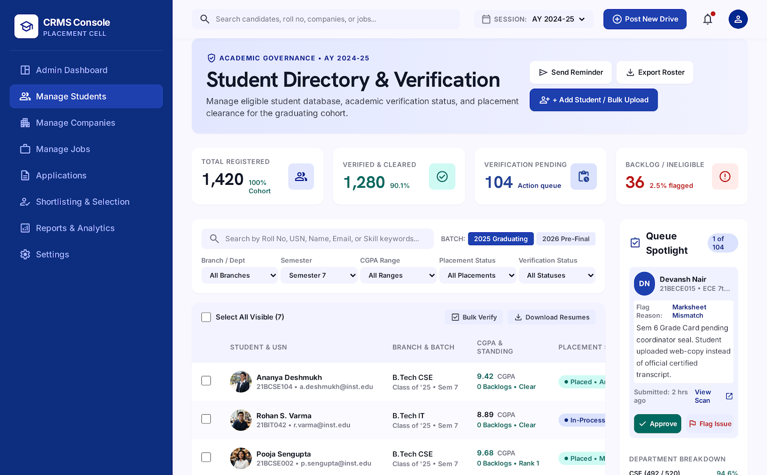
STUDENT MANAGEMENT
Student Directory & Verification Records
1. Comprehensive Student Profiles
Displays verified academic records: Roll number, Course/Branch, Semester, and CGPA.
🔒 localhost/crms/admin/students
2. Advanced Branch Filtering
Quickly filter eligible pools across B.Tech CSE, IT, ECE, MCA, or Mechanical.
3. Resume & Contact Links
Direct access to uploaded GitHub/PDF resumes and student contact channels.

Slide 4
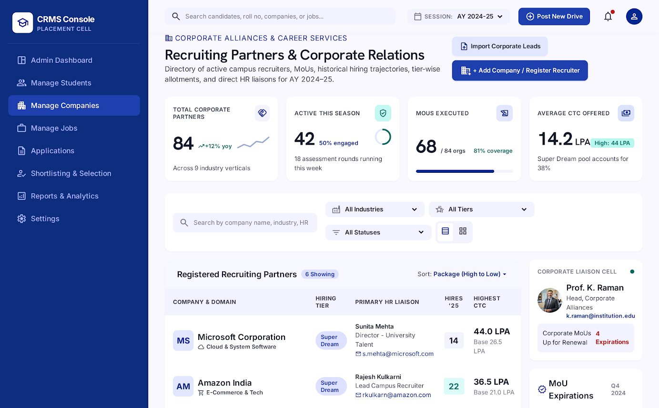
CORPORATE PARTNERS
Partner Companies & Recruiter Directory
1. Corporate Directory (CRUD)
Manage recruiting profiles for Google, Microsoft, AWS, TCS, Infosys, and startups.
🔒 localhost/crms/admin/companies
2. Recruiter Contact Database
Stores designated HR point of contact, corporate emails, phone numbers, and official websites.
3. Hiring History & Tiering
Categorize partners into Tier-1 and mass hiring categories with active opening indicators.

Slide 5
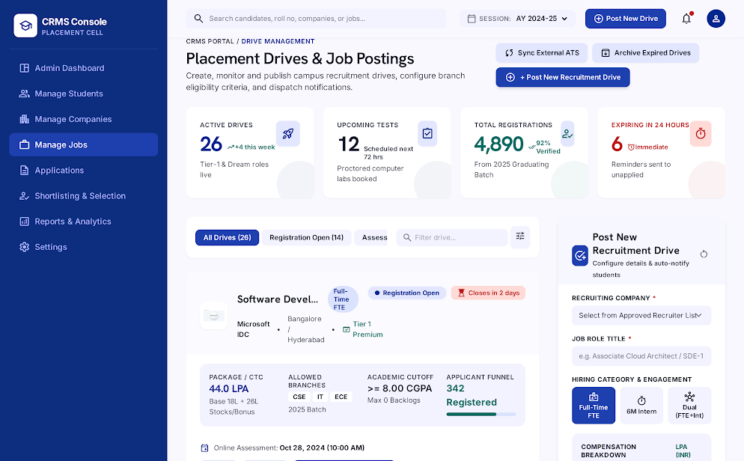
PLACEMENT DRIVES
Job Drives & Placement Drive Management
1. Drive Configuration
Create openings specifying Job Title, Job Type (Full-time / Internship), and CTC Salary Packages.
🔒 localhost/crms/admin/jobs
2. Strict Eligibility Criteria
Set minimum CGPA cut-off, allowed degrees, eligible semesters, and required skill tags.
3. Deadlines & Status Control
Enforces automated application deadlines and toggle active/closed drive status.

Slide 6
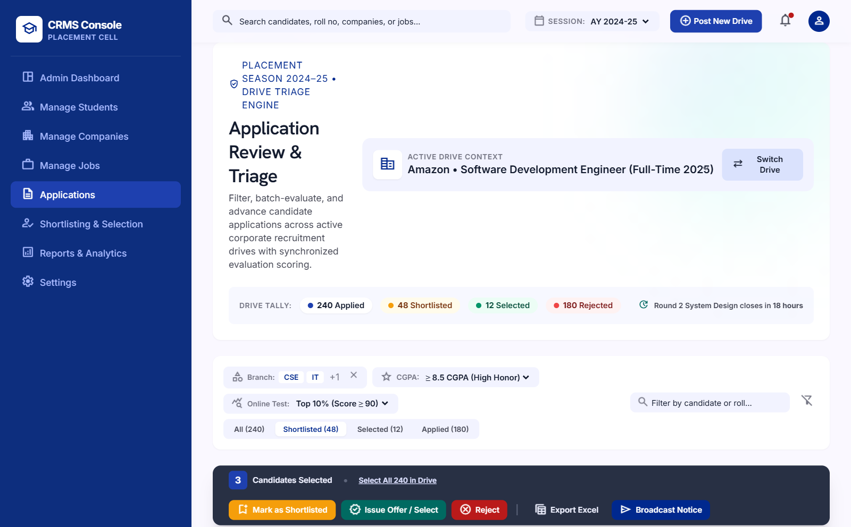
APPLICATION PIPELINE
Applications Review & Candidate Roster
1. Centralized Applications Feed
Real-time list of all submissions filtered by drive and hiring department.
🔒 localhost/crms/admin/applications
2. Status Action Controls
Easily update candidates to Under Review, Shortlisted, Selected, or Rejected.
3. Coordinator Notes
Log confidential interview comments and technical round evaluation scores.

Slide 7
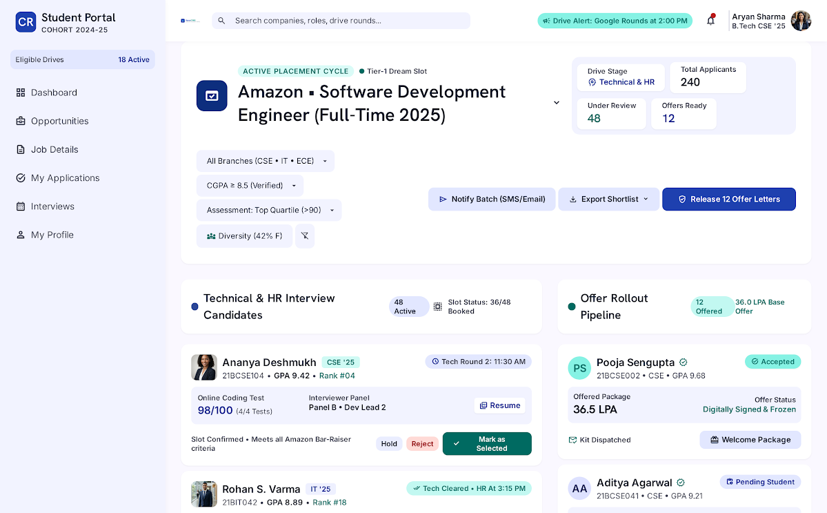
SELECTION & HIRING
Shortlisting Board & Offer Management
1. Interactive Selection Board
Drive-by-drive evaluation interface for placement coordinators.
🔒 localhost/crms/admin/shortlisting
2. Offer Letter Allocation
Assign official institutional offer reference numbers (e.g. MSFT-2026-INT-0441).
3. Remarks & Feedback
Record special packaging terms, PPO agreements, and joining remarks.

Slide 8
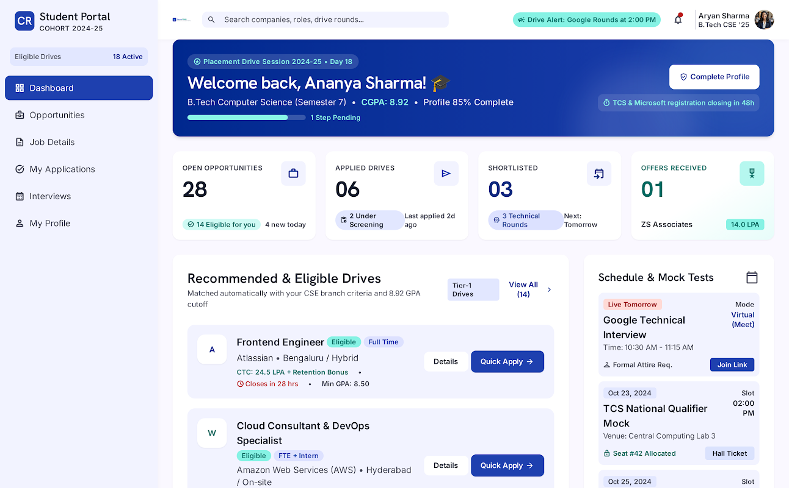
STUDENT PORTAL
Student Dashboard & Visual Application Tracker
1. Personalized Student View
Shows academic standing, current semester, verified CGPA, and skill badges.
🔒 localhost/crms/student/dashboard
2. 4-Stage Visual Stepper
Live color-coded status bar: Applied -> Under Review -> Shortlisted -> Selected!
3. Instant Offer Recognition
Direct view of received placement offers and coordinator recommendations.

Slide 9
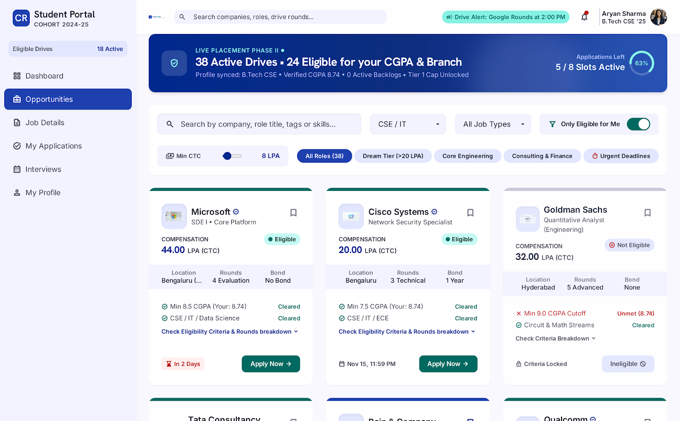
OPPORTUNITIES CATALOG
Smart Eligibility Engine & Job Catalog
1. Automated Eligibility Checks
Real-time algorithmic check against student CGPA, branch, and semester.
🔒 localhost/crms/student/opportunities
2. Visual Status Indicators
Green badge for Eligible drives (with skill match %); Red badge with exact disqualification reason.
3. 1-Click Fast Apply
Instant submission with guard checks preventing duplicate submissions.

Slide 10
NexusCRMS: Technology & Architecture Summary
A fully responsive, production-ready campus placement web application
Frontend Design
Bootstrap 5 + Vanilla CSS
Material Design Symbols
Mobile & Desktop Responsive
Chart.js Data Visualizations
Backend Architecture
PHP 8.2 (MVC Pattern)
Front Controller Routing
Clean OOP Domain Models
Strict Session Authentication
Database Layer
MySQL 8.0 Relational DB
PDO Prepared Statements
Foreign Key Constraints
Indexed Search Queries
Security Features
Bcrypt Password Hashing
SQLi Immunity via PDO
Duplicate Application Guards
Role-Based Access Control
✨ Thank you! Open for Questions & Live Demonstration (localhost/crms/)

