Slide 1
Detection and Mitigation of O1 Interface Attacks in O-RAN Using SIEM Pipelines
​
​
Author : Muhamamd Eahtesham​
Supervisor: Manasik Hassan​
Chair: Prof. Dr.-Ing. habil. Andreas Mitschele-Thiel ​
Department: RCSE ​
Semester: Summer 2026​

Slide 2
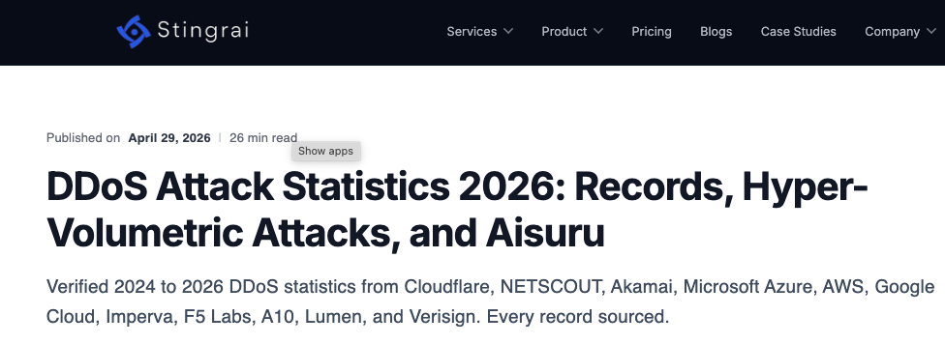
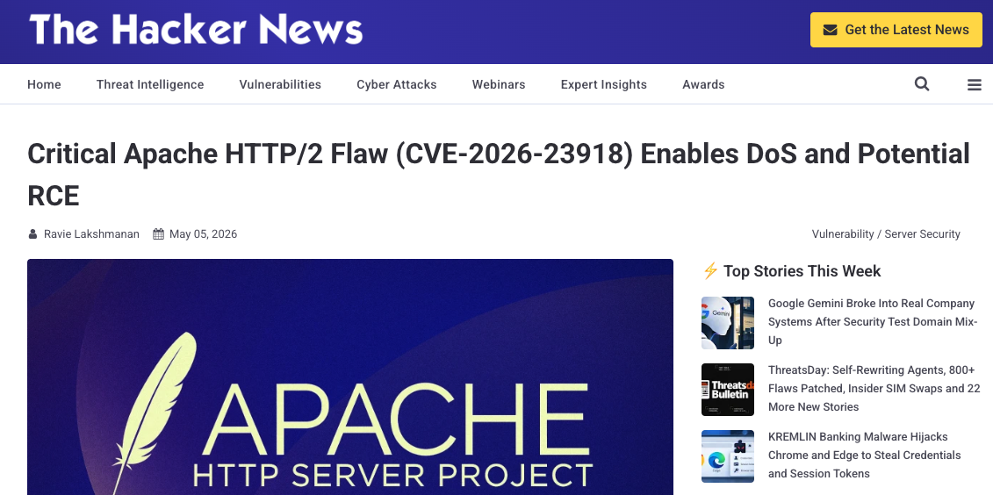
Motivation
DDoS attacks have reached record scale (2025–26)​
Record volumetric bursts: 31.4 Tbps (Cloudflare), 15.7 Tbps / 3.6 Bpps (Azure)​
Peak bandwidth +85% YoY, packet rate +56% — driven by IoT super-botnets of millions of device
Cover for stealth intrusion; telecom is a top-targeted sector​

Slide 3
Why this matters for O-RAN​
What this project targets​
Why detection must evolve​
Notes:
Why this matters for O-RAN​
​
Open interfaces widen the attack surface​
O1 controls the entire RAN centrally​
One management channel, one point of failure​
A high-value, high-impact DoS target​
What this project targets​
​
Focus: the O1 interface (SMO ↔ O-DU)​
Protocol: NETCONF over TLS, port 6513​
Threat scenario: T-SMO-03 (denial of service)​
Studies O1 exposure to DDoS attacks​
Telecom is a top-targeted sector​
Only 44% stay attack-free for 30 days​
​
Why detection must evolve​
Short-burst, low-volume attacks evade legacy tools​
Detection must be fast and behavioural​
Not volumetric thresholds alone​
Motivates this project's SIEM + anomaly pipeline​
​

Slide 4
Architecture

Slide 5
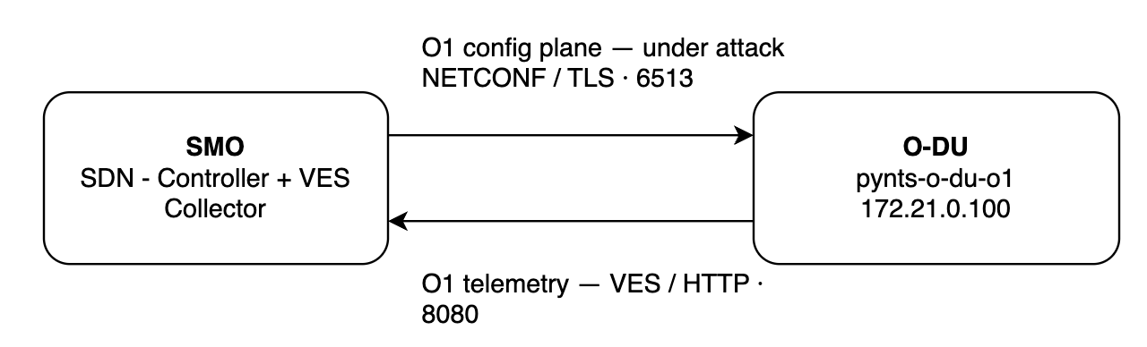
The O1 interface

Slide 6
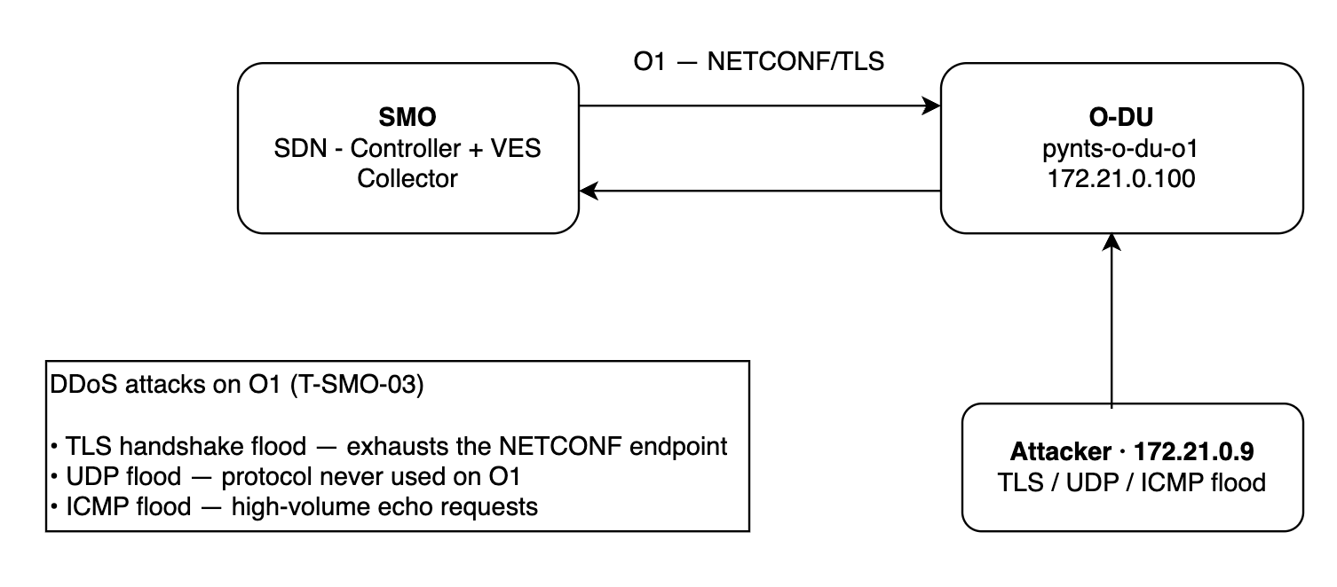
DDoS Threat Simulation

Slide 7
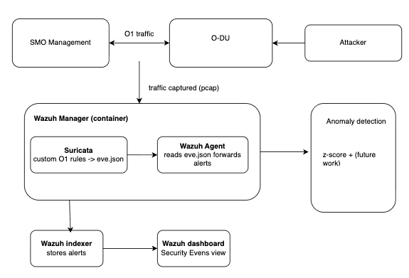
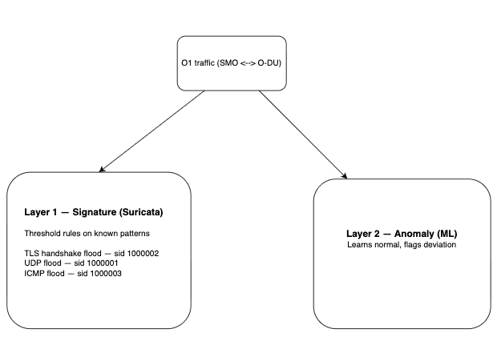
The detection pipeline Defending the infrastructure

Slide 8

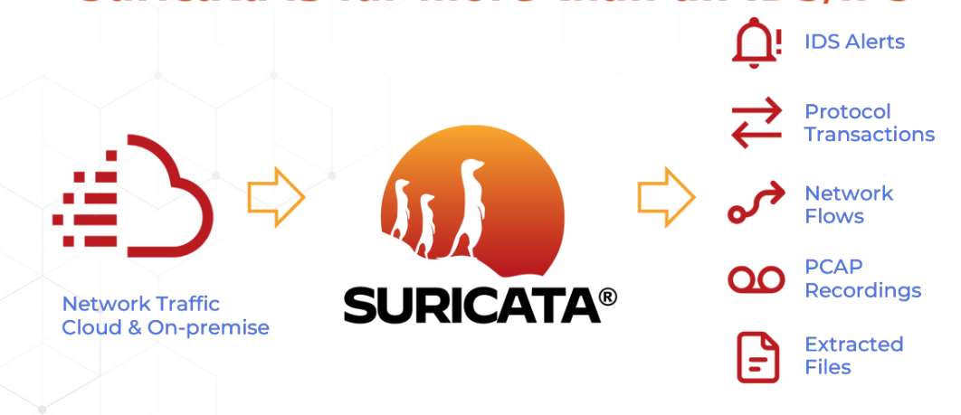
Monitoring stack (Wazuh 4.7.3, single-node)
Wazuh manager, indexer, and dashboard
Suricata installed as a process inside the Wazuh manager — the network sensor
Runs alongside the O-RAN stack, observing its traffic without being part of it

Slide 9
Methodology

Slide 10
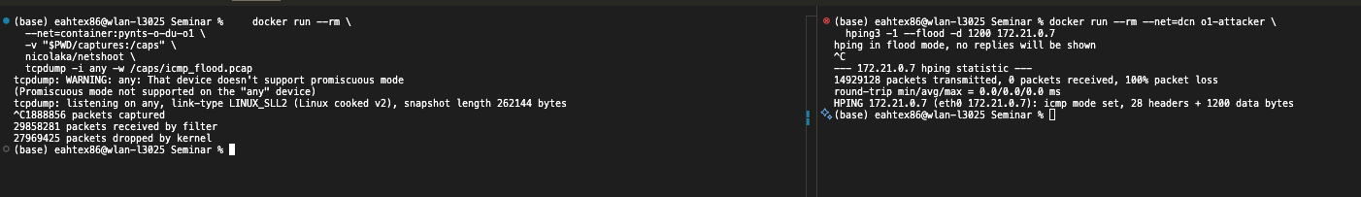
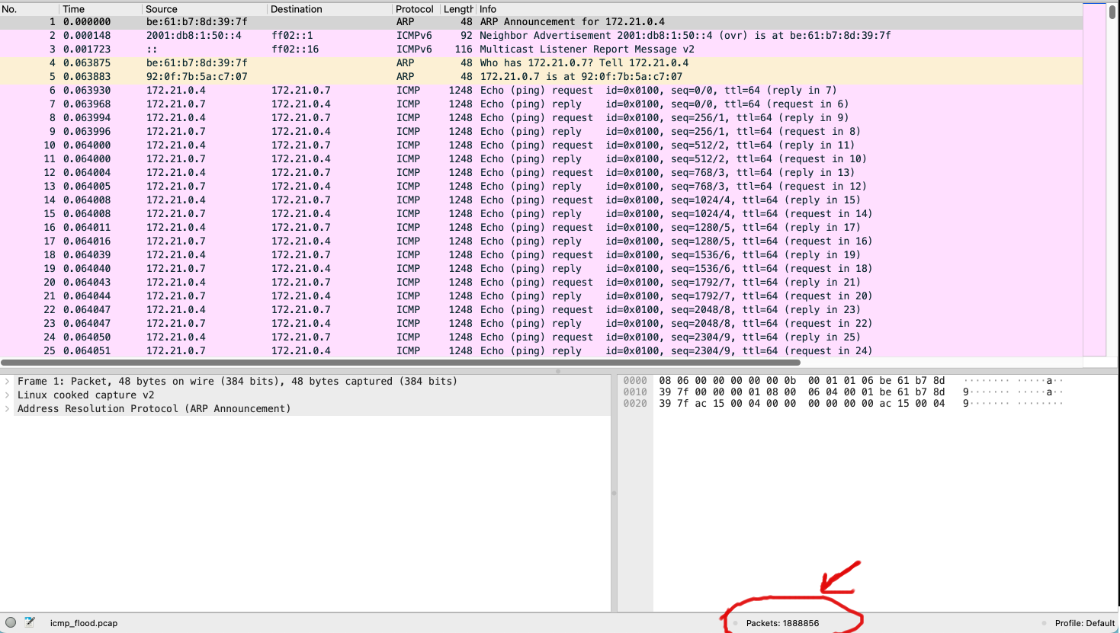
ICMP Flood

Slide 11
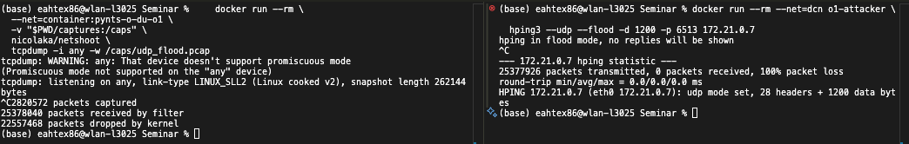
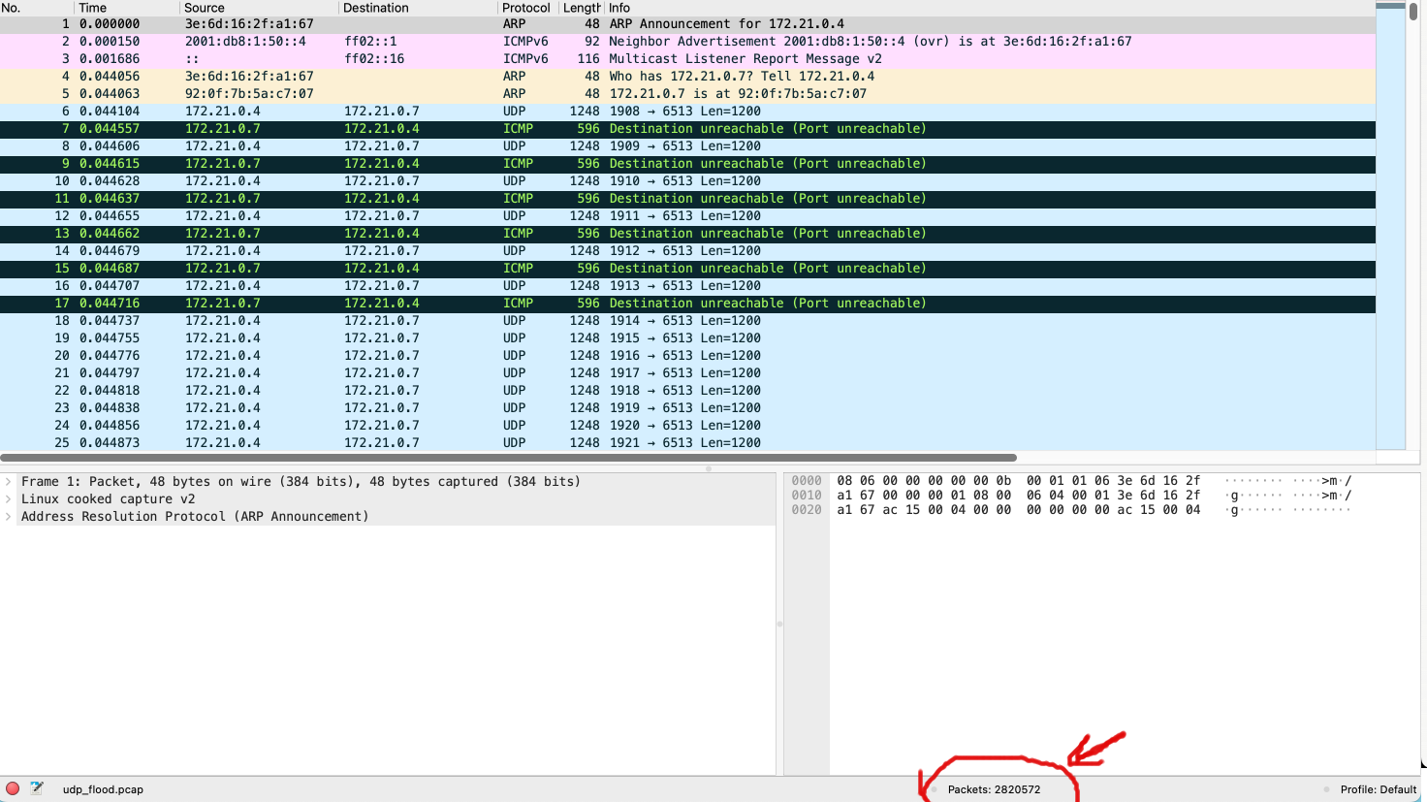
UDP Flood

Slide 12
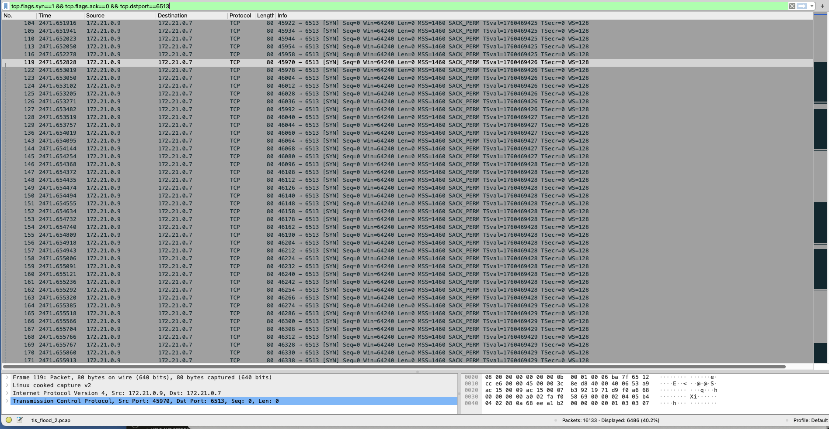
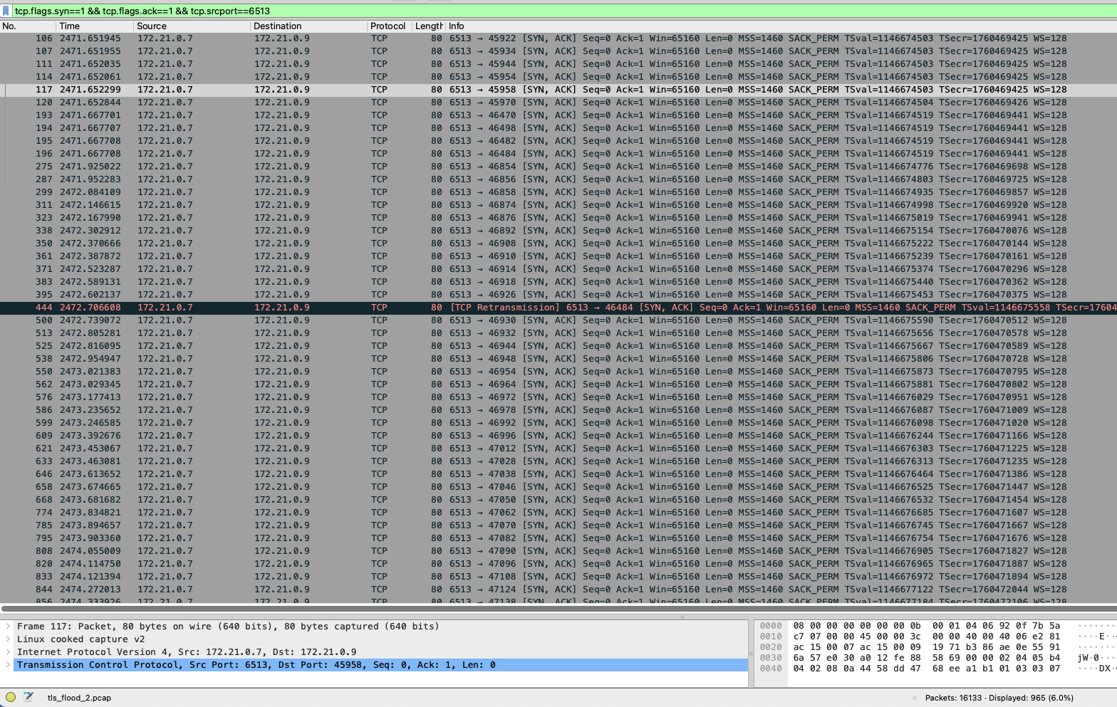
TLS Flood
SYNs – ~6,500 SYN-ACKs – ~950

Slide 13
The SIEM detection pipeline with signature-based detection
Pipeline overview
Goal: turn raw O1 attack traffic into actionable alerts an analyst can see
Four stages: capture → detect (Suricata) → forward (Wazuh agent) → store & visualise (indexer + dashboard)
Suricata runs as a process inside the Wazuh manager
Traffic ingestion
Attack and O1 traffic captured to pcap on the O-DU's dcn interface
suricata -r <pcap>

Slide 14
Suricata — detection engine
Reads the pcap and matches traffic against a ruleset
Custom rules, stored in oran-custom.rules, registered under suricata.yaml
Alerts written as JSON to eve.json

Slide 15
Three custom signatures:
  UDP flood
alert udp any any -> any 6513 (msg:"O1 Interface UDP Flood - T-SMO"; threshold: type both, track by_dst, count 100, seconds 1; sid:1000001; rev:1;)
  TLS handshake flood
alert tcp any any -> any 6513 (msg:"ORAN_T-SMO TLS handshake flood detected"; flow:to_server; content:"|16 03|"; depth:2; threshold:type threshold, track by_src, count 100, seconds 5; classtype:attempted-dos; sid:1000002; rev:1;)
  ICMP flood
alert icmp 172.21.0.0/16 any -> 172.21.0.7 any (msg:"ORAN T-SMO-03 ICMP flood on O1 interface O-DU"; itype:8; dsize:>1000; threshold: type threshold, track by_src, count 100, seconds 1; classtype:attempted-dos;sid:1000003;rev:1;)

Slide 16
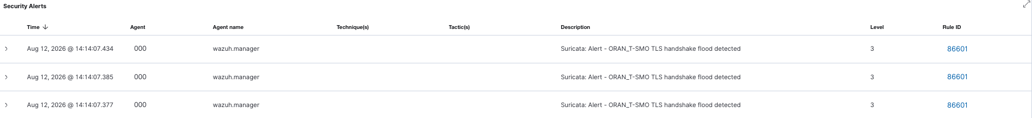
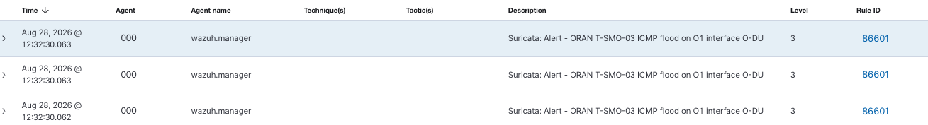
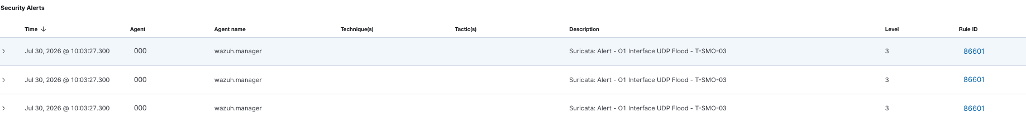
Wazuh Dashboard Results
TLS Detection
ICMP Detection
UDP Detection

Slide 17
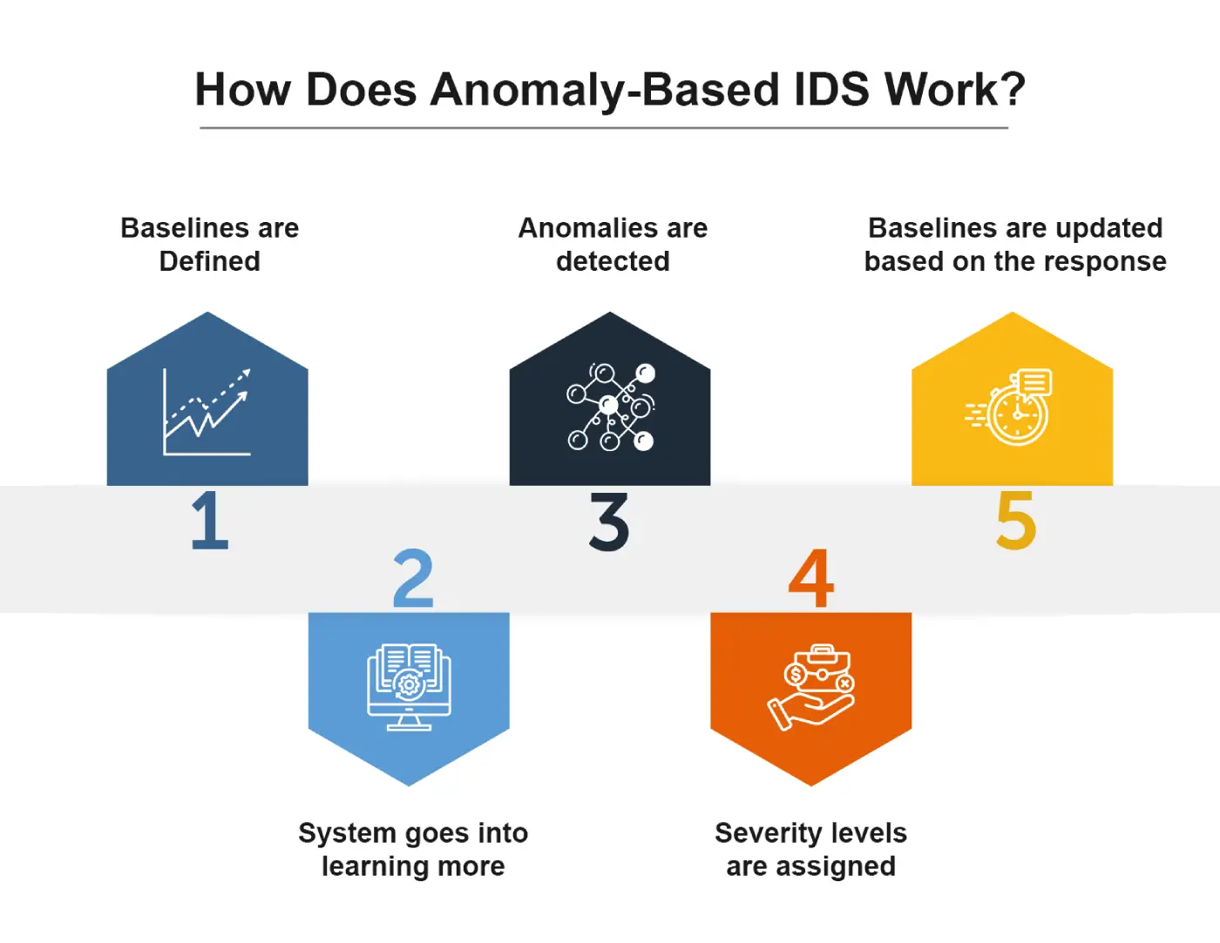
Anomaly-based detection with z-score
Why anomaly detection, and the need for a baseline
Signature detection catches known patterns; anomaly detection catches deviation from normal
Unsupervised approach: learn what normal O1 traffic looks like, then flag anything statistically far from it
Requires a benign baseline — a dataset of normal traffic, separate from any attack

Slide 18
Capturing the benign baseline
Traffic made irregular on purpose
Captured on the O-DU's dcn interface (eth0)
~20 minutes of active traffic
Confirmed content: TLS-dominated, sparse ICMP, no UDP
Notes:
Traffic made irregular on purpose — randomised pauses, occasional bursts, occasional pings — so the model learns realistic variation, not a fixed rhythm

Slide 19
Feature extraction — time-windowed features
Unit of analysis: 1-second windows
Features include: packets/sec, bytes/sec, mean & standard-deviation of packet size, unique destination ports, new-connection count (SYNs), TLS handshake count, per-protocol fractions
The discriminating features for TLS: syn_count and tls_handshake — near-zero in benign (one persistent session), high in the flood (a new connection per handshake)
Notes:
Unit of analysis: 1-second windows — not flows, because the ICMP flood collapses to a single flow while windows give a uniform, comparable sample from every capture
Unit of analysis: 1-second windows — not flows, because the ICMP flood collapses to a single flow while windows give a uniform, comparable sample from every capture

Slide 20
The z-score model and evaluation
Method
Formula: z = (x − μ) / σ; a window is flagged if any feature exceeds a threshold (3σ)
Train/test split: first 80% for training, last 20% for testing
Evaluated on three sets: held-out benign (false positives), TLS attack (detection), and — as a cross-check — ICMP attack
Results: TLS flood detected at ~71%, ICMP at 100%, false-positive rate ~6.6% on benign
Notes:
compute mean and standard deviation of each feature over the benign training data; score each window by how many standard deviations its most-extreme feature sits from normal
compute mean and standard deviation of each feature over the benign training data; score each window by how many standard deviations its most-extreme feature sits from normal

Slide 21
Future Work

Slide 22
Machine-learning anomaly detection
Richer benign baseline
Broader threat coverage
Automated mitigation (closing the loop)
Live deployment and validation
Notes:
Select 2 to 3 points

Slide 23
Questions ?

