Slide 1
Modular Programming
Algoritma & Pemrograman #7
Sufajar Butsianto, M.Kom
Rev.00
Notes:
This template can be used as a starter file for presenting training materials in a group setting.
Sections
Right-click on a slide to add sections. Sections can help to organize your slides or facilitate collaboration between multiple authors.
Notes
Use the Notes section for delivery notes or to provide additional details for the audience. View these notes in Presentation View during your presentation.
Keep in mind the font size (important for accessibility, visibility, videotaping, and online production)
Coordinated colors
Pay particular attention to the graphs, charts, and text boxes.
Consider that attendees will print in black and white or grayscale. Run a test print to make sure your colors work when printed in pure black and white and grayscale.
Graphics, tables, and graphs
Keep it simple: If possible, use consistent, non-distracting styles and colors.
Label all graphs and tables.

Slide 2
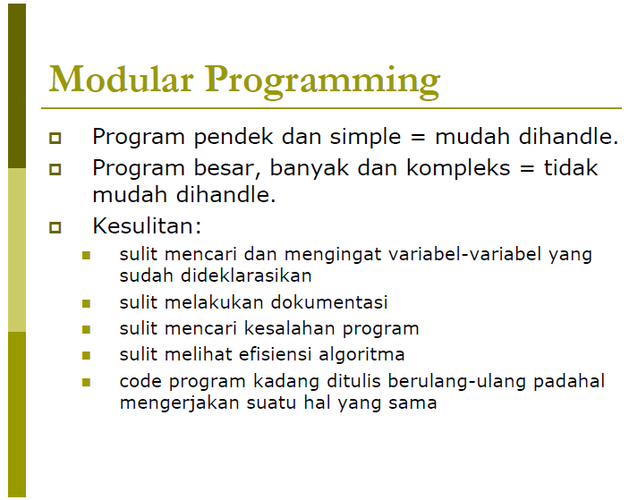
Notes:
Give a brief overview of the presentation. Describe the major focus of the presentation and why it is important.
Introduce each of the major topics.
To provide a road map for the audience, you can repeat this Overview slide throughout the presentation, highlighting the particular topic you will discuss next.

Slide 3
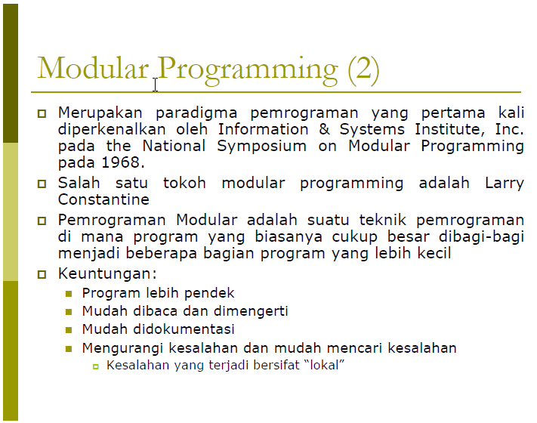
Notes:
Give a brief overview of the presentation. Describe the major focus of the presentation and why it is important.
Introduce each of the major topics.
To provide a road map for the audience, you can repeat this Overview slide throughout the presentation, highlighting the particular topic you will discuss next.

Slide 4
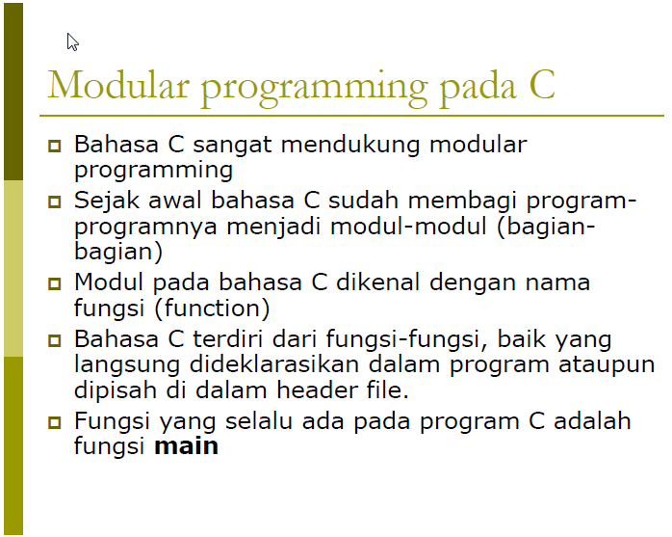
Notes:
Give a brief overview of the presentation. Describe the major focus of the presentation and why it is important.
Introduce each of the major topics.
To provide a road map for the audience, you can repeat this Overview slide throughout the presentation, highlighting the particular topic you will discuss next.

Slide 5
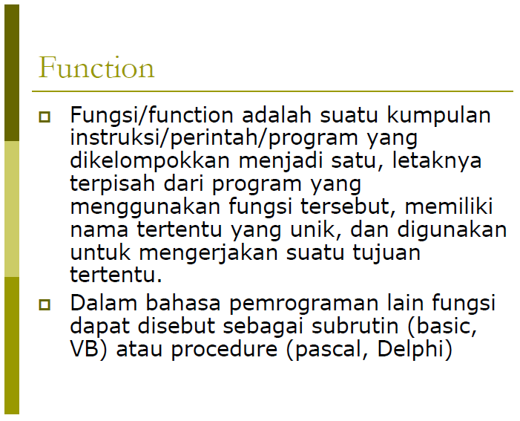
Notes:
Give a brief overview of the presentation. Describe the major focus of the presentation and why it is important.
Introduce each of the major topics.
To provide a road map for the audience, you can repeat this Overview slide throughout the presentation, highlighting the particular topic you will discuss next.

Slide 6
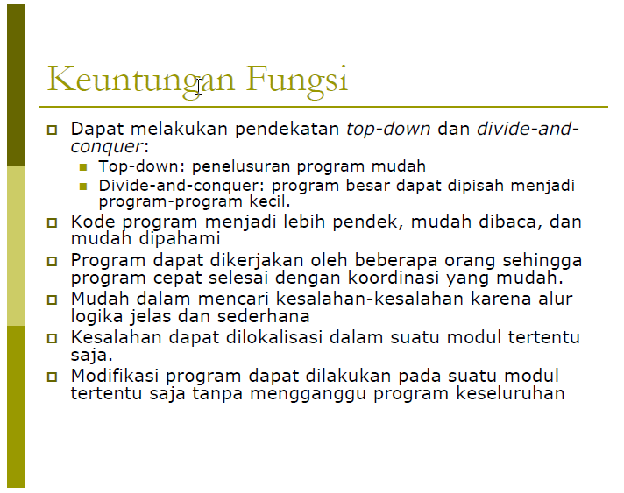
Notes:
Give a brief overview of the presentation. Describe the major focus of the presentation and why it is important.
Introduce each of the major topics.
To provide a road map for the audience, you can repeat this Overview slide throughout the presentation, highlighting the particular topic you will discuss next.

Slide 7
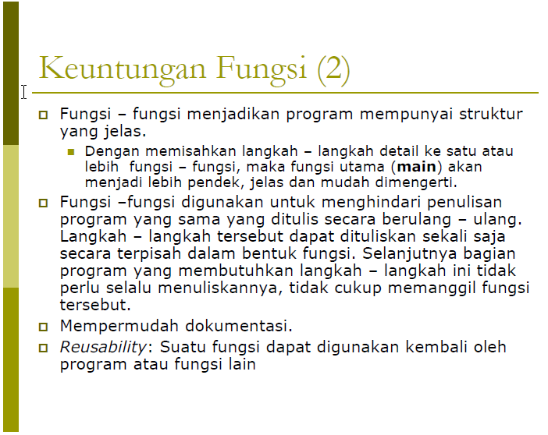
Notes:
Give a brief overview of the presentation. Describe the major focus of the presentation and why it is important.
Introduce each of the major topics.
To provide a road map for the audience, you can repeat this Overview slide throughout the presentation, highlighting the particular topic you will discuss next.

Slide 8
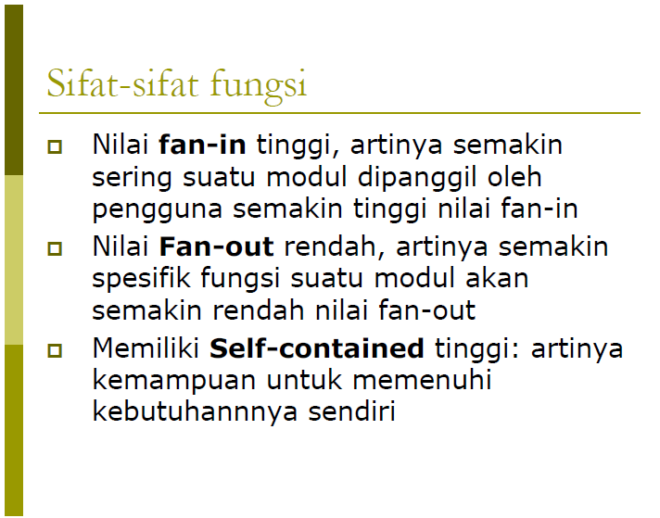
Notes:
Give a brief overview of the presentation. Describe the major focus of the presentation and why it is important.
Introduce each of the major topics.
To provide a road map for the audience, you can repeat this Overview slide throughout the presentation, highlighting the particular topic you will discuss next.

Slide 9
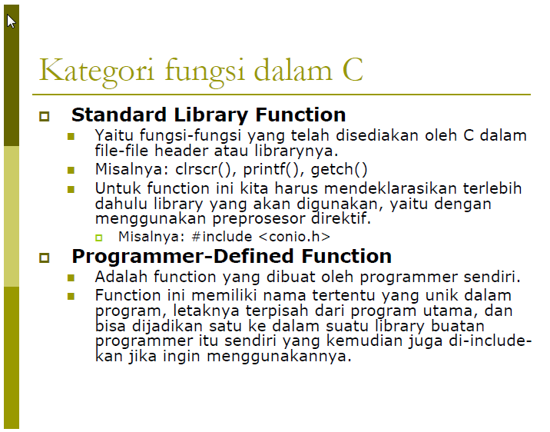
Notes:
Give a brief overview of the presentation. Describe the major focus of the presentation and why it is important.
Introduce each of the major topics.
To provide a road map for the audience, you can repeat this Overview slide throughout the presentation, highlighting the particular topic you will discuss next.

Slide 10
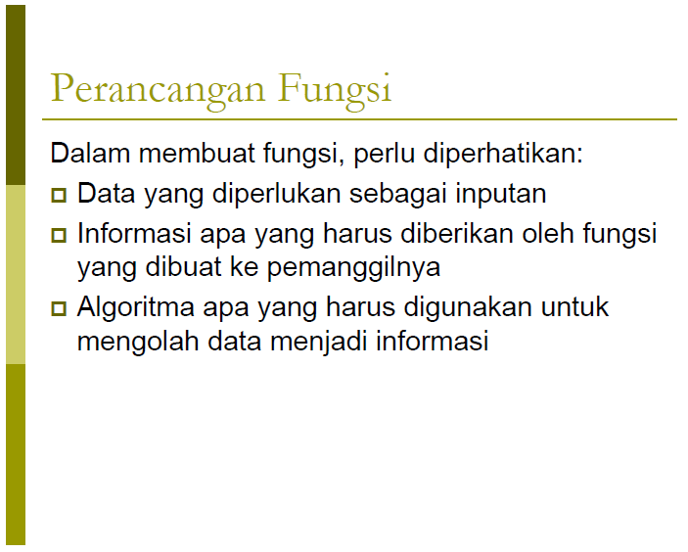
Notes:
Give a brief overview of the presentation. Describe the major focus of the presentation and why it is important.
Introduce each of the major topics.
To provide a road map for the audience, you can repeat this Overview slide throughout the presentation, highlighting the particular topic you will discuss next.

Slide 11
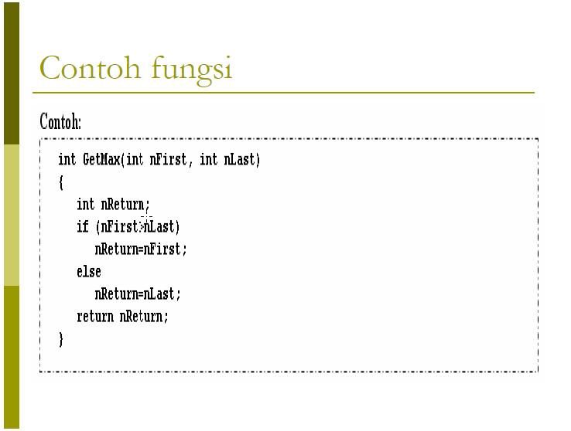
Notes:
Give a brief overview of the presentation. Describe the major focus of the presentation and why it is important.
Introduce each of the major topics.
To provide a road map for the audience, you can repeat this Overview slide throughout the presentation, highlighting the particular topic you will discuss next.

Slide 12

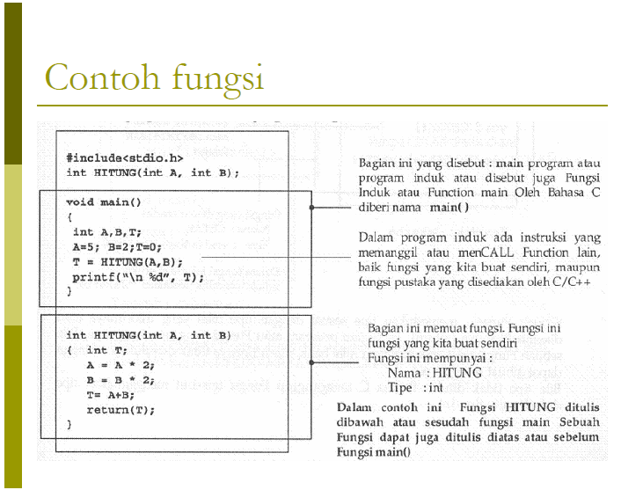
Notes:
This is another option for an Overview slides using transitions.

Slide 13
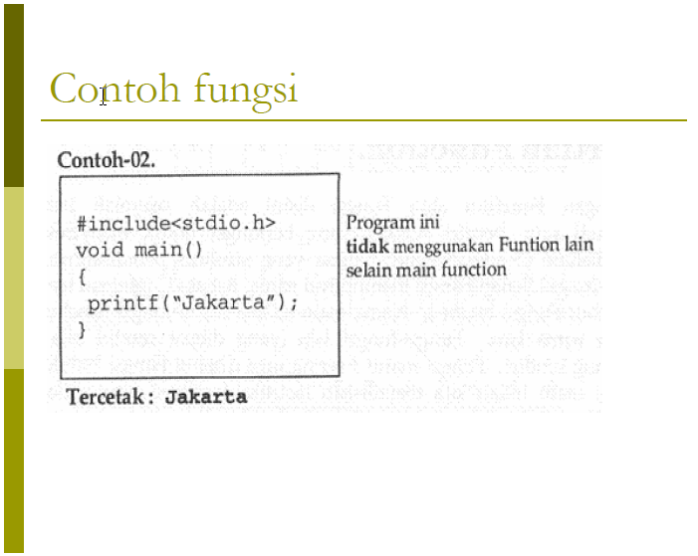
Notes:
This is another option for an Overview slides using transitions.

Slide 14
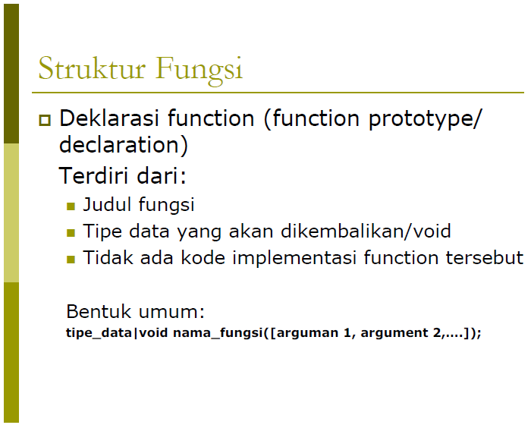
Notes:
This is another option for an Overview slides using transitions.

Slide 15
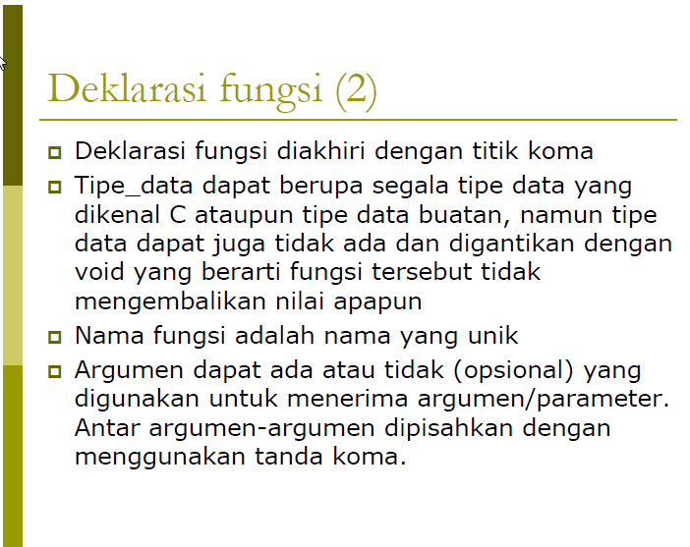

Slide 16
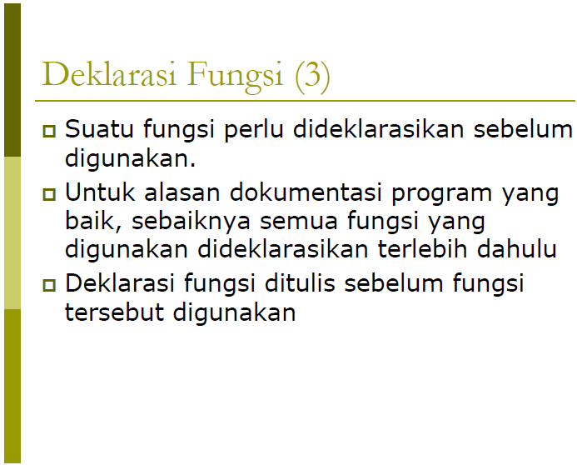


Slide 17

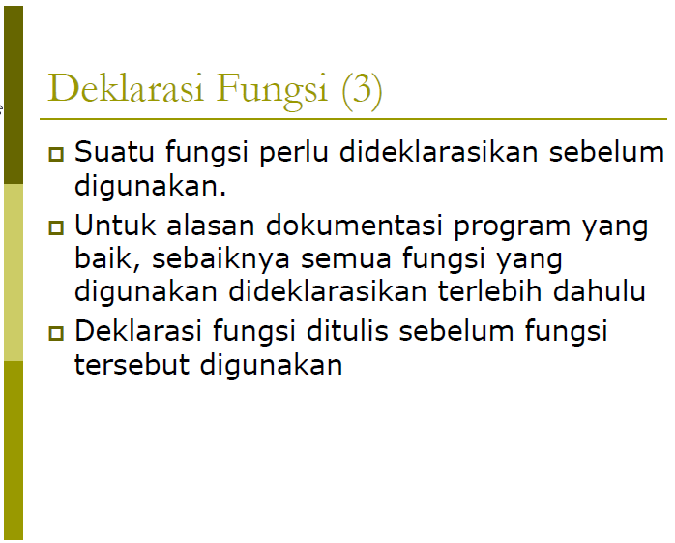

Slide 18
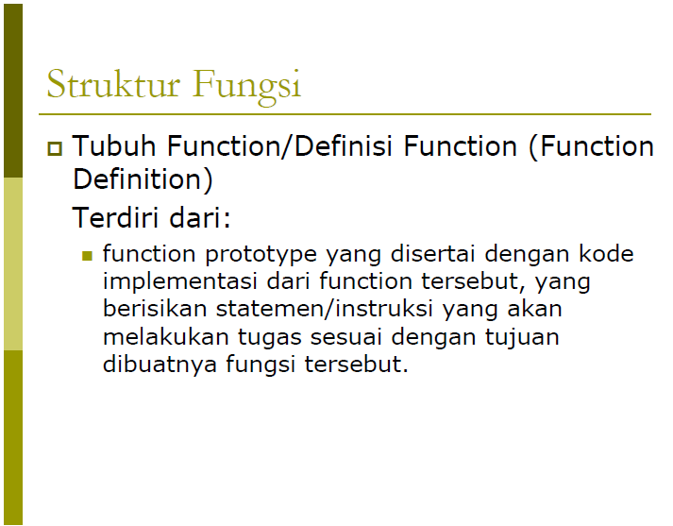
Notes:
What will the audience be able to do after this training is complete? Briefly describe each objective how the audience will benefit from this presentation.

Slide 19
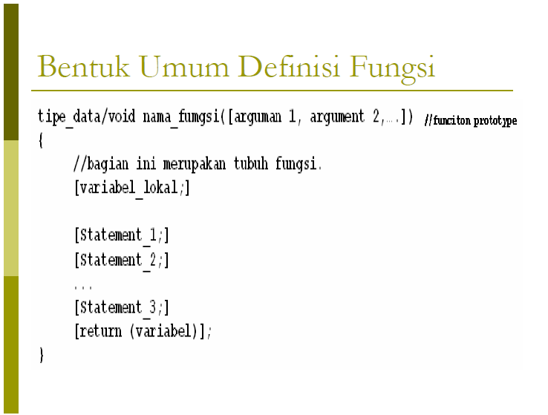
Notes:
What will the audience be able to do after this training is complete? Briefly describe each objective how the audience will benefit from this presentation.

Slide 20
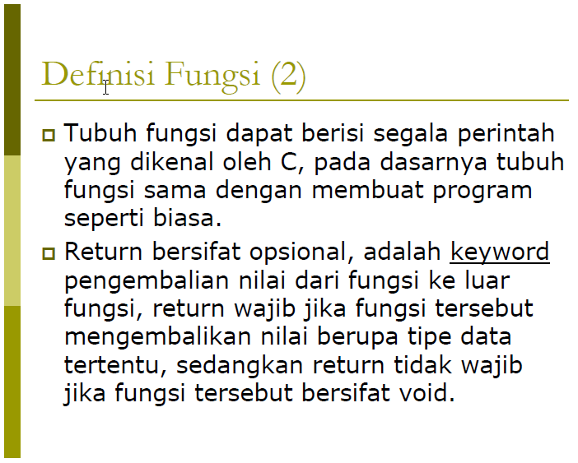

Slide 21
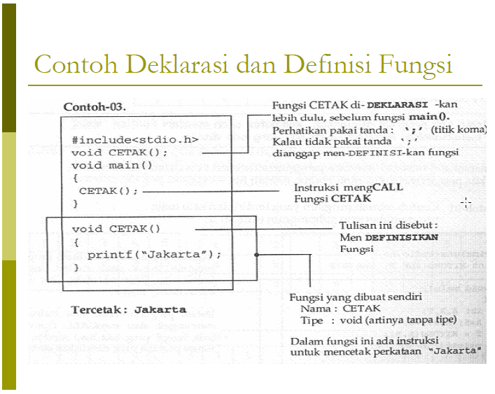

Slide 22
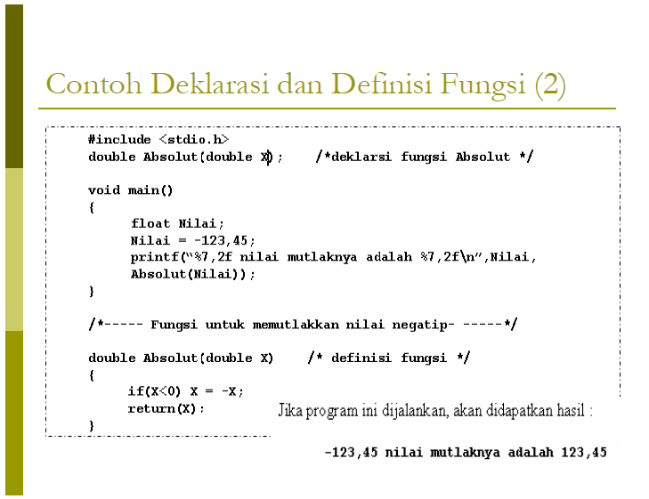

Slide 23
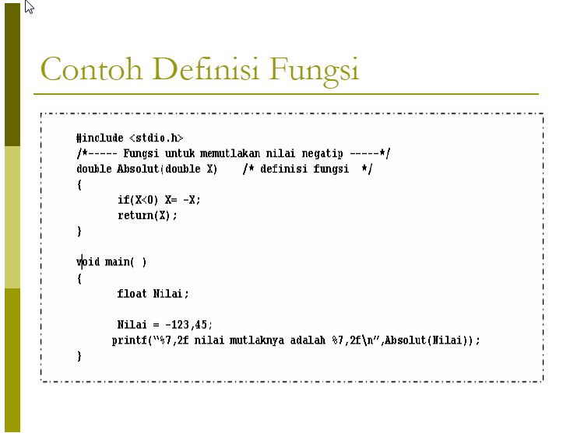

Slide 24
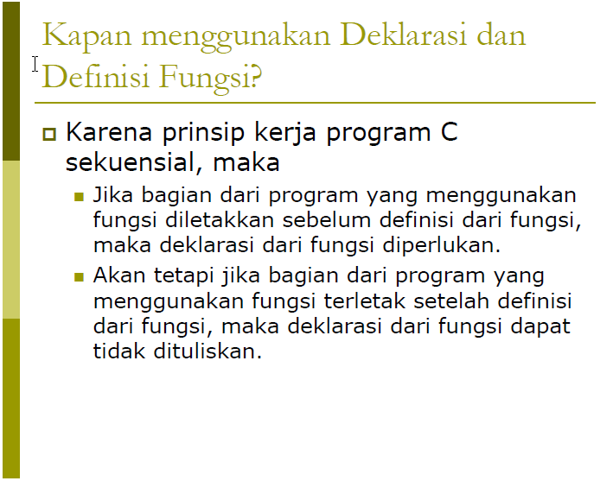

Slide 25
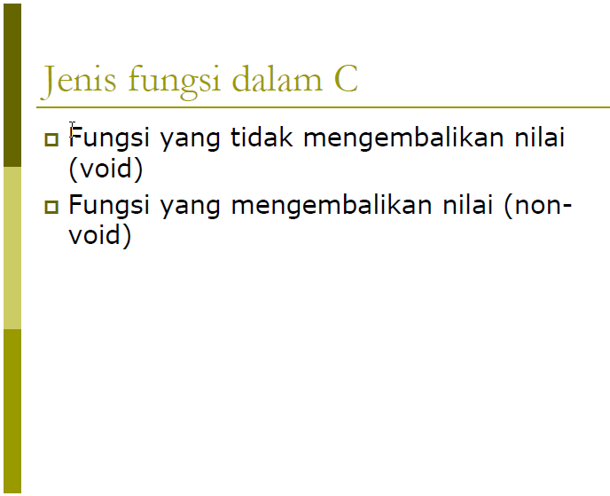

Slide 26
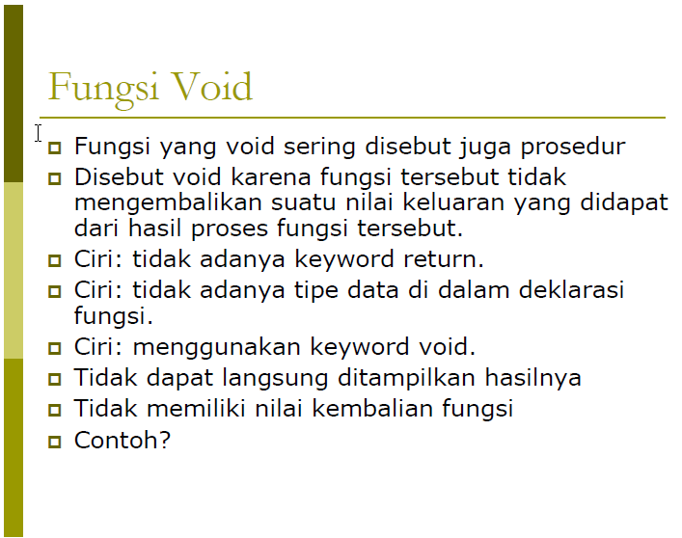

Slide 27
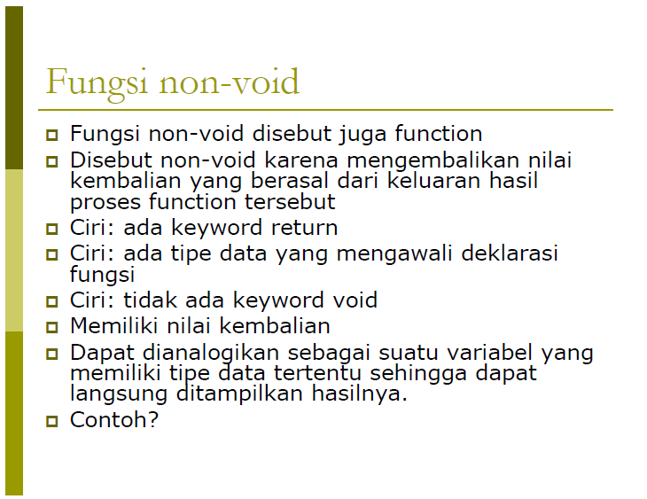

Slide 28
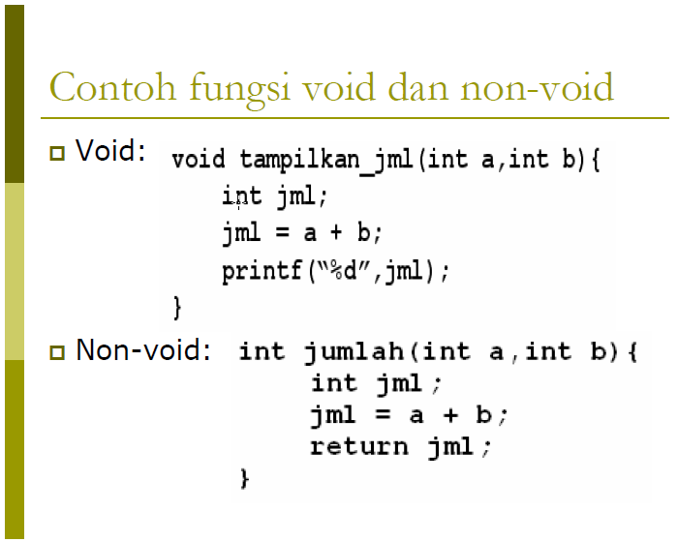

Slide 29
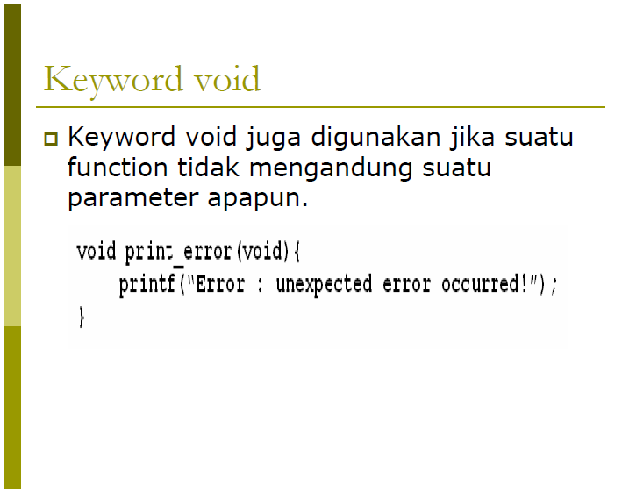

Slide 30
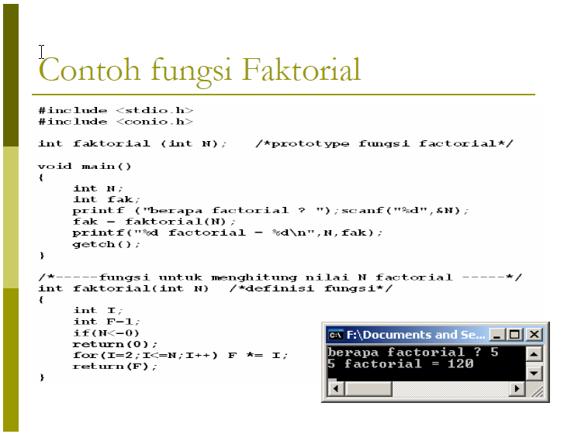

Slide 31
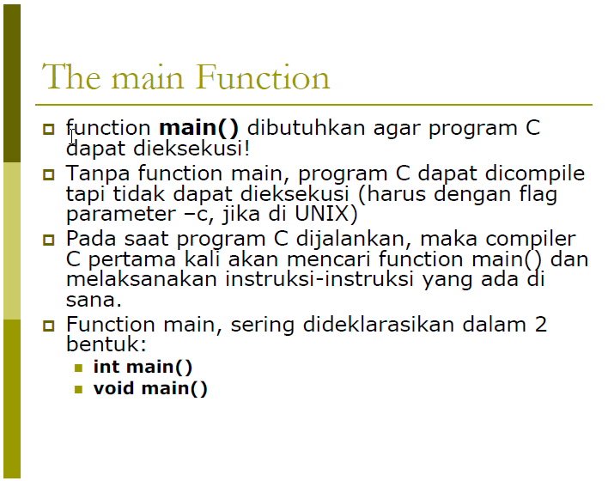

Slide 32
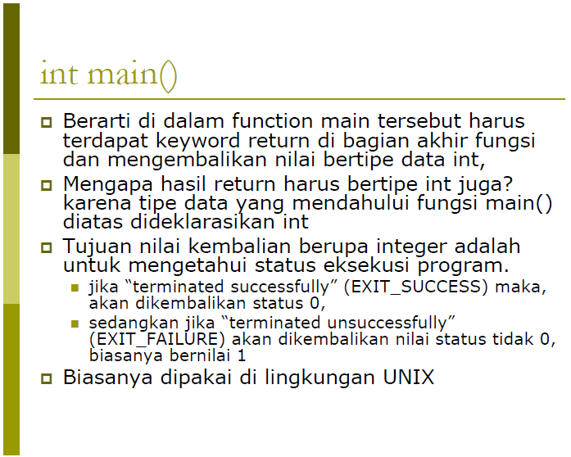

Slide 33
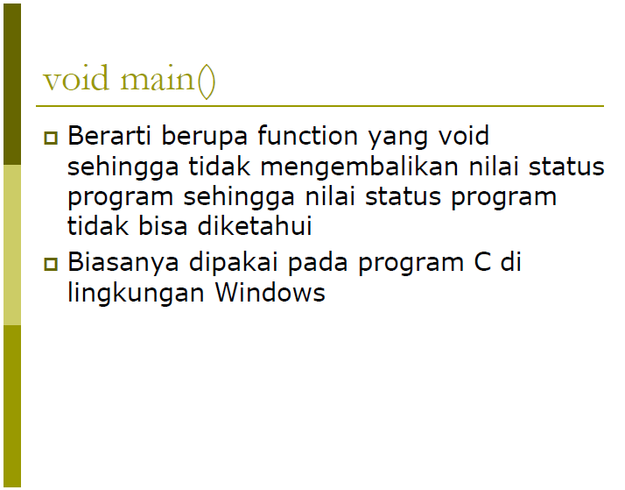

Slide 34
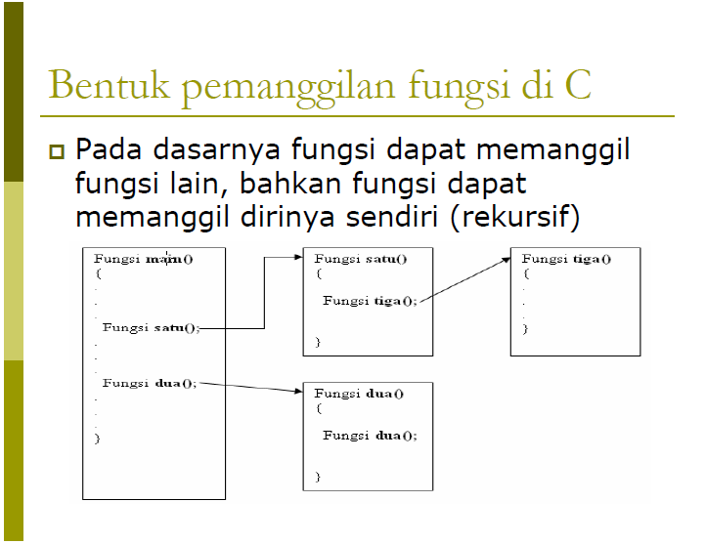

Slide 35
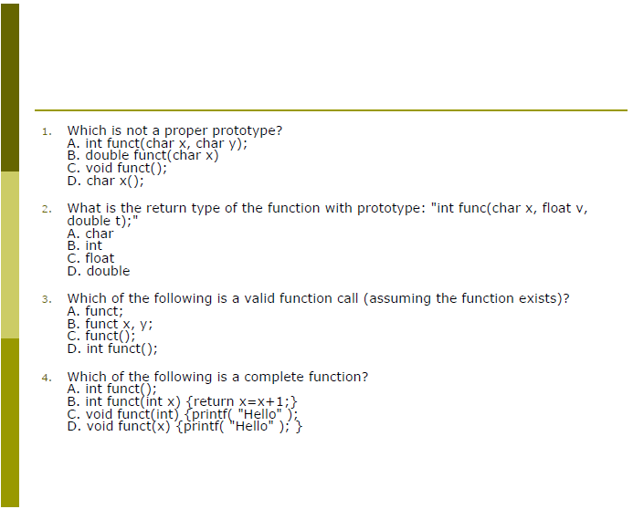

Slide 36
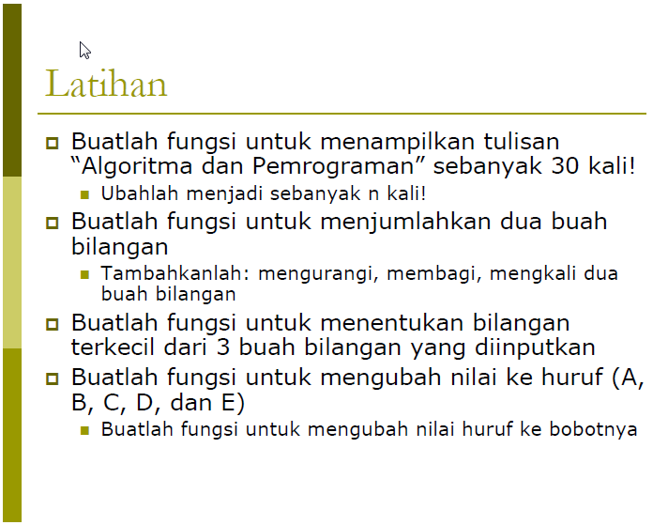

Slide 37
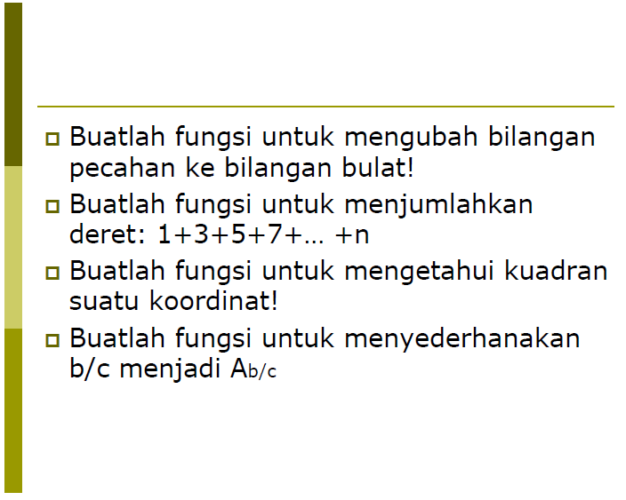

Slide 38
Thank You
Notes:
Is your presentation as crisp as possible? Consider moving extra content to the appendix.
Use appendix slides to store content that you might want to refer to during the Question slide or that may be useful for attendees to investigate deeper in the future.

