Slide 1
Machine Learning Foundation Course Project
Course link: https://www.coursera.org/learn/machine-learning-foundations-for-product-managers/
Presented by: Muhammad Faizan Khan

Slide 2
Combine cycle Power plant output
CCPP output is dependent on a few parameters
Atomspheric pressure
Exhaust steam pressure
Ambient temperature
Realitve humidity
Project detail: https://www.coursera.org/learn/machine-learning-foundations-for-product-managers/peer/U0ryB/course-project

Slide 3
How to solve - Regression
We want to predict a number (continuous value), power output. And we have features available with the dependent variable (output) so its is supervise learning example and particularly regression problem.
The label dataset is already provided.

Slide 4
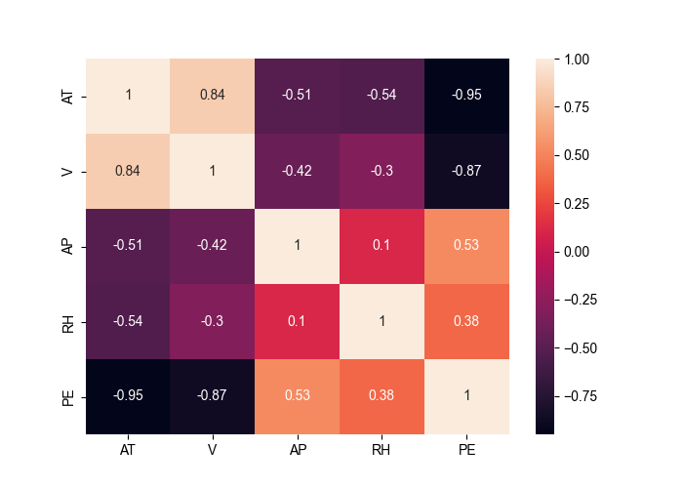
Data checking – Exploratory Data analysis
Try to figure out, the correlation with features and found that AT and V has strong negative correlation with PE.
Using python and following libraries
Matplolib.pyplot
seaborn
Correlation plot (heatmap) has generated

Slide 5
Training
Used three different algorithm used to train the data set.
Linear regression
Decision Tree
Random Forest
Data has divided into two set training and test set. (80%-20%).
4 training and test set created with following features.
df_1 = df['AT'] #We select only AT as the predictor (Since it has the strongest correlation with the target variable (PE))
df_2 = df[['AT','V']]
df_3 = df[['AT','V','RH']] #We select AT, V and RH as the predictors
df_4 = df[['AT', 'V', 'AP', 'RH']] #We select AT, V, AP, and RH as the predictors

Slide 6
Testing
Using sklearn libraries we have test the result with 3 different metrices.
Mean square error:
R-squared
Mean absolute error
Using train_test_split we split the data in to training and test set. And apply feature vice training and prediction.

Slide 7
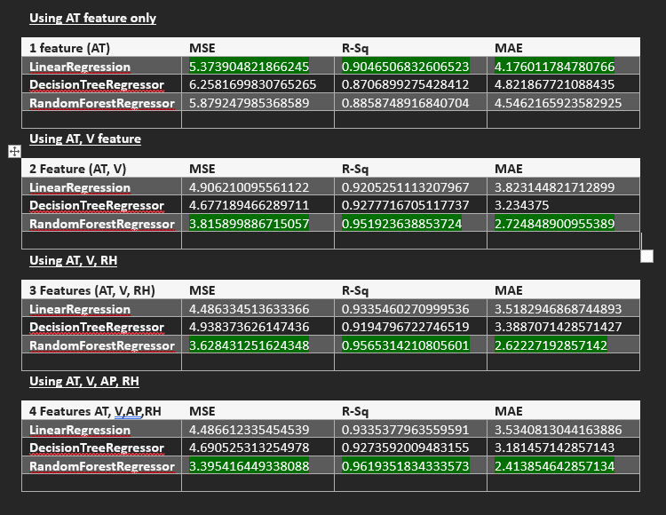
Evaluation metric results
3 Training Algorithm used to train 4 different feature set.
The green highlighted are performed best.
Conclusively, Random forest provide better result while all the features selected. About 96% in r-squared and lowest MSE and MAE.

Slide 8
Special Thanks
Sir who taught us this course Mr Jon Reifschneider from Duke Univesrity.
Also thanks to Timothy Osirike for a post which help me to solve the Course Project
https://medium.com/analytics-vidhya/prediction-of-the-output-power-of-a-combined-cycle-power-plant-using-machine-learning-a2ca01848eea

