Slide 1
Windows & Input Management, Messaging Systems & Resource Management
Yap Ming Han | RTIS | DIGIPEN

Slide 2

Slido Q&A

Slide 3
Windows & Input Management

Slide 4
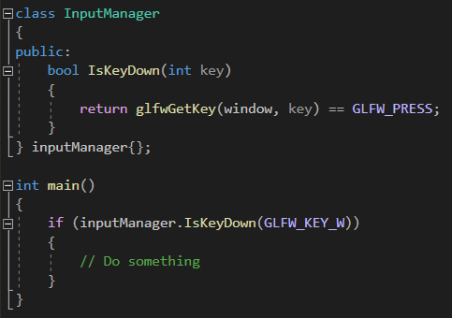
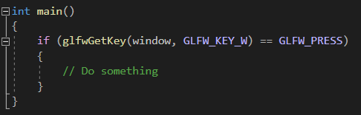
Why?
Abstraction, abstraction, abstraction

Slide 5
GLFW (Graphics Library Framework)
OpenGL / Vulkan
Handles window, context surface creation
Input reading, event handling
Documentation: www.glfw.org/docs/latest/

Slide 6

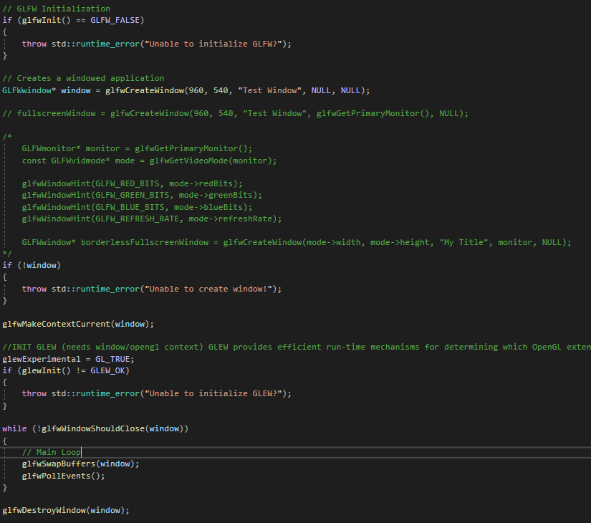




Example

Slide 7
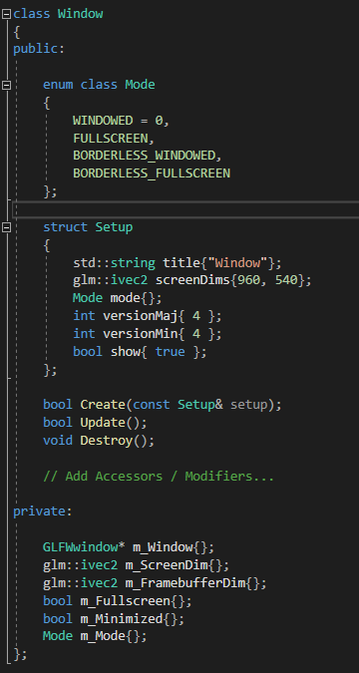
Wrapping into a Window Class

Slide 8
Some Important Notes
Framebuffer Size, DPI Scaling
Window Resize/Focus Callbacks (Tying to your Messaging Systems)
UI Constraints
glfwSwapInterval() / glfwSwapBuffers()

Slide 9
Win32 Programming (Advanced)
Uses WIN32 API, documented by Microsoft
(learn.microsoft.com/en-us/windows/win32/learnwin32/creating-a-window)
Why?
More control
Abstract things however you like
Bonus LT
Learning Experience

Slide 10
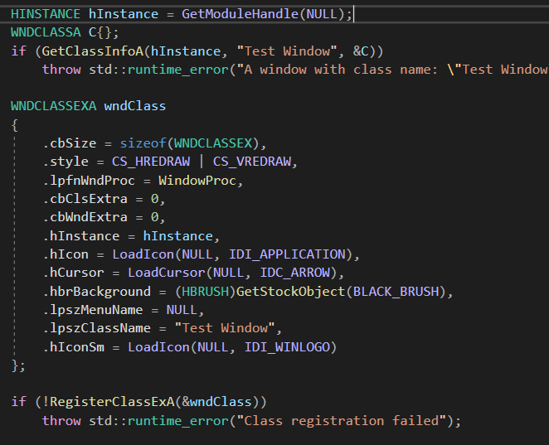
Class Registration
Doc: https://learn.microsoft.com/en-us/windows/win32/api/winuser/ns-winuser-wndclassexa

Slide 11
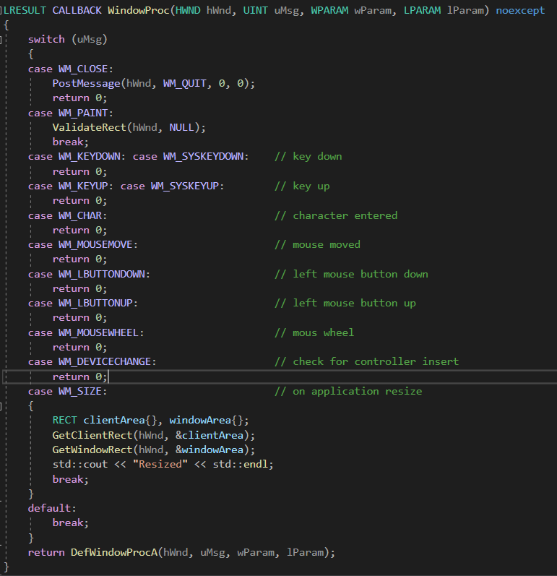
WinProc Function
Doc: https://learn.microsoft.com/en-us/windows/win32/api/winuser/nc-winuser-wndproc

Slide 12
Message Codes
Mouse Clicks
https://learn.microsoft.com/en-us/windows/win32/learnwin32/mouse-clicks
Mouse Movement
https://learn.microsoft.com/en-us/windows/win32/learnwin32/mouse-movement
Keyboard Input
https://learn.microsoft.com/en-us/windows/win32/learnwin32/keyboard-input

Slide 13
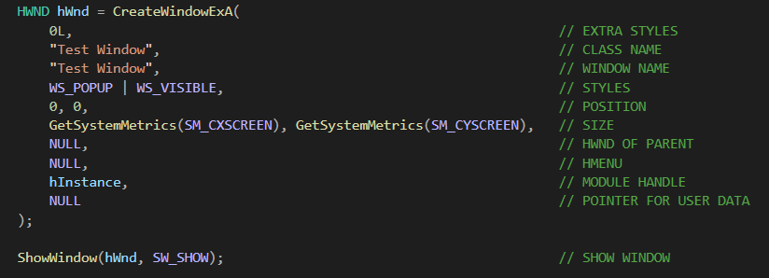
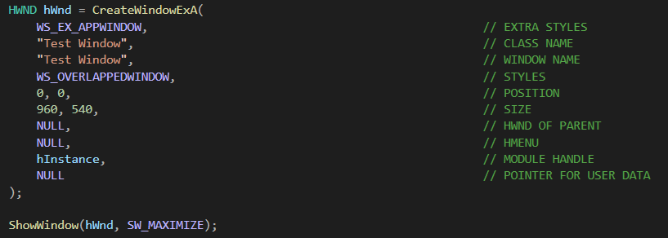
Window Creation
Doc: learn.microsoft.com/en-us/windows/win32/api/winuser/nf-winuser-createwindowexa

Slide 14
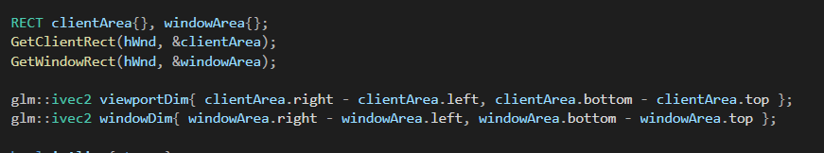
Window Size vs Client Size
https://stackoverflow.com/questions/7561049/what-is-the-difference-between-getclientrect-and-getwindowrect-in-winapi

Slide 15
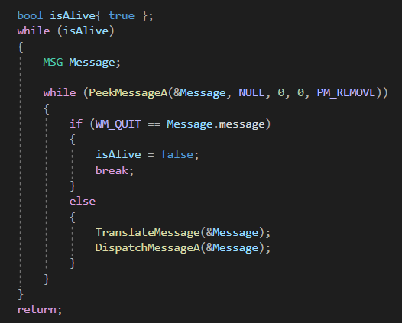
Win32 Messaging System
http://www.directxtutorial.com/Lesson.aspx?lessonid=9-1-4

Slide 16
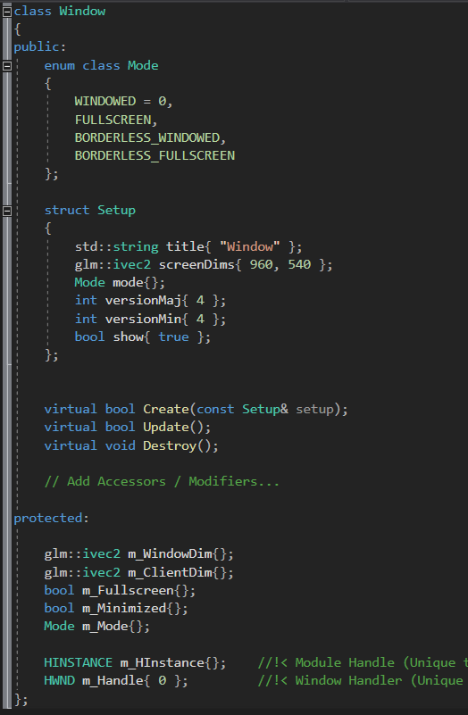
Wrapping into a Window Class

Slide 17
Input Management

Slide 18



How many ways to read input do we have?
1? 2? 3? 4?

Slide 19
Key Pressed vs Text Entered
Pressing SHIFT + ‘9’
Do we process SHIFT KEY DOWN + ‘9’ KEY DOWN EVENT?
Or do we process ‘)’ TEXT ENTERED?
https://stackoverflow.com/questions/8161741/handling-keyboard-input-in-win32-wm-char-or-wm-keydown-wm-keyup
https://www.glfw.org/docs/3.3/input_guide.html#input_char

Slide 20
Polling vs Callbacks
Polling | Callbacks
Checks the input state requested at any point in time | Executes a callback function called whenever requested event happens
Example: https://www.glfw.org/docs/3.3/input_guide.html#input_mouse_button

Slide 21
Other Things to Note
Input Remapping (Flex key bindings)
Window to World Coordinate Spaces
Mouse Triggered Logic (!= Mouse Released)
Ease of Use

Slide 22
Messaging/Event Systems (Advanced) (No, I’m not talking about emails, WhatsApp or Telegram)

Slide 23
Messaging/Event Systems?
Input
Window Events
Physics System
Messaging/Event System
Graphics System
Logic Systems

Slide 24
Message/Event Subscription
Player Component
TakeDamage()
Enemy Component
Subscribe to “Collision Event”
PlayAttackAnim()
DecreaseScore()
Score System

Slide 25
Message/Event Broadcasting/Notify
Collision System
Broadcast/Notify a “Collision Event”
Executes all subscribe functions
Player::TakeDamage()
Enemy::PlayAttackAnim()
ScoreSystem::DecreaseScore()

Slide 26
Why use Messaging/Event Systems?
Loose coupling between entities, systems, components
Flexibility
Scalability
Separation of Concerns
Debugging / Logging
Bonus LT
Slight overhead
Usability limitations if not designed properly

Slide 27
Simple Messaging/Event System Example
Some Improvement Considerations
Eliminate the use of strings
Can we somehow use templates in place of strings?
Function parameters
How do we bind a function that may require parameters?
Active/Inactive Listeners
What if we want some listeners to stop subscription for awhile?
Delayed execution callbacks
Must we execute the callbacks immediately?

Slide 28
Resource Management

Slide 29
Types of Resources
Textures
Sounds
Scenes
Prefabs
Scripts
Fonts
Shaders
Future GAM300:
Meshes
Materials

Slide 30
Important Goals of Resource Management
Loading/Updating/Unloading resources during runtime
Managing resources lifetime
Please try not to load every single resource during startup
Allow sharing of resources across components/systems
AKA do not load the same resource twice!
Centralize responsibilities for accessing resources
Accesses should be as performant as possible

Slide 31
Resource Directory Management
Always ensure the executable created is always able to access the Assets folder
Use the root directory of the executable
Use Post-Build events to copy any resources the exe relies on if need be

Slide 32
Some Advanced Implementation Techniques

Slide 33
Unique Identifiers
Every resource is assigned a unique ID (randomly generated)
More efficient accesses compared to string comparison
Less memory overall, especially during serialization
Reliable and consistent reference to resources
Usage of “.meta” files to keep track of resources
Some stuff you can read up on:
https://www.linkedin.com/pulse/resource-management-game-engines-rub%C3%A9n-crisp%C3%ADn-de-la-cruz/

Slide 34
Implementing a Folder Watcher (Editor)
Helps track any changes made to a folder recursively
Allows dynamic loading and unloading of resources during run-time
Online Resources:
https://solarianprogrammer.com/2019/01/13/cpp-17-filesystem-write-file-watcher-monitor/
Considerations:
Must be implemented as non-blocking
Ideally not part of your game, only active in editor

