Slide 1
Capstone Showcase
Market Prediction In FFXIV
By: Muhammad Hakami

Slide 2
Agenda.
1-Introduction.
2-Data collection process.
3-Data Cleaning and EDA.
4-Modeling.
5-Challenges.
6-Future work.

Slide 3

Introduction.
What’s Final Fantasy XIV?.
Massively Multiplayer Online Role-Playing Game (MMORPG).
Why did i worked on it?.
Target audience.

Slide 4
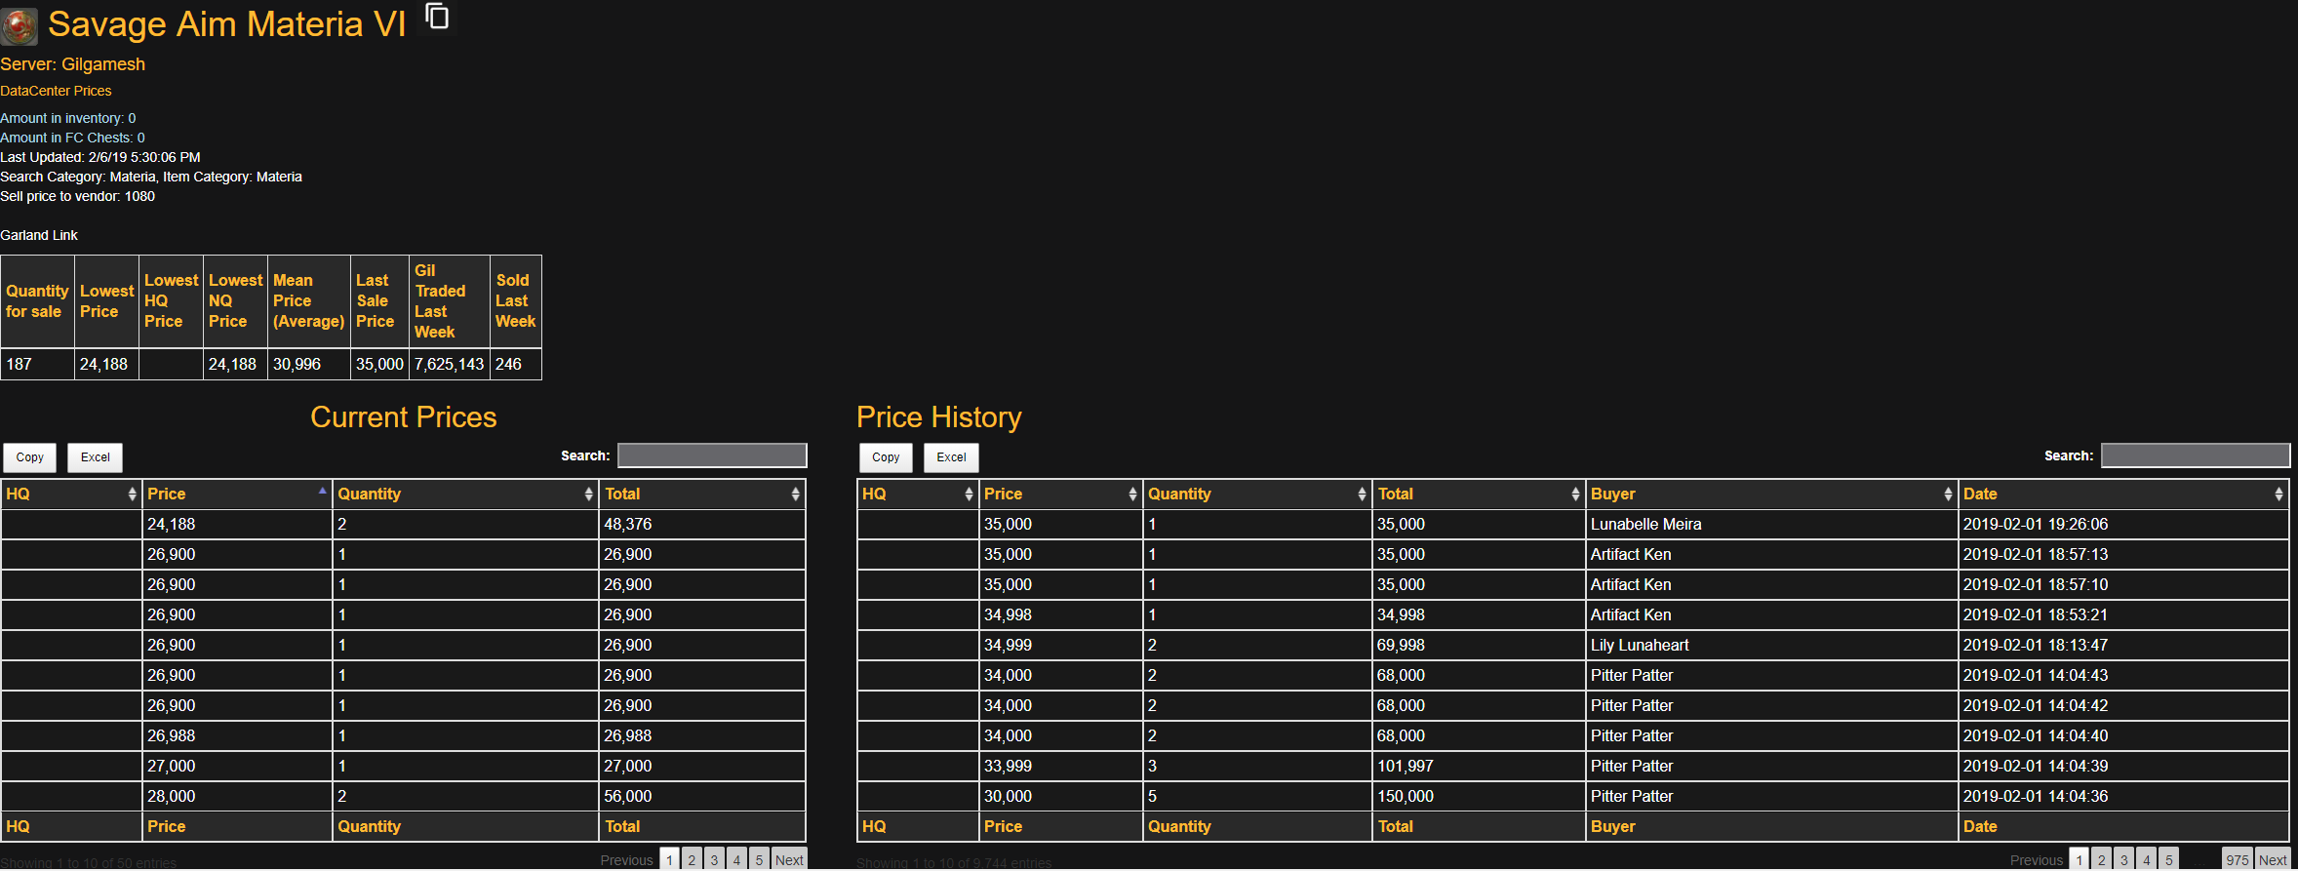
Data Collection. (ffxivmb.com)

Slide 5
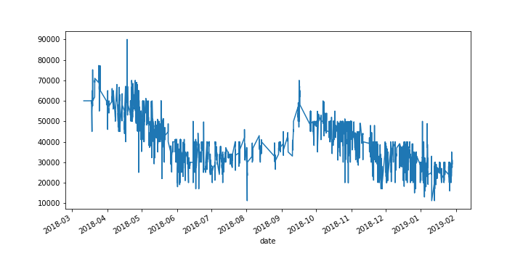
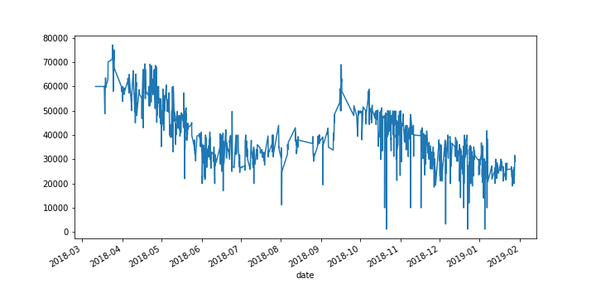
Before resampling.
Data Cleaning.
After resampling.
Replaced commas, changed to
DateTime.
Resampled for consistency.
Removed the outliers.

Slide 6
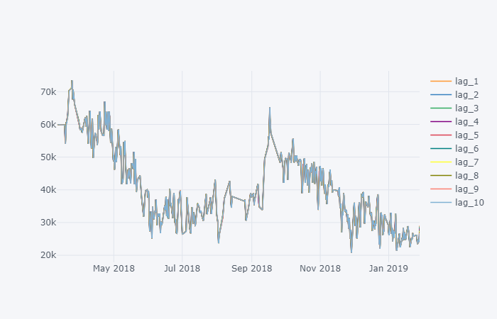
Feature Extraction.
Added multiple lags.
Calculated percentiles,
Standard deviation, mean
Also min and max values.

Slide 7
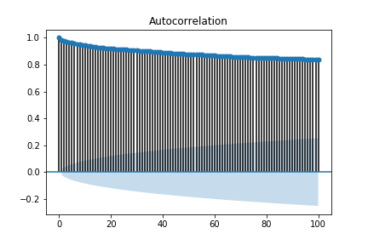
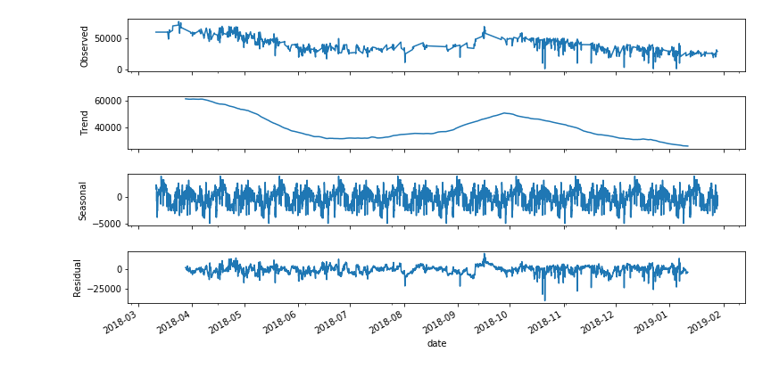
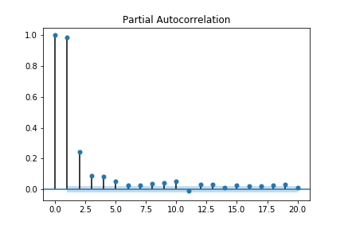
EDA.

Slide 8
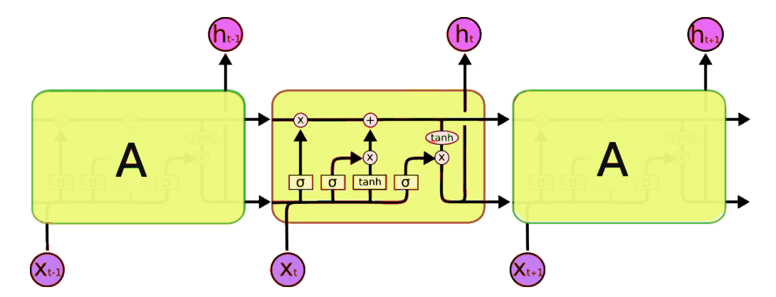
LSTM

Slide 9
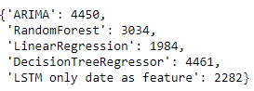

Modeling.
Time series as a supervised task.
With Time series split (CV).
Baseline accuracy(rmse) = 11772.

Slide 10
Challenges.
Unavailability of data.
Inconsistency Time Dates.
Computational power.

Slide 11
Future Work.
Gather more data.
Reinforcement Learning Agent that buys and sells automatically.

Slide 12
Thank you for listening.
Any question?

