Slide 1
Crime Prediction: A Comparative Analysis of Random Forest and LSTM
Group members
Hamza Sajjad , ABC , XYZ
Supervisor
Dr. Faisal Rehman

Slide 2

INTRODUCTION
Rising crime rates demand innovative solutions for prediction and prevention.
Traditional methods struggle with large and complex datasets.
This project employs Machine Learning (ML) and Deep Learning (DL) techniques for crime forecasting.
Random Forest (RF) and Long Short-Term Memory (LSTM) models are compared for performance.
The study aims to identify the most effective model for accurate crime prediction.

Slide 3

PROBLEM STATEMENT
Traditional crime analysis methods lack scalability and efficiency.
These methods fail to identify complex patterns in high-dimensional datasets.
Suboptimal predictions hinder effective crime prevention.
Inefficient resource allocation delays law enforcement responses.
There is an urgent need for accurate, scalable predictive systems to improve crime forecasting and resource management.

Slide 4
PROPOSED SOLUTION
This project addresses the limitations of traditional methods by implementing and evaluating five advanced predictive models:
Random Forest (RF): Known for its high accuracy and interpretability in structured datasets.
Long Short-Term Memory (LSTM): A deep learning model capable of capturing temporal dependencies in sequential data.
Multilayer Perceptron (MLP): A neural network architecture adept at learning complex non-linear relationships.
K-Nearest Neighbors (K-NN): A simple yet effective distance-based model for classification tasks.
Ensemble Learning: Combines multiple models to improve robustness and predictive performance.
The models are trained on a publicly available crime dataset and evaluated using metrics such as accuracy, precision, recall, and F1-score. Hyperparameter tuning is performed to optimize each model’s performance. By providing a detailed comparison, the study aims to recommend the best model for practical applications in crime prediction.

Slide 5
BENCHMARKING
Feature | Random Forest | LSTM | MLP | K-NN | Proposed Voting Ensemble
Real-Time Prediction | ✓ | ✗ | ✓ | ✗ | ✓
Multi-Crime Detection | ✓ | ✓ | ✓ | ✓ | ✓
Visual Crime Hotspots | ✓ | ✗ | ✗ | ✗ | ✓
Easy-to-Use Dashboard | ✓ | ✗ | ✓ | ✗ | ✓
Confidence Scores | ✓ | ✗ | ✓ | ✗ | ✓
Handles Large Cities | ✓ | ✗ | ✓ | ✗ | ✓
Fast Processing | ✓ | ✗ | ✓ | ✓ | ✗

Slide 6

OBJECTIVES & GOALS
Implement and compare Random Forest (RF) and Long Short-Term Memory (LSTM) models for crime prediction.
Preprocess and clean historical crime data to ensure accurate analysis.
Evaluate model performance using metrics like accuracy, precision, recall, and F1-score.
Provide actionable insights for optimizing resource allocation in crime prevention.
Recommend the best-performing model for real-world crime forecasting systems.

Slide 7
PROJECT FEATURES
Implementation of Random Forest (RF) and Long Short-Term Memory (LSTM) models for crime prediction.
Data preprocessing techniques to handle missing values, outliers, and feature encoding.
Performance evaluation using key metrics like accuracy, precision, recall, and F1-score.
Visualization of results through clear and intuitive graphs and tables.
Scalability to handle larger datasets and future enhancements.

Slide 8
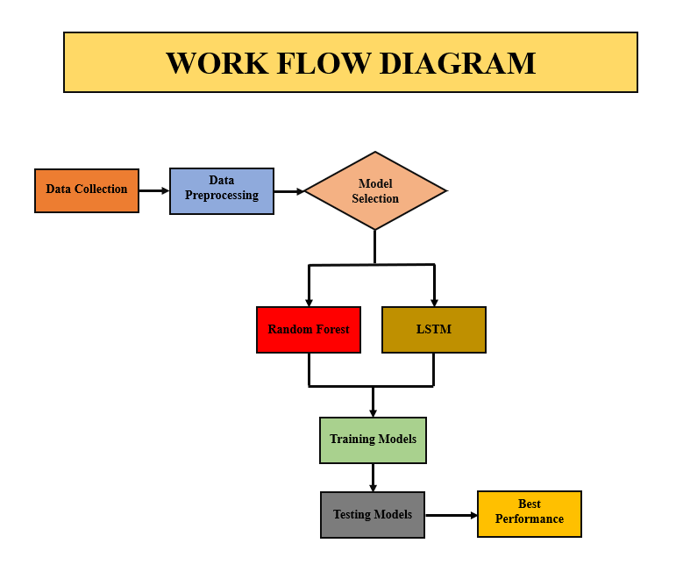

Slide 9
STAKEHOLDERS
Law Enforcement Agencies: Utilize the system for proactive crime prevention and efficient resource allocation.
Policymakers: Leverage insights for data-driven decisions and policy formulation.
Researchers: Explore the comparative analysis of ML and DL models for advancing crime prediction studies.
Data Science Community: Gain a reference for implementing predictive modeling in public safety domains.
General Public: Benefit indirectly through improved public safety and optimized law enforcement strategies.

Slide 10
FUNCTIONAL REQUIREMENTS
Data Preprocessing: Clean and prepare the dataset by handling missing values, outliers, and encoding categorical variables.
Model Implementation: Develop and train Random Forest (RF) and Long Short-Term Memory (LSTM) models for crime prediction.
Performance Evaluation: Measure model effectiveness using metrics such as accuracy, precision, recall, and F1-score.
Visualization: Provide graphical representations of predictions and performance metrics.
Result Comparison: Enable direct comparison between RF and LSTM models on the same dataset.

Slide 11

NON-FUNCTIONAL REQUIREMENTS
Performance: Ensure efficient processing and reasonable training times for the models.
Scalability: Design the system to handle larger datasets in future implementations.
Usability: Present results in an intuitive format with clear visualizations for stakeholders.
Security: Protect data privacy and ensure compliance with ethical standards.
Reliability: Maintain consistent and accurate results during repeated analyses.

Slide 12
CONSTRAINTS
Data Availability: Limited access to comprehensive and high-quality crime datasets.
Computational Power: High resource requirements for LSTM training compared to Random Forest.
Training Time: LSTM models take longer to train, which may impact time-sensitive applications.
Model Interpretability: LSTM lacks intuitive interpretability compared to Random Forest.
Ethical and Legal Compliance: Adhering to data privacy and anti-bias regulations.

Slide 13
FUNCTIONALITY CLASSIFICATION
Data preprocessing, including cleaning and encoding.
Training and implementation of Random Forest (RF) and LSTM models & others.
Evaluation of models using metrics like accuracy, precision, recall, and F1-score.
Visualization of results through graphs and tables.
Comparative analysis of RF and LSTM performance.

Slide 14
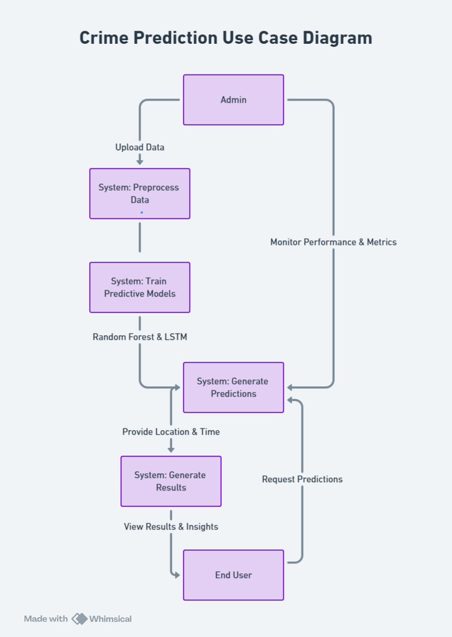

Slide 15
DESIGN METHODOLOGY
Collect historical crime data, including type, location, and time.
Preprocess the dataset by handling missing values, outliers, and encoding features.
Develop and train Random Forest (RF) and LSTM models on the prepared data.
Evaluate model performance using accuracy, precision, recall, and F1-score.
Visualize results and compare the models to identify the best approach for crime prediction.

Slide 16
TOOLS AND TECH
Programming Language: Python, HTML, Flask, CSS
Libraries: Scikit-learn, TensorFlow/Keras, Pandas, Matplotlib, Seaborn
Platform: Google Colab for model training with GPU support
Visualization Tools: Matplotlib, Seaborn
Version Control: Git/GitHub for collaboration and version tracking

Slide 17
REFERENCES
Sharma, R., Agrawal, R., & Rana, M. S. "Crime forecasting using machine learning algorithms." International Journal of Advanced Research in Computer and Communication Engineering, vol. 8, no. 5, pp. 23–29, May 2019.
Li, Y., Ma, J., Li, Y., & Zhang, D. "Crime hotspot detection and prediction using deep learning." Proceedings of the IEEE International Conference on Big Data (Big Data), pp. 456–465, Dec. 2021.
Singh, D., Jain, V., & Garg, R. "Time-series crime forecasting using LSTM and ARIMA." IEEE Transactions on Computational Social Systems, vol. 9, no. 2, pp. 345–356, 2022.
Gupta, A., Kumar, S., & Sharma, V. "Crime Prediction Using Random Forest and Deep Learning Models." Journal of Computer Science and Information Technology, vol. 10, no. 3, pp. 67–81, 2020.

