Slide 1
Student Management App
EDU.TRAC
#mobile application
An intuitive solution for efficient academic administration
M. Haris Munir
FA22-BCS-069
Supervised By: Sir Muhammad Jamil

Slide 2
About the App
A modern Flutter-based mobile application
Built for educational institutions to manage students, attendance, marks, and more
Designed for ease of use with attractive UI/UX

Slide 3
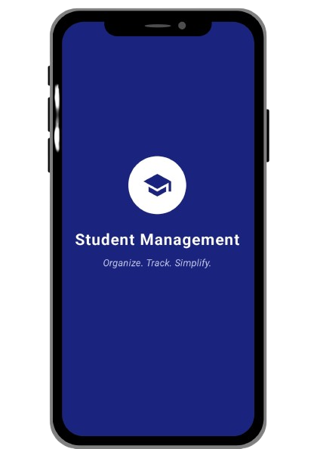
Key Features
Student List Management
Attendance Tracking
Marks
Library Records
Notifications
Profile & Settings Panel

Slide 4
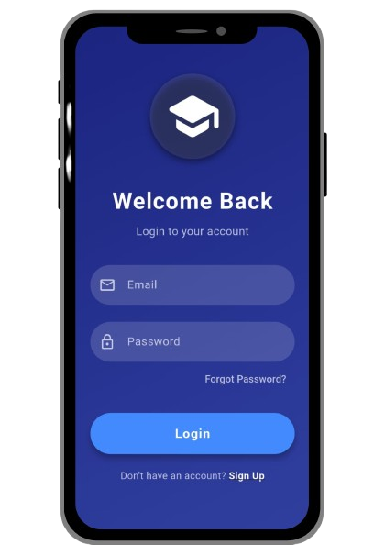
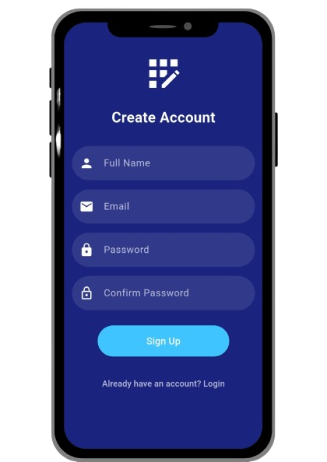
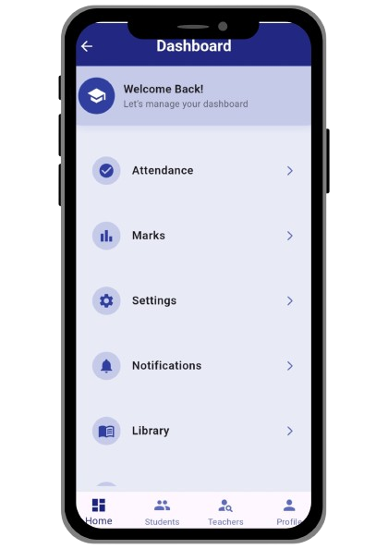
UI/UX Screens
Includes screens for:
Login
Dashboard
Student List
Attendance
Marks
Notifications

Slide 5
Modern Dashboard
Clean card-based layout
Quick access to all modules
Attractive icons and shadow effects
Built with responsive design principles

Slide 6
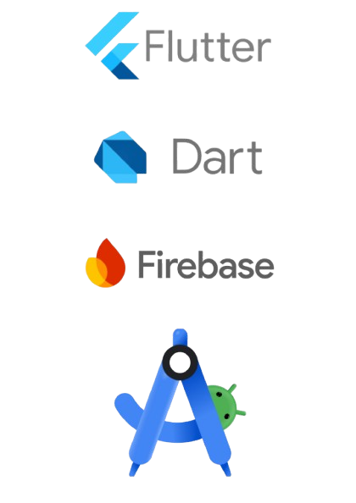
Tech Stack
Flutter – Cross-platform framework
Dart – Programming language
Firebase – Authentication & database
Android Studio – Development IDE

Slide 7
Why Use This App?
- Organized student records
- Real-time attendance
- Communication system
- Library access
- Admin control

Slide 8

Sustainable Development Goals (SDGs)
SDG 4 – Quality Education
Provides equal access to learning resources for all students
Tracks student attendance, performance, and progress
Enhances communication between students, teachers, and parents
Supports inclusive and efficient education management

Slide 9

Sustainable Development Goals (SDGs)
SDG 9 – Industry, Innovation, and Infrastructure
Uses modern technology to digitize educational administration
Promotes innovation in how schools manage student data
Builds a digital infrastructure that supports smart learning environments

Slide 10

Sustainable Development Goals (SDGs)
SDG 10 – Reduced Inequalities
Ensures all students, regardless of background, get equal access to education
Supports features that reduce the performance gap among students
Can be designed to support multiple languages and accessibility options

Slide 11
Roadmap (future changes)
- Add parental access portal
- Online fee payment system
- Cloud sync across devices
- AI-based performance insights

Slide 12
Thank You!
  Build by : M. Haris Munir
  Roll no: FA22-BCS-069
  Supervised By: Sir Muhammad Jamil

