Slide 1
CCNA LAB

Slide 2
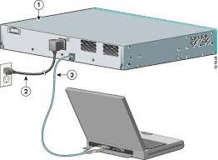
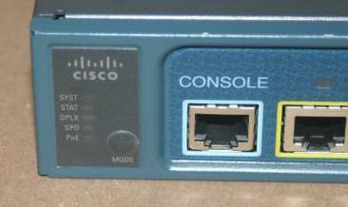
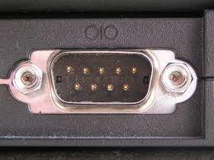
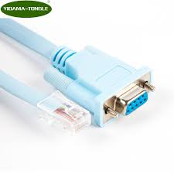
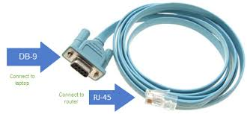
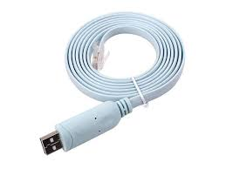
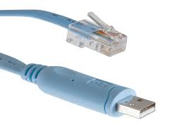
Accessories need for LAB

Slide 3

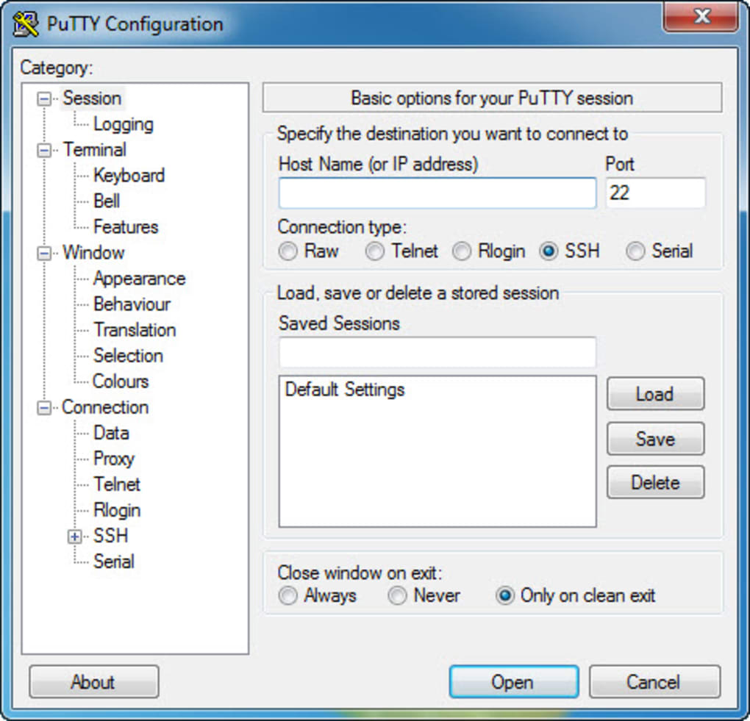
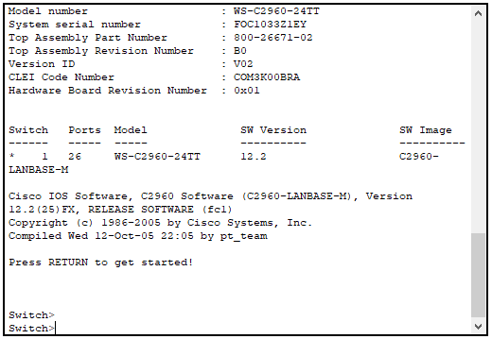
Connectivity with Putty
Com 1

Slide 4
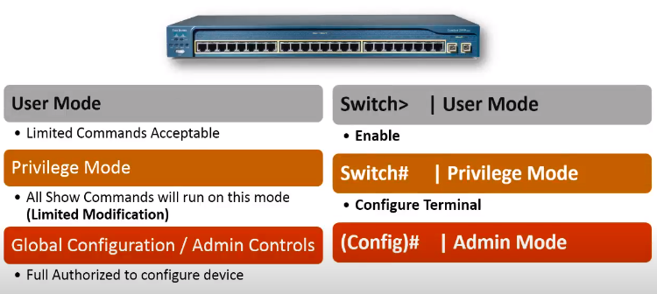

Slide 5
Start lab
Host name
Console password
vty password
Privileged mode password
Privileged mode secret
IP address on VLAN1 interface

Slide 6
Step 1: Configure the switch host name.
Switch>enable
Switch#configure terminal
Switch(config)#hostname CustomerSwitch

Slide 7
Step 2: Configure the privileged mode password and secret.
CustomerSwitch(config)#enable password cisco
CustomerSwitch(config)#enable secret cisco123
To avoid the security risk of someone looking over your shoulder and reading the passwords, encrypt all clear text passwords.
CustomerRouter(config)#service password-encryption

Slide 8
Step 3: Configure the console password.
CustomerSwitch(config)#line console 0
From line configuration mode, set the password to cisco and require the password to be entered at login.
CustomerSwitch(config-line)#password cisco
CustomerSwitch(config-line)#login
CustomerSwitch(config-line)#exit

Slide 9
Step 4: Configure the vty password.
CustomerSwitch(config)#line vty 0 15
From line configuration mode, set the password to cisco and require the password to be entered at login.
CustomerSwitch(config-line)#password cisco
CustomerSwitch(config-line)#login
CustomerSwitch(config-line)#exit

Slide 10
Step 5: Configure an IP address on interface VLAN1.
From global configuration mode, switch to interface configuration mode for VLAN1, and assign the IP address 192.168.1.5 with the subnet mask of 255.255.255.0.
CustomerSwitch(config)#interface vlan 1
CustomerSwitch(config-if)#ip address 192.168.1.5 255.255.255.0
CustomerSwitch(config-if)#no shutdown
CustomerSwitch(config-if)#exit

Slide 11
Configure a MOTD banner, and turn off domain server lookup
CustomerRouter(config)#banner motd $Authorized Access Only!$
CustomerRouter>emable
Translating "emable"...domain server (255.255.255.255)
To prevent this from happening, use the following command to stop all DNS lookups from the router
CLI.
CustomerRouter(config)#no ip domain-lookup

Slide 12
Configure a Telnet in Switch..
For telnet we follow the following steps.
Sw1(config)# enable password cisco
Sw1(config)#line vty 0 15
Sw1(config-line)#password cisco
Sw1(config-line)#login
Sw1(config-line)#exit
Sw1(config)#interface vlan 1
Sw1(config-if)#ip address 192.168.16.1.1 255.255.255.0
Sw1(config-if)#no shutdown

Slide 13
Configure a SSH in Switch..
We have to configure following things to established SSH connection for Router or Switch.
Sw1(config)# hostname sw1
Sw1(config)# enable password cisco
Sw1(config)# ip domain-name axiom.com
Sw1(config)# crypto key genrate rsa
Sw1(config)#username haseeb password axiom
Sw1(config)#line vty 0 15
Sw1(config-line)#login local
Sw1(config-line)#transport input ssh
Go to the system and enter following cmd
ssh -l haseeb 192.168.16.1

Slide 14
Home work
Configure a Telnet and SSH in Router
Hint. Same steps are followed the only different is router interface is used.

Slide 15
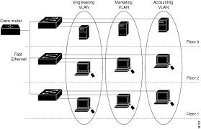
VLAN
What is a VLAN?
Virtual Local Area Networks (VLANs) separate an existing physical network into multiple logical networks. Thus, each VLAN creates its own broadcast domain. Communication between two VLANs can only occur through a router that is connected to both. VLANs work as though they are created using independent switches.
Advantage of VLAN
Broadcast Control:
Security:
Cost:
Physical Layer Transparency:

Slide 16
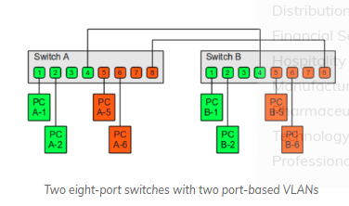
Types of VLAN Connection
There are two types of VLAN connection links.
Access link and
Trunk link.
Access link: An access link is a link that is part of only one vlan, and normally access links are for end devices. Any device attached to an access link is unaware of a vlan membership. An access-link connection can understand only standard Ethernet Frames. Switches remove any vlan information from the frame before it is sent to an access-link device.

Slide 17
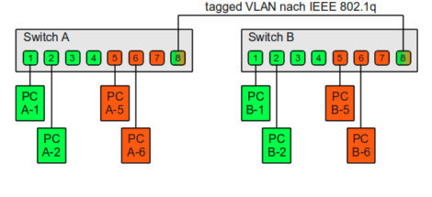
VLAN Continue…
Trunk link: A Trunk link can carry multiple vlan traffic and normally a trunk link is used to connect switches to other switches or to routers. To identify the vlan that a frame belongs to, Cisco switches support different identification techniques (vlan frame tagging). Our focus for CCNA Routing and Switching examination is on IEEE 802.1Q.

Slide 18
VTP(VLAN Trunking Protocol Version 2)
VTP is a Layer 2 messaging protocol that maintains VLAN configuration consistency by managing the addition, deletion, and renaming of VLANs within a VTP domain. A VTP domain (also called a VLAN management domain) is made up of one or more network devices that share the same VTP domain name and that are interconnected with trunks. VTP minimizes misconfigurations and configuration inconsistencies that can result in a number of problems, such as duplicate VLAN names, incorrect VLAN-type specifications, and security violations. Before you create VLANs, you must decide whether to use VTP in your network. With VTP, you can make configuration changes centrally on one or more network devices and have those changes automatically communicated to all the other network devices in the network

Slide 19
VTP modes
Server—In VTP server mode, you can create, modify, and delete VLANs and specify other configuration parameters (such as VTP version and VTP pruning) for the entire VTP domain. VTP servers advertise their VLAN configuration to other network devices in the same VTP domain and synchronize their VLAN configuration with other network devices based on advertisements received over trunk links. VTP server is the default mode.
Client—VTP clients behave the same way as VTP servers, but you cannot create, change, or delete VLANs on a VTP client.

Slide 20
VTP modes Continue….
Transparent—VTP transparent network devices do not participate in VTP. A VTP transparent network device does not advertise its VLAN configuration and does not synchronize its VLAN configuration based on received advertisements.
Off—In VTP off mode, a network device functions in the same manner as a VTP transparent device except that it does not forward VTP advertisements.

Slide 21
VTP LAB
Sw1
Sw1(config)# Vtp mode server
Sw1(config)# Vtp domain cisco
Sw1(config)# Vtp password cisco
Show vtp status
SW#2
Sw1(config)# Vtp mode transparent
Sw1(config)# Vtp domain cisco
Sw1(config)# Vtp password cisco

Slide 22
CIOs have the shortest tenures among C-level executives.
Sw3
Sw1(config)# Vtp mode client
Sw1(config)# Vtp domain cisco
Sw1(config)# Vtp password cisco
Show vtp status

Slide 23
DTP Protocol
Dynamic Trunking protocol is a protocol that automatically manages trunk negotiation.
It is Cisco Proprietary protocol and enable by default
Ports Modes
Switchport mode dynamic auto – (Wait for other end to ask to become trunk)
Switchport mode dynamic desirable – (forces other end to become trunk)
Switchport mode trunk
Switchport nonegotiate(Disable DTP)
Switchport mode Access
Show interface fa0/1 switchport

Slide 24
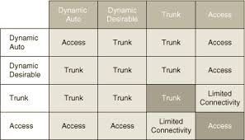

Slide 25
Implementation Port based Security on Switches
Sw1(config)#interface range fa0/1 -2
Sw1(config-if)#switchport mode access
Sw1(config-if)# switchport port-security
Sw1(config-if)# switchport port-security mac-address sticky
Sw1(config-if)# switchport port-security maximum 1
Sw1(config-if)# switchport port-security violation shutdown
Sw1(config-if)#exit
Note: when a port is shutdown you need to manually shutdown the port then again no shut, other wise port will remain in error disable mode.

Slide 26
Implementation IEEE(802.1d)STP and (802.1w)RSTP
STP is a protocol. It actively monitors all links of the network. To finds a redundant link, it uses an algorithm, known as the STA (spanning-tree algorithm). The STA algorithm first creates a topology database then it finds and disables the redundant links. Once redundant links are disabled, only the STP-chosen links remain active. If a new link is added or an existing link is removed, the STP re-runs the STA algorithm and re-adjusts all links to reflect the change.
Implement STP in order to prevent loops in the network. STP is used in situations where we want redundant links, but not loops. Redundant links are as important as backups in the case of a failover in a network. A failure of your primary activates the backup links so that users can continue to use the network.

Slide 27
BPDUs(Hello massages)
BPDUs (Bridge Protocol Data Unit) are multicast frames which switches use to share information about themselves and their connections. Besides sharing information, switches also use BPDUs to learn the network topology, to learn which switch is connected with which switches, and to learn whether any layer 2 switching loop exists in the learned topology or not.

Slide 28
STP operation in nutshell
All switches of the STP domain, first elect a root bridge. The root bridge acts as a point of reference for all other switches in the network. All ports of the root bridge remain in the forwarding mode.
Once the root bridge is elected, all remaining switches select a single port that has the shortest path cost to reach the root bridge and marked it as the root port.
After selecting the root port, switches determine a single designated port for each connection.
If multiple ports are connected with the same switch or LAN segment, the switch select only one port that has the lowest path cost and marks it as the designated port.
Once the root port and designated ports are selected, the switch blocks all remaining ports to remove any possible or existing loop from the network.

Slide 29
Components the STP uses in its operation
The following three method is used in STP.
Selecting the Root Bridge.
Selecting the root port.
Selecting the designated port and non designated port.
Selecting Root Bridge:
A Root Bridge is the starting point of the STP network topology. To elect a Root Bridge from all switches of the network, STP uses two parameters; a variable known as bridge priority and the MAC addresses of participating switches. A switch that has the lowest bridge priority value, is elected as the root bridge. If the bridge priority value is the same in all switches, the switch which has the lowest MAC address is elected as the Root Bridge.

Slide 30
STP Continue…. (Selecting Root Bridge)
Bridge Id = bridge priority + Mac address of SW.
BY default bridge priority is 32768 in all Cisco Switches.
Only one Root Bridge in the Network.
Non-Root Bridge:
Except the Root Bridge, all remaining switches of the network are considered as the Non-Root Bridges. Non-Root Bridges receive updates from the Root Bridge and update their STP databases relatively.

Slide 31
STP Continue…. (Selecting Root Port)
Root Port:
The Root port is the port that directly connects to the Root Bridge, or has the shortest path to the Root Bridge. The shortest path is the path that has the lowest path cost value. Remember that, a switch can go through many other switches to get the root bridge. So it’s not always the shortest path but it is the fastest path.
Least cost speed
The lowest forwarding switch id(priority + MAC Address)
Lowest forwarding physical port number

Slide 32
Port Cost
Based on the connected media link, STP assigns a value to each port of the network. This value is known as the port cost value. STP uses this value to choose the single best path when multiple links are available between two switches. It selects the port which has the lowest port cost value.
There are two sets of the port cost value. The following table lists both.
Bandwidth | Old Cost Value | New Cost Value
10 Gbps | 1 | 2
1 Gbps | 1 | 4
100 Mbps | 10 | 19
10 Mbps | 100 | 100
Notes:
Some old series switches, like the Catalyst 1900, use the old cost value. Cisco has already discontinued these old series switches. New series switches, like the 2960, use the new cost value. In the port selection process, the lower cost value is always preferred over the higher cost value. For example, if two ports; F0 and F1 have cost value 2 and 4 respectively. The port F0 will be selected.

Slide 33
STP Continue…
The lowest forwarding switch id(priority + MAC Address)
Switch Id = priority + Mac address
Lowest Forwarding physical port number
In one connected port is Fa 0/1 and other port is fa 0/2, so fa 0/1is lower then fa0/2, according to the role fa0/1 is selected

Slide 34
Selecting the designated port and non designated port.
A designated port is the port that has the lowest port cost value to get on a given network, compared to other ports on that segment. STP marks the designated ports as the forwarding ports. Forwarding ports are used to forward the frames.
A non-designated port is a port that has the higher port cost than the designated port. STP marks the non-designated port as the blocking port. Blocking ports are used to remove loops.

Slide 35
STP Port States
All ports on a STP running switch, go through the four different states.
Blocking,
Listening,
Learning, and
Forwarding.
Through these states, the switch not only understands the network topology but also calculates the path cost value and based on that value elects the designated and non-designated ports. After these states, the switch is considered as the STP convergent switch. Let’s understand each state in detail.

Slide 36
STP port states Continue…
STP Blocking state
When we power on a switch, the switch puts all of its ports in this state. In this state, the switch only listens and processes the BPDUs. Except the BPDUs, it drops all other frames. From the incoming BPDUs, it learns the network topology and determines the ports which will work as the root ports, as the designated ports, and as the blocked ports.
All ports remain in this state for twenty seconds. After twenty seconds, only the root port and designated ports move into the next state. Remaining ports stay in this state

Slide 37
STP port states Continue…
STP Listening state:
In this state, ports still listen and process only BPDUs. All other frames except BPDUs are dropped. The switch double checks the layer 2 topology to make sure that no loops occur in the network before processing the data frames. Ports remain in this state for fifteen seconds.
STP Learning state:
Only the root port and designated ports enter into the learning state from the listening state. In this state, ports still listen and process BPDUs. However, in this state, ports start processing user frames. Switch examines the source address of user frames and updates its CAM table but it does not forward any user frame to the destination port. Ports stay in this state for fifteen seconds.

Slide 38
STP port states Continue…
STP Forwarding state
In this state, the switch listens and processes both BPDUs and user frames. It uses BPDUs to monitor the network topology. By reading the source address field of users’ frames it also builds and updates CAM table entries. This state is also referred as the convergence.
STP Disable state
This state applies to all ports which are either manually shut down or removed from the STP by an administrator. All unplugged ports also remain in this state. Any port which belongs to this state does not participate in the STP operation.

Slide 39
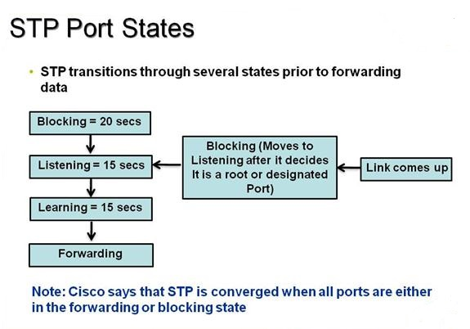

Slide 40
Different in physical and logical after STP

