Slide 1
CCNA LAB

Slide 2
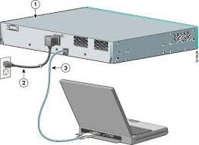
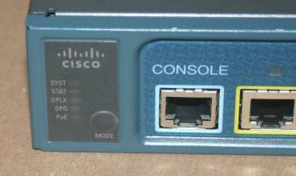
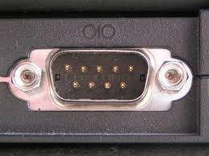
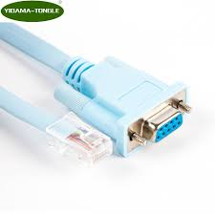
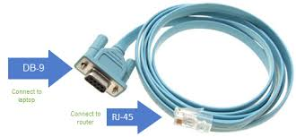
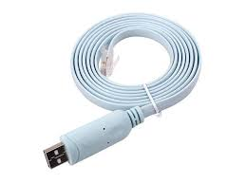
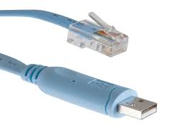
Accessories need for LAB

Slide 3

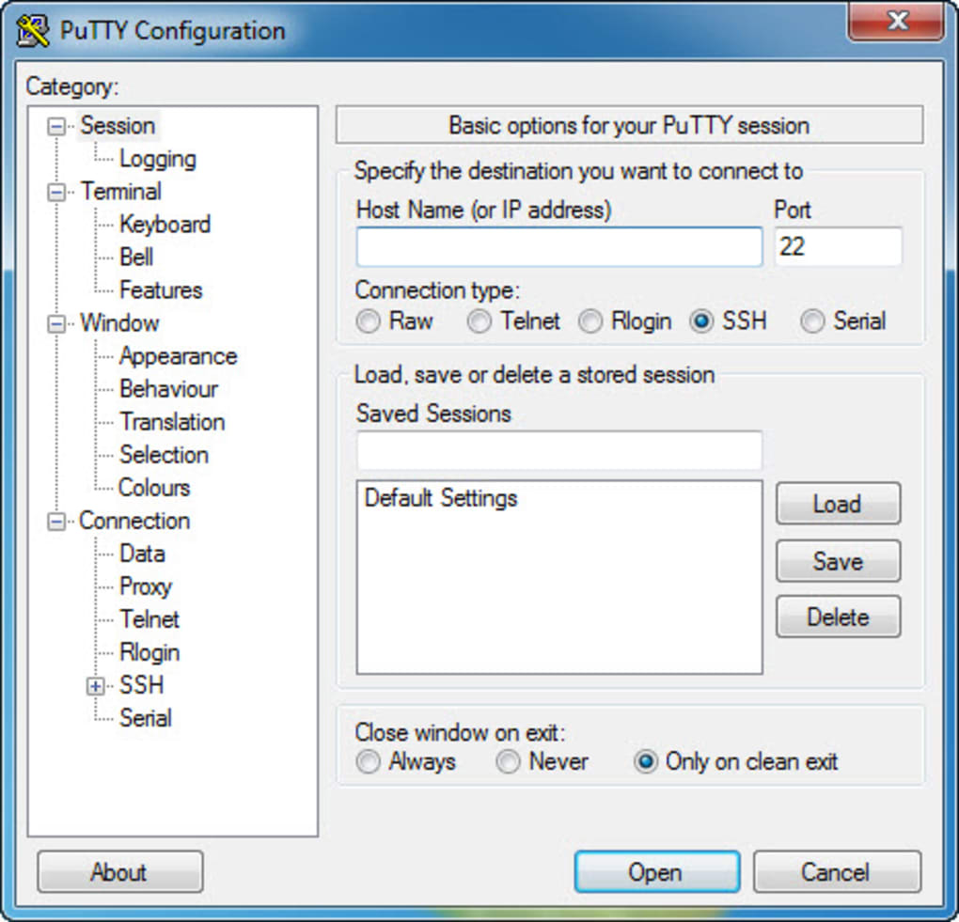
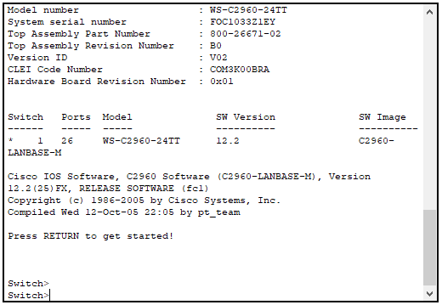
Connectivity with Putty
Com 1

Slide 4
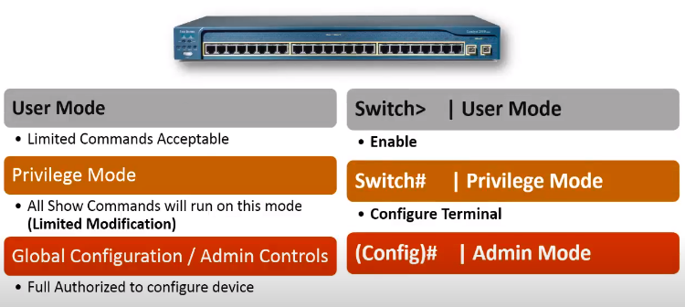

Slide 5
Start lab
Host name
Console password
vty password
Privileged mode password
Privileged mode secret
IP address on VLAN1 interface

Slide 6
Step 1: Configure the switch host name.
Switch>enable
Switch#configure terminal
Switch(config)#hostname CustomerSwitch

Slide 7
Step 2: Configure the privileged mode password and secret.
CustomerSwitch(config)#enable password cisco
CustomerSwitch(config)#enable secret cisco123
To avoid the security risk of someone looking over your shoulder and reading the passwords, encrypt all clear text passwords.
CustomerRouter(config)#service password-encryption

Slide 8
Step 3: Configure the console password.
CustomerSwitch(config)#line console 0
From line configuration mode, set the password to cisco and require the password to be entered at login.
CustomerSwitch(config-line)#password cisco
CustomerSwitch(config-line)#login
CustomerSwitch(config-line)#exit

Slide 9
Step 4: Configure the vty password.
CustomerSwitch(config)#line vty 0 15
From line configuration mode, set the password to cisco and require the password to be entered at login.
CustomerSwitch(config-line)#password cisco
CustomerSwitch(config-line)#login
CustomerSwitch(config-line)#exit

Slide 10
Step 5: Configure an IP address on interface VLAN1.
From global configuration mode, switch to interface configuration mode for VLAN1, and assign the IP address 192.168.1.5 with the subnet mask of 255.255.255.0.
CustomerSwitch(config)#interface vlan 1
CustomerSwitch(config-if)#ip address 192.168.1.5 255.255.255.0
CustomerSwitch(config-if)#no shutdown
CustomerSwitch(config-if)#exit

Slide 11
Configure a MOTD banner, and turn off domain server lookup
CustomerRouter(config)#banner motd $Authorized Access Only!$
CustomerRouter>emable
Translating "emable"...domain server (255.255.255.255)
To prevent this from happening, use the following command to stop all DNS lookups from the router
CLI.
CustomerRouter(config)#no ip domain-lookup

Slide 12
Configure a Telnet in Switch..
For telnet we follow the following steps.
Sw1(config)# enable password cisco
Sw1(config)#line vty 0 15
Sw1(config-line)#password cisco
Sw1(config-line)#login
Sw1(config-line)#exit
Sw1(config)#interface vlan 1
Sw1(config-if)#ip address 192.168.16.1.1 255.255.255.0
Sw1(config-if)#no shutdown

Slide 13
Configure a SSH in Switch..
We have to configure following things to established SSH connection for Router or Switch.
Sw1(config)# hostname sw1
Sw1(config)# enable password cisco
Sw1(config)# ip domain-name axiom.com
Sw1(config)# crypto key genrate rsa
Sw1(config)#username haseeb password axiom
Sw1(config)#line vty 0 15
Sw1(config-line)#login local
Sw1(config-line)#transport input ssh
Go to the system and enter following cmd
ssh -l haseeb 192.168.16.1

Slide 14
Home work
Configure a Telnet and SSH in Router
Hint. Same steps are followed the only different is router interface is used.

Slide 15
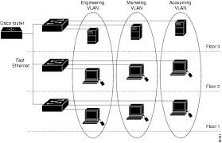
VLAN
What is a VLAN?
Virtual Local Area Networks (VLANs) separate an existing physical network into multiple logical networks. Thus, each VLAN creates its own broadcast domain. Communication between two VLANs can only occur through a router that is connected to both. VLANs work as though they are created using independent switches.
Advantage of VLAN
Broadcast Control:
Security:
Cost:
Physical Layer Transparency:

Slide 16
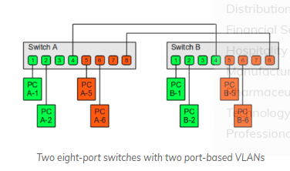
Types of VLAN Connection
There are two types of VLAN connection links.
Access link and
Trunk link.
Access link: An access link is a link that is part of only one vlan, and normally access links are for end devices. Any device attached to an access link is unaware of a vlan membership. An access-link connection can understand only standard Ethernet Frames. Switches remove any vlan information from the frame before it is sent to an access-link device.

Slide 17
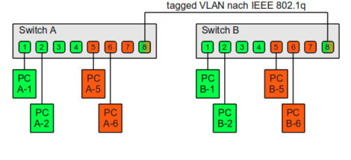
VLAN Continue…
Trunk link: A Trunk link can carry multiple vlan traffic and normally a trunk link is used to connect switches to other switches or to routers. To identify the vlan that a frame belongs to, Cisco switches support different identification techniques (vlan frame tagging). Our focus for CCNA Routing and Switching examination is on IEEE 802.1Q.

Slide 18
VTP(VLAN Trunking Protocol Version 2)
VTP is a Layer 2 messaging protocol that maintains VLAN configuration consistency by managing the addition, deletion, and renaming of VLANs within a VTP domain. A VTP domain (also called a VLAN management domain) is made up of one or more network devices that share the same VTP domain name and that are interconnected with trunks. VTP minimizes misconfigurations and configuration inconsistencies that can result in a number of problems, such as duplicate VLAN names, incorrect VLAN-type specifications, and security violations. Before you create VLANs, you must decide whether to use VTP in your network. With VTP, you can make configuration changes centrally on one or more network devices and have those changes automatically communicated to all the other network devices in the network

Slide 19
VTP modes
Server—In VTP server mode, you can create, modify, and delete VLANs and specify other configuration parameters (such as VTP version and VTP pruning) for the entire VTP domain. VTP servers advertise their VLAN configuration to other network devices in the same VTP domain and synchronize their VLAN configuration with other network devices based on advertisements received over trunk links. VTP server is the default mode.
Client—VTP clients behave the same way as VTP servers, but you cannot create, change, or delete VLANs on a VTP client.

Slide 20
VTP modes Continue….
Transparent—VTP transparent network devices do not participate in VTP. A VTP transparent network device does not advertise its VLAN configuration and does not synchronize its VLAN configuration based on received advertisements.
Off—In VTP off mode, a network device functions in the same manner as a VTP transparent device except that it does not forward VTP advertisements.

Slide 21
VTP LAB
Sw1
Sw1(config)# Vtp mode server
Sw1(config)# Vtp domain cisco
Sw1(config)# Vtp password cisco
Show vtp status
SW#2
Sw1(config)# Vtp mode transparent
Sw1(config)# Vtp domain cisco
Sw1(config)# Vtp password cisco

Slide 22
CIOs have the shortest tenures among C-level executives.
Sw3
Sw1(config)# Vtp mode client
Sw1(config)# Vtp domain cisco
Sw1(config)# Vtp password cisco
Show vtp status

Slide 23
DTP Protocol
Dynamic Trunking protocol is a protocol that automatically manages trunk negotiation.
It is Cisco Proprietary protocol and enable by default
Ports Modes
Switchport mode dynamic auto – (Wait for other end to ask to become trunk)
Switchport mode dynamic desirable – (forces other end to become trunk)
Switchport mode trunk
Switchport nonegotiate(Disable DTP)
Switchport mode Access
Show interface fa0/1 switchport

Slide 24
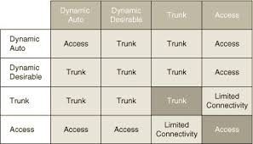

Slide 25
Implementation Port based Security on Switches
Sw1(config)#interface range fa0/1 -2
Sw1(config-if)#switchport mode access
Sw1(config-if)# switchport port-security
Sw1(config-if)# switchport port-security mac-address sticky
Sw1(config-if)# switchport port-security maximum 1
Sw1(config-if)# switchport port-security violation shutdown
Sw1(config-if)#exit
Note: when a port is shutdown you need to manually shutdown the port then again no shut, other wise port will remain in error disable mode.

Slide 26
Implementation IEEE(802.1d)STP and (802.1w)RSTP
STP is a protocol. It actively monitors all links of the network. To finds a redundant link, it uses an algorithm, known as the STA (spanning-tree algorithm). The STA algorithm first creates a topology database then it finds and disables the redundant links. Once redundant links are disabled, only the STP-chosen links remain active. If a new link is added or an existing link is removed, the STP re-runs the STA algorithm and re-adjusts all links to reflect the change.
Implement STP in order to prevent loops in the network. STP is used in situations where we want redundant links, but not loops. Redundant links are as important as backups in the case of a failover in a network. A failure of your primary activates the backup links so that users can continue to use the network.

Slide 27
BPDUs(Hello massages)
BPDUs (Bridge Protocol Data Unit) are multicast frames which switches use to share information about themselves and their connections. Besides sharing information, switches also use BPDUs to learn the network topology, to learn which switch is connected with which switches, and to learn whether any layer 2 switching loop exists in the learned topology or not.

Slide 28
STP operation in nutshell
All switches of the STP domain, first elect a root bridge. The root bridge acts as a point of reference for all other switches in the network. All ports of the root bridge remain in the forwarding mode.
Once the root bridge is elected, all remaining switches select a single port that has the shortest path cost to reach the root bridge and marked it as the root port.
After selecting the root port, switches determine a single designated port for each connection.
If multiple ports are connected with the same switch or LAN segment, the switch select only one port that has the lowest path cost and marks it as the designated port.
Once the root port and designated ports are selected, the switch blocks all remaining ports to remove any possible or existing loop from the network.

Slide 29
Components the STP uses in its operation
The following three method is used in STP.
Selecting the Root Bridge.
Selecting the root port.
Selecting the designated port and non designated port.
Selecting Root Bridge:
A Root Bridge is the starting point of the STP network topology. To elect a Root Bridge from all switches of the network, STP uses two parameters; a variable known as bridge priority and the MAC addresses of participating switches. A switch that has the lowest bridge priority value, is elected as the root bridge. If the bridge priority value is the same in all switches, the switch which has the lowest MAC address is elected as the Root Bridge.

Slide 30
STP Continue…. (Selecting Root Bridge)
Bridge Id = bridge priority + Mac address of SW.
BY default bridge priority is 32768 in all Cisco Switches.
Only one Root Bridge in the Network.

Slide 31
STP Continue…. (Selecting Root Port)

Slide 38
Different in physical and logical after STP

