Slide 1
CS-419 · DEEP LEARNING · SPRING 2026
TEAM
Authors
FINAL PROJECT
Muhammad Moiz
464192
Facial Emotion Recognition
Muhammad Haseeb ul Haq
454512
A study of seven deep learning models on the FER-2013 dataset — from MLP baselines to transfer learning.
INSTRUCTOR
Ma’am Nikhar Azhar
NATIONAL UNIVERSITY OF SCIENCES & TECHNOLOGY · BSCS-13-E
SEMESTER PROJECT · FINAL PRESENTATION
Notes:
1

Slide 2
PROBLEM STATEMENT
02 / 10
THE TASK
Reading emotion from a 48×48 grayscale face.
A multi-class image classification problem with seven possible labels — and a lot of ways to get it wrong.
A face showing fear can look almost identical to one showing surprise — and at 48 pixels, the difference can disappear entirely.
WHY IT'S HARD
Expressions vary across people, lighting, and angle. Subtle features — a furrowed brow, a half-smile — are washed out by low resolution.
WHY IT MATTERS
Applications in healthcare, accessibility, customer experience, and HCI — wherever a system needs to read affect.
OUR QUESTION
Which deep learning techniques helped the most, and why?
Notes:
2

Slide 3
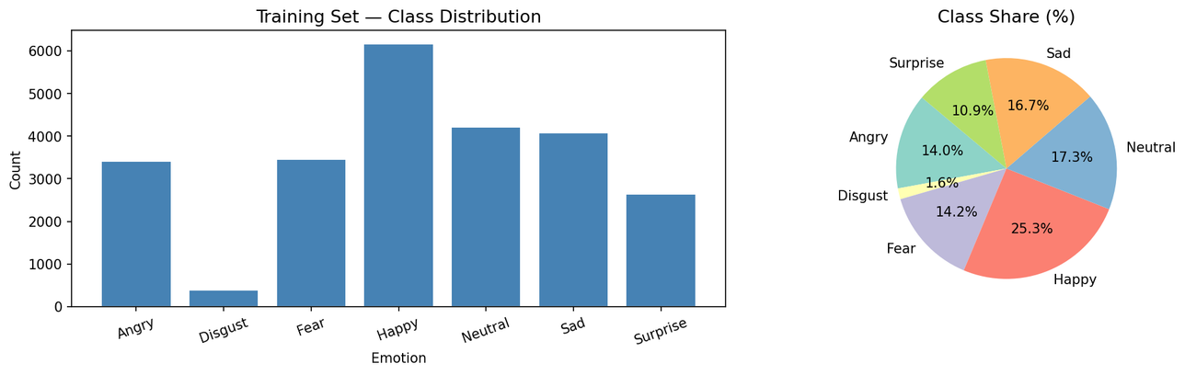
THE DATASET
03 / 10
FER-2013 · ICML 2013 CHALLENGES IN REPRESENTATION LEARNING
35,709 faces. Seven emotions. One stubborn imbalance.
24,402
4,307
7,178
TRAINING SET
VALIDATION SET
TEST SET
After reserving 15% as validation
Carved out from training data
Held out, never seen during training
SEVEN CLASSES
Happy 7,215
Neutral 4,965
Sad 4,830
Fear 4,097
Angry 3,995
Surprise 3,171
Disgust 436
Disgust appears ~10× less often than Happy. We compensated with class weighting — Disgust earned the largest weight at 8.96.
Notes:
3

Slide 4
METHODOLOGY
04 / 10
PREPROCESSING & TRAINING SETUP
A clean, controlled pipeline — one variable at a time.
i
Image Preparation
ii
Label Encoding
Read as grayscale via OpenCV, resized to 48×48, reshaped to (48,48,1), normalized to [0,1].
Emotion indices converted to one-hot vectors using Keras categorical utilities.
iii
Class Weighting
iv
Optimizer & Loss
Computed via sklearn's compute_class_weight("balanced") to fight the Disgust imbalance.
Adam at lr=0.001 (default), categorical cross-entropy loss. Batch size 64.
disgust → 8.96 · happy → 0.54
v
Training Length
vi
Checkpointing
Max 30 epochs with EarlyStopping (patience 6) and ReduceLROnPlateau (factor 0.5, patience 3).
Best weights saved per run — letting us recover from Colab session crashes without restarting from scratch.
Notes:
4

Slide 5
EXPERIMENTAL DESIGN
05 / 10
SEVEN CONFIGURATIONS · ONE VARIABLE AT A TIME
From a flat MLP to transfer learning — step by step.
Each model changes exactly one thing from the last, so we can isolate the effect of every technique.
01
02
03
04
★
05
06
07
MLP Baseline
Basic CNN
+ BatchNorm + Dropout
Optimizer Sweep
+ Data Augmentation
Transfer Learning
Ablation Study
3 conv + pool blocks. No regularization yet.
Flatten → dense layers only. No spatial structure.
Adds regularization and GlobalAveragePooling.
SGD vs Adam vs RMSProp on the same architecture.
RandomFlip, rotation ≤15°, zoom ≤15%.
MobileNetV2, ImageNet pretrained, 2-phase fine-tune.
Components removed from best model — what mattered most?
→ slide 08
32.77 %
53.78 %
54.39 %
57.73 %
58.30 %
37.60 %
Notes:
5

Slide 6
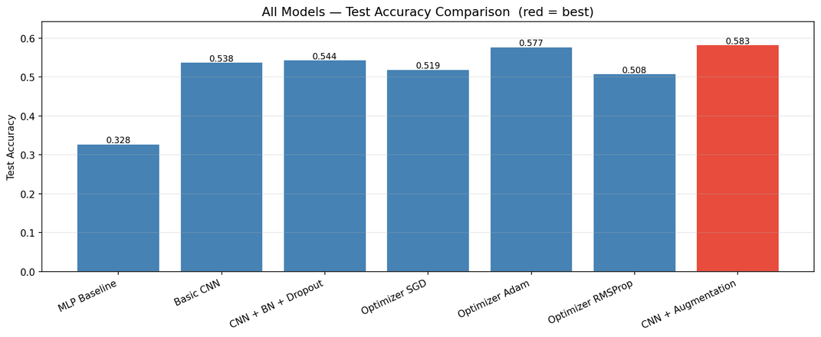

RESULTS
06 / 10
COMPARATIVE ANALYSIS
CNN + Augmentation wins on both accuracy and parameter count.
MODEL
TEST ACC.
PARAMETERS
RANK
MLP Baseline
32.77%
1,345,287
7
Basic CNN
53.78%
1,274,375
5
CNN + BN + Dropout
54.39%
457,351
4
Optimizer: SGD
51.95%
457,351
6
Optimizer: Adam
57.73%
457,351
2
Optimizer: RMSProp
50.84%
457,351
T-5
CNN + Augmentation ★
58.30%
456,199
1
HEADLINE FINDING
The biggest jump came from swapping MLP for CNN (+21.0%) . Spatial structure isn't optional — it's everything.
Transfer Learning (excluded — hardware)
37.60%
—
—
Notes:
6

Slide 7
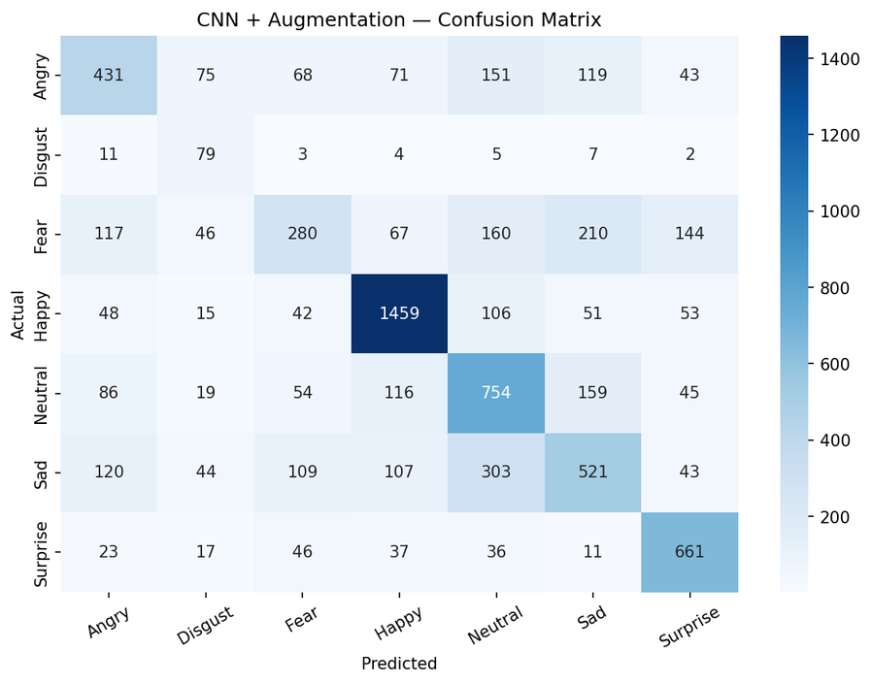
BEST MODEL
07 / 10
CNN + DATA AUGMENTATION
Our highest accuracy. Fewest parameters.
58.30%
WHY IT WORKED
The model sees the same face at different angles, scales, and orientations during training — and learns that the emotion label doesn't change. More variety, less memorization.
TEST ACCURACY · FER-2013 HOLDOUT
PARAMETERS
EPOCHS
456,199
30 (full)
OPTIMIZER
HUMAN CEILING
Adam · lr 0.001
~65%
WHAT WE CHANGED
Kept the same regularized CNN, baked augmentation directly into the model with Keras layers — RandomFlip, RandomRotation (≤15°), RandomZoom (≤15%).
Notes:
7

Slide 8
ERROR ANALYSIS & ABLATION
08 / 10
PER-CLASS PERFORMANCE · CNN + AUGMENTATION
The model loves a smile. Fear is its blind spot.
F1-SCORE BY EMOTION
WHAT IT GETS RIGHT
Happy & Surprise — visually distinctive features (a smile, an open mouth + raised brows) survive even at 48 pixels.
Happy
0.80
Surprise
0.73
WHAT IT GETS WRONG
Neutral
0.55
Fear overlaps with Surprise (wide eyes, open mouth) and Angry (furrowed brow) — subtle differences are lost at this resolution.
Angry
0.48
Disgust has high recall (0.71) but low precision (0.27) — the class weight pulled it forward, sometimes too aggressively.
Sad
0.45
Disgust
0.39
ABLATION HEADLINE
Fear
0.34
Removing augmentation drops accuracy from 58.30% → 43.80% — a −14.5 pt swing. The single most important component in our best model.
Notes:
8

Slide 9
REAL-WORLD CONSIDERATIONS
09 / 10
DEPLOYMENT · BIAS · DATA
58% on a benchmark is not 58% in the wild.
DEPLOYMENT
BIAS & ETHICS
DATA LIMITS
Built to run, not yet to ship.
Not every face is in the training set.
48 × 48 hides the signal.
Micro-expressions — the most informative cues — are simply invisible at this resolution.
Real-time inference is feasible — 456K parameters fits on a phone — but accuracy drops under bad lighting, occlusion, and off-angle faces.
Demographic bias — FER-2013 is known to perform unequally across ethnicity and gender.
Class imbalance — Disgust having 10× fewer samples is a data problem, not a model problem.
Cultural difference — a "neutral" face in one culture may read as "sad" in another.
Quantization (int8) needed for smooth performance on low-end devices.
High-stakes use in hiring, surveillance, or law enforcement should not happen without human oversight.
Crowd-sourced labels — expressions tend to be exaggerated and staged, not natural.
Real cameras output far higher resolution than 48×48 — a crop-and-align preprocessing step is essential.
Notes:
9

Slide 10
CONCLUSION & FUTURE WORK
10 / 10
WHAT HELPED · AND WHAT COMES NEXT
Architecture mattered more than any single technique.
Seven models, one consistent pipeline. The choice of CNN over MLP gave us a 21-point jump no amount of tuning could match. After that, augmentation and Adam carried the rest of the way.
+21.0
+6.9
+3.9
+0.6
Convolutions
Adam optimizer
Data augmentation
BatchNorm + Dropout
MLP → CNN. Spatial structure is the foundation.
vs SGD on the same architecture.
The most effective regularization we tried.
Helped generalization, smaller raw lift.
FUTURE WORK
Train on a higher-resolution dataset like AffectNet (1M images)
Re-run MobileNetV2 transfer learning with RGB 224×224 input
Try attention mechanisms or Vision Transformers (ViT)
Add face detection as a preprocessing step
Build a real-time webcam demo with quantized weights
Evaluate fairness across demographic subgroups
Notes:
10

Slide 11
Thank You!
Any Questions?

